Slide 1
Marketing Channels: Delivering Customer Value
LECTURE-18

Slide 2
Topic Outline
Supply Chains and the Value Delivery Network
The Nature and Importance of Marketing Channels
Channel Behavior and Organization
Channel Design Decisions
Channel Management Decisions
Public Policy and Distribution Decisions
Marketing Logistics and Supply Chain Management
Notes:
Companies rarely work alone in creating value for customers and building profitable customer relationships. Instead, most are only a single link in a larger supply chain and marketing channel. As such, a firm’s success depends not only on how well it performs but also on how well its entire marketing channel competes with competitors’ channels. The first part of this chapter explores the nature of marketing channels and the marketer’s channel design and management decisions. We then examine physical distribution—or logistics—an area that is growing dramatically in importance and sophistication. In the next chapter, we’ll look more closely at two major channel intermediaries: retailers and wholesalers.

Slide 3
Supply Chains and the
Value Delivery Network
Supply Chain Partners
Upstream partners:
Include raw material suppliers, components, parts, information, finances, and expertise to create a product or service.
Downstream partners:
Include the marketing channels or distribution channels that look toward the customer.
Notes:
Producing a product or service and making it available to buyers requires building relationships not only with customers but also with key suppliers and resellers in the company’s supply chain. This supply chain consists of upstream and downstream partners. Upstream from the company is the set of firms that supply the raw materials, components, parts, information, finances, and expertise needed to create a product or service. Marketers, however, have traditionally focused on the downstream side of the supply chain—the marketing channels (or distribution channels) that look toward the customer. Downstream marketing channel partners, such as wholesalers and retailers, form a vital link between the firm and its customers.

Slide 4
Supply Chains and the
Value Delivery Network
Supply Chain Views
Supply chain “make and sell” view includes the firm’s raw materials, productive inputs, and factory capacity
Demand chain “sense and respond” view suggests that planning starts with the needs of the target customer, and the firm responds to these needs by organizing a chain of resources and activities with the goal of creating customer value
Notes:
The term supply chain may be too limited, as it takes a make-and-sell view of the business. It suggests that raw materials, productive inputs, and factory capacity should serve as the starting point for market planning. A better term would be demand chain because it suggests a sense-and-respond view of the market. Under this view, planning starts by identifying the needs of target customers, to which the company responds by organizing a chain of resources and activities with the goal of creating customer value.

Slide 5
Supply Chains and the
Value Delivery Network
Value Delivery Network
Value delivery network is the firm’s suppliers, distributors, and ultimately customers who partner with each other to improve the performance of the entire system
Notes:
Yet, even a demand chain view of a business may be too limited because it takes a step-by-step, linear view of purchase-production-consumption activities. Instead, most large companies today are engaged in building and managing a complex, continuously evolving value delivery network. As defined in Chapter 2, a value delivery network is made up of the company, suppliers, distributors, and, ultimately, customers who “partner” with each other to improve the performance of the entire system.

Slide 6
The Nature and Importance of Marketing Channels
How Channel Members Add Value
Intermediaries offer producers greater efficiency in making goods available to target markets. Through their contacts, experience, specialization, and scale of operations, intermediaries usually offer the firm more than it can achieve on its own.
Notes:
Few producers sell their goods directly to final users. Instead, most use intermediaries to bring their products to market. They try to forge a marketing channel (or distribution channel)—a set of interdependent organizations that help make a product or service available for use or consumption by the consumer or business user.
A company’s channel decisions directly affect every other marketing decision. Pricing depends on whether the company works with national discount chains, uses high-quality specialty stores, or sells directly to consumers online. The firm’s sales force and communications decisions depend on how much persuasion, training, motivation, and support its channel partners need. Whether a company develops or acquires certain new products may depend on how well those products fit the capabilities of its channel members.
Companies often pay too little attention to their distribution channels—sometimes with damaging results. In contrast, many companies have used imaginative distribution systems to gain a competitive advantage. Enterprise Rent-A-Car revolutionized the car-rental business by setting up off-airport rental offices. Apple turned the retail music business on its head by selling music for the iPod via the Internet on iTunes. FedEx’s creative and imposing distribution system made it a leader in express package delivery. And Amazon.com forever changed the face of retailing and became the Walmart of the Internet by selling anything and everything without using physical stores.
Distribution channel decisions often involve long-term commitments to other firms. For example, companies such as Ford, McDonald’s, or HP can easily change their advertising, pricing, or promotion programs. They can scrap old products and introduce new ones as market tastes demand. But when they set up distribution channels through contracts with franchisees, independent dealers, or large retailers, they cannot readily replace these channels with company-owned stores or Internet sites if the conditions change. Therefore, management must design its channels carefully, with an eye on both today’s likely selling environment and tomorrow’s as well.

Slide 7
The Nature and Importance of Marketing Channels
How Channel Members Add Value
From an economic view, intermediaries transform the assortment of products into assortments wanted by consumers
Channel members add value by bridging the major time, place, and possession gaps that separate goods and services from those who would use them
Notes:
How Channel Members Add Value
Why do producers give some of the selling job to channel partners? After all, doing so means giving up some control over how and to whom they sell their products. Producers use intermediaries because they create greater efficiency in making goods available to target markets. Through their contacts, experience, specialization, and scale of operation, intermediaries usually offer the firm more than it can achieve on its own.

Slide 8
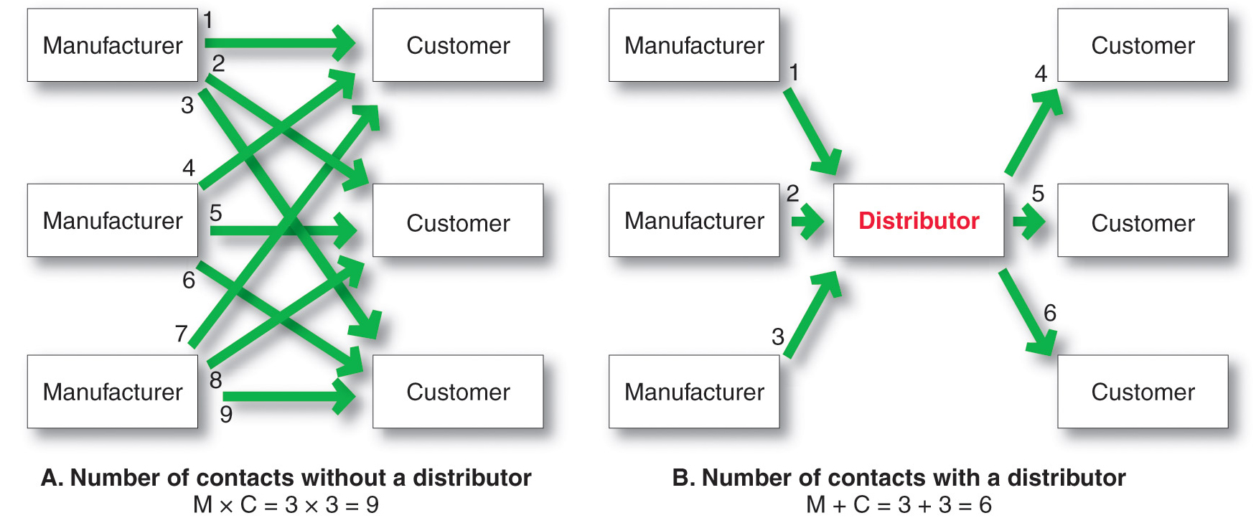
The Nature and Importance of Marketing Channels
How Channel Members Add Value
Notes:
Figure 12.1 shows how using intermediaries can provide economies. Figure 12.1A shows three manufacturers, each using direct marketing to reach three customers. This system requires nine different contacts. Figure 12.1B shows the three manufacturers working through one distributor, which contacts the three customers. This system requires only six contacts. In this way, intermediaries reduce the amount of work that must be done by both producers and consumers.
From the economic system’s point of view, the role of marketing intermediaries is to transform the assortments of products made by producers into the assortments wanted by consumers. Producers make narrow assortments of products in large quantities, but consumers want broad assortments of products in small quantities. Marketing channel members buy large quantities from many producers and break them down into the smaller quantities and broader assortments desired by consumers.

Slide 9
The Nature and Importance of Marketing Channels
How Channel Members Add Value
Information
Promotion
Contact
Matching
Negotiation
Physical distribution
Financing
Risk taking
Notes:
Note to Instructor
In making products and services available to consumers, channel members add value by bridging the major time, place, and possession gaps that separate goods and services from those who use them. Members of the marketing channel perform many key functions.
Channels perform the following functions:
Information: Gathering and distributing marketing research and intelligence information about actors and forces in the marketing environment needed for planning and aiding exchange.
Promotion: Developing and spreading persuasive communications about an offer.
Contact: Finding and communicating with prospective buyers.
Matching: Shaping and fitting the offer to the buyer’s needs, including activities such as manufacturing, grading, assembling, and packaging.
Negotiation: Reaching an agreement on price and other terms of the offer so that ownership or possession can be transferred.
Physical distribution: Transporting and storing goods.
Financing: Acquiring and using funds to cover the costs of the channel work.
Risk taking: Assuming the risks of carrying out the channel work
The question is not whether these functions need to be performed—they must be—but rather who will perform them. To the extent that the manufacturer performs these functions, its costs go up; therefore, its prices must be higher. When some of these functions are shifted to intermediaries, the producer’s costs and prices may be lower, but the intermediaries must charge more to cover the costs of their work. In dividing the work of the channel, the various functions should be assigned to the channel members who can add the most value for the cost.

Slide 10

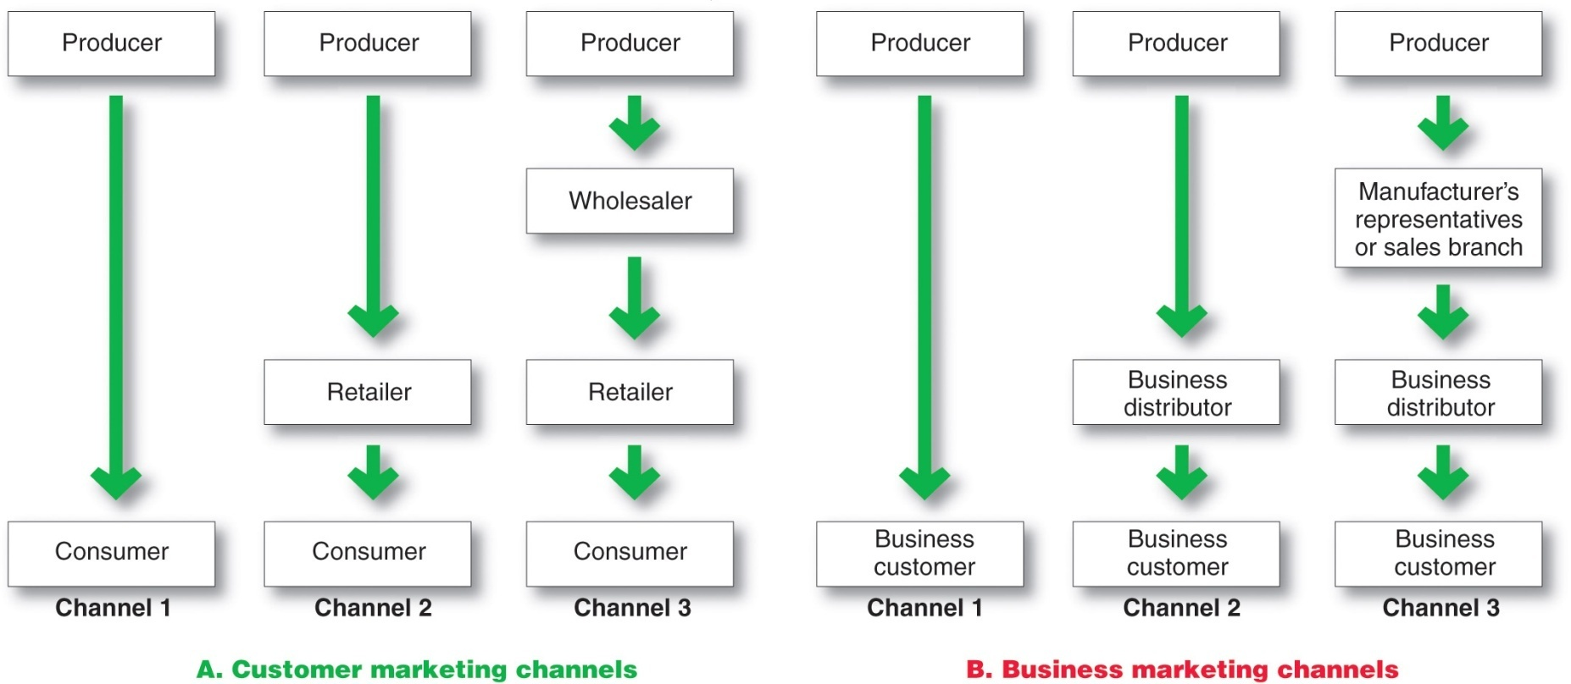
The Nature and Importance of Marketing Channels
Number of Channel Levels
Notes:
Note to Instructor
The remaining channels in Figure 12.2A are indirect marketing channels, containing one or more intermediaries.
Figure 12.2B shows some common business distribution channels. The business marketer can use its own sales force to sell directly to business customers. Or it can sell to various types of intermediaries, who in turn sell to these customers.
Channel 1, called a direct marketing channel, has no intermediary levels; the company sells directly to consumers.
Companies can design their distribution channels to make products and services available to customers in different ways. Each layer of marketing intermediaries that performs some work in bringing the product and its ownership closer to the final buyer is a channel level. Because both the producer and the final consumer perform some work, they are part of every channel.
The number of intermediary levels indicates the length of a channel. Figure 12.2 shows both consumer and business channels of different lengths. Figure 12.2A shows several common consumer distribution channels. Channel 1, called a direct marketing channel, has no intermediary levels—the company sells directly to consumers. For example, Mary Kay Cosmetics and Amway sell their products door-to-door, through home and office sales parties, and on the Internet; companies ranging from GEICO insurance to Omaha Steaks sell directly to customers via the Internet and telephone. The remaining channels in Figure 12.2A are indirect marketing channels, containing one or more intermediaries.
Figure 12.2B shows some common business distribution channels. The business marketer can use its own sales force to sell directly to business customers. Or it can sell to various types of intermediaries, who in turn sell to these customers. Although consumer and business marketing channels with even more levels can sometimes be found, these are less common. From the producer’s point of view, a greater number of levels means less control and greater channel complexity.

Slide 11
The Nature and Importance of Marketing Channels
Number of Channel Levels
Connected by types of flows:
Physical flow of products
Flow of ownership
Payment flow
Information flow
Promotion flow
Notes:
Moreover, all the institutions in the channel are connected by several types of flows. These include the physical flow of products, the flow of ownership, the payment flow, the information flow, and the promotion flow. These flows can make even channels with only one or a few levels very complex.

Slide 12
Channel Behavior and Organization
Channel Behavior
Marketing channel consists of firms that have partnered for their common good with each member playing a specialized role
Channel conflict refers to disagreement over goals, roles, and rewards by channel members
Horizontal conflict
Vertical conflict
Notes:
Distribution channels are more than simple collections of firms tied together by various flows. They are complex behavioral systems in which people and companies interact to accomplish individual, company, and channel goals. Some channel systems consist of only informal interactions among loosely organized firms. Others consist of formal interactions guided by strong organizational structures. Moreover, channel systems do not stand still—new types of intermediaries emerge and whole new channel systems evolve. Here we look at channel behavior and how members organize to do the work of the channel.
Channel Behavior
A marketing channel consists of firms that have partnered for their common good. Each channel member depends on the others. For example, a Ford dealer depends on Ford to design cars that meet customer needs. In turn, Ford depends on the dealer to attract customers, persuade them to buy Ford cars, and service the cars after the sale. Each Ford dealer also depends on other dealers to provide good sales and service that will uphold the brand’s reputation. In fact, the success of individual Ford dealers depends on how well the entire Ford marketing channel competes with the channels of other auto manufacturers.
Each channel member plays a specialized role in the channel. For example, the role of Samsung is to produce electronics products that consumers will like and create demand through national advertising. Best Buy’s role is to display these Samsung products in convenient locations, answer buyers’ questions, and complete sales. The channel will be most effective when each member assumes the tasks it can do best.
Ideally, because the success of individual channel members depends on the overall channel’s success, all channel firms should work together smoothly. They should understand and accept their roles, coordinate their activities, and cooperate to attain overall channel goals. However, individual channel members rarely take such a broad view. Cooperating to achieve overall channel goals sometimes means giving up individual company goals. Although channel members depend on one another, they often act alone in their own short-run best interests. They often disagree on who should do what and for what rewards. Such disagreements over goals, roles, and rewards generate channel conflict.
Horizontal conflict occurs among firms at the same level of the channel. For instance, some Ford dealers in Chicago might complain that other dealers in the city steal sales from them by pricing too low or advertising outside their assigned territories. Or Holiday Inn franchisees might complain about other Holiday Inn operators overcharging guests or giving poor service, hurting the overall Holiday Inn image.
Vertical conflict, conflict between different levels of the same channel, is even more common.

Slide 13
Channel Behavior and Organization
Conventional Distributions Systems
Conventional distribution systems consist of one or more independent producers, wholesalers, and retailers. Each seeks to maximize its own profits, and there is little control over the other members and no formal means for assigning roles and resolving conflict.
Notes:
Conventional distribution channels have lacked such leadership and power, often resulting in damaging conflict and poor performance.

Slide 14
Channel Behavior and Organization
Vertical Marketing Systems
Vertical marketing systems (VMSs) provide channel leadership and consist of producers, wholesalers, and retailers acting as a unified system and consist of:
Corporate marketing systems
Contractual marketing systems
Administered marketing systems
Notes:
For the channel as a whole to perform well, each channel member’s role must be specified, and channel conflict must be managed. The channel will perform better if it includes a firm, agency, or mechanism that provides leadership and has the power to assign roles and manage conflict.
A vertical marketing system (VMS) consists of producers, wholesalers, and retailers acting as a unified system. One channel member owns the others, has contracts with them, or wields so much power that they must all cooperate. The VMS can be dominated by the producer, the wholesaler, or the retailer.

Slide 15

Channel Behavior and Organization
Vertical Marketing Systems
Corporate vertical marketing system integrates successive stages of production and distribution under single ownership
Notes:
Corporate VMS
A corporate VMS integrates successive stages of production and distribution under single ownership. Coordination and conflict management are attained through regular organizational channels.

Slide 16
Channel Behavior and Organization
Vertical Marketing Systems
Contractual vertical marketing system consists of independent firms at different levels of production and distribution who join together through contracts to obtain more economies or sales impact than each could achieve alone. The most common form is the franchise organization.
Notes:
Contractual VMS
A contractual VMS consists of independent firms at different levels of production and distribution who join together through contracts to obtain more economies or sales impact than each could achieve alone. Channel members coordinate their activities and manage conflict through contractual agreements.

Slide 17
Channel Behavior and Organization
Vertical Marketing Systems
Franchise organization links several stages in the production distribution process
  Manufacturer-sponsored retailer franchise system
  Manufacturer-sponsored wholesaler franchise system
  Service firm-sponsored retailer franchise system
Notes:
The franchise organization is the most common type of contractual relationship. In this system, a channel member called a franchisor links several stages in the production-distribution process. In the United States alone, some 3,000 franchisors and 825,000 franchise outlets account for more than $2.1 trillion of economic output. Industry analysts estimate that a new franchise outlet opens somewhere in the United States every eight minutes and that about one out of every 12 retail business outlets is a franchised business. Almost every kind of business has been franchised—from motels and fast-food restaurants to dental centers and dating services, from wedding consultants and handyman services to fitness centers and funeral homes.
There are three types of franchises. The first type is the manufacturer-sponsored retailer franchise system—for example, Ford and its network of independent franchised dealers. The second type is the manufacturer-sponsored wholesaler franchise system—Coca-Cola licenses bottlers (wholesalers) in various world markets who buy Coca-Cola syrup concentrate and then bottle and sell the finished product to retailers locally. The third type is the service-firm-sponsored retailer franchise system—for example, Burger King and its nearly 12,300 franchisee-operated restaurants around the world. Other examples can be found in everything from auto rentals (Hertz, Avis), apparel retailers (The Athlete’s Foot, Plato’s Closet), and motels (Holiday Inn, Ramada Inn) to supplemental education (Huntington Learning Center, Kumon) and personal services (Great Clips, Massage Envy, Mr. Handyman).
The fact that most consumers cannot tell the difference between contractual and corporate VMSs shows how successfully the contractual organizations compete with corporate chains.

Slide 18
Channel Behavior and Organization
Vertical Marketing Systems
  Administered vertical marketing system has a few dominant channel members without common ownership. Leadership comes from size and power.
Notes:
In an administered VMS, leadership is assumed not through common ownership or contractual ties but through the size and power of one or a few dominant channel members. Manufacturers of a top brand can obtain strong trade cooperation and support from resellers. For example, GE, P&G, and Kraft can command unusual cooperation from many resellers regarding displays, shelf space, promotions, and price policies. In turn, large retailers such as Walmart, Home Depot, and Barnes & Noble can exert strong influence on the many manufacturers that supply the products they sell.
For example, with commodity prices increasing, many consumer goods manufacturers want to pass these costs along to Walmart and other retailers in the form of higher prices. However, Walmart wants to hold the line on its own costs and prices in order to maintain its low-price positioning with customers in tighter times. This creates push and pull between Walmart and its suppliers, a tussle in which Walmart—the biggest grocery seller in the United States—usually gets its way. Take Clorox Company, for instance. Although the company’s strong consumer brand preference gives in significant negotiating power, Walmart simple holds more cards. Sales to Walmart make up 26 percent of Clorox’s sales, so maintaining a strong relationships with the giant retailer is crucial.

Slide 19
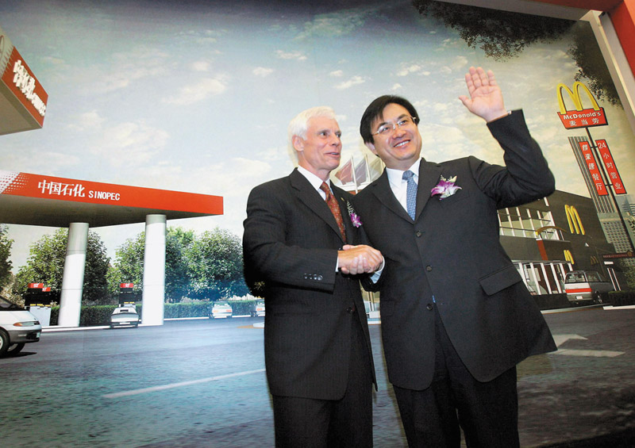
Channel Behavior and Organization
Horizontal Marketing System
  Horizontal marketing systems are when two or more companies at one level join together to follow a new marketing opportunity. Companies combine financial, production, or marketing resources to accomplish more than any one company could alone.
Notes:
Note to Instructor
Discussion Question
Can you think of an example where two companies join for a horizontal marketing system.
Students might notice that McDonald’s is in Wal-Mart or their gas station also has a coffee franchise.
Horizontal Marketing Systems
Another channel development is the horizontal marketing system, in which two or more companies at one level join together to follow a new marketing opportunity. By working together, companies can combine their financial, production, or marketing resources to accomplish more than any one company could alone.
Companies might join forces with competitors or noncompetitors. They might work with each other on a temporary or permanent basis, or they may create a separate company. For example, Walmart—famous for squeezing costs out of its supply chain—wants to team with PepsiCo’s Frito-Lay unit to buy potatoes jointly for a lower price than either company could get alone. That would help both companies to earn more on the spuds and chips they sell in Walmart’s stores. Walmart also partners with McDonald’s to place “express” versions of McDonald’s restaurants in Walmart stores. McDonald’s benefits from Walmart’s heavy store traffic, and Walmart keeps hungry shoppers from needing to go elsewhere to eat.
Competitors Microsoft and Yahoo! have joined forces to create a horizontal Internet search alliance. Until 2020, Microsoft’s Bing will power Yahoo! searches. In turn, Yahoo! will sell premium search advertising services for both companies. The collaboration, dubbed Bingahoo by industry insiders, has proven beneficial. Because one advertising purchase brings results on both Bing and Yahoo!, advertisers have more incentive to use the combined platform. In the first year, total ad spending climbed 44 percent, making the two companies together a stronger challenger to industry leader Google.

Slide 20

Channel Behavior and Organization
Multichannel Distribution Systems
Hybrid Marketing Channels
  Multichannel Distribution systems (Hybrid marketing channels) are when a single firm sets up two or more marketing channels to reach one or more customer segments
Notes:
Multichannel Distribution Systems
In the past, many companies used a single channel to sell to a single market or market segment. Today, with the proliferation of customer segments and channel possibilities, more and more companies have adopted multichannel distribution systems. Such multichannel marketing occurs when a single firm sets up two or more marketing channels to reach one or more customer segments.

Slide 21
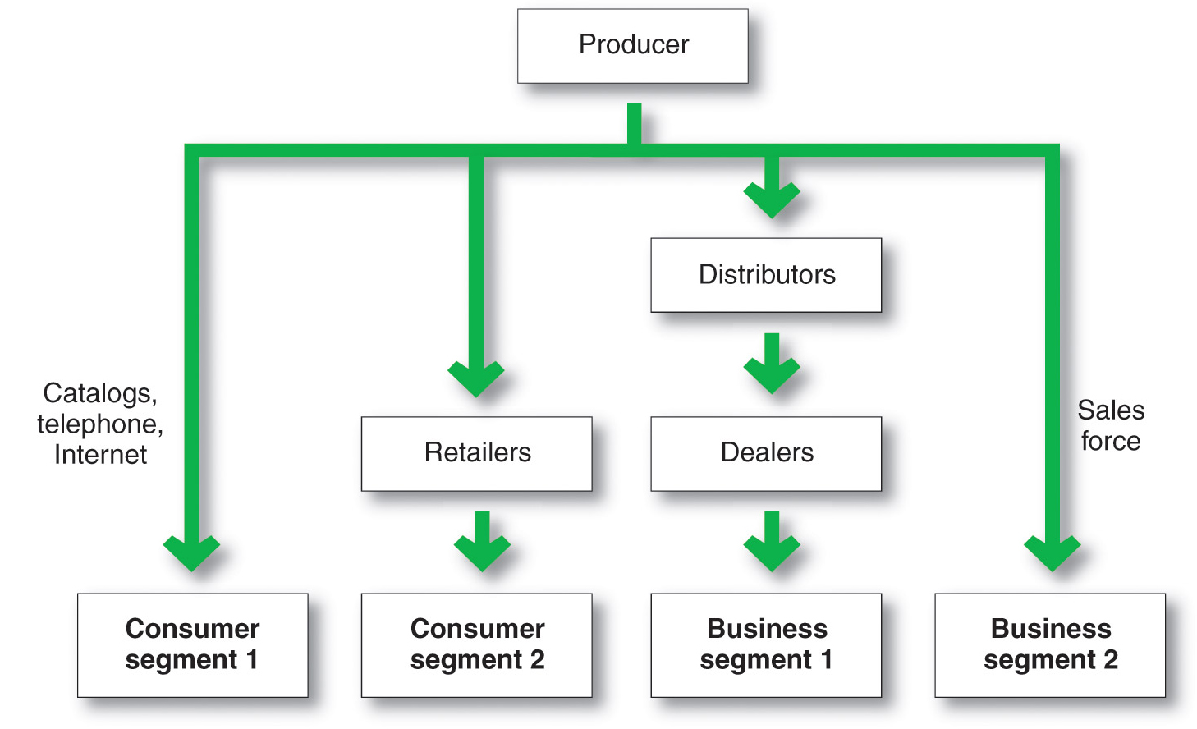
Channel Behavior and Organization
Multichannel Distribution System
Notes:
Multichannel distribution systems offer many advantages to companies facing large and complex markets. With each new channel, the company expands its sales and market coverage and gains opportunities to tailor its products and services to the specific needs of diverse customer segments. But such multichannel systems are harder to control, and they generate conflict as more channels compete for customers and sales. For example, when John Deere began selling selected consumer products through Lowe’s home improvement stores, many of its dealers complained loudly. To avoid such conflicts in its Internet marketing channels, the company routes all of its website sales to John Deere dealers.
Figure 12.4 shows a multichannel marketing system. In the figure, the producer sells directly to consumer segment 1 using catalogs, telemarketing, and the Internet and reaches consumer segment 2 through retailers. It sells indirectly to business segment 1 through distributors and dealers and to business segment 2 through its own sales force.
These days, almost every large company and many small ones distribute through multiple channels.

Slide 22
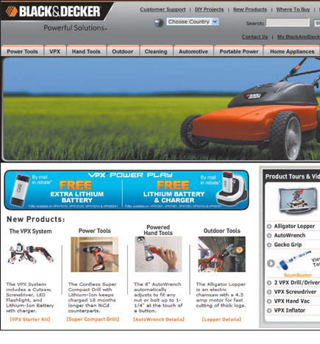
Channel Behavior and Organization
Changing Channel Organization
Disintermediation occurs when product or service producers cut out intermediaries and go directly to final buyers, or when radically new types of channel intermediaries displace traditional ones
Notes:
Changes in technology and the explosive growth of direct and online marketing are having a profound impact on the nature and design of marketing channels. One major trend is toward disintermediation—a big term with a clear message and important consequences. Disintermediation occurs when product or service producers cut out intermediaries and go directly to final buyers or when radically new types of channel intermediaries displace traditional ones.
Thus, in many industries, traditional intermediaries are dropping by the wayside. For example, Southwest, JetBlue, and other airlines sell tickets directly to final buyers, cutting travel agents from their marketing channels altogether. In other cases, new forms of resellers are displacing traditional intermediaries, as is the case with online marketers taking business from traditional brick-and-mortar retailers. For example, online music download services such as iTunes and Amazon MP3 have pretty much put traditional music-store retailers out of business. And Amazon.com almost single-handedly bankrupted the nation’s number two bookseller, Borders, in less than 10 years, and it has recently forced highly successful store retailers such as Best Buy to dramatically rethink their entire operating models. In fact, many retailing experts question whether stores like Best Buy can compete in the long run against online rivals.
Disintermediation presents both opportunities and problems for producers and resellers. Channel innovators who find new ways to add value in the channel can displace traditional resellers and reap the rewards. In turn, traditional intermediaries must continue to innovate to avoid being swept aside. For example, superstore booksellers Borders and Barnes & Noble pioneered huge book selections and low prices, sending most small independent bookstores into ruin. Then, along came Amazon.com, which threatened even the largest brick-and-mortar bookstores through online book sales. Now, both offline and online sellers of physical books are being threatened by digital book downloads and e-readers. Rather than being threatened by these digital developments, however, Amazon.com is leading them with its highly successful Kindle e‑readers. By contrast, Barnes & Noble—the giant that helped put so many independent bookstores out of business—is a latecomer to e-books with its Nook e‑reader and now finds itself locked in a battle for survival.
Like resellers, to remain competitive, product and service producers must develop new channel opportunities, such as the Internet and other direct channels. However, developing these new channels often brings them into direct competition with their established channels, resulting in conflict. To ease this problem, companies often look for ways to make going direct a plus for the entire channel. For example, guitar and amp maker Fender knows that many customers would prefer to buy its guitars, amps, and accessories online. But selling directly through its website would create conflicts with retail partners, from large chains such as Guitar Center, Sam Ash, and Best Buy to small shops scattered throughout the world, such as the Musician’s Junkyard in Windsor, Vermont, or Freddy for Music in Amman, Jordan. So Fender’s website provides detailed information about the company’s products, but you can’t buy a new Fender Stratocaster or Acoustasonic guitar there. Instead, the Fender website refers you to its resellers’ websites and stores. Thus, Fender’s direct marketing helps both the company and its channel partners.

Slide 23
Channel Design Decisions
Analyzing consumer needs
Setting channel objectives
Identifying major channel alternatives
Evaluation
Notes:
Note to Instructor
Discussion Questions
How might customer needs differ? Ask them how their needs on purchasing a book might differ from their parents? How does this translate to channel issues?
It will come down to analyzing customer needs in terms of:
Distance to travel
In person versus online
Breadth of assortment
Customer service

Slide 24
Channel Design Decisions
Analyzing Consumer Needs
Finding out what target consumers want from the channel
What segments to serve
Best channels to use
Minimizing the cost of meeting customer service requirements
Notes:
Analyzing Consumer Needs
As noted previously, marketing channels are part of the overall customer-value delivery network. Each channel member and level adds value for the customer. Thus, designing the marketing channel starts with finding out what target consumers want from the channel. Do consumers want to buy from nearby locations or are they willing to travel to more distant and centralized locations? Would customers rather buy in person, by phone, or online? Do they value breadth of assortment or do they prefer specialization? Do consumers want many add-on services (delivery, installation, repairs), or will they obtain these services elsewhere? The faster the delivery, the greater the assortment provided, and the more add-on services supplied, the greater the channel’s service level.
Providing the fastest delivery, the greatest assortment, and the most services may not be possible or practical, however. The company and its channel members may not have the resources or skills needed to provide all the desired services. Also, providing higher levels of service results in higher costs for the channel and higher prices for consumers. For example, your local independent hardware store probably provides more personalized service, a more convenient location, and less shopping hassle than the nearest huge Home Depot or Lowe’s store. But it may also charge higher prices. The company must balance consumer needs not only against the feasibility and costs of meeting these needs but also against customer price preferences. The success of discount retailing shows that consumers will often accept lower service levels in exchange for lower prices.
.

Slide 25
Channel Design Decisions
Setting Channel Objectives
Targeted levels of customer service
Balance consumer needs not only against the feasibility and costs of meeting these needs but also against customer price preferences
Notes:
Setting Channel Objectives
Companies should state their marketing channel objectives in terms of targeted levels of customer service. Usually, a company can identify several segments wanting different levels of service. The company should decide which segments to serve and the best channels to use in each case. In each segment, the company wants to minimize the total channel cost of meeting customer-service requirements.
The company’s channel objectives are also influenced by the nature of the company, its products, its marketing intermediaries, its competitors, and the environment. For example, the company’s size and financial situation determine which marketing functions it can handle itself and which it must give to intermediaries. Companies selling perishable products, for example, may require more direct marketing to avoid delays and too much handling.
In some cases, a company may want to compete in or near the same outlets that carry competitors’ products. For example, Maytag wants its appliances displayed alongside competing brands to facilitate comparison shopping. In other cases, companies may avoid the channels used by competitors. Mary Kay Cosmetics, for example, sells directly to consumers through its corps of more than two million independent beauty consultants in more than 35 markets worldwide rather than going head-to-head with other cosmetics makers for scarce positions in retail stores. GEICO primarily markets auto and homeowner’s insurance directly to consumers via the telephone and the Internet rather than through agents.
Finally, environmental factors such as economic conditions and legal constraints may affect channel objectives and design. For example, in a depressed economy, producers will want to distribute their goods in the most economical way, using shorter channels and dropping unneeded services that add to the final price of the goods.

Slide 26
Channel Design Decisions
Identifying Major Alternatives
Types of intermediaries
Number of marketing intermediaries
Responsibilities of channel members
Notes:
Note to Instructor
Identifying Major Alternatives
When the company has defined its channel objectives, it should next identify its major channel alternatives in terms of the types of intermediaries, the number of intermediaries, and the responsibilities of each channel member. Types of intermediaries refers to channel members available to carry out channel work. Examples include the company sales force, manufacturer’s agency, and industrial distributors.
Using many types of resellers in a channel provides both benefits and drawbacks. For example, by selling through retailers and value-added resellers in addition to its own direct channels, Dell can reach more and different kinds of buyers. However, the new channels will be more difficult to manage and control. In addition, the direct and indirect channels will compete with each other for many of the same customers, causing potential conflict. In fact, Dell often finds itself “stuck in the middle,” with its direct sales reps complaining about competition from retail stores, whereas its value-added resellers complain that the direct sales reps are undercutting their business.

Slide 27
Channel Design Decisions
Identifying Major Alternatives
Intensive distribution
Candy and toothpaste
Exclusive distribution
Luxury automobiles and prestige clothing
Selective distribution
Television and home appliance
Notes:
Number of Marketing Intermediaries
Companies must also determine the number of channel members to use at each level. Three strategies are available: intensive distribution, exclusive distribution, and selective distribution. Producers of convenience products and common raw materials typically seek intensive distribution—a strategy in which they stock their products in as many outlets as possible. These products must be available where and when consumers want them. For example, toothpaste, candy, and other similar items are sold in millions of outlets to provide maximum brand exposure and consumer convenience. Kraft, Coca-Cola, Kimberly-Clark, and other consumer-goods companies distribute their products in this way.
<ex12.08>
By contrast, some producers purposely limit the number of intermediaries handling their products. The extreme form of this practice is exclusive distribution, in which the producer gives only a limited number of dealers the exclusive right to distribute its products in their territories. Exclusive distribution is often found in the distribution of luxury brands. For example, exclusive Bentley automobiles are typically sold by only a handful of authorized dealers in any given market area. However, some shopping goods producers also practice exclusive distribution. For instance, outdoor power equipment maker STIHL doesn’t sell its chain saws, blowers, hedge trimmers, and other products through mass merchandisers such as Lowe’s, Home Depot, or Sears. Instead, it sells only through a select corps of independent hardware and lawn and garden dealers. By granting exclusive distribution, STIHL gains stronger dealer selling support. Exclusive distribution also enhances the STIHL brand’s image and allows for higher markups resulting from greater value-added dealer service.
Between intensive and exclusive distribution lies selective distribution—the use of more than one but fewer than all of the intermediaries who are willing to carry a company’s products. Most television, furniture, and home appliance brands are distributed in this manner. For example, Whirlpool and GE sell their major appliances through dealer networks and selected large retailers. By using selective distribution, they can develop good working relationships with selected channel members and expect a better-than-average selling effort. Selective distribution gives producers good market coverage with more control and less cost than does intensive distribution.
The producer and the intermediaries need to agree on the terms and responsibilities of each channel member. They should agree on price policies, conditions of sale, territory rights, and the specific services to be performed by each party. The producer should establish a list price and a fair set of discounts for the intermediaries. It must define each channel member’s territory, and it should be careful about where it places new resellers.
Mutual services and duties need to be spelled out carefully, especially in franchise and exclusive distribution channels. For example, McDonald’s provides franchisees with promotional support, a record-keeping system, training at Hamburger University, and general management assistance. In turn, franchisees must meet company standards for physical facilities and food quality, cooperate with new promotion programs, provide requested information, and buy specified food products.

Slide 28

Channel Design Decisions
Evaluating the Major Alternatives
Each alternative should be evaluated against:
  Economic criteria
  Control
  Adaptive criteria
Notes:
Note to Instructor
Using economic criteria, a company compares the likely sales, costs, and profitability of different channel alternatives.
The company must also consider control issues. Using intermediaries usually means giving them some control over the marketing of the product, and some intermediaries take more control than others. Other things being equal, the company prefers to keep as much control as possible.
Finally, the company must apply adaptive criteria. Channels often involve long-term commitments, yet the company wants to keep the channel flexible so that it can adapt to environmental changes.

Slide 29
Channel Design Decisions
Designing International Distribution Channels
Channel systems can vary from country to country
Must be able to adapt channel strategies to the existing structures within each country
Notes:
Designing International Distribution Channels
International marketers face many additional complexities in designing their channels. Each country has its own unique distribution system that has evolved over time and changes very slowly. These channel systems can vary widely from country to country. Thus, global marketers must usually adapt their channel strategies to the existing structures within each country.
In some markets, the distribution system is complex and hard to penetrate, consisting of many layers and large numbers of intermediaries. For example, many Western companies find Japan’s distribution system difficult to navigate. It’s steeped in tradition and very complex, with many distributors touching the product before it arrives on the store shelf.
At the other extreme, distribution systems in developing countries may be scattered, inefficient, or altogether lacking. For example, China and India are huge markets—each with a population well over one billion people. However, because of inadequate distribution systems, most companies can profitably access only a small portion of the population located in each country’s most affluent cities. Rural markets in both countries are highly decentralized, made of many distinct submarkets, each with its own subculture. China’s distribution system is so fragmented that logistics costs to wrap, bundle, load, unload, sort, reload, and transport goods amount to more than 17 percent of the nation’s GDP, far higher than in most other countries. (U.S. logistics costs account for just under 9 percent of the nation’s GDP.) After years of effort, even Walmart executives admit that they have been unable to assemble an efficient supply chain in China.
Sometimes local conditions can greatly influence how a company distributes products in global markets. For example, in low-income neighborhoods in Brazil where consumers have limited access to supermarkets, Nestlé supplements its distribution with thousands of self-employed salespeople who sell Nestlé products door to door. And in crowded cities in Asia and Africa, fast-food restaurants such as McDonald’s and KFC offer delivery:
<ex12.09>
When Americans are too busy or lazy to cook, they often place an order with their favorite Chinese restaurant. So who do people in China call when they want food delivered? Increasingly, McDonald’s and KFC. In the United States, McDonald’s derives about two-thirds of its sales from drive -through customers. However, in parts of the world where cities are too crowded and real estate costs too high to justify building drive-throughs, delivery is becoming an important part of fast-food strategy. In cities like Beijing, Seoul, and Cairo, armies of motorbike delivery drivers outfitted in colorful uniforms and bearing food in specially designed boxes strapped to their backs make their way through bustling traffic to deliver Big Macs and buckets of chicken wings. At McDonald’s, “we’ve used the slogan, ‘If you can’t come to us, we’ll come to you,’” says the president of the chain’s Asia/Pacific, Middle East, and Africa division, which operates 8,800 McDonald’s restaurants in 15 countries. In Egypt, more than 30 percent of McDonald’s total sales come from delivery. And delivery accounts for nearly 12 percent of McDonald’s sales in Singapore. Similarly, for KFC, delivery accounts for a third of sales in Egypt and nearly half in Kuwait.

Slide 30
Channel Management Decisions
Selecting channel members
Managing channel members
Motivating channel members
Evaluating channel members
Notes:
Note to Instructor
Discussion Question
If you were a manufacturer, how would you select channel members?
Most likely they will look at years in business, profitability, and other products served. In managing channel members companies practice Partner relationship management (PRM) and supply chain management (SCM) to develop long term relationships.
Discussion Question
How do you motivate and evaluate channel members?
Some students might have worked in stores where the salespeople were given rewards for excellent sales or service.
Once the company has reviewed its channel alternatives and determined the best channel design, it must implement and manage the chosen channel. Marketing channel management calls for selecting, managing, and motivating individual channel members and evaluating their performance over time.
Selecting Channel Members
Producers vary in their ability to attract qualified marketing intermediaries. Some producers have no trouble signing up channel members. For example, when Toyota first introduced its Lexus line in the United States, it had no trouble attracting new dealers. In fact, it had to turn down many would-be resellers.
At the other extreme are producers who have to work hard to line up enough qualified intermediaries. For example, when Timex first tried to sell its inexpensive watches through regular jewelry stores, most jewelry stores refused to carry them. The company then managed to get its watches into mass-merchandise outlets. This turned out to be a wise decision because of the rapid growth of mass merchandising.
Even established brands may have difficulty gaining and keeping their desired distribution, especially when dealing with powerful resellers. For example, you won’t find P&G’s Pampers diapers in a Costco store. After P&G declined to manufacture Costco’s Kirkland store brand diapers a few years ago, Costco gave Pampers the boot and now only carries Huggies and its own Kirkland brand (manufactured by Huggies maker Kimberly-Clark). The removal by Costco, the number-two diaper retailer after Walmart, has cost P&G an estimated $150 million to $200 million in annual sales.
When selecting intermediaries, the company should determine what characteristics distinguish the better ones. It will want to evaluate each channel member’s years in business, other lines carried, location, growth and profit record, cooperativeness, and reputation.
Managing and Motivating Channel Members
Once selected, channel members must be continuously managed and motivated to do their best. The company must sell not only through the intermediaries but also to and with them. Most companies see their intermediaries as first-line customers and partners. They practice strong partner relationship management to forge long-term partnerships with channel members. This creates a value delivery system that meets the needs of both the company and its marketing partners.
In managing its channels, a company must convince suppliers and distributors that they can succeed better by working together as a part of a cohesive value delivery system. Thus, P&G works closely with Target to create superior value for final consumers. The two jointly plan merchandising goals and strategies, inventory levels, and advertising and promotion programs. Similarly, Toyota works to create supplier satisfaction, which in turn helps to create greater customer satisfaction. Whether its heavy-equipment manufacturer Caterpillar partnering with its network of large dealers or cosmetics maker L’Oréal building mutually beneficial relationships with its large network of suppliers, companies must work in close harmony with others in the channel to find better ways to bring value to customers (see Real Marketing 12.1).
Many companies are now installing integrated high-tech partnership relationship management (PRM) systems to coordinate their whole-channel marketing efforts. Just as they use CRM software systems to help manage relationships with important customers, companies can now use PRM and supply chain management (SCM) software to help recruit, train, organize, manage, motivate, and evaluate relationships with channel partners.
Evaluating Channel Members
The company must regularly check channel member performance against standards such as sales quotas, average inventory levels, customer delivery time, treatment of damaged and lost goods, cooperation in company promotion and training programs, and services to the customer. The company should recognize and reward intermediaries who are performing well and adding good value for consumers. Those who are performing poorly should be assisted or, as a last resort, replaced.
Finally, companies need to be sensitive to the needs of their channel partners. Those who treat their partners poorly risk not only losing their support but also causing some legal problems. The next section describes various rights and duties pertaining to companies and other channel members.

Slide 31
Public Policy and Distribution Decisions
Exclusive distribution is when the seller allows only certain outlets to carry its products
Exclusive dealing is when the seller requires that the sellers not handle competitor’s products
Exclusive territorial agreements are where producer or seller limit territory
Tying agreements are agreements where the dealer must take most or all of the line
Notes:
For the most part, companies are legally free to develop whatever channel arrangements suit them. In fact, the laws affecting channels seek to prevent the exclusionary tactics of some companies that might keep another company from using a desired channel. Most channel law deals with the mutual rights and duties of channel members once they have formed a relationship.
Many producers and wholesalers like to develop exclusive channels for their products. When the seller allows only certain outlets to carry its products, this strategy is called exclusive distribution. When the seller requires that these dealers not handle competitors’ products, its strategy is called exclusive dealing. Both parties can benefit from exclusive arrangements: The seller obtains more loyal and dependable outlets, and the dealers obtain a steady source of supply and stronger seller support. But exclusive arrangements also exclude other producers from selling to these dealers. This situation brings exclusive dealing contracts under the scope of the Clayton Act of 1914. They are legal as long as they do not substantially lessen competition or tend to create a monopoly and as long as both parties enter into the agreement voluntarily.
Exclusive dealing often includes exclusive territorial agreements. The producer may agree not to sell to other dealers in a given area, or the buyer may agree to sell only in its own territory. The first practice is normal under franchise systems as a way to increase dealer enthusiasm and commitment. It is also perfectly legal—a seller has no legal obligation to sell through more outlets than it wishes. The second practice, whereby the producer tries to keep a dealer from selling outside its territory, has become a major legal issue.
Producers of a strong brand sometimes sell it to dealers only if the dealers will take some or all of the rest of its line. This is called full-line forcing. Such tying agreements are not necessarily illegal, but they violate the Clayton Act if they tend to lessen competition substantially. The practice may prevent consumers from freely choosing among competing suppliers of these other brands.
Finally, producers are free to select their dealers, but their right to terminate dealers is somewhat restricted. In general, sellers can drop dealers “for cause.” However, they cannot drop dealers if, for example, the dealers refuse to cooperate in a doubtful legal arrangement, such as exclusive dealing or tying agreements.

Slide 32

Marketing Logistics and
Supply Chain Management
Nature and Importance of Marketing Logistics
Marketing logistics (physical distribution) involves planning, implementing, and controlling the physical flow of goods, services, and related information from points of origin to points of consumption to meet consumer requirements at a profit
Notes:
In today’s global marketplace, selling a product is sometimes easier than getting it to customers. Companies must decide on the best way to store, handle, and move their products and services so that they are available to customers in the right assortments, at the right time, and in the right place. Logistics effectiveness has a major impact on both customer satisfaction and company costs. Here we consider the nature and importance of logistics management in the supply chain, the goals of the logistics system, major logistics functions, and the need for integrated supply chain management.

Slide 33
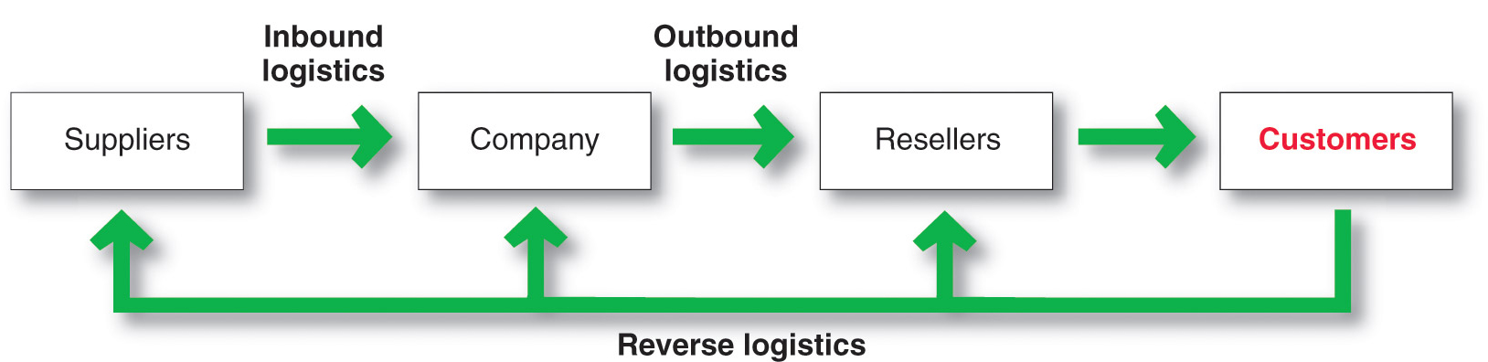
Marketing Logistics and Supply Chain Management
Nature and Importance of Marketing Logistics
Notes:
Nature and Importance of Marketing Logistics
To some managers, marketing logistics means only trucks and warehouses. But modern logistics is much more than this. Marketing logistics—also called physical distribution—involves planning, implementing, and controlling the physical flow of goods, services, and related information from points of origin to points of consumption to meet customer requirements at a profit. In short, it involves getting the right product to the right customer in the right place at the right time.
In the past, physical distribution planners typically started with products at the plant and then tried to find low-cost solutions to get them to customers. However, today’s customer-centered logistics starts with the marketplace and works backward to the factory or even to sources of supply. Marketing logistics involves not only outbound logistics (moving products from the factory to resellers and ultimately to customers) but also inbound logistics (moving products and materials from suppliers to the factory) and reverse logistics (reusing, recycling, refurbishing, or disposing of broken, unwanted, or excess products returned by consumers or resellers).

Slide 34
Marketing Logistics and
Supply Chain Management
Nature and Importance of Marketing Logistics
Supply chain management is the process of managing upstream and downstream value-added flows of materials, final goods, and related information among suppliers, the company, resellers, and final consumers
Notes:
That is, it involves entire supply chain management—managing upstream and downstream value-added flows of materials, final goods, and related information among suppliers, the company, resellers, and final consumers, as shown in Figure 12.5.

Slide 35
Marketing Logistics and
Supply Chain Management
Major Logistics Functions
Warehousing
Inventory management
Transportation
Logistics information management
Notes:
Discussion Question
What is the importance of logistics?
Their responses should include:
Competitive advantage by giving customers better service at lower prices.
Cost savings to the company and its customers.
Product variety requires improved logistics.
Information technology has created opportunities for distribution efficiency.
The logistics manager’s task is to coordinate the activities of suppliers, purchasing agents, marketers, channel members, and customers. These activities include forecasting, information systems, purchasing, production planning, order processing, inventory, warehousing, and transportation planning.
Companies today are placing greater emphasis on logistics for several reasons. First, companies can gain a powerful competitive advantage by using improved logistics to give customers better service or lower prices. Second, improved logistics can yield tremendous cost savings to both a company and its customers. As much as 20 percent of an average product’s price is accounted for by shipping and transport alone. This far exceeds the cost of advertising and many other marketing costs. American companies spend $1.1 trillion each year—about 7.7 percent of GDP—to wrap, bundle, load, unload, sort, reload, and transport goods. That’s more than the national GDPs of all but 13 countries worldwide.
Shaving off even a small fraction of logistics costs can mean substantial savings. For example, Walmart recently undertook a program of logistics improvements through more efficient sourcing, better inventory management, and greater supply chain productivity that will reduce supply chain costs by 5 to15 percent over the next five years—that’s a whopping $4 billion to $12 billion.
Third, the explosion in product variety has created a need for improved logistics management. For example, in 1916 the typical Piggly Wiggly grocery store carried only 605 items. Today, a Piggly Wiggly carries a bewildering stock of between 20,000 and 35,000 items, depending on store size. A Walmart Supercenter store carries more than 100,000 products, 30,000 of which are grocery products. Ordering, shipping, stocking, and controlling such a variety of products presents a sizable logistics challenge.
Improvements in information technology have also created opportunities for major gains in distribution efficiency. Today’s companies are using sophisticated supply chain management software, Internet-based logistics systems, point-of-sale scanners, RFID tags, satellite tracking, and electronic transfer of order and payment data. Such technology lets them quickly and efficiently manage the flow of goods, information, and finances through the supply chain.
Finally, more than almost any other marketing function, logistics affects the environment and a firm’s environmental sustainability efforts. Transportation, warehousing, packaging, and other logistics functions are typically the biggest supply chain contributors to the company’s environmental footprint. At the same time, they also provide one of the most fertile areas for cost savings. In other words, developing a green supply chain is not only environmentally responsible but can also be profitable. Here’s a simple example:
Consumer package goods maker SC Johnson made a seemingly simple but smart—and profitable—change in the way it packs its trucks. Under the old system, a load of its Ziploc products filled a truck trailer before reaching the maximum weight limit. In contrast, a load of Windex glass cleaner hit the maximum weight before the trailer was full. By strategically mixing the two products, SC Johnson found it could send the same amount of products with 2,098 fewer shipments, while burning 168,000 fewer gallons of diesel fuel and eliminating 1,882 tons of greenhouse gasses. Says the company’s director of environmental issues, “Loading a truck may seem simple, but making sure that a truck is truly full is a science. Consistently hitting a trailer’s maximum weight provided a huge opportunity to reduce our energy consumption, cut our greenhouse gas emissions, and save money [in the bargain.]” “Sustainability shouldn’t be about Washington jamming green stuff down your throat,” concludes one supply chain expert. “This is a lot about money, about reducing costs.”
See supply chain facts from “Fast Facts on the Global Supply Chain,” CSCMP, http://cscmp.org/press/fastfacts.asp, accessed September 2012.
William B. Cassidy, “Walmart Squeezes Costs from Supply Chain,” Journal of Commerce, January 5, 2010; and “Walmart Vows to ‘Drive Unnecessary Costs Out of Supply Chain’,” Procurement Leaders, January 24, 2011, www.procurementleaders.com/news/latestnews/0401-walmart-drives-supply-chain/.
Andy Brack, “Piggly Wiggly Center Offers Info-Packed Field Trip,” Charleston Currents, January 4, 2010, www.charlestoncurrents.com/issue/10_issues/10.0104.html; and information from http://en.wikipedia.org/wiki/Piggly_wiggly and http://walmartstores.com, accessed September 2012.
Bill Mongrelluzzo, “Supply Chain Expert Sees Profits in Sustainability,” Journal of Commerce, March 11, 2010, www.joc.com/logistics-economy/sustainability-can-lead-profits-says-expert. SC Johnson example from “SC Johnson Reduces Greenhouse Gasses by the Truckload,” CRS Press Release, www.csrwire.com/press_releases/22882-SC-Johnson-Reduces-Greenhouse-Gases-by-the-Truckload. Also see Leon Kaye, “Environmental Leaders,” Sustainable Industries, April 4, 2012, http://sustainableindustries.com/articles/2012/04/johnson-controls?page=2.
The goal of marketing logistics should be to provide a targeted level of customer service at the least cost. A company must first research the importance of various distribution services to customers and then set desired service levels for each segment. The objective is to maximize profits, not sales. Therefore, the company must weigh the benefits of providing higher levels of service against the costs. Some companies offer less service than their competitors and charge a lower price. Other companies offer more service and charge higher prices to cover higher costs.

Slide 36
Marketing Logistics and
Supply Chain Management
Warehousing Decisions
How many
What types
Where to locate
Warehouses
Distribution centers
Notes:
Warehousing
Production and consumption cycles rarely match, so most companies must store their goods while they wait to be sold. For example, Snapper, Toro, and other lawn mower manufacturers run their factories all year long and store up products for the heavy spring and summer buying seasons. The storage function overcomes differences in needed quantities and timing, ensuring that products are available when customers are ready to buy them.
A company must decide on how many and what types of warehouses it needs and where they will be located. The company might use either storage warehouses or distribution centers. Storage warehouses store goods for moderate to long periods. In contrast, distribution centers are designed to move goods rather than just store them. They are large and highly automated warehouses designed to receive goods from various plants and suppliers, take orders, fill them efficiently, and deliver goods to customers as quickly as possible.
For example, Home Depot operates 19 giant Rapid Deployment Centers (RDCs)—huge, highly mechanized distribution centers that supply almost all of the daily needs of Home Depot's 2,250 stores around the country The RDC in Westfield, Massachusetts, covers 657,000 square feet under a single roof (13 football fields) and serves some 115 Home Depot stores throughout New England. Nothing is stored at the RDCs. Instead, they are “pass-through” centers at which product shipments are received from suppliers, processed, and efficiently redistributed to individual Home Depot stores. The RDCs provide a maximum 72-hour turnaround from the time products reach the center until their delivery to stores, where 80 percent go directly to the sales floor. With such rapid and accurate delivery, individual Home Depot stores can improve merchandise availability to customers while at the same time carrying less in-store stock and reducing inventory costs.
Like almost everything else these days, warehousing has seen dramatic changes in technology in recent years. Outdated materials-handling methods are steadily being replaced by newer, computer-controlled systems requiring few employees. Computers and scanners read orders and direct lift trucks, electric hoists, or robots to gather goods, move them to loading docks, and issue invoices. For example, office supplies retailer Staples now employs “a team of super-retrievers—in day-glo orange—that keep its warehouse humming”:
Imagine a team of employees that works 16 hours a day, seven days a week. They never call in sick or show up late. They demand no benefits, require no health insurance, and receive no paychecks. And they never complain. Sounds like a bunch of robots, huh? They are, in fact, robots—and they’re dramatically changing the way Staples delivers notepads, pens, and paper clips to its customers. Every day, at Staples’ huge Chambersburg, Pennsylvania, distribution center, 150 robots resemble a well-trained breed of working dogs, say, golden retrievers. When orders come in, the robots retrieve racks with the appropriate items and carry them to picking stations, then wait patiently as humans pull the correct products and place them in boxes. When orders are filled, the robots neatly park the racks back among the rest. The robots pretty much take care of themselves. When they run low on power, they head to battery-charging terminals, or, as warehouse personnel say, “They get themselves a drink of water.” The robots now run 50 percent of the Chambersburg facility, where average daily output is up 60 percent since they arrived on the scene.

Slide 37
Marketing Logistics and
Supply Chain Management
Inventory Management
Just-in-time systems
RFID
  Knowing exact product location
Smart shelves
  Placing orders automatically
Notes:
Inventory Management
Inventory management also affects customer satisfaction. Here, managers must maintain the delicate balance between carrying too little inventory and carrying too much. With too little stock, the firm risks not having products when customers want to buy. To remedy this, the firm may need costly emergency shipments or production. Carrying too much inventory results in higher-than-necessary inventory-carrying costs and stock obsolescence. Thus, in managing inventory, firms must balance the costs of carrying larger inventories against resulting sales and profits.
Many companies have greatly reduced their inventories and related costs through just-in-time logistics systems. With such systems, producers and retailers carry only small inventories of parts or merchandise, often enough for only a few days of operations. New stock arrives exactly when needed, rather than being stored in inventory until being used. Just-in-time systems require accurate forecasting along with fast, frequent, and flexible delivery so that new supplies will be available when needed. However, these systems result in substantial savings in inventory-carrying and handling costs.
Marketers are always looking for new ways to make inventory management more efficient. In the not-too-distant future, handling inventory might even become fully automated. For example, in Chapter 3 we discussed RFID or “smart tag” technology, by which small transmitter chips are embedded in or placed on products and packaging for everything from flowers and razors to tires. “Smart” products could make the entire supply chain—which accounts for nearly 75 percent of a product’s cost—intelligent and automated.
Companies using RFID know, at any time, exactly where a product is located physically within the supply chain. “Smart shelves” would not only tell them when it’s time to reorder but also place the order automatically with their suppliers. Such exciting new information technology are revolutionizing distribution as we know it. Many large and resourceful marketing companies, such as Walmart, P&G, Kraft, IBM, and HP are investing heavily to make the full use of RFID technology a reality.

Slide 38
Marketing Logistics and
Supply Chain Management
Major Logistics Functions
Transportation affects the pricing of products, delivery performance, and condition of the goods when they arrive
Truck
Rail
Water
Pipeline
Air
Internet
Notes:
Transportation
The choice of transportation carriers affects the pricing of products, delivery performance, and the condition of goods when they arrive—all of which will affect customer satisfaction. In shipping goods to its warehouses, dealers, and customers, the company can choose among five main transportation modes: truck, rail, water, pipeline, and air, along with an alternative mode for digital products—the Internet.
<ex12.13>
Trucks have increased their share of transportation steadily and now account for 40 percent of total cargo ton-miles moved in the United States. U.S. trucks travel more than 431 billion miles a year—more than double the distance traveled 25 years ago—carrying 8.7 billion tons of freight. According to the American Trucking Association, 80 percent of U.S. communities depend solely on trucks for their goods and commodities. Trucks are highly flexible in their routing and time schedules, and they can usually offer faster service than railroads. They are efficient for short hauls of high-value merchandise. Trucking firms have evolved in recent years to become full-service providers of global transportation services. For example, large trucking firms now offer everything from satellite tracking, Internet-based shipment management, and logistics planning software to cross-border shipping operations.
Railroads account for 40 percent of the total cargo ton-miles moved. They are one of the most cost-effective modes for shipping large amounts of bulk products—coal, sand, minerals, and farm and forest products—over long distances. In recent years, railroads have increased their customer services by designing new equipment to handle special categories of goods, providing flatcars for carrying truck trailers by rail (piggyback), and providing in-transit services such as the diversion of shipped goods to other destinations en route and the processing of goods en route.
Water carriers, which account for less than 5 percent of the cargo ton-miles, transport large amounts of goods by ships and barges on U.S. coastal and inland waterways. Although the cost of water transportation is very low for shipping bulky, low-value, nonperishable products such as sand, coal, grain, oil, and metallic ores, water transportation is the slowest mode and may be affected by the weather. Pipelines, which account for less than 1 percent of the cargo ton-miles, are a specialized means of shipping petroleum, natural gas, and chemicals from sources to markets. Most pipelines are used by their owners to ship their own products.
Although air carriers transport less than 1 percent of the cargo ton-miles of the nation’s goods, they are an important transportation mode. Airfreight rates are much higher than rail or truck rates, but airfreight is ideal when speed is needed or distant markets have to be reached. Among the most frequently airfreighted products are perishables (such as fresh fish, cut flowers) and high-value, low-bulk items (technical instruments, jewelry). Companies find that airfreight also reduces inventory levels, packaging costs, and the number of warehouses needed.
The Internet carries digital products from producer to customer via satellite, cable, phone wire, or wireless signal. Software firms, the media, music and video companies, and education all make use of the Internet to transport digital products. The Internet holds the potential for lower product distribution costs. Whereas planes, trucks, and trains move freight and packages, digital technology moves information bits.
Shippers also use intermodal transportation—combining two or more modes of transportation. Twelve percent of the total cargo ton-miles are moved via multiple modes. Piggyback describes the use of rail and trucks; fishyback, water and trucks; trainship, water and rail; and airtruck, air and trucks. Combining modes provides advantages that no single mode can deliver. Each combination offers advantages to the shipper. For example, not only is piggyback cheaper than trucking alone, but it also provides flexibility and convenience.
In choosing a transportation mode for a product, shippers must balance many considerations: speed, dependability, availability, capacity, cost, and others. Thus, if a shipper needs speed, air and truck are the prime choices. If the goal is low cost, then water or rail might be best.

Slide 39
Marketing Logistics and
Supply Chain Management
Logistics Information Management
Logistics information management is the management of the flow of information, including customer orders, billing, inventory levels, and customer data
EDI (electronic data interchange)
VMI (vendor-managed inventory)
Notes:
Logistics Information Management
Companies manage their supply chains through information. Channel partners often link up to share information and make better joint logistics decisions. From a logistics perspective, flows of information, such as customer transactions, billing, shipment and inventory levels, and even customer data, are closely linked to channel performance. Companies need simple, accessible, fast, and accurate processes for capturing, processing, and sharing channel information.
Information can be shared and managed in many ways, but most sharing takes place through electronic data interchange (EDI), the digital exchange of data between organizations, which primarily is transmitted via the Internet. Walmart, for example, requires EDI links with its more than 100,000 suppliers through its Retail Link sales data system. If new suppliers don’t have EDI capability, Walmart will work with them to find and implement the needed tools.
In some cases, suppliers might actually be asked to generate orders and arrange deliveries for their customers. Many large retailers—such as Walmart and Home Depot—work closely with major suppliers such as P&G or Moen to set up vendor-managed inventory (VMI) systems or continuous inventory replenishment systems. Using VMI, the customer shares real-time data on sales and current inventory levels with the supplier. The supplier then takes full responsibility for managing inventories and deliveries. Some retailers even go so far as to shift inventory and delivery costs to the supplier. Such systems require close cooperation between the buyer and seller.

Slide 40
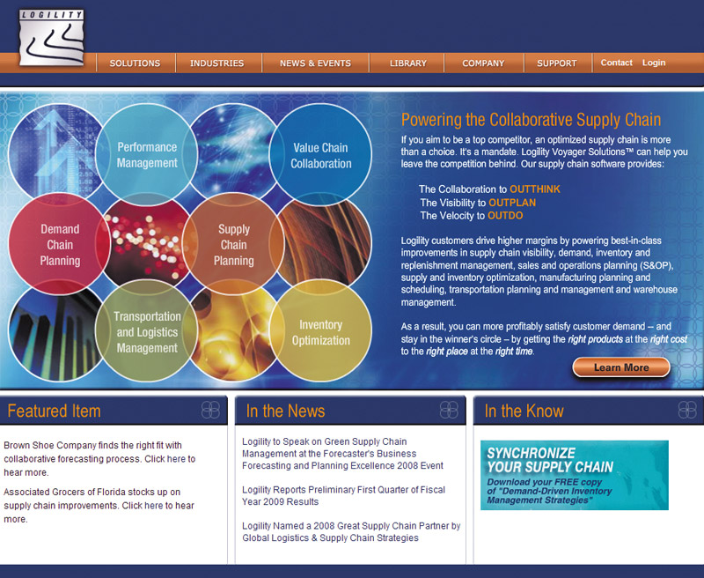
Marketing Logistics and
Supply Chain Management
Integrated Logistics Management
Integrated logistics management is the recognition that providing customer service and trimming distribution costs requires teamwork internally and externally
Notes:
Integrated Logistics Management
Today, more and more companies are adopting the concept of integrated logistics management. This concept recognizes that providing better customer service and trimming distribution costs require teamwork, both inside the company and among all the marketing channel organizations. Inside, the company’s various departments must work closely together to maximize its own logistics performance. Outside, the company must integrate its logistics system with those of its suppliers and customers to maximize the performance of the entire distribution network.
Cross-Functional Teamwork Inside the Company
Most companies assign responsibility for various logistics activities to many different departments—marketing, sales, finance, operations, and purchasing. Too often, each function tries to optimize its own logistics performance without regard for the activities of the other functions. However, transportation, inventory, warehousing, and information management activities interact, often in an inverse way. Lower inventory levels reduce inventory-carrying costs. But they may also reduce customer service and increase costs from stockouts, back orders, special production runs, and costly fast-freight shipments. Because distribution activities involve strong trade-offs, decisions by different functions must be coordinated to achieve better overall logistics performance.
The goal of integrated supply chain management is to harmonize all of the company’s logistics decisions. Close working relationships among departments can be achieved in several ways. Some companies have created permanent logistics committees composed of managers responsible for different physical distribution activities. Companies can also create supply chain manager positions that link the logistics activities of functional areas. For example, P&G has created product supply managers who manage all the supply chain activities for each product category. Many companies have a vice president of logistics with cross-functional authority.
Finally, companies can employ sophisticated, systemwide supply chain management software, now available from a wide range of software enterprises large and small, from SAP and Oracle to Infor and Logility. The important thing is that the company must coordinate its logistics and marketing activities to create high market satisfaction at a reasonable cost.
Building Logistics Partnerships
Companies must do more than improve their own logistics. They must also work with other channel partners to improve whole-channel distribution. The members of a marketing channel are linked closely in creating customer value and building customer relationships. One company’s distribution system is another company’s supply system. The success of each channel member depends on the performance of the entire supply chain. For example, IKEA can create its stylish but affordable furniture and deliver the “IKEA lifestyle” only if its entire supply chain—consisting of thousands of merchandise designers and suppliers, transport companies, warehouses, and service providers—operates at maximum efficiency and customer-focused effectiveness.
Smart companies coordinate their logistics strategies and forge strong partnerships with suppliers and customers to improve customer service and reduce channel costs. Many companies have created cross-functional, cross-company teams. For example, Nestlé’s Purina pet food unit has a team of dozens of people working in Bentonville, Arkansas, the home base of Walmart. The Purina Walmart team members work jointly with their counterparts at Walmart to find ways to squeeze costs out of their distribution system. Working together benefits not only Purina and Walmart but also their shared, final consumers.
Other companies partner through shared projects. For example, many large retailers conduct joint in-store programs with suppliers. Home Depot allows key suppliers to use its stores as a testing ground for new merchandising programs. The suppliers spend time at Home Depot stores watching how their product sells and how customers relate to it. They then create programs specially tailored to Home Depot and its customers. Clearly, both the supplier and the customer benefit from such partnerships. The point is that all supply chain members must work together in the cause of bringing value to final consumers.

Slide 41
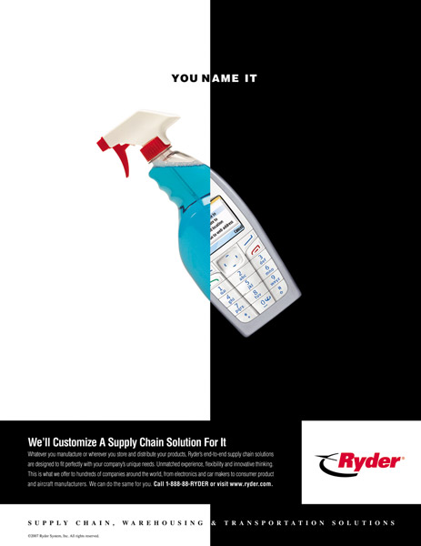
Marketing Logistics and
Supply Chain Management
Integrated Logistics Management
Third-party logistics is the outsourcing of logistics functions to third-party logistics providers (3PLs)
Notes:
Third-Party Logistics
Although most big companies love to make and sell their products, many loathe the associated logistics “grunt work.” They detest the bundling, loading, unloading, sorting, storing, reloading, transporting, customs clearing, and tracking required to supply their factories and get products to their customers. They hate it so much that a growing number of firms now outsource some or all of their logistics to third-party logistics (3PL) providers such as Ryder, Penske Logistics, BAX Global, DHL Logistics, FedEx Logistics, and UPS Business Solutions. Outsourced logistics providers can help companies improve their own logistics systems or even take over and manage part or all of their logistics operations . Here’s an example:
Stonyfield Farm, the world’s largest yogurt maker, had a distribution problem. As the company grew, inefficiencies had crept into its distribution system. To help fix the problem, Stonyfield turned to 3PL provider Ryder Supply Chain Solutions. Together, Ryder and Stonyfield designed a new transportation system that cut processing and distribution costs and improved service levels, while at the same time dramatically reducing the company’s carbon footprint. After evaluating the Stonyfield network, Ryder identified optimal transportation solutions, including the use of fuel-efficient RydeGreen vehicles. It helped Stonyfield set up a small, dedicated truck fleet to make regional deliveries in New England and replaced Stonyfield’s national less-than-truckload distribution network with a regional multistop truckload system. As a result, Stonyfield now moves more product in fewer trucks, cutting in half the number of miles traveled. In all, the changes produced a 40 percent reduction in transportation-related carbon dioxide emissions and knocked an eye-popping 13 percent off Stonyfield’s transportation costs.
Ryder, UPS, and other 3PL providers help clients tighten up sluggish, overstuffed supply chains; slash inventories; and get products to customers more quickly and reliably. According to a survey of chief logistics executives at Fortune 500 companies, 82 percent of these companies use 3PL (also called outsourced logistics or contract logistics) services. In all, North American shippers spend 47 percent of their logistics budget on outsourced logistics.
Companies use third-party logistics providers for several reasons. First, since getting the product to market is their main focus, using these providers makes the most sense, as they can often do it more efficiently and at lower cost. Outsourcing typically results in a 15 to 30 percent cost savings. Second, outsourcing logistics frees a company to focus more intensely on its core business. Finally, integrated logistics companies understand increasingly complex logistics environments.

Slide 42
Bibliography
Principles of Marketing by Philip Kotler & Gary Armstrong
Fifteenth Edition, Published by Prentice Hall
Marketing Management – A South Asian Perspective
by Philip Kotler, Kevin Lane Keller, Abraham Koshy &
Mithileshwar Jha, 13th Edition, Published by Pearson
Education, Inc.
Principles and Practices of Marketing by Jobber, D. 4th
edition, McGraw Hill International.
Principles of Advertising & IMC by Tom Duncan 2nd
Edition, Published by McGraw-Hill Irwin.

Slide 43


The End
"It has been my philosophy of life that difficulties vanish when faced boldly."
Isaac Asimov

