Slide 1
Pricing:
Understanding and Capturing Customer Value
LECTURE-16

Slide 2
Topic Outline
What Is a Price?
Major Pricing Strategies
Other Internal and External Considerations Affecting Price Decisions
Notes:
We now look at the second major marketing mix tool—pricing. If effective product development, promotion, and distribution sow the seeds of business success, effective pricing is the harvest. Firms successful at creating customer value with the other marketing mix activities must still capture some of this value in the prices they earn. In this chapter, we discuss the importance of pricing, dig into three major pricing strategies, and look at internal and external considerations that affect pricing decisions. In the next chapter, we examine some additional pricing considerations and approaches.
Companies today face a fierce and fast-changing pricing environment. Value-seeking customers have put increased pricing pressure on many companies. Thanks to economic woes in recent years, the pricing power of the Internet, and value-driven retailers such as Walmart, today’s more frugal consumers are pursuing spend-less strategies. In response, it seems that almost every company has been looking for ways to cut prices.
<ex10.02>
Yet, cutting prices is often not the best answer. Reducing prices unnecessarily can lead to lost profits and damaging price wars. It can cheapen a brand by signaling to customers that price is more important than the customer value a brand delivers. Instead, in both good economic times and bad, companies should sell value, not price. In some cases, that means selling lesser products at rock-bottom prices. But in most cases, it means persuading customers that paying a higher price for the company’s brand is justified by the greater value they gain.

Slide 3
What Is a Price?
Price is the amount of money charged for a product or service. It is the sum of all the values that consumers give up in order to gain the benefits of having or using a product or service.
Price is the only element in the marketing mix that produces revenue; all other elements represent costs
Notes:
Note to Instructor
Discussion Question
How does a company like Starbuck’s price their products?
This will lead to a good overview of the chapter as students will most likely focus on customers, costs and competitors.
, price has been the major factor affecting buyer choice. In recent decades, however, nonprice factors have gained increasing importance. Even so, price remains one of the most important elements that determines a firm’s market share and profitability.
Price is the only element in the marketing mix that produces revenue; all other elements represent costs. Price is also one of the most flexible marketing mix elements. Unlike product features and channel commitments, prices can be changed quickly. At the same time, pricing is the number-one problem facing many marketing executives, and many companies do not handle pricing well. Some managers view pricing as a big headache, preferring instead to focus on other marketing mix elements. However, smart managers treat pricing as a key strategic tool for creating and capturing customer value. Prices have a direct impact on a firm’s bottom line. A small percentage improvement in price can generate a large percentage increase in profitability. More importantly, as part of a company’s overall value proposition, price plays a key role in creating customer value and building customer relationships. “Instead of running away from pricing,” says an expert, “savvy marketers are embracing it.”

Slide 4
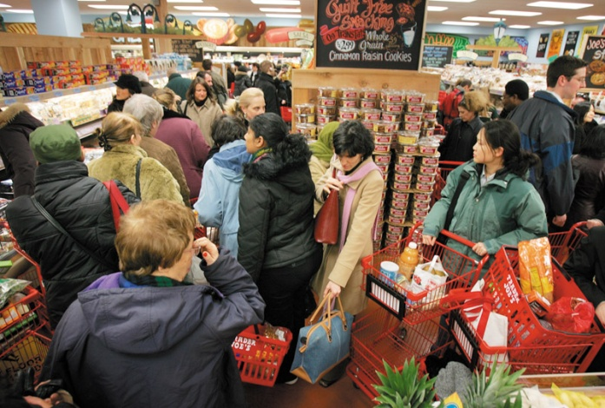
Major Pricing Strategies
Customer Value-Based Pricing
Understanding how much value consumers place on the benefits they receive from the product and setting a price that captures that value
Notes:
The price the company charges will fall somewhere between one that is too low to produce a profit and one that is too high to produce any demand. Figure 10.1 summarizes the major considerations in setting price. Customer perceptions of the product’s value set the ceiling for prices. If customers perceive that the product’s price is greater than its value, they will not buy the product. Likewise, product costs set the floor for prices. If the company prices the product below its costs, the company’s profits will suffer. In setting its price between these two extremes, the company must consider several external and internal factors, including competitors’ strategies and prices, the overall marketing strategy and mix, and the nature of the market and demand.

Slide 5
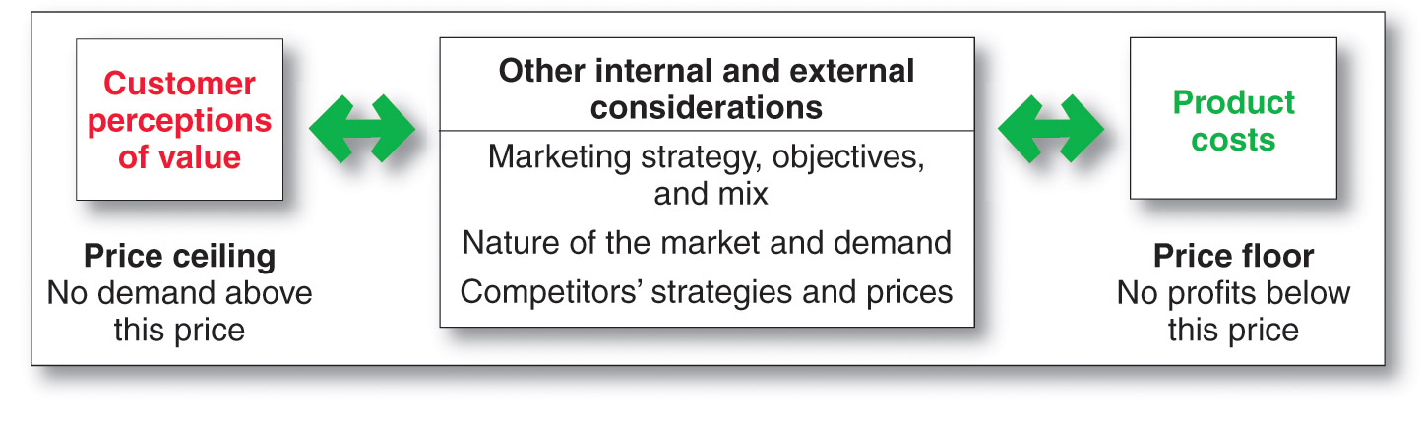
Major Pricing Strategies
Customer Value-Based Pricing
Notes:
Figure 10.1 suggests three major pricing strategies: customer value-based pricing, cost-based pricing, and competition-based pricing.

Slide 6
Major Pricing Strategies
Customer Value-Based Pricing
Value-based pricing uses the buyers’ perceptions of value, not the sellers cost, as the key to pricing. Price is considered before the marketing program is set.
Value-based pricing is customer driven
Cost-based pricing is product driven
Notes:
Note to Instructor
Students often confuse value with low price. You might want to bring up a product that some of them will value even at a high price. You can bring up the latest iPhone product or a luxury car. Some students will feel that the price for these products is too high, however, others will see the value these products offer to the consumer.
Customer Value-Based Pricing
In the end, the customer will decide whether a product’s price is right. Pricing decisions, like other marketing mix decisions, must start with customer value. When customers buy a product, they exchange something of value (the price) to get something of value (the benefits of having or using the product). Effective, customer-oriented pricing involves understanding how much value consumers place on the benefits they receive from the product and setting a price that captures that value.
Customer value-based pricing uses buyers’ perceptions of value as the key to pricing. Value-based pricing means that the marketer cannot design a product and marketing program and then set the price.
Figure 10.2 compares value-based pricing with cost-based pricing. Although costs are an important consideration in setting prices, cost-based pricing is often product driven. The company designs what it considers to be a good product, adds up the costs of making the product, and sets a price that covers costs plus a target profit. Marketing must then convince buyers that the product’s value at that price justifies its purchase. If the price turns out to be too high, the company must settle for lower markups or lower sales, both resulting in disappointing profits.
Value-based pricing reverses this process. The company first assesses customer needs and value perceptions. It then sets its target price based on customer perceptions of value. The targeted value and price drive decisions about what costs can be incurred and the resulting product design. As a result, pricing begins with analyzing consumer needs and value perceptions, and the price is set to match perceived value.
It’s important to remember that “good value” is not the same as “low price.” For example, a Steinway piano—any Steinway piano—costs a lot. But to those who own one, a Steinway is a great value.

Slide 7
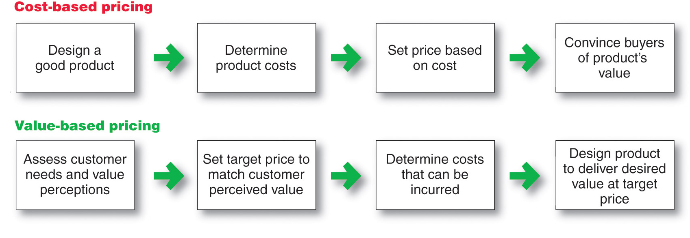
Major Pricing Strategies
Customer Value-Based Pricing

Slide 8
Major Pricing Strategies
Customer Value-Based Pricing
Good-value pricing
offers the right combination of quality and good service at a fair price
Notes:
Note to Instructor
Existing brands are being redesigned to offer more quality for a given price or the same quality for less price.
In many cases good-value pricing includes less expensive items. Good-Value Pricing
The Great Recession of 2008 to 2009 caused a fundamental and lasting shift in consumer attitudes toward price and quality. In response, many companies have changed their pricing approaches to bring them in line with changing economic conditions and consumer price perceptions. More and more, marketers have adopted good-value pricing strategies—offering the right combination of quality and good service at a fair price.
In many cases, this has involved introducing less-expensive versions of established, brand-name products. For example, fast-food restaurants such as Taco Bell and McDonald’s offer value menu and dollar menu items. Every car company now offers small, inexpensive models better suited to tighter consumer budgets and thriftier spending habits. P&G has introduced “Basic” versions of its Bounty and Charmin brands that sell for less and recently launched bargain-priced Gain dish soap, its first new dish soap in almost 40 years. The company has also reduced the size of some Tide laundry detergent packages from 100 ounces to 75 ounces and sells the smaller size packages for 20 percent less at Walmart and other discount stores. “Today, when you ask the consumer, ‘What is value?’ the No. 1 answer is ‘brand names for less,’” says a pricing expert.
In other cases, good-value pricing has involved redesigning existing brands to offer more quality for a given price or the same quality for less. Some companies even succeed by offering less value but at very low prices. For example, passengers flying low-cost European airline Ryanair won’t get much in the way of free amenities, but they’ll like the airline’s unbelievably low prices See Christine Birkner, “Marketing in 2012: The End of the Middle?” Marketing News, January 31, 2012, pp. 22-23.

Slide 9
Major Pricing Strategies
Customer Value-Based Pricing
Everyday low pricing (EDLP) charging a constant everyday low price with few or no temporary price discounts
Notes:
Note to Instructor
An important type of good-value pricing at the retail level is everyday low pricing (EDLP). EDLP involves charging a constant, everyday low price with few or no temporary price discounts. Retailers such as Costco and Lumber Liquidators practice EDLP. However, the king of EDLP is Walmart, which practically defined the concept. Except for a few sale items every month, Walmart promises everyday low prices on everything it sells.

Slide 10
Major Pricing Strategies
Customer Value-Based Pricing
High-low pricing charging higher prices on an everyday basis but running frequent promotions to lower prices temporarily on selected items
Notes:
High-low pricing involves charging higher prices on an everyday basis but running frequent promotions to lower prices temporarily on selected items. Department stores such as Kohl’s and Macy’s practice high-low pricing by having frequent sale days, early-bird savings, and bonus earnings for store credit-card holders.

Slide 11
Major Pricing Strategies
Customer Value-Based Pricing
Value-added pricing attaches value-added features and services to differentiate offers, support higher prices, and build pricing power
Notes:
Value-Added Pricing
Value-based pricing doesn’t mean simply charging what customers want to pay or setting low prices to meet competition. Instead, many companies adopt value-added pricing strategies. Rather than cutting prices to match competitors, they attach value-added features and services to differentiate their offers and thus support their higher prices. For example, even as recession-era consumer spending habits linger, some movie theater chains are adding amenities and charging more rather than cutting services to maintain lower admission prices.

Slide 12
Major Pricing Strategies
Cost-Based Pricing
Cost-based pricing setting prices based on the costs for producing, distributing, and selling the product plus a fair rate of return for effort and risk.
Cost-based pricing adds a standard markup to the cost of the product.
Notes:
Whereas customer-value perceptions set the price ceiling, costs set the floor for the price that the company can charge. Cost-based pricing involves setting prices based on the costs of producing, distributing, and selling the product plus a fair rate of return for its effort and risk. A company’s costs may be an important element in its pricing strategy.
Some companies, such as Walmart or Southwest Airlines, work to become the low-cost producers in their industries. Companies with lower costs can set lower prices that result in smaller margins but greater sales and profits. However, other companies—such as Apple, BMW, and Steinway—intentionally pay higher costs so that they can add value and claim higher prices and margins.

Slide 13
Major Pricing Strategies
Cost-Based Pricing
Fixed costs are the costs that do not vary with production or sales level
  Rent
  Heat
  Interest
  Executive salaries
Notes:
Fixed costs (also known as overhead) are costs that do not vary with production or sales level. For example, a company must pay each month’s bills for rent, heat, interest, and executive salaries regardless of the company’s level of output.

Slide 14
Major Pricing Strategies
Cost-Based Pricing
Variable costs are the costs that vary with the level of production
  Packaging
  Raw materials
Notes:
Variable costs vary directly with the level of production. Each PC produced by HP involves a cost of computer chips, wires, plastic, packaging, and other inputs. Although these costs tend to be the same for each unit produced, they are called variable costs because the total varies with the number of units produced.

Slide 15
Major Pricing Strategies
Cost-Based Pricing
Total costs are the sum of the fixed and variable costs for any given level of production
Notes:
Management wants to charge a price that will at least cover the total production costs at a given level of production.
The company must watch its costs carefully. If it costs the company more than its competitors to produce and sell a similar product, the company will need to charge a higher price or make less profit, putting it at a competitive disadvantage.

Slide 16
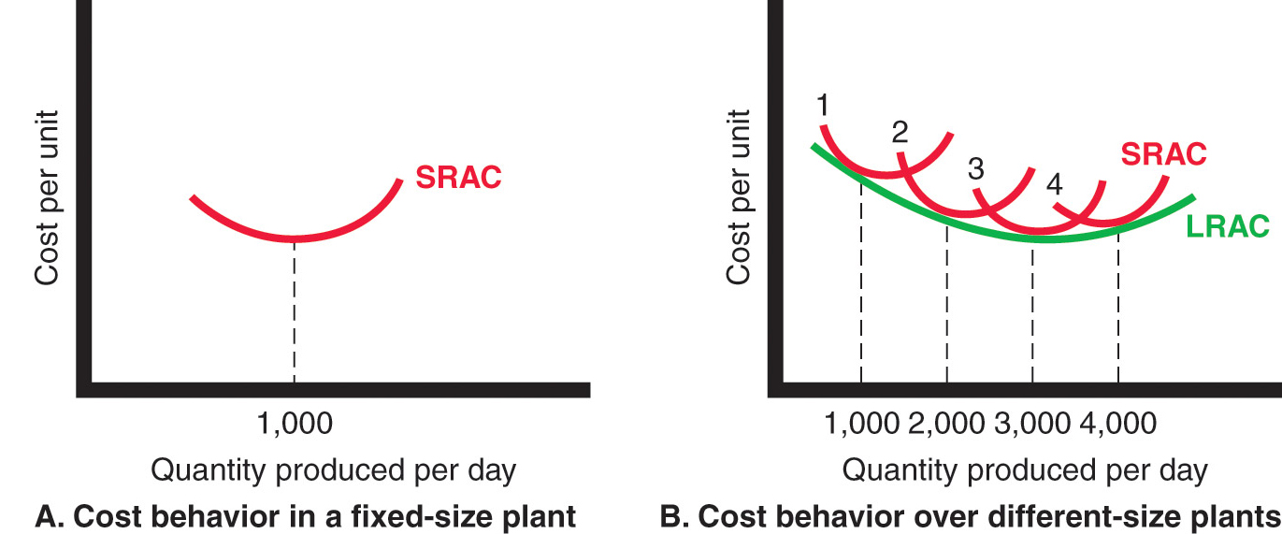
Major Pricing Strategies
Costs as a Function of Production Experience
Notes:
Note to Instructor
It is best to use an example like the Texas Instruments (TI) example given in the book:
TI has built a plant to produce 1,000 calculators per day. Figure 10.3A shows the typical short‑run average cost curve (SRAC). It shows that the cost per calculator is high if TI’s factory produces only a few per day. But as production moves up to 1,000 calculators per day, average cost falls. This is because fixed costs are spread over more units, with each one bearing a smaller share of the fixed cost. TI can try to produce more than 1,000 calculators per day, but average costs will increase because the plant becomes inefficient. Workers have to wait for machines, the machines break down more often, and workers get in each other’s way.
If TI believed it could sell 2,000 calculators a day, it should consider building a larger plant. The plant would use more efficient machinery and work arrangements. Also, the unit cost of producing 2,000 calculators per day would be lower than the unit cost of producing 1,000 units per day, as shown in the long‑run average cost (LRAC) curve (Figure 10.3B). In fact, a 3,000‑capacity plant would even be more efficient, according to Figure 10.3B. But a 4,000-daily production plant would be less efficient because of increasing diseconomies of scale—too many workers to manage, paperwork slowing things down, and so on. Figure 10.3B shows that a 3,000-daily production plant is the best size to build if demand is strong enough to support this level of production.

Slide 17
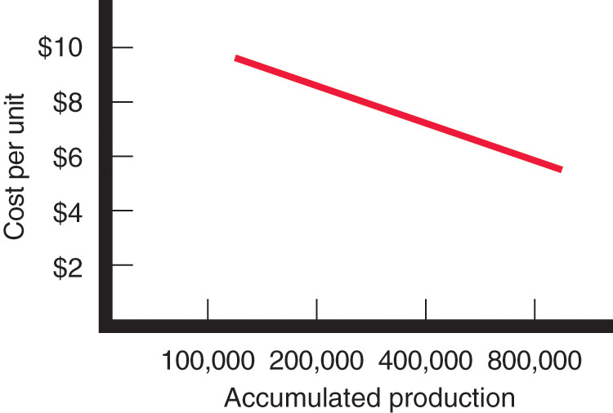
Major Pricing Strategies
Costs as a Function of Production Experience
Experience or learning curve is when average cost falls as production increases because fixed costs are spread over more units
Notes:
Note to Instructor
The TI example continues as follows:
Suppose TI runs a plant that produces 3,000 calculators per day. As TI gains experience in producing calculators, it learns how to do it better. Workers learn shortcuts and become more familiar with their equipment. With practice, the work becomes better organized, and TI finds better equipment and production processes. With higher volume, TI becomes more efficient and gains economies of scale. As a result, average cost tends to fall with accumulated production experience. This is shown in Figure 10.4. Thus, the average cost of producing the first 100,000 calculators is $10 per calculator. When the company has produced the first 200,000 calculators, the average cost has fallen to $9. After its accumulated production experience doubles again to 400,000, the average cost is $7. Here accumulated production is drawn on a semilog scale so that equal distances represent the same percentage increase in output.
This drop in the average cost with accumulated production experience is called the experience curve (or the learning curve).
If a downward-sloping experience curve exists, this is highly significant for the company. Not only will the company’s unit production cost fall, but it will fall faster if the company makes and sells more during a given time period. But the market has to stand ready to buy the higher output. And to take advantage of the experience curve, TI must get a large market share early in the product’s life cycle. This suggests the following pricing strategy: TI should price its calculators low; its sales will then increase, and its costs will decrease through gaining more experience, and then it can lower its prices further.
Some companies have built successful strategies around the experience curve. However, a single-minded focus on reducing costs and exploiting the experience curve will not always work. Experience-curve pricing carries some major risks. The aggressive pricing might give the product a cheap image. The strategy also assumes that competitors are weak and not willing to fight it out by meeting the company’s price cuts. Finally, while the company is building volume under one technology, a competitor may find a lower-cost technology that lets it start at prices lower than those of the market leader, who still operates on the old experience curve.

Slide 18
Major Pricing Strategies
Cost-Plus Pricing
Cost-plus pricing adds a standard markup to the cost of the product
Benefits
  Sellers are certain about costs
  Prices are similar in industry and price competition is minimized
  Buyers feel it is fair
Disadvantages
  Ignores demand and competitor prices
Notes:
Cost-Plus Pricing
The simplest pricing method is cost-plus pricing (or markup pricing)—adding a standard markup to the cost of the product. Construction companies, for example, submit job bids by estimating the total project cost and adding a standard markup for profit. Lawyers, accountants, and other professionals typically price by adding a standard markup to their costs. Some sellers tell their customers they will charge cost plus a specified markup; for example, aerospace companies often price this way to the government.
To illustrate markup pricing, suppose a toaster manufacturer had the following costs and expected sales:
Variable cost $10
Fixed costs $300,000
Expected unit sales 50,000
Then the manufacturer’s cost per toaster is given by the following:
Now suppose the manufacturer wants to earn a 20 percent markup on sales. The manufacturer’s markup price is given by the following:
The manufacturer would charge dealers $20 per toaster and make a profit of $4 per unit. The dealers, in turn, will mark up the toaster. If dealers want to earn 50 percent on the sales price, they will mark up the toaster to $40 ($20 + 50% of $40). This number is equivalent to a markup on cost of 100 percent ($20/$20).
Does using standard markups to set prices make sense? Generally, no. Any pricing method that ignores demand and competitor prices is not likely to lead to the best price. Still, markup pricing remains popular for many reasons. First, sellers are more certain about costs than about demand. By tying the price to cost, sellers simplify pricing; they do not need to make frequent adjustments as demand changes. Second, when all firms in the industry use this pricing method, prices tend to be similar, so price competition is minimized. Third, many people feel that cost-plus pricing is fairer to both buyers and sellers. Sellers earn a fair return on their investment but do not take advantage of buyers when buyers’ demand becomes great.
The arithmetic of markups and margins is discussed in Appendix 2, Marketing by the Numbers.

Slide 19
Major Pricing Strategies
Break-Even Analysis and Target Profit Pricing
Break-even pricing is the price at which total costs are equal to total revenue and there is no profit
Target return pricing is the price at which the firm will break even or make the profit it’s seeking
Notes:
Break-Even Analysis and Target Profit Pricing
Another cost-oriented pricing approach is break-even pricing (or a variation called target return pricing). The firm tries to determine the price at which it will break even or make the target return it is seeking.
Target return pricing uses the concept of a break-even chart, which shows the total cost and total revenue expected at different sales volume levels. Figure 10.5 shows a break-even chart for the toaster manufacturer discussed here. Fixed costs are $300,000 regardless of sales volume. Variable costs are added to fixed costs to form total costs, which rise with volume. The total revenue curve starts at zero and rises with each unit sold. The slope of the total revenue curve reflects the price of $20 per unit.
The total revenue and total cost curves cross at 30,000 units. This is the break-even volume. At $20, the company must sell at least 30,000 units to break even, that is, for total revenue to cover total cost. Break-even volume can be calculated using the following formula:
If the company wants to make a profit, it must sell more than 30,000 units at $20 each. Suppose the toaster manufacturer has invested $1,000,000 in the business and wants to set a price to earn a 20 percent return, or $200,000. In that case, it must sell at least 50,000 units at $20 each. If the company charges a higher price, it will not need to sell as many toasters to achieve its target return. But the market may not buy even this lower volume at the higher price. Much depends on price elasticity and competitors’ prices.
The manufacturer should consider different prices and estimate break-even volumes, probable demand, and profits for each. This is done in Table 10.1. The table shows that as price increases, the break-even volume drops (column 2). But as price increases, the demand for toasters also decreases (column 3). At the $14 price, because the manufacturer clears only $4 per toaster ($14 less $10 in variable costs), it must sell a very high volume to break even. Even though the low price attracts many buyers, demand still falls below the high break-even point, and the manufacturer loses money. At the other extreme, with a $22 price, the manufacturer clears $12 per toaster and must sell only 25,000 units to break even. But at this high price, consumers buy too few toasters, and profits are negative. The table shows that a price of $18 yields the highest profits. Note that none of the prices produce the manufacturer’s target return of $200,000. To achieve this return, the manufacturer will have to search for ways to lower the fixed or variable costs, thus lowering the break-even volume.

Slide 20
Major Pricing Strategies
Competition-based pricing
Setting prices based on competitors’ strategies, costs, prices, and market offerings.
Consumers will base their judgments of a product’s value on the prices that competitors charge for similar products.
Notes:
Competition-Based Pricing
Competition-based pricing involves setting prices based on competitors’ strategies, costs, prices, and market offerings. Consumers will base their judgments of a product’s value on the prices that competitors charge for similar products.
In assessing competitors’ pricing strategies, the company should ask several questions. First, how does the company’s market offering compare with competitors’ offerings in terms of customer value? If consumers perceive that the company’s product or service provides greater value, the company can charge a higher price. If consumers perceive less value relative to competing products, the company must either charge a lower price or change customer perceptions to justify a higher price.
Next, how strong are current competitors and what are their current pricing strategies? If the company faces a host of smaller competitors charging high prices relative to the value they deliver, it might charge lower prices to drive weaker competitors from the market. If the market is dominated by larger, lower-price competitors, the company may decide to target unserved market niches with value-added products at higher prices.

Slide 21
Considerations in Setting Price
Notes:
Overall Marketing Strategy, Objectives, and Mix
Price is only one element of the company’s broader marketing strategy. So, before setting price, the company must decide on its overall marketing strategy for the product or service. Sometimes, a company’s overall strategy is built around its price and value story. For example, grocery retailer Trader Joe’s unique price-value positioning has made it one of the nation’s fastest-growing, most popular food stores. Trader Joe’s understands that success comes not just from what products you offer customers or from the prices you charge. It comes from offering the combination of products, prices, and store operations that produces the greatest customer value—what customers get for the prices they pay. If the company has selected its target market and positioning carefully, then its marketing mix strategy, including price, will be fairly straightforward. For example, Kohler’s Kallista line of bath and kitchen fixtures is positioned for the luxury market. It “combines passion with a profound sense of aesthetic and functional efficiency,” giving you “the bold look of Kohler.” Each Kallista product features “exquisite details—from surfaces finished by hand to cultured stone—carefully articulated to express a simple, singular elegance.” The Kallista line’s luxury positioning requires charging a higher price. In contrast, Kohler’s Sterling division offers more affordable fixtures that are “inspired by the realities of life.” Sterling fixtures are positioned on simplicity, convenience, comfort, and economical design for budget-conscious homeowners. Sterling’s mid-market positioning calls for charging lower prices. Thus, pricing strategy is largely determined by decisions on market positioning.
Pricing may play an important role in helping to accomplish company objectives at many levels. A firm can set prices to attract new customers or profitably retain existing ones. It can set prices low to prevent competition from entering the market or set prices at competitors’ levels to stabilize the market. It can price to keep the loyalty and support of resellers or avoid government intervention. Prices can be reduced temporarily to create excitement for a brand. Or one product may be priced to help the sales of other products in the company’s line.
Price decisions must be coordinated with product design, distribution, and promotion decisions to form a consistent and effective integrated marketing mix program. Decisions made for other marketing mix variables may affect pricing decisions. For example, a decision to position the product on high-performance quality will mean that the seller must charge a higher price to cover higher costs. And producers whose resellers are expected to support and promote their products may have to build larger reseller margins into their prices.
See www.kohler.com and www.sterlingplumbing.com, accessed June 2012.

Slide 22
Other Internal and External Considerations Affecting Price Decisions
Target costing starts with an ideal selling price based on consumer value considerations and then targets costs that will ensure that the price is met
Notes:
Companies often position their products on price and then tailor other marketing mix decisions to the prices they want to charge. Here, price is a crucial product-positioning factor that defines the product’s market, competition, and design. Many firms support such price-positioning strategies with a technique called target costing. Target costing reverses the usual process of first designing a new product, determining its cost, and then asking, “Can we sell it for that?” Instead, it starts with an ideal selling price based on customer-value considerations and then targets costs that will ensure that the price is met.
Other companies deemphasize price and use other marketing mix tools to create nonprice positions. Often, the best strategy is not to charge the lowest price but rather differentiate the marketing offer to make it worth a higher price.
Thus, marketers must consider the total marketing strategy and mix when setting prices. But again, even when featuring price, marketers need to remember that customers rarely buy on price alone. Instead, they seek products that give them the best value in terms of benefits received for the prices paid.
Some marketers even position their products on high prices, featuring high prices as part of their product’s allure.

Slide 23
Other Internal and External Considerations Affecting Price Decisions
Organizational considerations include:
Who should set the price
Who can influence the prices
Notes:
Organizational Considerations
Management must decide who within the organization should set prices. Companies handle pricing in a variety of ways. In small companies, prices are often set by top management rather than by the marketing or sales departments. In large companies, pricing is typically handled by divisional or product managers. In industrial markets, salespeople may be allowed to negotiate with customers within certain price ranges. Even so, top management sets the pricing objectives and policies, and it often approves the prices proposed by lower-level management or salespeople.
In industries in which pricing is a key factor (airlines, aerospace, steel, railroads, oil companies), companies often have pricing departments to set the best prices or help others set them. These departments report to the marketing department or top management. Others who have an influence on pricing include sales managers, production managers, finance managers, and accountants.

Slide 24
Other Internal and External Considerations Affecting Price Decisions
The Market and Demand
Before setting prices, the marketer must understand the relationship between price and demand for its products
Notes:
The Market and Demand
As noted earlier, good pricing starts with an understanding of how customers’ perceptions of value affect the prices they are willing to pay. Both consumer and industrial buyers balance the price of a product or service against the benefits of owning it. Thus, before setting prices, the marketer must understand the relationship between price and demand for the company’s product. In this section, we take a deeper look at the price-demand relationship and how it varies for different types of markets. We then discuss methods for analyzing the price-demand relationship.

Slide 25
Other Internal and External Consideration Affecting Price Decisions
Competition
Pure competition
Monopolistic competition
Oligopolistic competition
Pure monopoly
Notes:
Note to Instructor
Discussion Question
How has the Internet has changed pricing competition?
Under pure competition, the market consists of many buyers and sellers trading in a uniform
commodity, such as wheat, copper, or financial securities. No single buyer or seller has
much effect on the going market price. In a purely competitive market, marketing research,
product development, pricing, advertising, and sales promotion play little or no role. Thus,
sellers in these markets do not spend much time on marketing strategy.
Under monopolistic competition, the market consists of many buyers and sellers who
trade over a range of prices rather than a single market price. A range of prices occurs because
sellers can differentiate their offers to buyers.
Under oligopolistic competition, the market consists of a few sellers who are highly sensitive
to each other’s pricing and marketing strategies. Because there are few sellers, each
seller is alert and responsive to competitors’ pricing strategies and moves.
In a pure monopoly, the market consists of one seller. The seller may be a government
monopoly (the U.S. Postal Service), a private regulated monopoly (a power company), or a
private nonregulated monopoly (DuPont when it introduced nylon). Pricing is handled differently
in each case.

Slide 26
Other Internal and External Considerations Affecting Price Decisions
The demand curve shows the number of units the market will buy in a given period at different prices
Normally, demand and price are inversely related
Higher price = lower demand
For prestige (luxury) goods, higher price can equal higher demand when consumers perceive higher prices as higher quality
Notes:
Each price the company might charge will lead to a different level of demand. The relationship between the price charged and the resulting demand level is shown in the demand curve in Figure 10.6. The demand curve shows the number of units the market will buy in a given time period at different prices that might be charged. In the normal case, demand and price are inversely related—that is, the higher the price, the lower the demand. Thus, the company would sell less if it raised its price from P₁ to P₂. In short, consumers with limited budgets probably will buy less of something if its price is too high.

Slide 27
Other Internal and External Considerations Affecting Price Decisions
Price elasticity of demand illustrates the response of demand to a change in price
Inelastic demand occurs when demand hardly changes when there is a small change in price
Elastic demand occurs when demand changes greatly for a small change in price
Price elasticity of demand =
% change in quantity demand
% change in price
Notes:
Price Elasticity of Demand
Consider the two demand curves in Figure 10.6. In Figure 10.6A, a price increase from P₁ to P₂ leads to a relatively small drop in demand from Q₁ to Q₂. In Figure 10.6B, however, the same price increase leads to a large drop in demand from Qꞌ₁ to Qꞌ₂. If demand hardly changes with a small change in price, we say the demand is inelastic. If demand changes greatly, we say the demand is elastic. The price elasticity of demand is given by the following formula:
Suppose demand falls by 10 percent when a seller raises its price by 2 percent. The price elasticity of demand is therefore -5 (the minus sign confirms the inverse relation between price and demand), and demand is elastic. If demand falls by 2 percent with a 2 percent increase in price, then elasticity is -1. In this case, the seller’s total revenue stays the same: The seller sells fewer items but at a higher price that preserves the same total revenue. If demand falls by 1 percent when price is increased by 2 percent, then elasticity is -, and demand is inelastic. The less elastic the demand, the more it pays for the seller to raise the price.
What determines the price elasticity of demand? Buyers are less price sensitive when the product they are buying is unique or when it is high in quality, prestige, or exclusiveness; substitute products are hard to find or when they cannot easily compare the quality of substitutes; and the total expenditure for a product is low relative to their income or when the cost is shared by another party.
If demand is elastic rather than inelastic, sellers will consider lowering their prices. A lower price will produce more total revenue. This practice makes sense as long as the extra costs of producing and selling more do not exceed the extra revenue. At the same time, most firms want to avoid pricing that turns their products into commodities. In recent years, forces such as dips in the economy, deregulation, and the instant price comparisons afforded by the Internet and other technologies have increased consumer price sensitivity, turning products ranging from phones and computers to new automobiles into commodities in some consumers’ eyes.
Marketers need to work harder than ever to differentiate their offerings when a dozen competitors are selling virtually the same product at a comparable or lower price. More than ever, companies need to understand the price sensitivity of their customers and the trade-offs people are willing to make between price and product characteristics.

Slide 28
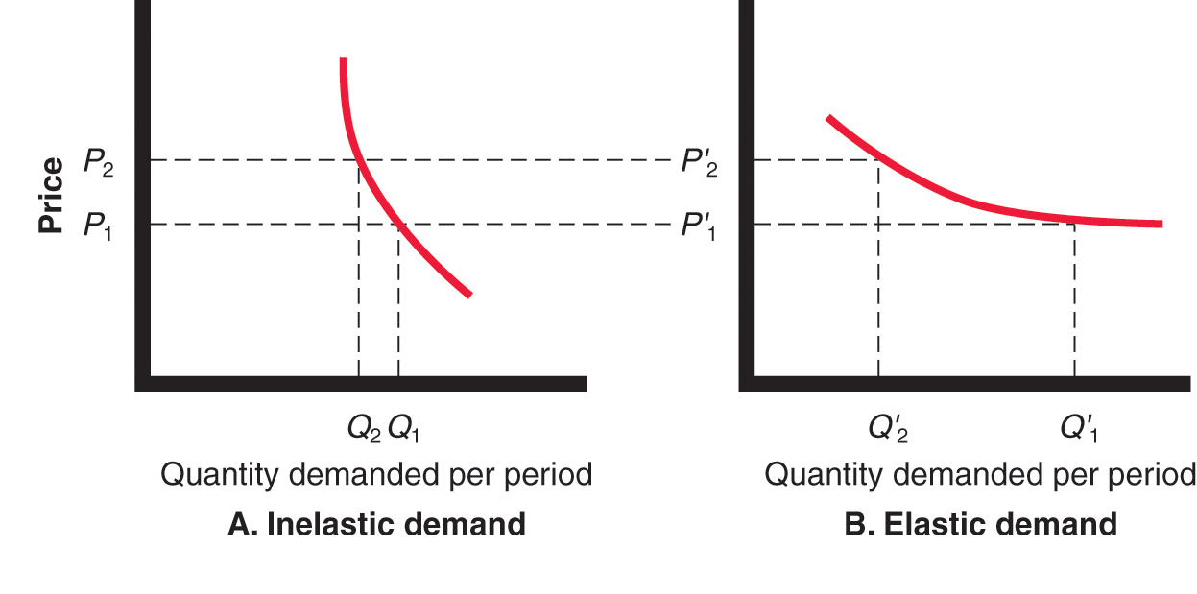
Other Internal and External Considerations Affecting Price Decisions

Slide 29
Other Internal and External Consideration Affecting Price Decisions
Economic conditions
Reseller’s response to price
Government
Social concerns
Notes:
The Economy
Economic conditions can have a strong impact on the firm’s pricing strategies. Economic factors such as a boom or recession, inflation, and interest rates affect pricing decisions because they affect consumer spending, consumer perceptions of the product’s price and value, and the company’s costs of producing and selling a product.
In the aftermath of the recent Great Recession, many consumers have rethought the price-value equation. They have tightened their belts and become more value conscious. Consumers will likely continue their thriftier ways well beyond any economic recovery. As a result, many marketers have increased their emphasis on value-for-the-money pricing strategies.
The most obvious response to the new economic realities is to cut prices and offer discounts. Thousands of companies have done just that. Lower prices make products more affordable and help spur short-term sales. However, such price cuts can have undesirable long-term consequences. Lower prices mean lower margins. Deep discounts may cheapen a brand in consumers’ eyes. And once a company cuts prices, it’s difficult to raise them again when the economy recovers.
Rather than cutting prices, many companies have instead shifted their marketing focus to more affordable items in their product mixes. For example, whereas its previous promotions emphasized high-end products and pricey concepts such as creating dream kitchens, Home Depot’s more recent advertising pushes items like potting soil and hand tools under the tagline: “More saving. More doing. That’s the power of Home Depot.”
Other companies are holding prices but redefining the “value” in their value propositions. Consider upscale grocery retailer Whole Foods Market:
<ex10.11>
Whole Foods Market grew rapidly by serving up high-quality grocery items to upscale customers who were willing and able to pay more for the extra value they got. Then came the Great Recession of 2008, and even relatively affluent customers began cutting back and spending less. All of a sudden, Whole Foods Market faced a difficult question: Should it hold the line on its premium price positioning, or should it cut prices and reposition itself to fit the leaner times? Whole Foods decided to stick with its core up-market positioning, but it also began to subtly realign its value proposition. Rather than dropping everyday prices across the board, Whole Foods lowered prices on selected basic items and offered significant sales on others. It also started emphasizing its lower-price private-label brand, 365 Everyday Value.
At the same time, however, Whole Foods Market launched a new marketing program that did more than simply promote more affordable merchandise. It convinced shoppers that, for what you get, Whole Foods’s regular products and prices offer good value as well. When it comes to quality food, price isn’t everything. The upscale retailer even assigned workers to serve as “value tour guides” to escort shoppers around stores and point out the value in both sale and regular items. As one tour guide notes, “Value means getting a good exchange for your money.” As a result of subtle shifts in its value strategy, Whole Foods Market is now back on track in the post-recession economy. It is meeting the challenges of more frugal times in a way that preserves all the things that have made it special to customers through the years.
Remember, even in tough economic times, consumers do not buy based on prices alone. They balance the price they pay against the value they receive. For example, according to one survey, despite selling its shoes for as much as $150 a pair, Nike commands the highest consumer loyalty of any brand in the footwear segment. Customers perceive the value of Nike’s products and the Nike ownership experience to be well worth the price. Thus, no matter what price they charge—low or high—companies need to offer great value for the money.
Other External Factors
Beyond the market and the economy, the company must consider several other factors in its external environment when setting prices. It must know what impact its prices will have on other parties in its environment. How will resellers react to various prices? The company should set prices that give resellers a fair profit, encourage their support, and help them to sell the product effectively. The government is another important external influence on pricing decisions. Finally, social concerns may need to be taken into account. In setting prices, a company’s short-term sales, market share, and profit goals may need to be tempered by broader societal considerations.

Slide 30
Bibliography
Principles of Marketing by Philip Kotler & Gary Armstrong
Fifteenth Edition, Published by Prentice Hall
Marketing Management – A South Asian Perspective
by Philip Kotler, Kevin Lane Keller, Abraham Koshy &
Mithileshwar Jha, 13th Edition, Published by Pearson
Education, Inc.
Principles and Practices of Marketing by Jobber, D. 4th
edition, McGraw Hill International.
Principles of Advertising & IMC by Tom Duncan 2nd
Edition, Published by McGraw-Hill Irwin.

Slide 31


The End
People will always throw stones in your path! It depends on you! What do you make from it:
A “Wall” of difficulties
or
A “Bridge” of success.

