Slide 1
Brand, Branding And Building Customer Value
LECTURE-14

Slide 2
Topic Outline
Brand
Branding
Branding Strategy: Building Strong Brands
Notes:
After examining customer-driven marketing strategy, we now take a deeper look at the marketing mix: the tactical tools that marketers use to implement their strategies and deliver superior customer value. The product and brand are usually the first and most basic marketing consideration. We start with a seemingly simple question: What is a product? In this and the next chapter, we study how companies develop and manage products and brands.

Slide 3
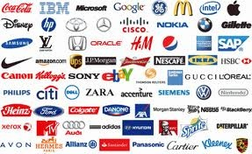
What is a Brand?
A brand is a name, term, sign, symbol or design, or a combination of them, intended to identify the goods or services of one seller or group of sellers and to differentiate them from those of competitors.

Slide 4
The Role of Brands
Identify the maker
Simplify product handling
Organize accounting
Offer legal protection
Signify quality
Create barriers to entry
Serve as a competitive advantage
Secure price premium

Slide 5
What is Branding?
Branding is endowing products and services with the power of the brand.

Slide 6
Advantages of Strong Brands
Improved perceptions of product performance
Greater loyalty
Less vulnerability to competitive marketing actions
Less vulnerability to crises
Larger margins
More inelastic consumer response
Greater trade cooperation
Increased marketing communications effectiveness
Possible licensing opportunities

Slide 7
What is a Brand Promise?
A brand promise is the marketer’s vision of what the brand must be and do for consumers.

Slide 8
Drivers of Brand Equity
Brand elements
  These are those trademarkable devices that identify & differentiate the brand.
Marketing activities
Meaning transference

Slide 9
Brand Elements
Brand names
Slogans
Characters
Symbols
Logos
URLs

Slide 10
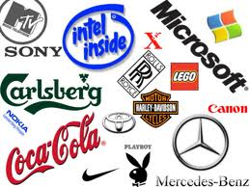
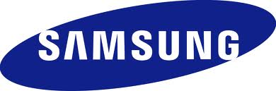
Brand Logo

Slide 11
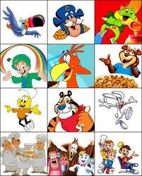
Brand Characters

Slide 12
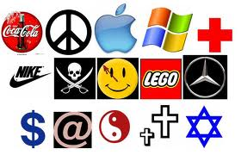
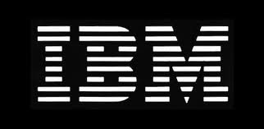
Brand Symbol

Slide 13
Brand Element Choice Criteria
Memorable
Meaningful
Likeability
Transferable
Adaptable
Protectable

Slide 14
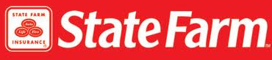
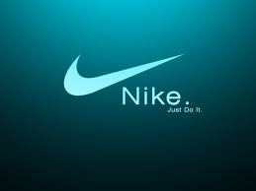
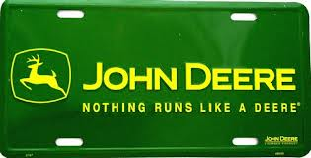
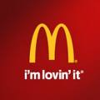

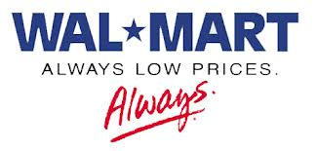
Slogans
Like a good neighbor, State Farm is there
Just do it
Nothing runs like a Deere
I’m lovin’ it
We try harder
Always low prices

Slide 15
The 10 Most Valuable Brands
Brand | Brand Value (Billions)
Coca-Cola | $67.00
Microsoft | $56.93
IBM | $56.20
GE | $48.91
Intel | $38.32
Nokia | $30.13
Toyota | $27.94
Disney | $27.85
McDonald’s | $27.50
Mercedes-Benz | $22.13

Slide 16
Devising a Branding Strategy
Develop new brand elements
Apply existing brand elements
Use a combination of old and new

Slide 17
Branding Strategy: Building Strong Brands
Brand equity
Brand equity is the added value endowed on products and services, which may be reflected in the way consumers, think, feel, and act with respect to the brand.
Notes:
Brand Equity
Brands are more than just names and symbols. They are a key element in the company’s relationships with consumers. Brands represent consumers’ perceptions and feelings about a product and its performance—everything that the product or the service means to consumers. In the final analysis, brands exist in the heads of consumers. As one well-respected marketer once said, “Products are created in the factory, but brands are created in the mind.” Adds Jason Kilar, CEO of the online video service Hulu, “A brand is what people say about you when you’re not in the room.”
A powerful brand has high brand equity. Brand equity is the differential effect that knowing the brand name has on customer response to the product and its marketing. It’s a measure of the brand’s ability to capture consumer preference and loyalty. A brand has positive brand equity when consumers react more favorably to it than to a generic or unbranded version of the same product. It has negative brand equity if consumers react less favorably than to an unbranded version.
Ad agency Young & Rubicam’s BrandAsset Valuator measures brand strength along four consumer perception dimensions: differentiation (what makes the brand stand out), relevance (how consumers feel it meets their needs), knowledge (how much consumers know about the brand), and esteem (how highly consumers regard and respect the brand). Brands with strong brand equity rate high on all four dimensions. The brand must be distinct, or consumers will have no reason to choose it over other brands. However, the fact that a brand is highly differentiated doesn’t necessarily mean that consumers will buy it. The brand must stand out in ways that are relevant to consumers’ needs. Even a differentiated, relevant brand is far from a shoe-in. Before consumers will respond to the brand, they must first know about and understand it. And that familiarity must lead to a strong, positive consumer-brand connection.
Thus, positive brand equity derives from consumer feelings about and connections with a brand. Consumers sometimes bond very closely with specific brands. As perhaps the ultimate expression of brand devotion, a surprising number of people—and not just Harley-Davidson fans—have their favorite brand tattooed on their bodies. Whether its contemporary new brand such as Facebook or Amazon or old classics like Harley or Reese’s, strong brands are built around an ideal of improving consumers’ lives in some relevant way (see Real Marketing 8.2).
<insert ex08.15 inside Real Marketing 8.2>
A brand with high brand equity is a very valuable asset. Brand valuation is the process of estimating the total financial value of a brand. Measuring such value is difficult. However, according to one estimate, the brand value of Apple is a whopping $153 billion, with Google at $112 billion, IBM at $100 billion, McDonald’s at $81 billion, Microsoft at $78 billion, and Coca-Cola at $73 billion. Other brands rating among the world’s most valuable include AT&T, China Mobile, GE, Walmart, and Amazon.com.
High brand equity provides a company with many competitive advantages. A powerful brand enjoys a high level of consumer brand awareness and loyalty. Because consumers expect stores to carry the particular brand, the company has more leverage in bargaining with resellers. Because a brand name carries high credibility, the company can more easily launch line and brand extensions. A powerful brand also offers the company some defense against fierce price competition.
Above all, however, a powerful brand forms the basis for building strong and profitable customer relationships. The fundamental asset underlying brand equity is customer equity—the value of customer relationships that the brand creates. A powerful brand is important, but what it really represents is a profitable set of loyal customers. The proper focus of marketing is building customer equity, with brand management serving as a major marketing tool. Companies need to think of themselves not as portfolios of brands but as portfolios of customers.

Slide 18
Measuring Brand Equity
Brand audits
  A consumer focused series of procedures to assess the health of the brand (Equity)
Brand tracking
  Quantitative data from consumers on a routine basis over time.
Brand valuation
  Total financial value of the brand.

Slide 19
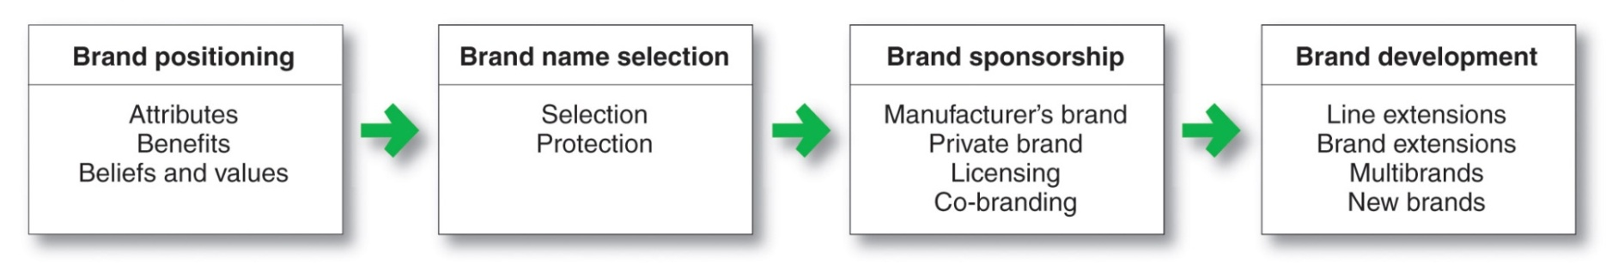
Branding Strategy: Building Strong Brands
Notes:
Building Strong Brands
Branding poses challenging decisions to the marketer. Figure 8.5 shows that the major brand strategy decisions involve brand positioning, brand name selection, brand sponsorship, and brand development.

Slide 20
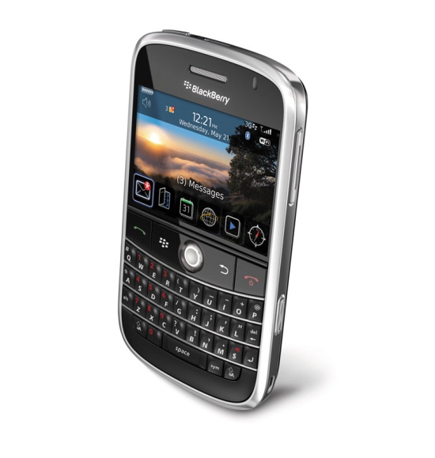
Branding Strategy: Building Strong Brands
Brand Positioning
Brand strategy decisions include:
Product attributes
Product benefits
Product beliefs and values
Notes:
Brand Positioning
Marketers need to position their brands clearly in target customers’ minds. They can position brands at any of three levels. At the lowest level, they can position the brand on product attributes. For example, P&G invented the disposable diaper category with its Pampers brand. Early Pampers marketing focused on attributes such as fluid absorption, fit, and disposability. In general, however, attributes are the least desirable level for brand positioning. Competitors can easily copy attributes. More importantly, customers are not interested in attributes as such—they are interested in what the attributes will do for them.
A brand can be better positioned by associating its name with a desirable benefit. Thus, Pampers can go beyond technical product attributes and talk about the resulting containment and skin-health benefits from dryness. Some successful brands positioned on benefits are FedEx (guaranteed on-time delivery), Nike (performance), Lexus (quality), and Walmart (low prices).
The strongest brands go beyond attribute or benefit positioning. They are positioned on strong beliefs and values, engaging customers on a deep, emotional level. For example, to parents, Pampers mean much more than just containment and dryness. The “Pampers village” website (www.pampers.com) positions Pampers as a “where we grow together” brand that’s concerned about happy babies, parent-child relationships, and total baby care. Says a former P&G executive, “Our baby care business didn’t start growing aggressively until we changed Pampers from being about dryness to helping mom with her baby’s development.”
Successful brands engage customers on a deep, emotional level. Advertising agency Saatchi & Saatchi suggests that brands should strive to become lovemarks, products or services that “inspire loyalty beyond reason.” Brands ranging from Apple, Google, Disney, and Coca-Cola to Nike, Trader Joe’s, Facebook, Wrangler, In-N-Out Burger, and even WD-40 have achieved this status with many of their customers. Lovemark brands pack an emotional wallop. Customers don’t just like these brands, they have strong emotional connections with them and love them unconditionally.
When positioning a brand, the marketer should establish a mission for the brand and a vision of what the brand must be and do. A brand is the company’s promise to deliver a specific set of features, benefits, services, and experiences consistently to buyers. The brand promise must be simple and honest. Motel 6, for example, offers clean rooms, low prices, and good service but does not promise expensive furnishings or large bathrooms. In contrast, The Ritz-Carlton offers luxurious rooms and a truly memorable experience but does not promise low prices.

Slide 21
Branding Strategy: Building Strong Brands
Brand Name Selection
Desirable qualities
Suggest benefits and qualities
Easy to pronounce, recognize, & remember
Distinctive
Extendable
Translatable for the global economy
Capable of registration and legal protection
Notes:
Note to Instructor
The text has example for each of these:
It should suggest something about the product’s benefits and qualities. Examples: Beautyrest, Die Hard, Intensive Care, Curves (women’s fitness centers).
It should be easy to pronounce, recognize, and remember: Tide, Silk, iPod Touch, JetBlue.
The brand name should be distinctive: Lexus, Zappos.
It should be extendable: Amazon.com began as an online bookseller but chose a name that would allow expansion into other categories.
The name should translate easily into foreign languages. Before changing its name to Exxon, Standard Oil of New Jersey rejected the name Enco, which it learned meant a stalled engine when pronounced in Japanese

Slide 22
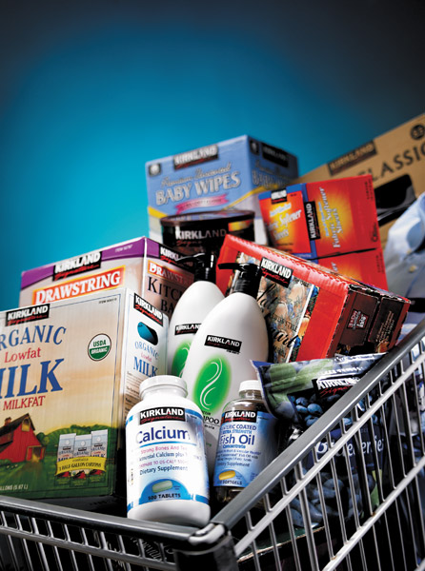
Branding Strategy: Building Strong Brands
Brand Sponsorship
Manufacturer’s brand
Private brand
Licensed brand
Co-brand
Notes:
Brand Sponsorship
A manufacturer has four sponsorship options. The product may be launched as a national brand (or manufacturer’s brand), as when Samsung and Kellogg sell their output under their own brand names (the Samsung Galaxy tablet or Kellogg’s Frosted Flakes). Or the manufacturer may sell to resellers who give the product a private brand (also called a store brand or distributor brand). Although most manufacturers create their own brand names, others market licensed brands. Finally, two companies can join forces and co-brand a product. We discuss each of these options in turn.
National Brands versus Store Brands. National brands (or manufacturers’ brands) have long dominated the retail scene. In recent times, however, an increasing number of retailers and wholesalers have created their own store brands (or private brands). Store brands have been gaining strength for more than two decades, but recent tighter economic times have created a store-brand boom. Studies show that consumers are now buying even more private brands, which on average yield a 29 percent savings. “[Thrifty] times are good times for private labels,” says a brand expert. “As consumers become more price-conscious, they also become less brand-conscious.”
In fact, store brands are growing much faster than national brands. For example, five years ago, private labels accounted for about 20 percent of U.S. food and beverage purchases. Since the Great Recession of 2008, however, unit sales of private label goods have grown at more than twice the rate of national brands. Private labels now account for 29 percent of supermarket sales. Similarly, for apparel sales, private-label brands—such as Hollister, The Limited, Arizona Jean Company (JCPenney), and Xhilaration (Target)—now capture a 50 percent share of all U.S. apparel sales, up from 25 percent a decade ago. Even upscale retailer Saks Fifth Avenue carries its own clothing line, which features $98 men’s ties, $200 halter tops, and $250 cotton dress shirts.
<ex08.17>
Many large retailers skillfully market a deep assortment of store-brand merchandise. For example, Walmart’s private brands account for a whopping 40 percent of its sales: brands such as Great Value food products; Sam’s Choice beverages; Equate pharmacy, health, and beauty products; White Cloud brand toilet tissue and diapers; Simple Elegance laundry products; and Canopy outdoor home products. Its private label brands alone generate nearly twice the sales of all P&G brands combined, and Walmart’s Great Value is the nation’s largest single food brand. At the other end of the grocery spectrum, upscale Whole Foods Market offers an array of store brand products under its 365 Everyday Value brand, from organic Canadian maple syrup and frozen chicken Caesar pizza to chewy children’s multivitamins and organic whole wheat pasta.
Once known as “generic” or “no-name” brands, today’s store brands are shedding their image as cheap knockoffs of national brands. Store brands now offer much greater selection, and they are rapidly achieving name-brand quality. In fact, retailers such as Target and Trader Joe’s are out-innovating many of their national-brand competitors. As a result, consumers are becoming loyal to store brands for reasons besides price. “It’s much less about value and price than it used to be,” says one analyst. It’s now more about “loyalty and positive experiences.” In some cases, notes another analyst, “consumers even pay more for store brands, many of which had been positioned as gourmet or specialty items.”
In the so-called battle of the brands between national and private brands, retailers have many advantages. They control what products they stock, where they go on the shelf, what prices they charge, and which ones they will feature in local promotions. Retailers often price their store brands lower than comparable national brands and feature the price differences in side-by-side comparisons on store shelves. Although store brands can be hard to establish and costly to stock and promote, they also yield higher profit margins for the reseller. And they give resellers exclusive products that cannot be bought from competitors, resulting in greater store traffic and loyalty. Fast-growing retailer Trader Joe’s, which carries 80 percent store brands, largely controls its own brand destiny, rather than relying on producers to make and manage the brands it needs to serve its customers best.
To compete with store brands, national brands must sharpen their value propositions, especially when appealing to today’s more frugal consumers. Many national brands are fighting back by rolling out more discounts and coupons to defend their market share. In the long run, however, leading brand marketers must compete by investing in new brands, new features, and quality improvements that set them apart. They must design strong advertising programs to maintain high awareness and preference. And they must find ways to partner with major distributors to find distribution economies and improved joint performance.
For example, in response to the recent surge in private-label sales, consumer product giant Procter & Gamble has redoubled its efforts to develop and promote new and better products, particularly at lower price points. “We invest $2 billion a year in research and development, $400 million on consumer knowledge, and about 10 percent of sales on advertising,” says P&G’s CEO, Bob McDonald. “Store brands don’t have that capacity.”
Licensing. Most manufacturers take years and spend millions to create their own brand names. However, some companies license names or symbols previously created by other manufacturers, names of well-known celebrities, or characters from popular movies and books. For a fee, any of these can provide an instant and proven brand name.
Apparel and accessories sellers pay large royalties to adorn their products—from blouses to ties and linens to luggage—with the names or initials of well-known fashion innovators such as Calvin Klein, Tommy Hilfiger, Gucci, or Armani. Sellers of children’s products attach an almost endless list of character names to clothing, toys, school supplies, linens, dolls, lunch boxes, cereals, and other items. Licensed character names range from classics such as Sesame Street, Disney, Barbie, Star Wars, Scooby Doo, Hello Kitty, and Dr. Seuss characters to the more recent Dora the Explorer; Go, Diego, Go!; Little Einsteins; and Hannah Montana. And currently a number of top-selling retail toys are products based on television shows and movies.
Name and character licensing has grown rapidly in recent years. Annual retail sales of licensed products worldwide have grown from only $4 billion in 1977 to $55 billion in 1987 and more than $182 billion today. Licensing can be a highly profitable business for many companies. For example, Disney, the world’s biggest licensor, reported nearly $28 billion in worldwide merchandise sales last year and plans to double that figure in the next 5 to 7 years. And Nickelodeon has developed a stable full of hugely popular characters, such as Dora the Explorer; Go, Diego, Go!; iCarly; Team Umizoomi, and SpongeBob SquarePants. SpongeBob alone has generated more than $8 billion in sales and licensing fees over the past decade.
Co-branding. Co-branding occurs when two established brand names of different companies are used on the same product. Co-branding offers many advantages. Because each brand dominates in a different category, the combined brands create broader consumer appeal and greater brand equity. For example, PepsiCo’s Lay’s brand joined KC Masterpiece to create Lay’s KC Masterpiece Barbeque chips. Pillsbury and Cinnabon joined forces to create Pillsbury Cinnabon cinnamon rolls. And Dairy Queen and the Girl Scouts teamed up to create Girl Scout limited edition cookie-filled Blizzards. The Thin Mint Blizzard is the most popular DQ limited edition to date, selling more than 10 million in one month.
<ex08.18>
Co-branding can take advantage of the complementary strengths of two brands. For example, the Tim Hortons coffee chain has established co-branded Tim Hortons–Cold Stone Creamery shops. Tim Hortons is strong in the morning and midday periods, with coffee and baked goods, soups, and sandwiches. By contrast, Cold Stone Creamery’s ice cream snacks are strongest in the afternoon and evening, which are Tim Hortons’s nonpeak periods. The co-branded locations offer customers a reason to visit morning, noon, and night.
Co-branding also allows a company to expand its existing brand into a category it might otherwise have difficulty entering alone. For example, Nike and Apple co-branded the Nike+iPod Sport Kit, which lets runners link their Nike shoes with their iPods to track and enhance running performance in real time. “Your iPod Nano [or iPod Touch] becomes your coach. Your personal trainer. Your favorite workout companion.” The Nike+iPod arrangement gives Apple a presence in the sports and fitness market. At the same time, it helps Nike bring new value to its customers.
Co-branding can also have limitations. Such relationships usually involve complex legal contracts and licenses. Co-branding partners must carefully coordinate their advertising, sales promotion, and other marketing efforts. Finally, when co-branding, each partner must trust that the other will take good care of its brand. If something damages the reputation of one brand, it can tarnish the co-brand as well.

Slide 23
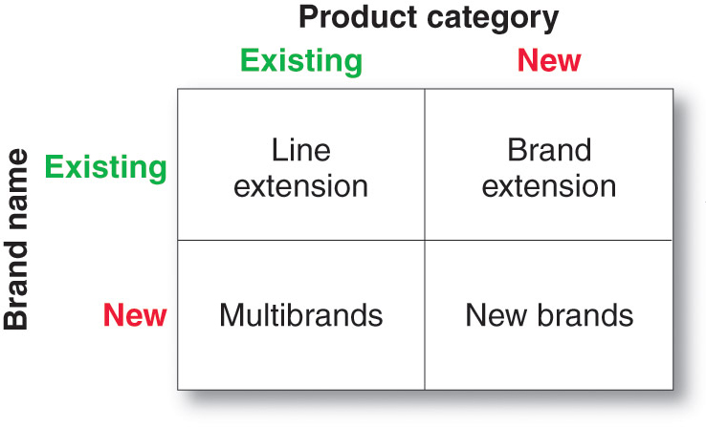
Branding Strategy: Building Strong Brands
Brand Development Strategies
Notes:
Brand Development
A company has four choices when it comes to developing brands (see Figure 8.6). It can introduce line extensions, brand extensions, multibrands, or new brands.
Line Extensions. Line extensions occur when a company extends existing brand names to new forms, colors, sizes, ingredients, or flavors of an existing product category. Thus, the Cheerios line of cereals includes Honey Nut, Frosted, Yogurt Burst, MultiGrain, Banana Nut, and several other variations.
A company might introduce line extensions as a low-cost, low-risk way to introduce new products. Or it might want to meet consumer desires for variety, use excess capacity, or simply command more shelf space from resellers. However, line extensions involve some risks. An overextended brand name might cause consumer confusion or lose some of its specific meaning. For example, the original Doritos Tortilla Chips have morphed into a U.S. roster of 22 different types of flavors and chips, plus dozens more in foreign markets. Flavors include everything from Nacho Cheese and Pizza Supreme to Blazin’ Buffalo & Ranch, Fiery Fusion, and Salsa Verde. Or how about duck-flavored Gold Peking Duck Chips or wasabi-flavored Mr. Dragon’s Fire Chips (Japan). Although the line seems to be doing well with global sales of nearly $5 billion, the original Doritos chips seem like just another flavor. And how much would adding yet another flavor steal from Dorito’s own sales versus competitors? A line extension works best when it takes sales away from competing brands, not when it “cannibalizes” the company’s other items.
Brand Extensions. A brand extension extends a current brand name to new or modified products in a new category. For example, Kellogg’s has extended its Special K cereal brand into a full line of cereals plus lines of crackers, fruit crisps, snack and nutrition bars, breakfast shakes, protein waters, and other health and nutrition products. Victorinox extended its venerable Swiss Army brand from multitool knives to products ranging from cutlery and ballpoint pens to watches, luggage, and apparel. And P&G has leveraged the strength of its Mr. Clean household cleaner brand to launch several new lines: cleaning pads (Magic Eraser), bathroom cleaning tools (Magic Reach), and home auto cleaning kits (Mr. Clean AutoDry). It even launched Mr. Clean-branded car washes.
<ex08.19>
A brand extension gives a new product instant recognition and faster acceptance. It also saves the high advertising costs usually required to build a new brand name. At the same time, a brand extension strategy involves some risk. The extension may confuse the image of the main brand. Brand extensions such as Cheetos lip balm, Heinz pet food, and Life Savers gum met early deaths. And if a brand extension fails, it may harm consumer attitudes toward other products carrying the same brand name. Furthermore, a brand name may not be appropriate to a particular new product, even if it is well made and satisfying—would you consider flying on Hooters Air or wearing an Evian water-filled padded bra (both failed). Thus, before transferring a brand name to a new product, marketers must research how well the product fits the brand’s associations.
Multibrands. Companies often market many different brands in a given product category. For example, in the United States, PepsiCo markets at least five brands of soft drinks (Pepsi, Sierra Mist, Slice, Mountain Dew, and Mug root beer), four brands of sports and energy drinks (Gatorade, No Fear, Propel, and AMP Energy), five brands of bottled teas and coffees (Lipton, SoBe, Seattle’s Best, Starbucks, and Tazo), two brands of bottled waters (Aquafina and SoBe), and two brands of fruit drinks (Tropicana and Ocean Spray). Each brand includes a long list of subbrands. For instance, SoBe consists of SoBe Teas & Elixers, SoBe Lifewater, SoBe Lean, and SoBe Lifewater with Purevia. Aquafina includes regular Aquafina, Aquafina Flavorsplash, and Aquafina Sparkling.
Multibranding offers a way to establish different features that appeal to different customer segments, lock up more reseller shelf space, and capture a larger market share. For example, although PepsiCo’s many brands of beverages compete with one another on supermarket shelves, the combined brands reap a much greater overall market share than any single brand ever could. Similarly, by positioning multiple brands in multiple segments, Pepsi’s five saft drink brands combine to capture much more market share than any single brand could capture by itself.
A major drawback of multibranding is that each brand might obtain only a small market share, and none may be very profitable. The company may end up spreading its resources over many brands instead of building a few brands to a highly profitable level. These companies should reduce the number of brands they sell in a given category and set up tighter screening procedures for new brands. This happened to GM, which in recent years has cut numerous brands from its portfolio, including Saturn, Oldsmobile, Pontiac, Hummer, and Saab.
New Brands. A company might believe that the power of its existing brand name is waning, so a new brand name is needed. Or it may create a new brand name when it enters a new product category for which none of its current brand names are appropriate. For example, Toyota created the separate Lexus brand aimed at luxury car consumers and the Scion brand, targeted toward Millennial consumers.
As with multibranding, offering too many new brands can result in a company spreading its resources too thin. And in some industries, such as consumer packaged goods, consumers and retailers have become concerned that there are already too many brands, with too few differences between them. Thus, P&G, PepsiCo, Kraft, and other large consumer-product marketers are now pursuing megabrand strategies—weeding out weaker or slower-growing brands and focusing their marketing dollars on brands that can achieve the number-one or number-two market share positions with good growth prospects in their categories.

Slide 24
Bibliography
Principles of Marketing by Philip Kotler & Gary Armstrong
Fifteenth Edition, Published by Prentice Hall
Marketing Management – A South Asian Perspective
by Philip Kotler, Kevin Lane Keller, Abraham Koshy &
Mithileshwar Jha, 13th Edition, Published by Pearson
Education, Inc.
Principles and Practices of Marketing by Jobber, D. 4th
edition, McGraw Hill International.
Principles of Advertising & IMC by Tom Duncan 2nd
Edition, Published by McGraw-Hill Irwin.

Slide 25


The End
"The man who does not read good books has no advantage over the man who cannot read them.“
Mark Twain

