Slide 1
Product And Services
LECTURE-13

Slide 2
Topic Outline
Product, Services, and Experiences
Product and Services Decisions
Services Marketing
Notes:
After examining customer-driven marketing strategy, we now take a deeper look at the marketing mix: the tactical tools that marketers use to implement their strategies and deliver superior customer value. The product and brand are usually the first and most basic marketing consideration. We start with a seemingly simple question: What is a product? In this and the next chapter, we study how companies develop and manage products and brands.

Slide 3
What Is a Product?
Products, Services, and Experiences
Product is anything that can be offered in a market for attention, acquisition, use, or consumption that might satisfy a need or want
Service is a product that consists of activities, benefits or satisfaction that is essentially intangible and does not result in the ownership of anything
Notes:
Products include more than just tangible objects, such as cars, computers, or mobile phones. Broadly defined, products also include services, events, persons, places, organizations, ideas, or a mixture of these. Throughout this text, we use the term product broadly to include any or all of these entities. Thus, an Apple iPhone, a Toyota Camry, and a Caffé Mocha at Starbucks are products. But so are a trip to Las Vegas, Schwab online investment services, your Facebook page, and advice from your family doctor.
Because of their importance in the world economy, we give special attention to services. Services are a form of product that consists of activities, benefits, or satisfactions offered for sale that are essentially intangible and do not result in the ownership of anything. Examples include banking, hotel services, airline travel, retail, wireless communication, and home-repair services. We will look at services more closely later in this chapter.

Slide 4
What Is a Product?
Products, Services, and Experiences
Experiences represent what buying the product or service will do for the customer
Notes:
Today, as products and services become more commoditized, many companies are moving to a new level in creating value for their customers. To differentiate their offers, beyond simply making products and delivering services, they are creating and managing customer experiences with their brands or company.
Experiences have always been an important part of marketing for some companies. Disney has long manufactured dreams and memories through its movies and theme parks.

Slide 5
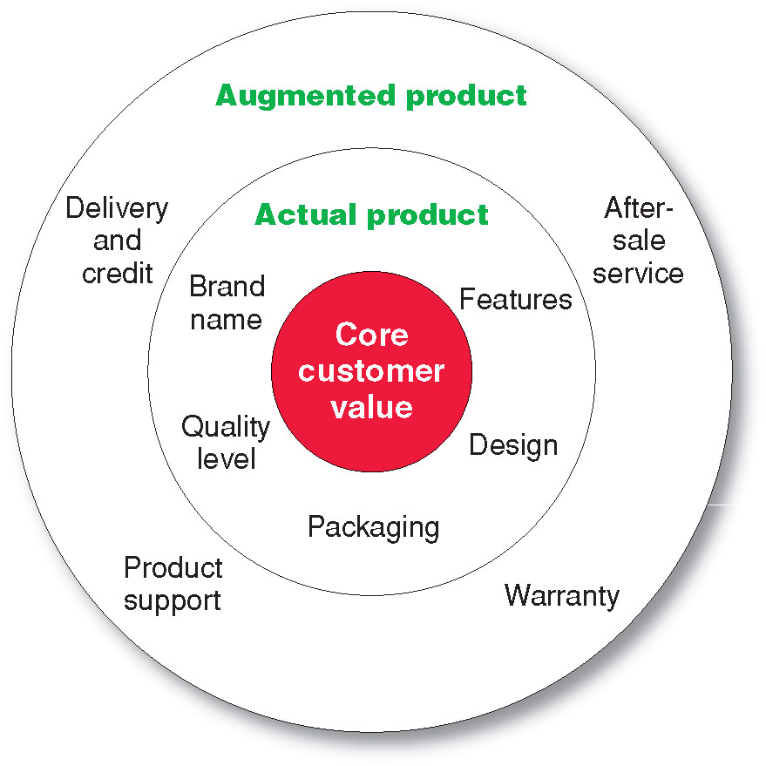
What Is a Product?
Levels of Product and Services
Notes:
Levels of Product and Services
Product planners need to think about products and services on three levels (see Figure 8.1). Each level adds more customer value. The most basic level is the core customer value, which addresses the question: What is the buyer really buying? When designing products, marketers must first define the core, problem-solving benefits or services that consumers seek. A woman buying lipstick buys more than lip color. Charles Revson of Revlon saw this early: “In the factory, we make cosmetics; in the store, we sell hope.” And people who buy an Apple iPad are buying much more than just a tablet computer. They are buying entertainment, self-expression, productivity, and connectivity with friends and family—a mobile and personal window to the world.
<ex08.03>
At the second level, product planners must turn the core benefit into an actual product. They need to develop product and service features, a design, a quality level, a brand name, and packaging. For example, the iPad is an actual product. Its name, parts, styling, features, packaging, and other attributes have all been carefully combined to deliver the core customer value of staying connected.
Finally, product planners must build an augmented product around the core benefit and actual product by offering additional consumer services and benefits. The iPad is more than just a digital device. It provides consumers with a complete connectivity solution. Thus, when consumers buy an iPad, Apple and its resellers also might give buyers a warranty on parts and workmanship, instructions on how to use the device, quick repair services when needed, and a website to use if they have problems or questions. It also provides access to a huge assortment of apps and accessories.
Consumers see products as complex bundles of benefits that satisfy their needs. When developing products, marketers first must identify the core customer value that consumers seek from the product. They must then design the actual product and find ways to augment it to create this customer value and the most satisfying brand experience.
Discussion Question: It is a good idea for the students to bring in some products so the class can discuss the levels of product and services. Products including Gatorade, toothpaste, facial moisturizer or cosmetics work well in this discussion. You can often find augmented product features on the product’s websites including games, features and support.

Slide 6
What Is a Product?
Product and Service Classifications
Consumer products
Industrial products
Notes:
Product and Service Classifications
Products and services fall into two broad classes based on the types of consumers that use them: consumer products and industrial products. Broadly defined, products also include other marketable entities such as experiences, organizations, persons, places, and ideas.

Slide 7
What Is a Product?
Product and Service Classifications
Consumer products are products and services for personal consumption
Classified by how consumers buy them
  Convenience products
  Shopping products
  Specialty products
  Unsought products
Notes:
Consumer Products
Consumer products are products and services bought by final consumers for personal consumption. Marketers usually classify these products and services further based on how consumers go about buying them. Consumer products include convenience products, shopping products, specialty products, and unsought products. These products differ in the ways consumers buy them and, therefore, in how they are marketed (see Table 8.1).

Slide 8
What Is a Product?
Product and Service Classifications
Convenience products consumer products and services that the customer usually buys frequently, immediately, and with a minimum comparison and buying effort
  Newspapers
  Candy
  Fast food
Notes:
Convenience products are consumer products and services that customers usually buy frequently, immediately, and with minimal comparison and buying effort. Examples include laundry detergent, candy, magazines, and fast food. Convenience products are usually low priced, and marketers place them in many locations to make them readily available when customers need or want them.
Discussion Question: What is a convenience product that you buy?

Slide 9
What Is a Product?
Product and Service Classifications
Shopping products consumer products and services that the customer compares carefully on suitability, quality, price, and style
  Furniture
  Cars
  Appliances
Notes:
Shopping products are less frequently purchased consumer products and services that customers compare carefully on suitability, quality, price, and style. When buying shopping products and services, consumers spend much time and effort in gathering information and making comparisons. Examples include furniture, clothing, used cars, major appliances, and hotel and airline services. Shopping product marketers usually distribute their products through fewer outlets but provide deeper sales support to help customers in their comparison efforts.
Discussion Question: What is a shopping product that you buy?

Slide 10
What Is a Product?
Product and Service Classifications
Specialty products consumer products and services with unique characteristics or brand identification for which a significant group of buyers is willing to make a special purchase effort
    Medical services
    Designer clothes
    High-end electronics
Notes:
Specialty products are consumer products and services with unique characteristics or brand identification for which a significant group of buyers is willing to make a special purchase effort. Examples include specific brands of cars, high-priced photography equipment, designer clothes, gourmet foods, and the services of medical or legal specialists. A Lamborghini automobile, for example, is a specialty product because buyers are usually willing to travel great distances to buy one. Buyers normally do not compare specialty products. They invest only the time needed to reach dealers carrying the wanted products.
Discussion Question: What is a specialty product that you buy?

Slide 11
What Is a Product?
Product and Service Classifications
Unsought products consumer products that the consumer does not know about or knows about but does not normally think of buying
    Life insurance
    Funeral services
    Blood donations
Notes:
Note to Instructor
Unsought products are consumer products that the consumer either does not know about or knows about but does not normally consider buying. Most major new innovations are unsought until the consumer becomes aware of them through advertising. Classic examples of known but unsought products and services are life insurance, preplanned funeral services, and blood donations to the Red Cross. By their very nature, unsought products require a lot of advertising, personal selling, and other marketing efforts.
Discussion Question
What is a product that could be convenience, shopping, and specialty?
This is a bit of a puzzle. They might realize that a camera could fall into several categories depending on the buyer and the situation. Certainly, if you are on vacation and you forgot your camera, you would pick one up at a convenience store, pharmacy, or maybe the hotel store. If you were a professional photographer, a camera purchase could easily be specialty if you were buying a $5,000 camera. Other examples might include mats for the floor of a automobile, tires, or a fan.

Slide 12
What Is a Product?
Product and Service Classifications
Industrial products: Products purchased for further processing or for use in conducting a business
Classified by the purpose for which the product is purchased
      Materials and parts
      Capital
      Raw materials

Slide 13
What Is a Product?
Product and Service Classifications
Capital items are industrial products that aid in the buyer’s production or operations
Materials and parts include raw materials and manufactured materials and parts usually sold directly to industrial users
Supplies and services include operating supplies, repair and maintenance items, and business services
Notes:
Industrial products are those products purchased for further processing or for use in conducting a business. Thus, the distinction between a consumer product and an industrial product is based on the purpose for which the product is purchased. If a consumer buys a lawn mower for use around home, the lawn mower is a consumer product. If the same consumer buys the same lawn mower for use in a landscaping business, the lawn mower is an industrial product.
The three groups of industrial products and services are materials and parts, capital items, and supplies and services. Materials and parts include raw materials as well as manufactured materials and parts. Raw materials consist of farm products (wheat, cotton, livestock, fruits, vegetables) and natural products (fish, lumber, crude petroleum, iron ore). Manufactured materials and parts consist of component materials (iron, yarn, cement, wires) and component parts (small motors, tires, castings). Most manufactured materials and parts are sold directly to industrial users. Price and service are the major marketing factors; branding and advertising tend to be less important.
Capital items are industrial products that aid in the buyer’s production or operations, including installations and accessory equipment. Installations consist of major purchases such as buildings (factories, offices) and fixed equipment (generators, drill presses, large computer systems, elevators). Accessory equipment includes portable factory equipment and tools (hand tools, lift trucks) and office equipment (computers, fax machines, desks). They have a shorter life than installations and simply aid in the production process.
The final group of industrial products is supplies and services. Supplies include operating supplies (lubricants, coal, paper, pencils) and repair and maintenance items (paint, nails, brooms). Supplies are the convenience products of the industrial field because they are usually purchased with a minimum of effort or comparison. Business services include maintenance and repair services (window cleaning, computer repair) and business advisory services (legal, management consulting, advertising). Such services are usually supplied under contract.

Slide 14
What Is a Product?
Organizations, Persons, Places, and Ideas
Organization marketing consists of activities undertaken to create, maintain, or change attitudes and behavior of target consumers toward an organization
Notes:
Both profit and not-for-profit organizations practice organization marketing. Business firms sponsor public relations or corporate image marketing campaigns to market themselves and polish their images. IBM’s Smarter Planet campaign, for example, markets IBM as a company that provides innovative solutions that improve the world’s IQ. IBM smart solutions span an incredible breadth of industries and processes—from commerce and digital communications to health care, education, and sustainability.

Slide 15
What Is a Product?
Organizations, Persons, Places, and Ideas
Person marketing consists of activities undertaken to create, maintain, or change attitudes and behavior of target consumers toward particular people
Notes:
People can also be thought of as products. Person marketing consists of activities undertaken to create, maintain, or change attitudes or behavior toward particular people. People ranging from presidents, entertainers, and sports figures to professionals such as doctors, lawyers, and architects use person marketing to build their reputations. And businesses, charities, and other organizations use well-known personalities to help sell their products or causes.

Slide 16
What Is a Product
Organizations, Persons, Places, and Ideas
Place marketing consists of activities undertaken to create, maintain, or change attitudes and behavior of target consumers toward particular places
Social marketing is the use of commercial marketing concepts and tools in programs designed to influence individuals’ behavior to improve their well-being and that of society
Notes:
Place marketing involves activities undertaken to create, maintain, or change attitudes or behavior toward particular places. Cities, states, regions, and even entire nations compete to attract tourists, new residents, conventions, and company offices and factories. New York State advertises “I NY.” And Michigan invites you to experience unspoiled nature, lakes that feel like oceans, miles of cherry orchards, glorious sunsets, and nighttime skies scattered with stars in Pure Michigan.
Brand USA, a public-private marketing partnership created by recent act of Congress, promotes the United States as a tourist destination to international travelers. Supported by a $200 million budget, Brand USA’s mission is to “represent the true greatness of America—from sea to shining sea.” Competition for international tourism is fierce from other countries marketing their attractions, led by Mexico, which spends about $175 annually advertising the country. Great Britain spends $160 million; Australia, $107 million; and Turkey, $99 million. One expert estimates that, without effective marketing, the United States has lost a potential 78 million visitors over the past 10 years, representing an estimated $606 billion in spending. The Brand USA marketing campaign includes country-by-country ads and promotions, as well as a comprehensive DiscoverAmerica.com website, which provides featured destinations, U.S. travel information and tips, and travel planning tools.
. Ideas can also be marketed. In one sense, all marketing is the marketing of an idea, whether it is the general idea of brushing your teeth or the specific idea that Crest toothpastes create “healthy, beautiful smiles for life.” Here, however, we narrow our focus to the marketing of social ideas. This area has been called social marketing, defined by the Social Marketing Institute (SMI) as the use of commercial marketing concepts and tools in programs designed to influence individuals’ behavior to improve their well-being and that of society.
Social marketing programs cover a wide range of issues. The Ad Council of America (www.adcouncil.org), for example, has developed dozens of social advertising campaigns involving issues ranging from health care, education, and environmental sustainability to human rights and personal safety. But social marketing involves much more than just advertising—the SMI encourages the use of a broad range of marketing tools. “Social marketing goes well beyond the promotional ‘P’ of the marketing mix to include every other element to achieve its social change objectives,” says the SMI’s executive director.

Slide 17
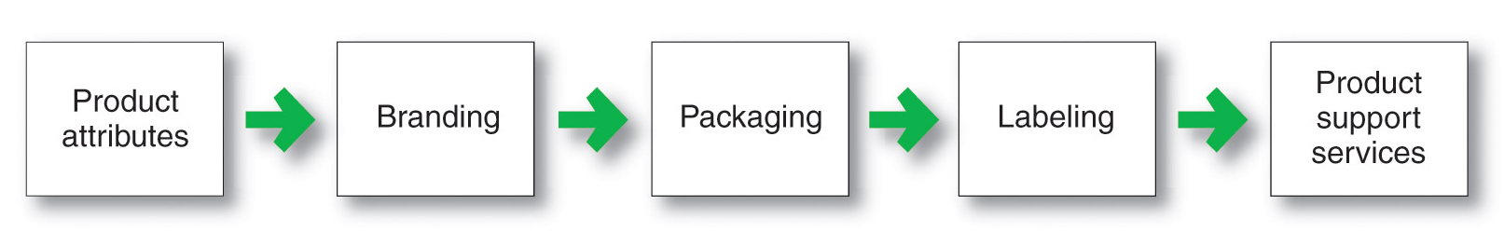
Product and Service Decisions
Individual Product and Service Decisions
Notes:
Figure 8.2 shows the important decisions in the development and marketing of individual products and services. We will focus on decisions about product attributes, branding, packaging, labeling, and product support services.

Slide 18
Product and Service Decisions
Individual Product and Service Decisions
Product or service attributes
communicate and deliver the benefits
Quality
Features
Style and design
Notes:
Developing a product or service involves defining the benefits that it will offer. These benefits are communicated and delivered by product attributes such as quality, features, and style and design.

Slide 19
Product and Service Decisions
Individual Product and Service Decisions
Product Quality Level is the level of quality that supports the product’s positioning
Product Conformance Quality is the product’s freedom from defects and consistency in delivering a targeted level of performance
Notes:
Product quality is one of the marketer’s major positioning tools. Quality affects product or service performance; thus, it is closely linked to customer value and satisfaction. In the narrowest sense, quality can be defined as “freedom from defects.” But most marketers go beyond this narrow definition. Instead, they define quality in terms of creating customer value and satisfaction. The American Society for Quality defines quality as the characteristics of a product or service that bear on its ability to satisfy stated or implied customer needs. Similarly, Siemens defines quality this way: “Quality is when our customers come back and our products don’t.”
Total quality management (TQM) is an approach in which all of the company’s people are involved in constantly improving the quality of products, services, and business processes. For most top companies, customer-driven quality has become a way of doing business. Today, companies are taking a return on quality approach, viewing quality as an investment and holding quality efforts accountable for bottom-line results.
Product quality has two dimensions: level and consistency. In developing a product, the marketer must first choose a quality level that will support the product’s positioning. Here, product quality means performance quality—the product’s ability to perform its functions. For example, a Rolls-Royce provides higher performance quality than a Chevrolet: It has a smoother ride, provides more luxury and “creature comforts,” and lasts longer.
Beyond quality level, high quality also can mean high levels of quality consistency. Here, product quality means conformance quality—freedom from defects and consistency in delivering a targeted level of performance. All companies should strive for high levels of conformance quality. In this sense, a Chevrolet can have just as much quality as a Rolls-Royce. Although a Chevy doesn’t perform at the same level as a Rolls-Royce, it can just as consistently deliver the quality that customers pay for and expect.

Slide 20
Product and Service Decisions
Individual Product and Service Decisions
Product features
are a competitive tool for differentiating a product from competitors’ products
are assessed based on the value to the customer versus the cost to the company
Notes:
Product Features. A product can be offered with varying features. A stripped-down model, one without any extras, is the starting point. The company can then create higher-level models by adding more features. Features are a competitive tool for differentiating the company’s product from competitors’ products. Being the first producer to introduce a valued new feature is one of the most effective ways to compete.
How can a company identify new features and decide which ones to add to its product? It should periodically survey buyers who have used the product and ask these questions: How do you like the product? Which specific features of the product do you like most? Which features could we add to improve the product? The answers to these questions provide the company with a rich list of feature ideas. The company can then assess each feature’s value to customers versus its cost to the company. Features that customers value highly in relation to costs should be added.

Slide 21
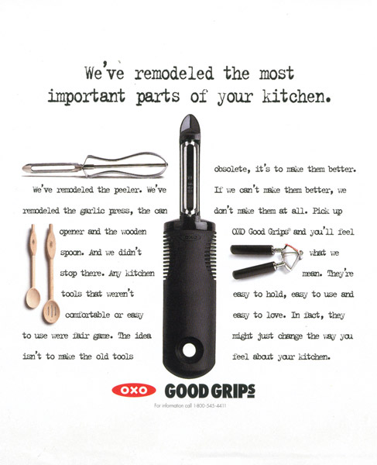

Product and Service Decisions
Individual Product and Service Decisions
Style describes the appearance of the product
Design contributes to a product’s usefulness as well as to its looks
Notes:
Product Style and Design. Another way to add customer value is through distinctive product style and design. Design is a larger concept than style. Style simply describes the appearance of a product. Styles can be eye catching or yawn producing. A sensational style may grab attention and produce pleasing aesthetics, but it does not necessarily make the product perform better. Unlike style, design is more than skin deep—it goes to the very heart of a product. Good design contributes to a product’s usefulness as well as to its looks.
Good design doesn’t start with brainstorming new ideas and making prototypes. Design begins with observing customers, deeply understanding their needs, and shaping their product-use experience. Product designers should think less about technical product specifications and more about how customers will use and benefit from the product.

Slide 22
Product and Service Decisions
Individual Product and Service Decisions
Brand is the name, term, sign, or design—or a combination of these—that identifies the maker or seller of a product or service
Notes:
Note to Instructor
Discussion Questions
What brands do you tend to purchase consistently? Why?
This discussion should lead to the consumer benefits of brands including quality and consistency. It is interesting to now ask students what the benefits might be for the seller of having a strong brand. This will include segmentation, positioning, and the ability to communicate product features
Consumers view a brand as an important part of a product, and branding can add value to a consumer’s purchase. Customers attach meanings to brands and develop brand relationships. As a result, brands have meaning well beyond a product’s physical attributes.
Branding has become so strong that today hardly anything goes unbranded. Salt is packaged in branded containers, common nuts and bolts are packaged with a distributor’s label, and automobile parts—spark plugs, tires, filters—bear brand names that differ from those of the automakers. Even fruits, vegetables, dairy products, and poultry are branded—Sunkist oranges, Dole Classic iceberg salads, Horizon Organic milk, Perdue chickens, and Eggland’s Best eggs.
Branding helps buyers in many ways. Brand names help consumers identify products that might benefit them. Brands also say something about product quality and consistency—buyers who always buy the same brand know that they will get the same features, benefits, and quality each time they buy. Branding also gives the seller several advantages. The seller’s brand name and trademark provide legal protection for unique product features that otherwise might be copied by competitors. Branding helps the seller to segment markets.

Slide 23
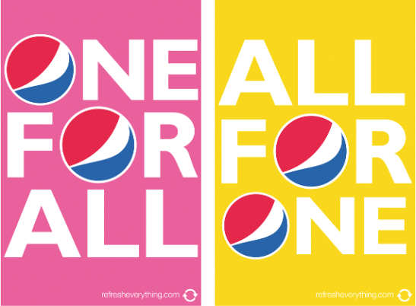
Product and Service Decisions
Individual Product and Service Decisions
Packaging involves designing and producing the container or wrapper for a product
Labels identify the product or brand, describe attributes, and provide promotion
Notes:
Packaging involves designing and producing the container or wrapper for a product. Traditionally, the primary function of the package was to hold and protect the product. In recent times, however, packaging has become an important marketing tool as well. Increased competition and clutter on retail store shelves means that packages must now perform many sales tasks—from attracting buyers, to communicating brand positioning, to closing the sale. As one packaging expert notes, “Not every consumer sees a brand’s advertising or is exposed to the exciting social media that your brand is doing. But all of the consumers who buy your product do interact with your humble package.”
Companies are realizing the power of good packaging to create immediate consumer recognition of a brand. For example, an average supermarket stocks about 38,700 items; the average Walmart supercenter carries 142,000 items. The typical shopper makes 70 percent of all purchase decisions in stores and passes by some 300 items per minute. In this highly competitive environment, the package may be the seller’s last and best chance to influence buyers. Thus, for many companies, the package itself has become an important promotional medium. James Black, “What Is Your Product Saying to Consumers?
Poorly designed packages can cause headaches for consumers and lost sales for the company. Think about all those hard-to-open packages, such as DVD cases sealed with impossibly sticky labels, packaging with finger-splitting wire twist-ties, or sealed plastic clamshell containers that cause “wrap rage” and send about 6,000 people to the hospital each year with lacerations and puncture wounds. Another packaging issue is overpackaging—as when a tiny UBS flash drive in an oversized cardboard and plastic display package is delivered in a giant corrugated shipping carton. Overpackaging creates an incredible amount of waste, frustrating those who care about the environment.
By contrast, innovative packaging can give a company an advantage over competitors and boost sales. For example, Puma recently replace the traditional shoebox with an attractive and functional yet environmentally friendly alternative—the Clever Little Bag:
In their search for the next generation of shoe packaging, Puma’s designers spent 21 months road testing 40 shoebox prototypes, checking on their potential environmental impact from production and transport through use and future re-use. They came up with what Puma calls the Clever Little Bag with a big impact. The new container—which consists of a light cardboard insert that slides seamlessly into a colorful, reusable red bag—uses 65 percent less paper to make and reduces water, energy, and fuel consumption during manufacturing by more than 60 percent a year. Because it takes up less space and weighs, the new container also reduces carbon emissions during shipping by 10,000 tons a year. What’s more, everything is 100 percent recyclable. In all, Puma’s Clever Little Bag is more than just friendly to the environment, it’s also very friendly to consumers” likes and the company’s bottom line. Pretty clever, huh?
In recent years, product safety has also become a major packaging concern. We have all learned to deal with hard-to-open “childproof” packaging. Due to the rash of product tampering scares in the 1980s, most drug producers and food makers now put their products in tamper-resistant packages. In making packaging decisions, the company also must heed growing environmental concerns. Fortunately, like Puma, many companies have gone “green” by reducing their packaging and using environmentally responsible packaging materials.
Labeling
Labels range from simple tags attached to products to complex graphics that are part of the packaging. They perform several functions. At the very least, the label identifies the product or brand, such as the name Sunkist stamped on oranges. The label might also describe several things about the product—who made it, where it was made, when it was made, its contents, how it is to be used, and how to use it safely. Finally, the label might help to promote the brand, support its positioning, and connect with customers. For many companies, labels have become an important element in broader marketing campaigns.
Labels and brand logos can support the brand’s positioning and add personality to the brand. For example, although similar to the familiar red, white, and blue logo that customers would have seen 60 years ago, Pepsi’s recently introduced a new, more uplifting smiling logo. “It feels like the same Pepsi we know and love,” says a brand expert, “but it’s more adventurous, more youthful, with a bit more personality to it.” It presents a “spirit of optimism and youth,” says a Pepsi marketer.
<ex08.07>
In fact, brand labels and logos can become a crucial element in the brand-customer connection. For example, when Gap recently introduced a more contemporary redesign of its familiar old logo—the well-known white text on a blue square—customers went ballistic and imposed intense online pressure. Gap reinstated the old logo after only one week. Such examples “highlight a powerful connection people have to the visual representations of their beloved brands,” says an analyst.
Along with the positives, there has been a long history of legal concerns about packaging and labels. The Federal Trade Commission Act of 1914 held that false, misleading, or deceptive labels or packages constitute unfair competition. Labels can mislead customers, fail to describe important ingredients, or fail to include needed safety warnings. As a result, several federal and state laws regulate labeling. The most prominent is the Fair Packaging and Labeling Act of 1966, which set mandatory labeling requirements, encouraged voluntary industry packaging standards, and allowed federal agencies to set packaging regulations in specific industries.
Labeling has been affected in recent times by unit pricing (stating the price per unit of a standard measure), open dating (stating the expected shelf life of the product), and nutritional labeling (stating the nutritional values in the product). The Nutritional Labeling and Educational Act of 1990 requires sellers to provide detailed nutritional information on food products, and recent sweeping actions by the Food and Drug Administration (FDA) regulate the use of health-related terms such as low fat, light, and high fiber. Sellers must ensure that their labels contain all the required information.

Slide 24
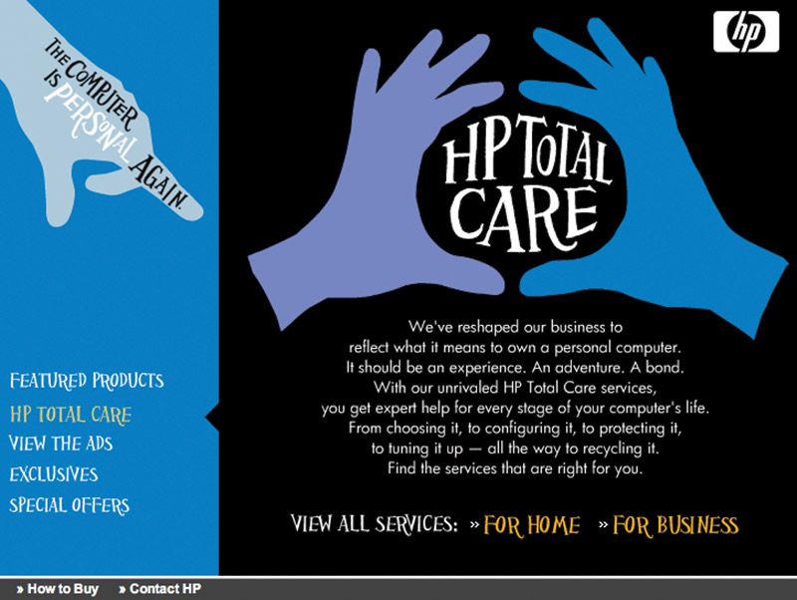
Product and Service Decisions
Individual Product and Service Decisions
Product support services augment actual products
Notes:
Note to Instructor
Companies must continually:
Assess the value of current services to obtain ideas for new ones.
Assess the costs of providing these services.
Develop a package of services to satisfy customers and provide profit to the company.
Product Support Services
Customer service is another element of product strategy. A company’s offer usually includes some support services, which can be a minor part or a major part of the total offering. Later in this chapter, we will discuss services as products in themselves. Here, we discuss services that augment actual products.
Support services are an important part of the customer’s overall brand experience. For example, upscale department store retailer Nordstrom knows that good marketing doesn’t stop with making the sale. Keeping customers happy after the sale is the key to building lasting relationships. Nordstrom’s motto: “Take care of customers, no matter what it takes,” before, during, and after the sale.
Many companies now use a sophisticated mix of phone, e-mail, Internet, and interactive voice and data technologies to provide support services that were not possible before. For example, AT&T offers a complete set of after-sale services for all of its products from wireless to digital TV. Customers can access 24/7 tech support via an AT&T Live Agent, either by phone or online. In addition, its online support pages offer troubleshooting, virtual tours, and Ask Charlie, AT&T’s virtual expert feature.

Slide 25
Product and Service Decisions
Product Line Decisions
Product line is a group of products that are closely related because they function in a similar manner, are sold to the same customer groups, are marketed through the same types of outlets, or fall within given price ranges
Notes:
The major product line decision involves product line length—the number of items in the product line. The line is too short if the manager can increase profits by adding items; the line is too long if the manager can increase profits by dropping items. Managers need to analyze their product lines periodically to assess each item’s sales and profits and understand how each item contributes to the line’s overall performance.

Slide 26
Product and Service Decisions
Product Line Decisions
Product line length is the number of items in the product line
Line stretching
Line filling
Notes:
A company can expand its product line in two ways: by line filling or line stretching. Product line filling involves adding more items within the present range of the line. There are several reasons for product line filling: reaching for extra profits, satisfying dealers, using excess capacity, being the leading full-line company, and plugging holes to keep out competitors. However, line filling is overdone if it results in cannibalization and customer confusion. The company should ensure that new items are noticeably different from existing ones.
Product line stretching occurs when a company lengthens its product line beyond its current range. The company can stretch its line downward, upward, or both ways. Companies located at the upper end of the market can stretch their lines downward. A company may stretch downward to plug a market hole that otherwise would attract a new competitor or respond to a competitor’s attack on the upper end. Or it may add low-end products because it finds faster growth taking place in the low-end segments. Companies can also stretch their product lines upward. Sometimes, companies stretch upward to add prestige to their current products. Or they may be attracted by a faster growth rate or higher margins at the higher end.

Slide 27
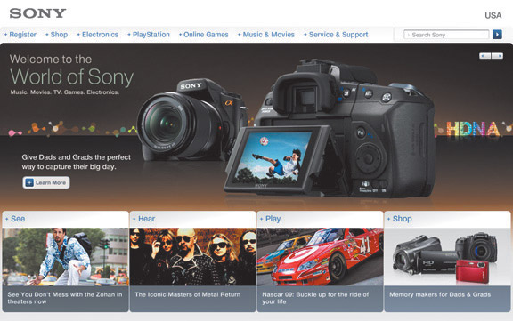
Product and Service Decisions
Product Mix Decisions
Product mix consists of all the products and items that a particular seller offers for sale
        Width
        Length
        Depth
        Consistency
Notes:
Note to Instructor
In slideshow view, click on movie icon to launch Swiss Army video snippet. See accompanying DVD for full video segment.
Product mix width is the number of different product lines the company carries.
Product mix length is the total number of items the company carries within its product lines.
Product mix depth is the number of versions offered of each product in the line.
Consistency is how closely the various product lines are in end use, production requirements, or distribution channels.
These product mix dimensions provide the handles for defining the company’s product strategy. The company can increase its business in four ways. It can add new product lines, widening its product mix. In this way, its new lines build on the company’s reputation in its other lines. The company can lengthen its existing product lines to become a more full-line company. It can add more versions of each product and thus deepen its product mix. Finally, the company can pursue more product line consistency—or less—depending on whether it wants to have a strong reputation in a single field or in several fields.
From time to time, a company may also have to streamline its product mix to pare out marginally performing lines and models and to regain its focus.

Slide 28
Services Marketing
Types of Service Industries
Government
Private not-for-profit organizations
Business services
Notes:
Services have grown dramatically in recent years. Services now account for close to 65 percent of the U.S. gross domestic product (GDP). And the service industry is growing. By 2014, it is estimated that more than four out of five jobs in the United States will be in service industries. Services are growing even faster in the world economy, making up 64 percent of the gross world product.
Service industries vary greatly. Governments offer services through courts, employment services, hospitals, military services, police and fire departments, the postal service, and schools. Private not-for-profit organizations offer services through museums, charities, churches, colleges, foundations, and hospitals. In addition, a large number of business organizations offer services—airlines, banks, hotels, insurance companies, consulting firms, medical and legal practices, entertainment and telecommunications companies, real-estate firms, retailers, and others.

Slide 29
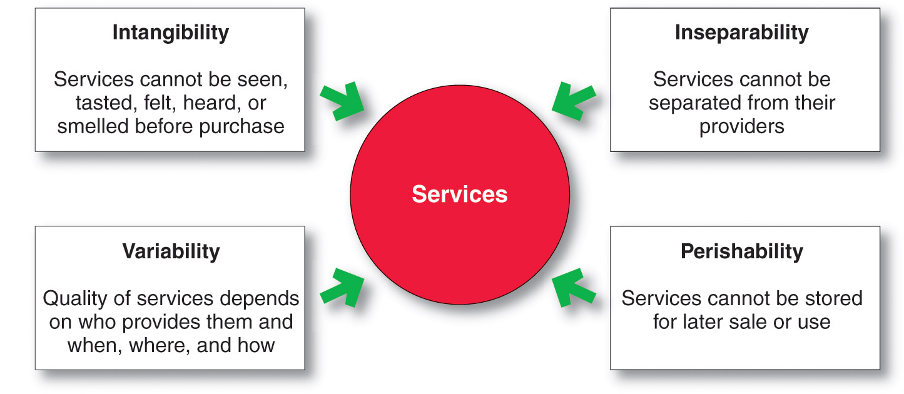
Services Marketing
Nature and Characteristics of a Service
Notes:
Note to Instructor
Intangibility refers to the fact that services cannot be seen, tasted, felt, heard, or smelled before they are purchased.
Inseparability refers to the fact that services cannot be separated from their providers.
Variability refers to the fact that service quality depends on who provides the services as well as when, where, and how they are provided.
Perishability refers to the fact that services cannot be stored for later sale or use.

Slide 30
Services Marketing
Marketing Strategies for Service Firms
In addition to traditional marketing strategies, service firms often require additional strategies
Service-profit chain
Internal marketing
Interactive marketing
Notes:
In a service business, the customer and the front-line service employee interact to co-create the service. Effective interaction, in turn, depends on the skills of front-line service employees and on the support processes backing these employees. Thus, successful service companies focus their attention on both their customers and their employees. They understand the service profit chain, which links service firm profits with employee and customer satisfaction.

Slide 31
Services Marketing
Marketing Strategies for Service Firms
Service-profit chain links service firm profits with employee and customer satisfaction
Internal service quality
Satisfied and productive service employees
Greater service value
Satisfied and loyal customers
Healthy service profits and growth
Notes:
Marketing Strategies for Service Firms
Just like manufacturing businesses, good service firms use marketing to position themselves strongly in chosen target markets. FedEx promises to take your packages “faster, farther”; Angie’s List offers “Reviews you can trust.” At Hampton, “We love having you here.” And St. Jude Children’s Hospital is “Finding cures. Saving children.” These and other service firms establish their positions through traditional marketing mix activities. However, because services differ from tangible products, they often require additional marketing approaches. Internal service quality: superior employee selection and training, a quality work environment, and strong support for those dealing with customers, which results in . . .
Satisfied and productive service employees: more satisfied, loyal, and hardworking employees, which results in . . .
Greater service value: more effective and efficient customer value creation and service delivery, which results in . . .
Satisfied and loyal customers: satisfied customers who remain loyal, make repeat purchases, and refer other customers, which results in . . .
Healthy service profits and growth: superior service firm performance.

Slide 32
Services Marketing
Marketing Strategies for Service Firms
Internal marketing means that the service firm must orient and motivate its customer contact employees and supporting service people to work as a team to provide customer satisfaction
Internal marketing must precede external marketing
Notes:
Service marketing requires more than just traditional external marketing using the four Ps. Figure 8.4 shows that service marketing also requires internal marketing and interactive marketing. Internal marketing means that the service firm must orient and motivate its customer-contact employees and supporting service people to work as a team to provide customer satisfaction. Marketers must get everyone in the organization to be customer centered. In fact, internal marketing must precede external marketing. For example, Zappos starts by hiring the right people and carefully orienting and inspiring them to give unparalleled customer service.
Interactive marketing means that service quality depends heavily on the quality of the buyer-seller interaction during the service encounter. In product marketing, product quality often depends little on how the product is obtained. But in services marketing, service quality depends on both the service deliverer and the quality of delivery. Service marketers, therefore, have to master interactive marketing skills. Thus, Zappos selects only people with an innate “passion to serve” and instructs them carefully in the fine art of interacting with customers to satisfy their every need. All new hires—at all levels of the company—complete a four-week customer-loyalty training regimen.

Slide 33
Services Marketing
Marketing Strategies for Service Firms
Interactive marketing means that service quality depends heavily on the quality of the buyer-seller interaction during the service encounter
Service differentiation
Service quality
Service productivity

Slide 34
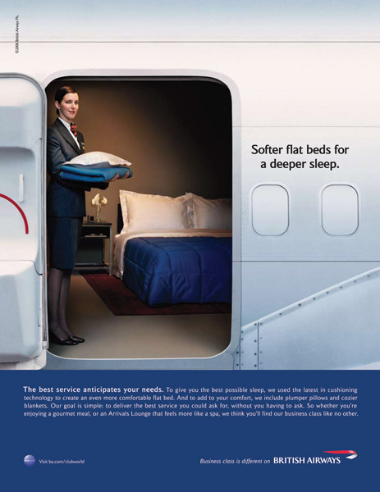
Services Marketing
Marketing Strategies for Service Firms
Managing service differentiation creates a competitive advantage from the offer, delivery, and image of the service
Offer can include distinctive features
Delivery can include more able and reliable customer contact people, environment, or process
Image can include symbols and branding
Notes:
Managing Service Differentiation
In these days of intense price competition, service marketers often complain about the difficulty of differentiating their services from those of competitors. To the extent that customers view the services of different providers as similar, they care less about the provider than the price. The solution to price competition is to develop a differentiated offer, delivery, and image.
The offer can include innovative features that set one company’s offer apart from competitors’ offers. For example, some retailers differentiate themselves by offerings that take you well beyond the products they stock. Dick’s Sporting Goods has grown from a single bait-and-tackle store in Binghamton, New York, into a 450-store, $4.8-billion sporting goods megaretailer in 42 states by offering interactive services that set it apart from ordinary sporting goods stores. Customers can sample shoes on Dick’s indoor footwear track, test golf clubs with an on-site golf swing analyzer and putting green, shoot bows in its archery range, and receive personalized fitness product guidance from an in-store team of fitness trainers. Such differentiated services help make Dick’s “the ultimate sporting goods destination store for core athletes and outdoor enthusiasts.”
Service companies can differentiate their service delivery by having more able and reliable customer-contact people, developing a superior physical environment in which the service product is delivered, or designing a superior delivery process. For example, many grocery chains now offer online shopping and home delivery as a better way to shop than having to drive, park, wait in line, and tote groceries home. And most banks allow you to access your account information from almost anywhere—from the ATM to your mobile device.
Finally, service companies also can work on differentiating their images through symbols and branding. Aflac adopted the duck as its advertising symbol. Today, the duck is immortalized through stuffed animals, golf club covers, and free ring tones and screensavers. The well-known Aflac duck helped make the big but previously unknown insurance company memorable and approachable. Other well-known service characters and symbols include the GEICO gecko, Progressive Insurance’s Flo, McDonald’s golden arches, Allstate’s “good hands,” and the Travelers red umbrella.

Slide 35
Services Marketing
Marketing Strategies for Service Firms
Managing service quality provides a competitive advantage by delivering consistently higher quality than its competitors
Service quality always varies depending on interactions between employees and customers
Notes:
Managing Service Quality
A service firm can differentiate itself by delivering consistently higher quality than its competitors provide. Like manufacturers before them, most service industries have now joined the customer-driven quality movement. And like product marketers, service providers need to identify what target customers expect in regard to service quality.
Unfortunately, service quality is harder to define and judge than product quality. For instance, it is harder to agree on the quality of a haircut than on the quality of a hair dryer. Customer retention is perhaps the best measure of quality; a service firm’s ability to hang onto its customers depends on how consistently it delivers value to them.
Top service companies set high service-quality standards. They watch service performance closely, both their own and that of competitors. They do not settle for merely good service—they strive for 100 percent defect-free service. A 98 percent performance standard may sound good, but using this standard, the U.S. Postal Service would lose or misdirect 391,000 pieces of mail each hour, and U.S. pharmacists would misfill more than 1.4 million prescriptions each week.
Unlike product manufacturers who can adjust their machinery and inputs until everything is perfect, service quality will always vary, depending on the interactions between employees and customers. As hard as they may try, even the best companies will have an occasional late delivery, burned steak, or grumpy employee. However, good service recovery can turn angry customers into loyal ones. In fact, good recovery can win more customer purchasing and loyalty than if things had gone well in the first place. For example, Southwest airlines has a proactive customer communications team whose job is to find the situations in which something went wrong—a mechanical delay, bad weather, a medical emergency, or a berserk passenger—then remedy the bad experience quickly, within 24 hours, if possible. The teams communications to passengers, usually e-mails these days, have three basic components: a sincere apology, a brief explanation of what happened, and a gift to make it up, usually a voucher in dollars that can be used on their next Southwest flight. Surveys show that when Southwest handles a delay situation well, customers score it 14 to 16 points higher than on regular on-time flights.
These days, social media such as Facebook and Twitter can help companies to root out and remedy customer dissatisfaction with service. Consider Marriott International:
John Wolf, Marriott Hotel’s the director of public relations, heads a team of Marriott people who work full-time monitoring the company’s Twitter feed and other social media. The team seeks out people who are complaining about problems they’ve had at Marriott. “We’d rather know that there’s an issue than not know it, and we’d rather be given the opportunity to solve the problem,” Wolf says. This strategy helps Marriott to solve customer problems as they arise and to recover previously dissatisfied customers. For example, when the team discovered an unhappy Marriott regular tweeting and blogging about an experience at a Marriott hotel that resulted in a ruined pair of shoes and big dry cleaning bill, they contacted him directly via Twitter, asking for his contact information. The next day, the disgruntled customer received a personal call from Marriott offering an explanation, a sincere apology, and a generous amount of reward points added to his account to be applied to future stays at Marriott. The result: a once-again happy and loyal customer who now blogged and tweeted to others about his positive experience.

Slide 36
Services Marketing
Marketing Strategies for Service Firms
Managing service productivity refers to the cost side of marketing strategies for service firms
Employee recruiting, hiring, and training strategies
Service quantity and quality strategies
Notes:
Managing Service Productivity
With their costs rising rapidly, service firms are under great pressure to increase service productivity. They can do so in several ways. They can train current employees better or hire new ones who will work harder or more skillfully. Or they can increase the quantity of their service by giving up some quality. Finally, a service provider can harness the power of technology. Although we often think of technology’s power to save time and costs in manufacturing companies, it also has great—and often untapped—potential to make service workers more productive.
However, companies must avoid pushing productivity so hard that doing so reduces quality. Attempts to streamline a service or cut costs can make a service company more efficient in the short run. But that can also reduce its longer-run ability to innovate, maintain service quality, or respond to consumer needs and desires. For example, some airlines have learned this lesson the hard way as they attempt to economize in the face of rising costs. Passengers on many airlines now encounter “time-saving” check-in kiosks rather than personal counter service. And most airlines have stopped offering even the little things for free—such as in-flight snacks—and now charge extra for everything from luggage to aisle seats. The result is a plane full of resentful customers. In their attempts to improve productivity, these airlines have mangled customer service.
Thus, in attempting to improve service productivity, companies must be mindful of how they create and deliver customer value. They should be careful not to take service out of the service. In fact, a company may purposely lower service productivity in order to improve service quality, in turn allowing it to maintain higher prices and profit margins.

Slide 37
Bibliography
Principles of Marketing by Philip Kotler & Gary Armstrong
Fifteenth Edition, Published by Prentice Hall
Marketing Management – A South Asian Perspective
by Philip Kotler, Kevin Lane Keller, Abraham Koshy &
Mithileshwar Jha, 13th Edition, Published by Pearson
Education, Inc.
Principles and Practices of Marketing by Jobber, D. 4th
edition, McGraw Hill International.
Principles of Advertising & IMC by Tom Duncan 2nd
Edition, Published by McGraw-Hill Irwin.

Slide 38


The End
"What lies behind us, and what lies before us are small matters compared to what lies within us."
Ralph Waldo Emerson

