Slide 1
Creating Value for Target Customers
LECTURE-12

Slide 2
Topic Outline
Market Targeting
Differentiation and Positioning
Notes:
In this chapter, we dig deeper into steps two and three of the marketing process: designing customer-driven marketing strategies and constructing marketing programs. First, we look at the organization’s overall strategic planning, which guides marketing strategy and planning. Next, we discuss how, guided by the strategic plan, marketers partner closely with others inside and outside the firm to create value for customers. We then examine marketing strategy and planning—how marketers choose target markets, position their market offerings, develop a marketing mix, and manage their marketing programs. Finally, we look at the important step of measuring and managing return on marketing investment (marketing ROI).

Slide 3
Market Targeting
Selecting Target Market Segments
Target market consists of a set of buyers who share common needs or characteristics that the company decides to serve
Notes:
Market segmentation reveals the firm’s market segment opportunities. The firm now has to evaluate the various segments and decide how many and which segments it can serve best. We now look at how companies evaluate and select target segments.

Slide 4
Market Targeting
Evaluating Market Segments
Segment size and growth
Segment structural attractiveness
Company objectives and resources
Notes:
Evaluating Market Segments
In evaluating different market segments, a firm must look at three factors: segment size and growth, segment structural attractiveness, and company objectives and resources. First, a company wants to select segments that have the right size and growth characteristics. But “right size and growth” is a relative matter. The largest, fastest-growing segments are not always the most attractive ones for every company. Smaller companies may lack the skills and resources needed to serve larger segments. Or they may find these segments too competitive. Such companies may target segments that are smaller and less attractive, in an absolute sense, but that are potentially more profitable for them.
The company also needs to examine major structural factors that affect long-run segment attractiveness. For example, a segment is less attractive if it already contains many strong and aggressive competitors or if it is easy for new entrants to come into the segment. The existence of many actual or potential substitute products may limit prices and the profits that can be earned in a segment. The relative power of buyers also affects segment attractiveness. Buyers with strong bargaining power relative to sellers will try to force prices down, demand more services, and set competitors against one another—all at the expense of seller profitability. Finally, a segment may be less attractive if it contains powerful suppliers who can control prices or reduce the quality or quantity of ordered goods and services.
Even if a segment has the right size and growth and is structurally attractive, the company must consider its own objectives and resources. Some attractive segments can be dismissed quickly because they do not mesh with the company’s long-run objectives. Or the company may lack the skills and resources needed to succeed in an attractive segment. For example, the economy segment of the automobile market is large and growing. But given its objectives and resources, it would make little sense for luxury-performance carmaker BMW to enter this segment. A company should only enter segments in which it can create superior customer value and gain advantages over its competitors.
See Michael Porter, Competitive Advantage (New York: Free Press, 1985), pp. 4–8, 234–236. For more recent discussions, see Kenneth Sawka and Bill Fiora, “The Four Analytical Techniques Every Analyst Must Know: 2. Porter’s Five Forces Analysis,” Competitive Intelligence Magazine, May–June 2003, p. 57; and Philip Kotler and Kevin Lane Keller, Marketing Management, 14th ed. (Upper Saddle River, NJ: Prentice Hall, 2012), p. 232.

Slide 5
Market Targeting
Target Marketing Strategies
Undifferentiated marketing targets the whole market with one offer
  Mass marketing
  Focuses on common needs rather than what’s different
Notes:
Undifferentiated Marketing
Using an undifferentiated marketing (or mass marketing) strategy, a firm might decide to ignore market segment differences and target the whole market with one offer. Such a strategy focuses on what is common in the needs of consumers rather than on what is different. The company designs a product and a marketing program that will appeal to the largest number of buyers.
As noted earlier in the chapter, most modern marketers have strong doubts about this strategy. Difficulties arise in developing a product or brand that will satisfy all consumers. Moreover, mass marketers often have trouble competing with more-focused firms that do a better job of satisfying the needs of specific segments and niches.

Slide 6
Market Targeting
Target Marketing Strategies
Differentiated marketing targets several different market segments and designs separate offers for each
Goal is to achieve higher sales and stronger position
More expensive than undifferentiated marketing
Notes:
Differentiated Marketing
Using a differentiated marketing (or segmented marketing) strategy, a firm decides to target several market segments and designs separate offers for each. P&G markets six different laundry detergent brands in the United States (Bold, Cheer, Dash, Dreft, Gain, and Tide), which compete with each other on supermarket shelves. Then, P&G further segments each brand to serve even narrower niches.
By offering product and marketing variations to segments, companies hope for higher sales and a stronger position within each market segment. Developing a stronger position within several segments creates more total sales than undifferentiated marketing across all segments. Thanks to its differentiated approach, Hallmark’s brands account for almost one of every two greeting cards purchased in the United States. Similarly, P&G’s multiple detergent brands capture four times the market share of its nearest rival.
But differentiated marketing also increases the costs of doing business. A firm usually finds it more expensive to develop and produce, say, ten units of ten different products than 100 units of a single product. Developing separate marketing plans for separate segments requires extra marketing research, forecasting, sales analysis, promotion planning, and channel management. And trying to reach different market segments with different advertising campaigns increases promotion costs. Thus, the company must weigh increased sales against increased costs when deciding on a differentiated marketing strategy.

Slide 7

Market Targeting
Target Market Strategies
Concentrated marketing targets a small share of a large market
Limited company resources
Knowledge of the market
More effective and efficient
Notes:
Concentrated Marketing
When using a concentrated marketing (or niche marketing) strategy, instead of going after a small share of a large market, a firm goes after a large share of one or a few smaller segments or niches. For example, Whole Foods Market has more than 300 stores and over $10 billion in sales, compared with goliaths such as Kroger (more than 3,600 stores and sales of $82 billion) and Walmart (close to 9,000 stores and sales of $421 billion). Yet, over the past five years, the smaller, more upscale retailer has grown faster and more profitably than either of its giant rivals. Whole Foods thrives by catering to affluent customers who the Walmarts of the world can’t serve well, offering them “organic, natural, and gourmet foods, all swaddled in Earth Day politics.” In fact, a typical Whole Foods customer is more likely to boycott the local Walmart than to shop at it.
Through concentrated marketing, the firm achieves a strong market position because of its greater knowledge of consumer needs in the niches it serves and the special reputation it acquires. It can market more effectively by fine-tuning its products, prices, and programs to the needs of carefully defined segments. It can also market more efficiently, targeting its products or services, channels, and communications programs toward only consumers that it can serve best and most profitably.
Niching lets smaller companies focus their limited resources on serving niches that may be unimportant to or overlooked by larger competitors. Many companies start as nichers to get a foothold against larger, more-resourceful competitors and then grow into broader competitors. For example, Southwest Airlines began by serving intrastate, no-frills commuters in Texas but is now one of the nation’s largest airlines. And Enterprise Rent-A-Car began by building a network of neighborhood offices rather competing with Hertz and Avis in airport locations. Enterprise is now the nation’s largest car rental company.
Today, the low cost of setting up shop on the Internet makes it even more profitable to serve seemingly miniscule niches. Small businesses, in particular, are realizing riches from serving small niches on the Web. Consider online women’s clothing nicher Modcloth.com:
Just a girl in a thrift store—that’s how it all began. While her classmates were going to the mall and watching movies in high school, Susan Gregg Koger was locked in her bedroom, sifting through vintage clothing and hatching an online business. At the ripe old age of 18, Gregg Koger and her boyfriend, now husband, Eric Koger, launched Modcloth.com, turning their Carnegie Mellon dorm rooms into backroom operations that belied the size of the fledgling company and experience of its founders. “I was shipping products out of my dorm room,” she recalled. Eric handled the technology end of things.
Today, Modcloth.com boasts more than 275 employees and 700 independent designers, as well as one-of-a-kind finds such as a vintage gray wedding dress from the Fifties for $249.99, and a royal blue and black Rothchild coat from the Eighties for $79.99. Modcloth.com’s unique selection of indie clothing, engaging promotions on the ModLife blog and various social networks, and Web interactivity—such as letting customers play a big role in selecting featured apparel and even its design direction—have attracted a devoted following. In only the decade since its founding, Modcloth’s revenues have grown to more than $15 million a year and the site draws more than 2 million visitors per month.
Concentrated marketing can be highly profitable. At the same time, it involves higher-than-normal risks. Companies that rely on one or a few segments for all of their business will suffer greatly if the segment turns sour. Or larger competitors may decide to enter the same segment with greater resources. For these reasons, many companies prefer to diversify in several market segments.

Slide 8
Marketing Targeting
Target Market Strategies
Micromarketing is the practice of tailoring products and marketing programs to suit the tastes of specific individuals and locations
Local marketing
Individual marketing
Notes:
Micromarketing
Differentiated and concentrated marketers tailor their offers and marketing programs to meet the needs of various market segments and niches. At the same time, however, they do not customize their offers to each individual customer. Micromarketing is the practice of tailoring products and marketing programs to suit the tastes of specific individuals and locations. Rather than seeing a customer in every individual, micromarketers see the individual in every customer. Micromarketing includes local marketing and individual marketing.
Local Marketing. Local marketing involves tailoring brands and promotions to the needs and wants of local customer groups—cities, neighborhoods, and even specific stores. For example, Walgreens-owned New York City drugstore chain Duane Reade adapts its merchandise assortments to individual neighborhoods. In Manhattan, around Penn Station and the Port Authority, it sells sandwiches and quick lunches to the area’s many office workers and commuters. On Wall Street, the Duane Reade features a sushi station, organic fresh foods, a shoeshine area, and a nail salon, all catering to an upscale market. In the Williamsburg neighborhood of Brooklyn—an area short on bars and beer-buying locations—Duane Reade stores sell an abundance of growlers and six-packs of microbrew beer.
Advances in communications technology have given rise to new high-tech versions of location-based marketing. Using location-based social networks such as Foursquare or Shopkick and local-marketing deal-of-the-day services such as Groupon or LivingSocial, retailers can engage consumers with local online or mobile phone deals (see Real Marketing 7.2). Increasingly, location-based marketing is going mobile, reaching on-the-go consumers as they come and go in key local market areas.
<insert ex07.12 inside Real Marketing 7.2>
<ex07.13>
With the rise of smartphones and tablets that integrate geo-location technology such as GPS, marketers are now tapping into what experts are now calling the Social Local Mobile (SoLoMo) search revolution. SoLoMo refers to the ability of on-the-go consumers to get local information fast, wherever they may be. Services ranging from Groupon and Foursquare to retailers such as Starbucks have readily embraced SoLoMo tactics, primarily in the form of smartphone and tablet apps. For example, a shopper with a sudden craving a cup of Starbucks coffee can use an app to pinpoint the location of the store closest to his location.
Mobile app Shopkick excels at SoLoMo by sending rewards and special offers to shoppers simply for walking into client stores such as Target, American Eagle, Best Buy, or Crate&Barrel. The Shopkick app on a nearby shopper’s phone picks up a signal emitted from participating store and then pushes out coupons and information about deals occurring within the store. Similarly, shopping center operator DDR Coproration, which operates 27 open-air malls across 16 markets, uses technology that picks up shoppers when they enter a mall’s border and sends real-time text messages about various store sales and promotions to customers who have opted in. Such geo-targeting benefits both marketers and consumers. It “not only helps merchants get their message out, but it also allows the consumer to have an extremely personalized shopping experience,” says one SoLoMo marketer.
Local marketing has some drawbacks, however. It can drive up manufacturing and marketing costs by reducing the economies of scale. It can also create logistics problems as companies try to meet the varied requirements of different regional and local markets. Still, as companies face increasingly fragmented markets, and as new supporting technologies develop, the advantages of local marketing often outweigh the drawbacks.
Individual Marketing. In the extreme, micromarketing becomes individual marketing—tailoring products and marketing programs to the needs and preferences of individual customers. Individual marketing has also been labeled one-to-one marketing, mass customization, and markets-of-one marketing.
The widespread use of mass marketing has obscured the fact that for centuries consumers were served as individuals: The tailor custom-made a suit, the cobbler designed shoes for an individual, and the cabinetmaker made furniture to order. Today, new technologies are permitting many companies to return to customized marketing. More detailed databases, robotic production and flexible manufacturing, and interactive media such as mobile phones and the Internet have combined to foster mass customization. Mass customization is the process by which firms interact one-to-one with masses of customers to design products and services tailor-made to individual needs.
Individual marketing has made relationships with customers more important than ever. Just as mass production was the marketing principle of the twentieth century, interactive marketing is becoming a marketing principle for the twenty-first century. The world appears to be coming full circle—from the good old days when customers were treated as individuals to mass marketing when nobody knew your name and then back again.

Slide 9
Market Targeting
Target Market Strategies
Local marketing involves tailoring brands and promotion to the needs and wants of local customer groups
Cities
Neighborhoods
Stores
Notes:
Note to Instructor
Advances in communications technology have given rise to a new high-tech
version of location-based marketing. By coupling mobile phone services with GPS devices, many marketers are now targeting customers wherever they are with what they want. This might include marketers reaching people near their stores, looking to make a decision.
Discussion Question
What are the drawbacks of local marketing?
It can drive up manufacturing and marketing costs by reducing economies of scale. It can also create logistics problems as companies try to meet the varied requirements of different regional and local markets. Further, a brand’s overall image might be diluted if the product and message vary too much in different localities.

Slide 10
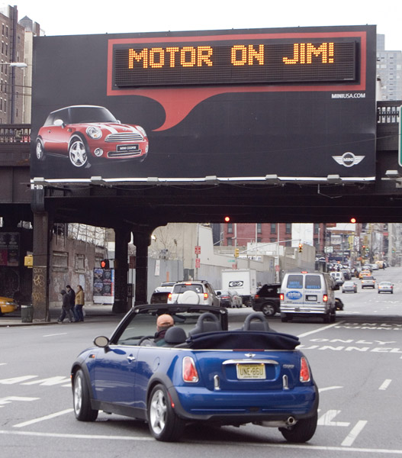
Market Targeting
Target Market Strategies
Individual marketing involves tailoring products and marketing programs to the needs and preferences of individual customers
Also known as:
  One-to-one marketing
  Mass customization
Notes:
Note to Instructor
Mass customization is the process through which firms interact one-to-one with masses of customers to design products and services tailor-made to meet individual needs.
Companies these days are hypercustomizing everything from food to artwork, earphones, sneakers and motorcycles.
At mymms.com, candylovers can buy M&Ms embossed with images of their kids or pets. JH Audio in Orlando makes music earphones based on molds of customers’ ears to provide optimized fit and better and safer sound. The company even laser prints designs on the tiny ear buds—some people request a kid for each ear; others prefer a dog. Nike’s NikeID program lets users choose materials for shoes’ tread (say, for trail or street) and upper (Gore-Tex, mesh, or other), pick the color of the swoosh and stitching, and even imprint text on the heels. Different-sized right and left feet? That, too, can be retooled. On a much larger scale, Harley-Davidson’s H-D1 factory customization program lets customers go online, design their own Harley, and get it in as little as four weeks. It invites customers to explore some 8,000 ways to “configure a Harley-Davidson motorcycle to create your own masterpiece—a truly one-of-a-kind ride. Imagine a new Harley Davidson 1200 Custom designed by you, rolling down the assembly line with your name on it. You dream it. We build it.”
Business-to-business marketers are also finding new ways to customize their offerings. For example, John Deere manufactures seeding equipment that can be configured in more than two million versions to individual customer specifications. The seeders are produced one at a time, in any sequence, on a single production line. Mass customization provides a way to stand out against competitors.

Slide 11
Four levels of Micromarketing
Segments Marketing
Niche Marketing
Local areas Marketing
Individuals Marketing

Slide 12
What is a Market Segment?
A market segment consists of a group of customers who share a similar set of needs and wants.

Slide 13

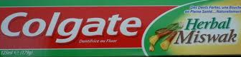
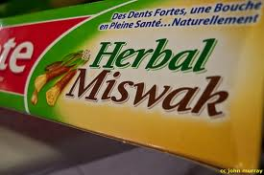
Niche Marketing
A niche is more narrowly defined customer group seeking a distinctive mix of benefits.

Slide 14
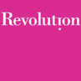
Niche Marketing…
Revolution
Revolution pioneered the concept of “plus sized fashion”, and is very proud to be a brand that accepts women as they are.
http://www.revolution.bz/aboutus.php

Slide 15
Market Targeting
Choosing a Target Market
Depends on:
Company resources
Product variability
Product life-cycle stage
Market variability
Competitor’s marketing strategies
Notes:
hoosing a Targeting Strategy
Companies need to consider many factors when choosing a market-targeting strategy. Which strategy is best depends on the company’s resources. When the firm’s resources are limited, concentrated marketing makes the most sense. The best strategy also depends on the degree of product variability. Undifferentiated marketing is more suited for uniform products, such as grapefruit or steel. Products that can vary in design, such as cameras and cars, are more suited to differentiation or concentration. The product’s life-cycle stage also must be considered. When a firm introduces a new product, it may be practical to launch one version only, as undifferentiated marketing or concentrated marketing may make the most sense. In the mature stage of the product life cycle, however, differentiated marketing often makes more sense.
Another factor is market variability. If most buyers have the same tastes, buy the same amounts, and react the same way to marketing efforts, undifferentiated marketing is appropriate. Finally, competitors’ marketing strategies are important. When competitors use differentiated or concentrated marketing, undifferentiated marketing can be suicidal. Conversely, when competitors use undifferentiated marketing, a firm can gain an advantage by using differentiated or concentrated marketing, focusing on the needs of buyers in specific segments.

Slide 16
Market Targeting
Socially Responsible Target Marketing
Benefits customers with specific needs
Concern for vulnerable segments
  Children
    Cigarettes
Notes:
Socially Responsible Target Marketing
Smart targeting helps companies become more efficient and effective by focusing on the segments that they can satisfy best and most profitably. Targeting also benefits consumers—companies serve specific groups of consumers with offers carefully tailored to their needs. However, target marketing sometimes generates controversy and concern. The biggest issues usually involve the targeting of vulnerable or disadvantaged consumers with controversial or potentially harmful products.
For example, over the years marketers in a wide range of industries—from cereal, soft drinks, and fast food to toys and fashion—have been heavily criticized for their marketing efforts directed toward children. Critics worry that premium offers and high-powered advertising appeals presented through the mouths of lovable animated characters will overwhelm children’s defenses. In recent years, for instance, McDonald’s has been criticized by various health advocates and parents groups who are concerned that its popular Happy Meals offers—featuring trinkets and other items tied in to kids movies such as Toy Story—create a too-powerful connection between children and the often fat- and calorie-laden meals. Some critics have even asked McDonald’s to retire its iconic Ronald McDonald character. McDonald’s has responded by putting the Happy Meal on a diet, cutting overall calorie count by 20 percent and adding fruit to every meal.
Other problems arise when the marketing of adult products spills over into the children’s segment—intentionally or unintentionally. For example, Victoria’s Secret targets its highly successful Pink line of young, hip, and sexy clothing to young women from 18 to 30 years old. However, critics charge that Pink is now all the rage among girls as young as 11 years old. Responding to Victoria’s Secret’s designs and marketing messages, tweens are flocking into stores and buying Pink, with or without their mothers. More broadly, critics worry that marketers of everything from Barbie dolls to lingerie are directly or indirectly targeting young girls with provocative products, promoting a premature focus on sex and appearance. For example, Barbie now comes in a “bling-bling” style, replete with halter top and go-go boots. And Abercrombie & Fitch recently marketed a padded “push-up” bikini top for girls as young as 8. “The sexualization of teens is bad enough and now it’s trickling down to our babies,” laments one reporter.
To encourage responsible advertising, the Children’s Advertising Review Unit, the advertising industry’s self-regulatory agency, has published extensive children’s advertising guidelines that recognize the special needs of child audiences. Still, critics feel that more should been done. Some have even called for a complete ban on advertising to children.
Cigarette, beer, and fast-food marketers have also generated controversy in recent years by their attempts to target inner-city minority consumers. For example, fast-food chains have drawn criticism for pitching their high-fat, salt-laden fare to low-income, urban residents who are much more likely than suburbanites to be heavy consumers. Similarly, big banks and mortgage lenders have been criticized for targeting consumers in poor urban areas with attractive adjustable rate home mortgages that they can’t really afford.
The growth of the Internet and other carefully targeted direct media has raised fresh concerns about potential targeting abuses. The Internet allows more precise targeting, letting the makers of questionable products or deceptive advertisers zero in on the most vulnerable audiences. Unscrupulous marketers can now send tailor-made, deceptive messages by e-mail directly to millions of unsuspecting consumers. For example, the FBI’s Internet Crime Complaint Center website alone received more than 300,000 complaints last year.
Not all attempts to target children, minorities, or other special segments draw such criticism. In fact, most provide benefits to targeted consumers. For example, Pantene markets Relaxed and Natural hair products to women of color. Samsung markets the Jitterbug, an easy-to-use phone, directly to seniors who need a simpler mobile phone with bigger buttons, large screen text, and a louder speaker. And Colgate makes a large selection of toothbrush shapes and toothpaste flavors for children—from Colgate SpongeBob SquarePants Mild Bubble Fruit toothpaste to Colgate Dora the Explorer character toothbrushes. Such products help make tooth brushing more fun and get children to brush longer and more often.
Thus, in target marketing, the issue is not really who is targeted but rather how and for what. Controversies arise when marketers attempt to profit at the expense of targeted segments—when they unfairly target vulnerable segments or target them with questionable products or tactics. Socially responsible marketing calls for segmentation and targeting that serve not just the interests of the company but also the interests of those targeted.

Slide 17

Differentiation and Positioning
Product position is the way the product is defined by consumers on important attributes—the place the product occupies in consumers’ minds relative to competing products
  Perceptions
  Impressions
  Feelings
Notes:
the company must decide on a value proposition—how it will create differentiated value for targeted segments and what positions it wants to occupy in those segments. A product position is the way a product is defined by consumers on important attributes—the place the product occupies in consumers’ minds relative to competing products. Products are made in factories, but brands happen in the minds of consumers.
Method laundry detergent is positioned as a smarter, easier, and greener detergent; Dreft is positioned as the gentle detergent for baby clothes. At IHOP, you “Come hungry. Leave happy.”; at Olive Garden, “When You’re Here, You’re Family.” In the automobile market, the Nissan Versa and Honda Fit are positioned on economy, Mercedes and Cadillac on luxury, and Porsche and BMW on performance. Folger’s Coffee is “The best part of wakin’ up”; Honest Tea says “Nature got it right. We put it in a bottle.”
Consumers are overloaded with information about products and services. They cannot reevaluate products every time they make a buying decision. To simplify the buying process, consumers organize products, services, and companies into categories and “position” them in their minds. A product’s position is the complex set of perceptions, impressions, and feelings that consumers have for the product compared with competing products.
Consumers position products with or without the help of marketers. But marketers do not want to leave their products’ positions to chance. They must plan positions that will give their products the greatest advantage in selected target markets, and they must design marketing mixes to create these planned positions.

Slide 18
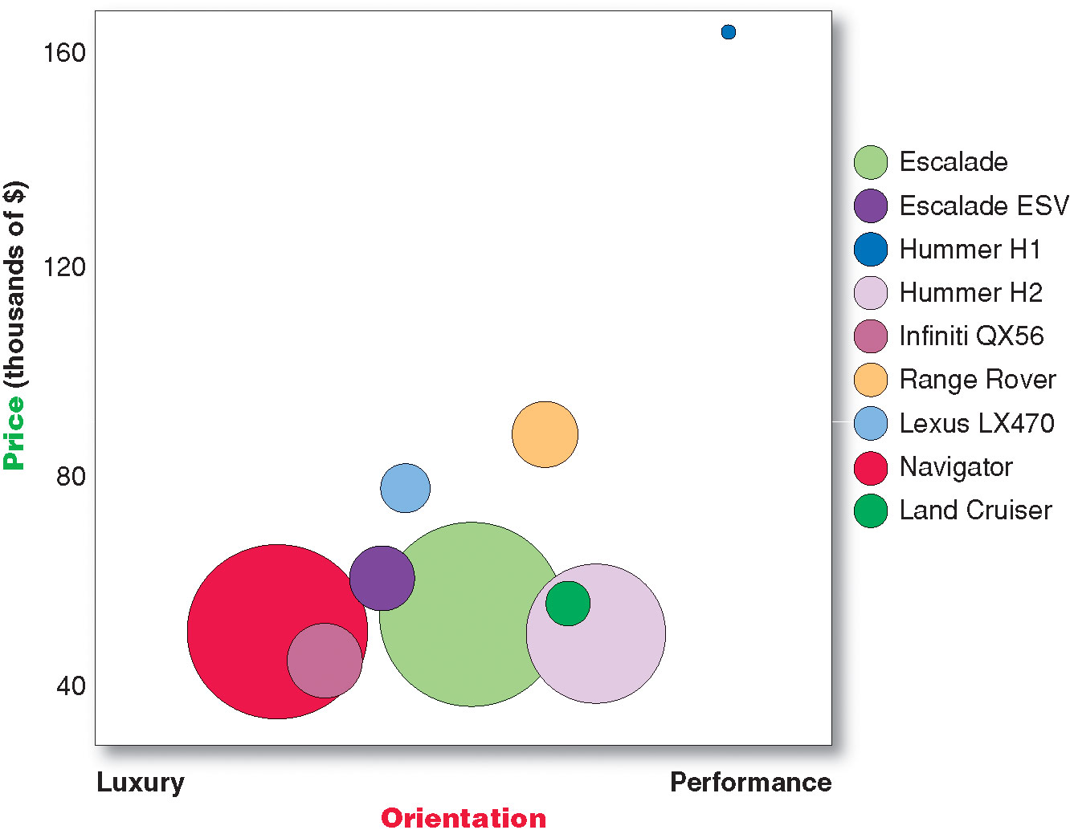
Differentiation and Positioning
Positioning maps show consumer perceptions of their brands versus competing products on important buying dimensions
Notes:
Positioning Maps
In planning their differentiation and positioning strategies, marketers often prepare perceptual positioning maps that show consumer perceptions of their brands versus competing products on important buying dimensions. Figure 7.3 shows a positioning map for the U.S. large luxury sport utility vehicle (SUV) market. The position of each circle on the map indicates the brand’s perceived positioning on two dimensions: price and orientation (luxury versus performance). The size of each circle indicates the brand’s relative market share.

Slide 19
Differentiation and Positioning
Choosing a Differentiation and Positioning Strategy
Identifying a set of possible competitive advantages to build a position
Choosing the right competitive advantages
Selecting an overall positioning strategy
Communicating and delivering the chosen position to the market
Notes:
Choosing a Differentiation and Positioning Strategy
Some firms find it easy to choose a differentiation and positioning strategy. For example, a firm well known for quality in certain segments will go after this position in a new segment if there are enough buyers seeking quality. But in many cases, two or more firms will go after the same position. Then each will have to find other ways to set itself apart. Each firm must differentiate its offer by building a unique bundle of benefits that appeals to a substantial group within the segment.
Above all else, a brand’s positioning must serve the needs and preferences of well-defined target markets.
The differentiation and positioning task consists of three steps: identifying a set of differentiating competitive advantages on which to build a position, choosing the right competitive advantages, and selecting an overall positioning strategy. The company must then effectively communicate and deliver the chosen position to the market.

Slide 20
Differentiation and Positioning
Identifying Possible Value Differences and Competitive Advantages
Competitive advantage is an advantage over competitors gained by offering consumers greater value, either through lower prices or by providing more benefits that justify higher prices
Notes:
Identifying Possible Value Differences and Competitive Advantages
To build profitable relationships with target customers, marketers must understand customer needs and deliver more customer value better than competitors do. To the extent that a company can differentiate and position itself as providing superior customer value, it gains competitive advantage.
But solid positions cannot be built on empty promises. If a company positions its product as offering the best quality and service, it must actually differentiate the product so that it delivers the promised quality and service. Companies must do much more than simply shout out their positions with slogans and taglines. They must first live the slogan.

Slide 21
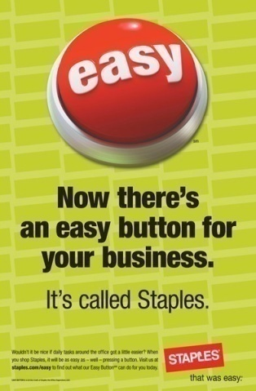
Differentiation and Positioning
Choosing a Differentiation and Positioning Strategy
Identifying a set of possible competitive advantages to build a position by providing superior value from:
Product differentiation
Service differentiation
Channel differentiation
People differentiation
Image differentiation
Notes:
To find points of differentiation, marketers must think through the customer’s entire experience with the company’s product or service. An alert company can find ways to differentiate itself at every customer contact point. In what specific ways can a company differentiate itself or its market offer? It can differentiate along the lines of product, services, channels, people, or image.
<ex07.17>
Through product differentiation, brands can be differentiated on features, performance, or style and design. Thus, Bose positions its speakers on their striking design and sound characteristics. By gaining the approval of the American Heart Association as an approach to a healthy lifestyle, Subway differentiates itself as the healthy fast-food choice. And Seventh Generation, a maker of household cleaning and laundry supplies, paper products, diapers, and wipes, differentiates itself not so much by how its products perform but by the fact that its products are greener. Seventh Generation products are “Protecting Planet Home.”
Beyond differentiating its physical product, a firm can also differentiate the services that accompany the product. Some companies gain services differentiation through speedy, convenient, or careful delivery. For example, First Convenience Bank of Texas offers “Real Hours for Real People”; it is open seven days a week, including evenings. Others differentiate their service based on high-quality customer care. In an age where customer satisfaction with airline service is in constant decline, Singapore Airlines sets itself apart through extraordinary customer care and the grace of its flight attendants. “Everyone expects excellence from us,” says the international airline. “[So even] in the smallest details of flight, we rise to each occasion and deliver the Singapore Airlines experience.”
Firms that practice channel differentiation gain competitive advantage through the way they design their channel’s coverage, expertise, and performance. Amazon.com and GEICO, for example, set themselves apart with their smooth-functioning direct channels. Companies can also gain a strong competitive advantage through people differentiation—hiring and training better people than their competitors do. People differentiation requires that a company select its customer-contact people carefully and train them well. For example, Disney World people are known to be friendly and upbeat. Disney trains its theme park people thoroughly to ensure that they are competent, courteous, and friendly—from the hotel check-in agents, to the monorail drivers, to the ride attendants, to the people who sweep Main Street USA. Each employee is carefully trained to understand customers and to “make people happy.”
Even when competing offers look the same, buyers may perceive a difference based on company or brand image differentiation. A company or brand image should convey a product’s distinctive benefits and positioning. Developing a strong and distinctive image calls for creativity and hard work. A company cannot develop an image in the public’s mind overnight by using only a few ads. If Ritz-Carlton means quality, this image must be supported by everything the company says and does.
Symbols, such as the McDonald’s golden arches, the colorful Google logo, the Nike swoosh, or Apple’s “bite mark” logo, can provide strong company or brand recognition and image differentiation. The company might build a brand around a famous person, as Nike did with its Michael Jordan, Kobe Bryant, and LeBron James basketball shoe and apparel collections. Some companies even become associated with colors, such as Coca-Cola (red), IBM (blue), or UPS (brown). The chosen symbols, characters, and other image elements must be communicated through advertising that conveys the company’s or brand’s personality.

Slide 22
Differentiation and Positioning
Choosing the Right Competitive Advantage
Difference to promote should be:
Important
Distinctive
Superior
Communicable
Preemptive
Affordable
Profitable
Notes:
Discussion Question
Are you familiar with GEICO advertisements? If so, what is their positioning?
Which Differences to Promote. Not all brand differences are meaningful or worthwhile, and each difference has the potential to create company costs as well as customer benefits. A difference is worth establishing to the extent that it satisfies the following criteria:
Important: The difference delivers a highly valued benefit to target buyers.
Distinctive: Competitors do not offer the difference, or the company can offer it in a more distinctive way.
Superior: The difference is superior to other ways that customers might obtain the same benefit.
Communicable: The difference is communicable and visible to buyers.
Preemptive: Competitors cannot easily copy the difference.
Affordable: Buyers can afford to pay for the difference.
Profitable: The company can introduce the difference profitably.
Many companies have introduced differentiations that failed one or more of these tests.
The Web link is to a YouTube ad. The question is what do they promote as their difference. It is that they cost less and they are easy to use. The instructor might want to play competitor’s ads to see what differences they promote (State Farm) is a good example.
Thus, choosing competitive advantages on which to position a product or service can be difficult, yet such choices may be crucial to success. Choosing the right differentiators can help a brand stand out from the pack of competitors. For example, when carmaker Nissan introduced its novel little Cube, it didn’t position the car only on attributes shared with competing models, such as affordability and customization. It positioned it as a “mobile device” that fits today’s digital lifestyles.

Slide 23
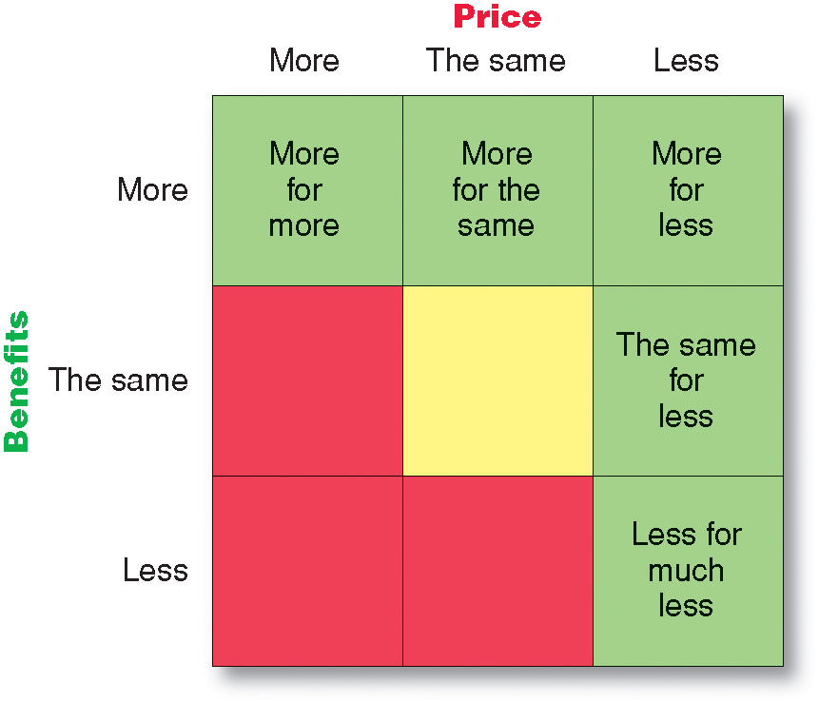
Differentiation and Positioning
Selecting an Overall Positioning Strategy
Value proposition is the full mix of benefits upon which a brand is positioned
Notes:
The full positioning of a brand is called the brand’s value proposition—the full mix of benefits on which a brand is differentiated and positioned. It is the answer to the customer’s question “Why should I buy your brand?” BMW’s “ultimate driving machine” value proposition hinges on performance but also includes luxury and styling, all for a price that is higher than average but seems fair for this mix of benefits.
Figure 7.4 shows possible value propositions on which a company might position its products. In the figure, the five green cells represent winning value propositions— differentiation and positioning that gives the company a competitive advantage. The red cells, however, represent losing value propositions. The center yellow cell represents at best a marginal proposition. In the following sections, we discuss the five winning value propositions: more for more, more for the same, the same for less, less for much less, and more for less.
More for More. More-for-more positioning involves providing the most upscale product or service and charging a higher price to cover the higher costs. A more-for-more market offering not only offers higher quality, it also gives prestige to the buyer. It symbolizes status and a loftier lifestyle. Four Seasons hotels, Rolex watches, Mercedes automobiles, SubZero appliances—each claims superior quality, craftsmanship, durability, performance, or style and, therefore, charges a higher price. When Apple premiered its iPhone, it offered higher-quality features than a traditional mobile phone with a hefty price tag to match.
<ex07.19>
Similarly, the marketers of Hearts On Fire diamonds have created a more-for-more niche as “The World’s Most Perfectly Cut Diamond.” Hearts On Fire diamonds have a unique “hearts and arrow” design. When viewed under magnification from the bottom, a perfect ring of eight hearts appears; from the top comes a perfectly formed Fireburst of light. Hearts On Fire diamonds aren’t for everyone, says the company. “Hearts On Fire is for those who expect more and give more in return.” The brand commands a 15 to 20 percent price premium over comparable competing diamonds.
Although more-for-more can be profitable, this strategy can also be vulnerable. It often invites imitators who claim the same quality but at a lower price. For example, more-for-more brand Starbucks now faces “gourmet” coffee competitors ranging from Dunkin’ Donuts to McDonald’s. Also, luxury goods that sell well during good times may be at risk during economic downturns when buyers become more cautious in their spending. The recent gloomy economy hit premium brands, such as Starbucks, the hardest.
More for the Same. Companies can attack a competitor’s more-for-more positioning by introducing a brand offering comparable quality at a lower price. For example, Toyota introduced its Lexus line with a more-for-the-same value proposition versus Mercedes and BMW. Its first headline read: “Perhaps the first time in history that trading a $72,000 car for a $36,000 car could be considered trading up.” It communicated the high quality of its new Lexus through rave reviews in car magazines and a widely distributed video showing side-by-side comparisons of Lexus and Mercedes automobiles. It published surveys showing that Lexus dealers were providing customers with better sales and service experiences than were Mercedes dealerships. Many Mercedes owners switched to Lexus, and the Lexus repurchase rate has been 60 percent, twice the industry average.
The Same for Less. Offering the same for less can be a powerful value proposition—everyone likes a good deal. Discount stores such as Walmart and “category killers” such as Best Buy, PetSmart, David’s Bridal, and DSW Shoes use this positioning. They don’t claim to offer different or better products. Instead, they offer many of the same brands as department stores and specialty stores but at deep discounts based on superior purchasing power and lower-cost operations. Other companies develop imitative but lower-priced brands in an effort to lure customers away from the market leader. For example, Amazon.com offers the Kindle Fire tablet computer, which sells for less than 40 percent of the price of the Apple iPad or Samsung Galaxy
Less for Much Less. A market almost always exists for products that offer less and therefore cost less. Few people need, want, or can afford “the very best” in everything they buy. In many cases, consumers will gladly settle for less than optimal performance or give up some of the bells and whistles in exchange for a lower price. For example, many travelers seeking lodgings prefer not to pay for what they consider unnecessary extras, such as a pool, an attached restaurant, or mints on the pillow. Hotel chains such as Ramada Limited, Holiday Inn Express, and Motel 6 suspend some of these amenities and charge less accordingly.
Less-for-much-less positioning involves meeting consumers’ lower performance or quality requirements at a much lower price. For example, Family Dollar and Dollar General stores offer more affordable goods at very low prices. Costco warehouse stores offer less merchandise selection and consistency and much lower levels of service; as a result, they charge rock-bottom prices.
More for Less. Of course, the winning value proposition would be to offer more for less. Many companies claim to do this. And, in the short run, some companies can actually achieve such lofty positions. For example, when it first opened for business, Home Depot had arguably the best product selection, the best service, and the lowest prices compared to local hardware stores and other home improvement chains.
Yet in the long run, companies will find it very difficult to sustain such best-of-both positioning. Offering more usually costs more, making it difficult to deliver on the “for-less” promise. Companies that try to deliver both may lose out to more focused competitors. For example, facing determined competition from Lowe’s stores, Home Depot must now decide whether it wants to compete primarily on superior service or on lower prices.
All said, each brand must adopt a positioning strategy designed to serve the needs and wants of its target markets. More for more will draw one target market, less for much less will draw another, and so on. Thus, in any market, there is usually room for many different companies, each successfully occupying different positions. The important thing is that each company must develop its own winning positioning strategy, one that makes the company special to its target consumers.

Slide 24
Differentiation and Positioning
Developing a Positioning Statement
To (target segment and need) our (brand) is (concept) that (point of difference)
Notes:
Developing a Positioning Statement
Company and brand positioning should be summed up in a positioning statement. The statement should follow the form: To (target segment and need) our (brand) is (concept) that (point of difference). Here is an example using the popular digital information management application, Evernote: “To busy multitaskers who need help remembering things, Evernote is digital content management application that makes it easy to capture and remember moments and ideas from your everyday life using your computer, phone, tablet, and the Web.”
Note that the positioning statement first states the product’s membership in a category (digital content management application) and then shows its point of difference from other members of the category (easily capture moments and ideas and remember them later). Evernote helps you “remember everything” by letting you take notes, capture photos, create to-do lists, and record voice reminders, and then makes them easy to find and access using about any device, anywhere—at home, at work, or on the go.
Placing a brand in a specific category suggests similarities that it might share with other products in the category. But the case for the brand’s superiority is made on its points of difference. For example, the U.S. Postal Service ships packages just like UPS and FedEx, but it differentiates its priority mail from competitors with convenient, low-price, flat-rate shipping boxes and envelopes. “If it fits, it ships,” promises the Post Office. Based on information from Philip Kotler and Kevin Lane Keller, Marketing

Slide 25
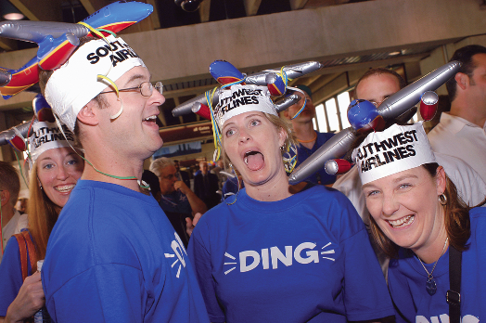
Communication and Delivering the Chosen Position
Choosing the positioning is often easier than implementing the position.
Notes:
Communicating and Delivering the Chosen Position
Once it has chosen a position, the company must take strong steps to deliver and communicate the desired position to its target consumers. All the company’s marketing mix efforts must support the positioning strategy.
Positioning the company calls for concrete action, not just talk. If the company decides to build a position on better quality and service, it must first deliver that position. Designing the marketing mix—product, price, place, and promotion—involves working out the tactical details of the positioning strategy. Thus, a firm that seizes on a more-for-more position knows that it must produce high-quality products, charge a high price, distribute through high-quality dealers, and advertise in high-quality media. It must hire and train more service people, find retailers who have a good reputation for service, and develop sales and advertising messages that broadcast its superior service. This is the only way to build a consistent and believable more-for-more position.
Companies often find it easier to come up with a good positioning strategy than to implement it. Establishing a position or changing one usually takes a long time. In contrast, positions that have taken years to build can quickly be lost. Once a company has built the desired position, it must take care to maintain the position through consistent performance and communication. It must closely monitor and adapt the position over time to match changes in consumer needs and competitors’ strategies. However, the company should avoid abrupt changes that might confuse consumers. Instead, a product’s position should evolve gradually as it adapts to the ever-changing marketing environment.

Slide 26
Bibliography
Principles of Marketing by Philip Kotler & Gary Armstrong
Fifteenth Edition, Published by Prentice Hall
Marketing Management – A South Asian Perspective
by Philip Kotler, Kevin Lane Keller, Abraham Koshy &
Mithileshwar Jha, 13th Edition, Published by Pearson
Education, Inc.
Principles and Practices of Marketing by Jobber, D. 4th
edition, McGraw Hill International.
Principles of Advertising & IMC by Tom Duncan 2nd
Edition, Published by McGraw-Hill Irwin.

Slide 27


The End
“Judge your success by the degree that you are enjoying peace, health and love”

