Slide 1
Business Markets and Business Buying Behavior
LECTURE-10

Slide 2
Topic Outline
Business Markets
Business Buyer Behavior
The Business Buying Process
E-Procurement: Buying on the Internet
Institutional and Government Markets
Notes:
In this chapter, we dig deeper into steps two and three of the marketing process: designing customer-driven marketing strategies and constructing marketing programs. First, we look at the organization’s overall strategic planning, which guides marketing strategy and planning. Next, we discuss how, guided by the strategic plan, marketers partner closely with others inside and outside the firm to create value for customers. We then examine marketing strategy and planning—how marketers choose target markets, position their market offerings, develop a marketing mix, and manage their marketing programs. Finally, we look at the important step of measuring and managing return on marketing investment (marketing ROI).

Slide 3
Business Markets
Business buyer behavior refers to the buying behavior of the organizations that buy goods and services for use in production of other products and services that are sold, rented, or supplied to others.
Business buying process is the process where business buyers determine which products and services are needed to purchase, and then find, evaluate, and choose among alternative brands
Notes:
In this chapter, we’ll do the same for business customers—those that buy goods and services for use in producing their own products and services or for resale to others. As when selling to final buyers, firms marketing to business customers must build profitable relationships with business customers by creating superior customer value.
The business market is huge. In fact, business markets involve far more dollars and items than do consumer markets. For example, think about the large number of business transactions involved in the production and sale of a single set of Goodyear tires. Various suppliers sell Goodyear the rubber, steel, equipment, and other goods that it needs to produce tires. Goodyear then sells the finished tires to retailers, who in turn sell them to consumers. Thus, many sets of business purchases were made for only one set of consumer purchases. In addition, Goodyear sells tires as original equipment to manufacturers that install them on new vehicles and as replacement tires to companies that maintain their own fleets of company cars, trucks, or other vehicles.
In some ways, business markets are similar to consumer markets. Both involve people who assume buying roles and make purchase decisions to satisfy needs. However, business markets differ in many ways from consumer markets. The main differences are in market structure and demand, the nature of the buying unit, and the types of decisions and the decision process involved.

Slide 4
Business Markets
Market Structure and Demand
Fewer and larger buyers
Derived demand
Inelastic demand
Fluctuating demand
Notes:
Market Structure and Demand
The business marketer normally deals with far fewer but far larger buyers than the consumer marketer does. Even in large business markets, a few buyers often account for most of the purchasing. For example, when Goodyear sells replacement tires to final consumers, its potential market includes millions of car owners around the world. But its fate in business markets depends on getting orders from only a handful of large automakers.
Further, business demand is derived demand—it ultimately derives from the demand for consumer goods. For example, W. L. Gore & Associates sells its Gore-Tex brand to manufacturers who make and sell outdoor apparel brands made from Gore-Tex fabrics. If demand for these brands increases, so does demand for Gore-Tex fabrics. So to boost demand for Gore-Tex, Gore advertises to final consumers to educate them on the benefits of Gore-Tex fabrics in the brands they buy. It also directly markets brands containing Gore-Tex—from Arc’teryx, Marmot, and The North Face to Burton and L.L. Bean—on its own website (www.gore-tex.com).
To deepen its direct relationship with outdoor enthusiasts further, Gore even sponsors an “Experience More” online community in which members can share experiences and videos, connect with outdoor experts, and catch exclusive gear offers from partner brands. As a result, consumers around the world have learned to look for the familiar Gore-Tex brand label, and both Gore and its partner brands win. No matter what brand of apparel or footwear you buy, says the label, if it’s made with Gore-Tex fabric, it’s “guaranteed to keep you dry.”
Finally, many business markets have inelastic and more fluctuating demand. The total demand for many business products is not much affected by price changes, especially in the short run. A drop in the price of leather will not cause shoe manufacturers to buy much more leather unless it results in lower shoe prices that, in turn, increase consumer demand for shoes. And the demand for many business goods and services tends to change more—and more quickly—than does the demand for consumer goods and services. A small percentage increase in consumer demand can cause large increases in business demand.

Slide 5
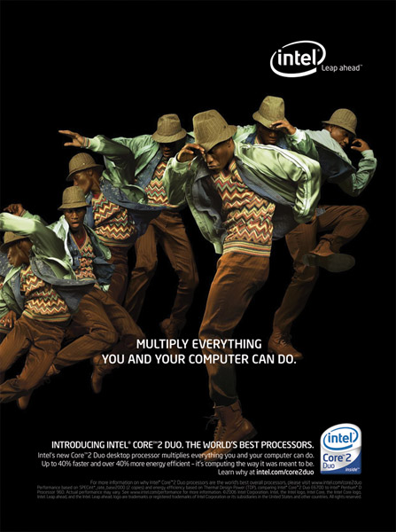
Business Markets
Decision Process
More complex
More decision participants
More professional purchasing effort
Buyer and seller more dependent
Notes:
Nature of the Buying Unit
Compared with consumer purchases, a business purchase usually involves more decision participants and a more professional purchasing effort. Often, business buying is done by trained purchasing agents who spend their working lives learning how to buy better. The more complex the purchase, the more likely it is that several people will participate in the decision-making process. Buying committees composed of technical experts and top management are common in the buying of major goods. Beyond this, B-to-B marketers now face a new breed of higher-level, better-trained supply managers. Therefore, companies must have well-trained marketers and salespeople to deal with these well-trained buyers.
Types of Decisions and the Decision Process
Business buyers usually face more complex buying decisions than do consumer buyers. Business purchases often involve large sums of money, complex technical and economic considerations, and interactions among people at many levels of the buyer’s organization. The business buying process also tends to be longer and more formalized. Large business purchases usually call for detailed product specifications, written purchase orders, careful supplier searches, and formal approval.
Finally, in the business buying process, the buyer and seller are often much more dependent on each other. B-to-B marketers may roll up their sleeves and work closely with their customers during all stages of the buying process—from helping customers define problems, to finding solutions, to supporting after-sale operation. They often customize their offerings to individual customer needs. In the short run, sales go to suppliers who meet buyers’ immediate product and service needs. In the long run, however, business-to-business marketers keep customers by meeting current needs and by partnering with them to help solve their problems. For example, Dow Performance Plastics doesn’t just sell commodity plastics to its industrial customers—it works with these customers to help them succeed in their own markets:
Quotes and other information from www.omnexus.com/sf/dow/?id=plastics, accessed March 2010; and http://plastics.dow.com/, accessed March 2012.

Slide 6
Business Markets
Decision Process
Supplier development: systematic development of networks of supplier-partners to ensure an appropriate and dependable supply of products and materials that they will use in making their own products or resell
Notes:
Many customer companies are now practicing supplier development, systematically developing networks of supplier-partners to ensure a dependable supply of products and materials that they use in making their own products or reselling to others.
Walmart doesn’t have a “Purchasing Department”; it has a “Supplier Development Department.” The giant retailer knows that it can’t just rely on spot suppliers who might be available when needed. Instead, Walmart manages a robust network of supplier-partners that help provide the hundreds of billions of dollars of goods that it sells to its customers each year.

Slide 7
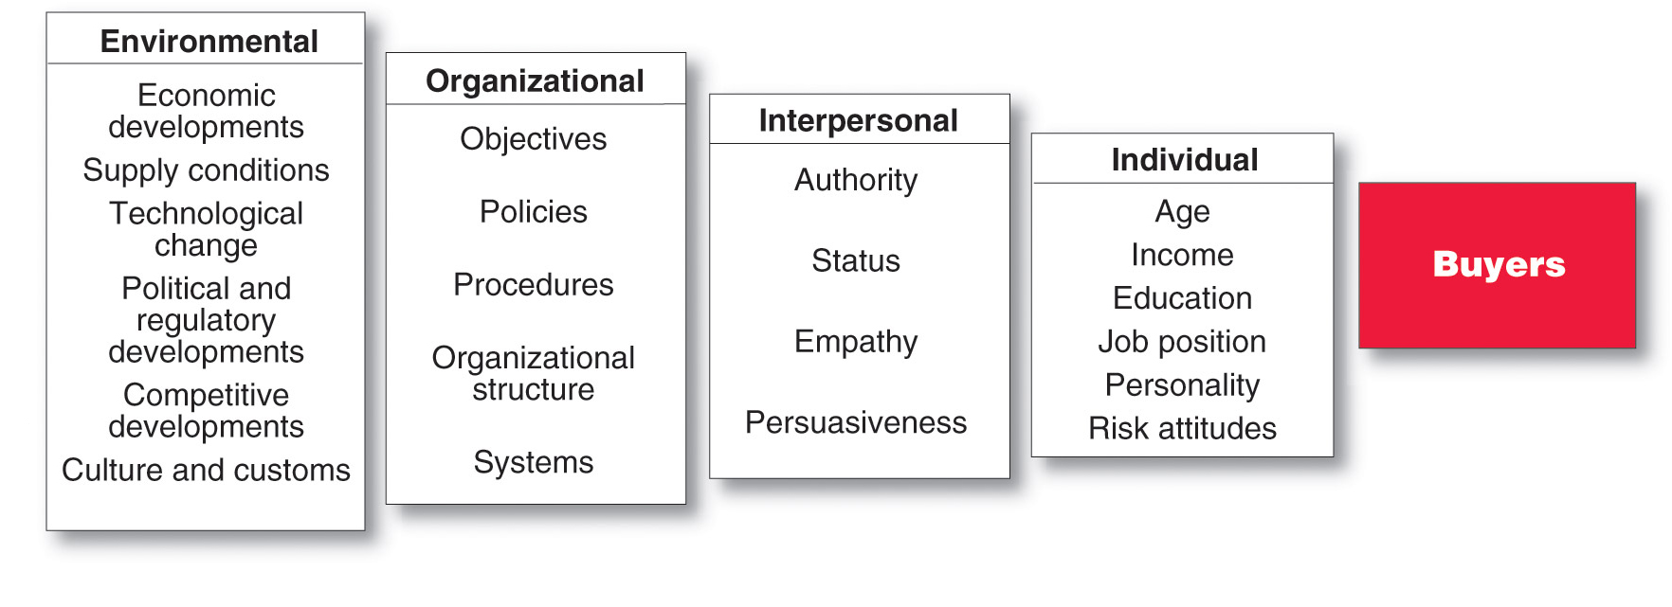
Business Buyer Behavior
The Model of Business Buyer Behavior
Notes:
At the most basic level, marketers want to know how business buyers will respond to various marketing stimuli. Figure 6.1 shows a model of business buyer behavior. In this model, marketing and other stimuli affect the buying organization and produce certain buyer responses. To design good marketing strategies, marketers must understand what happens within the organization to turn stimuli into purchase responses.
Within the organization, buying activity consists of two major parts: the buying center, composed of all the people involved in the buying decision, and the buying decision process. The model shows that the buying center and the buying decision process are influenced by internal organizational, interpersonal, and individual factors as well as external environmental factors.
The model in Figure 6.1 suggests four questions about business buyer behavior: What buying decisions do business buyers make? Who participates in the business buying process? What are the major influences on buyers? How do business buyers make their buying decisions?
Ma
Discussion Question
How would the purchase of a chair like the one you are sitting in be different for the University versus an end consumer like yourself buying a chair for your desk?
It may be difficult for students with no business buying experience to grasp the difference between business and consumer buying. Students will note how the university needs to buy more, that they need to ask users about the chairs, that they will organize more intricately for the buying effort, that they will work with the vendors for reduced prices for bulk purchases. In addition, this can tie directly to the major types of buying situations.
Discussion Questions
How could the chair be a straight rebuy versus a modified rebuy. What implications would the different situation make on the process?

Slide 8
Business Buyer Behavior
Major Types of Buying Situations
Straight rebuy is a routine purchase decision such as reorder without any modification
Modified rebuy is a purchase decision that requires some research where the buyer wants to modify the product specification, price, terms, or suppliers
New task is a purchase decision that requires thorough research such as a new product
Notes:
Major Types of Buying Situations
There are three major types of buying situations. In a straight rebuy, the buyer reorders something without any modifications. It is usually handled on a routine basis by the purchasing department. To keep the business, “in” suppliers try to maintain product and service quality. “Out” suppliers try to find new ways to add value or exploit dissatisfaction so that the buyer will consider them.
In a modified rebuy, the buyer wants to modify product specifications, prices, terms, or suppliers. The “in” suppliers may become nervous and feel pressured to put their best foot forward to protect an account. “Out” suppliers may see the modified rebuy situation as an opportunity to make a better offer and gain new business.
A company buying a product or service for the first time faces a new task situation. In such cases, the greater the cost or risk, the larger the number of decision participants and the greater the company’s efforts to collect information. The new task situation is the marketer’s greatest opportunity and challenge. The marketer not only tries to reach as many key buying influences as possible but also provides help and information. The buyer makes the fewest decisions in the straight rebuy and the most in the new task decision.
Major Types of Buying Situations
There are three major types of buying situations. In a straight rebuy, the buyer reorders something without any modifications. It is usually handled on a routine basis by the purchasing department. To keep the business, “in” suppliers try to maintain product and service quality. “Out” suppliers try to find new ways to add value or exploit dissatisfaction so that the buyer will consider them.
In a modified rebuy, the buyer wants to modify product specifications, prices, terms, or suppliers. The “in” suppliers may become nervous and feel pressured to put their best foot forward to protect an account. “Out” suppliers may see the modified rebuy situation as an opportunity to make a better offer and gain new business.
A company buying a product or service for the first time faces a new task situation. In such cases, the greater the cost or risk, the larger the number of decision participants and the greater the company’s efforts to collect information. The new task situation is the marketer’s greatest opportunity and challenge. The marketer not only tries to reach as many key buying influences as possible but also provides help and information. The buyer makes the fewest decisions in the straight rebuy and the most in the new task decision.

Slide 9
Business Buyer Behavior
Major Types of Buying Situations
Systems selling
involves the purchase
of a packaged solution
from a single seller
Notes:
Many business buyers prefer to buy a complete solution to a problem from a single seller rather than buying separate products and services from several suppliers and putting them together. The sale often goes to the firm that provides the most complete system for meeting the customer’s needs and solving its problems. Such systems selling (or solutions selling) is often a key business marketing strategy for winning and holding accounts.

Slide 10
Business Buyer Behavior
Participants in the Business Buying Process
Buying center is all of the individuals and units that participate in the business decision-making process
Notes:
Who does the buying of the trillions of dollars’ worth of goods and services needed by business organizations? The decision-making unit of a buying organization is called its buying center. It consists of all the individuals and units that play a role in the business purchase decision-making process. This group includes the actual users of the product or service, those who make the buying decision, those who influence the buying decision, those who do the actual buying, and those who control buying information.

Slide 11
Business Buyer Behavior
Participants in the Business Buying Process
Users are those that will use the product or service
Influencers help define specifications and provide information for evaluating alternatives
Buyers have formal authority to select the supplier and arrange terms of purchase
Deciders have formal or informal power to select and approve final suppliers
Gatekeepers control the flow of information
Notes:
The buying center includes all members of the organization who play any of five roles in the purchase decision process.
Users are members of the organization who will use the product or service. In many cases, users initiate the buying proposal and help define product specifications.
Influencers often help define specifications and also provide information for evaluating alternatives. Technical personnel are particularly important influencers.
Buyers have formal authority to select the supplier and arrange terms of purchase. Buyers may help shape product specifications, but their major role is in selecting vendors and negotiating. In more complex purchases, buyers might include high-level officers participating in the negotiations.
Deciders have formal or informal power to select or approve the final suppliers. In routine buying, the buyers are often the deciders, or at least the approvers.
Gatekeepers control the flow of information to others. For example, purchasing agents often have authority to prevent salespersons from seeing users or deciders. Other gatekeepers include technical personnel and even personal secretaries.
The buying center is not a fixed and formally identified unit within the buying organization. It is a set of buying roles assumed by different people for different purchases. Within the organization, the size and makeup of the buying center will vary for different products and for different buying situations. For some routine purchases, one person—say, a purchasing agent—may assume all the buying center roles and serve as the only person involved in the buying decision. For more complex purchases, the buying center may include 20 or 30 people from different levels and departments in the organization.

Slide 12

Business Buyer Behavior
Participants in the Business Buying Process
Buying center provides a major challenge
Who participates in the process
  Their relative authority
  What evaluation criteria each participant uses
  Informal participants
Notes:
The buying center concept presents a major marketing challenge. The business marketer must learn who participates in the decision, each participant’s relative influence, and what evaluation criteria each decision participant uses. This can be difficult.
The buying center usually includes some obvious participants who are involved formally in the buying decision. For example, the decision to buy a corporate jet will probably involve the company’s CEO, the chief pilot, a purchasing agent, some legal staff, a member of top management, and others formally charged with the buying decision. It may also involve less obvious, informal participants, some of whom may actually make or strongly affect the buying decision. Sometimes, even the people in the buying center are not aware of all the buying participants. For example, the decision about which corporate jet to buy may actually be made by a corporate board member who has an interest in flying and who knows a lot about airplanes. This board member may work behind the scenes to sway the decision. Many business buying decisions result from the complex interactions of ever-changing buying center participants.

Slide 13
Business Buyer Behavior
Major Influences on Business Buyers
Economic Factors
Price
Service
Personal Factors
Emotion
Notes:
Major Influences on Business Buyers
Business buyers are subject to many influences when they make their buying decisions. Some marketers assume that the major influences are economic. They think buyers will favor the supplier who offers the lowest price or the best product or the most service. They concentrate on offering strong economic benefits to buyers. Such economic factors are very important to most buyers, especially in a tough economy. However, business buyers actually respond to both economic and personal factors. Far from being cold, calculating, and impersonal, business buyers are human and social as well. They react to both reason and emotion.
Today, most B-to-B marketers recognize that emotion plays an important role in business buying decisions.

Slide 14
Business Buyer Behavior
Major Influences on Business Buyers
Environmental Factors
Demand for product
Economic outlook
Cost of money
Supply of Materials
Technology
Culture
Politics
Competition
Notes:
Business buyers are heavily influenced by factors in the current and expected economic environment, such as the level of primary demand, the economic outlook, and the cost of money. Another environmental factor is the supply of key materials. Many companies now are more willing to buy and hold larger inventories of scarce materials to ensure adequate supply. Business buyers also are affected by technological, political, and competitive developments in the environment. Finally, culture and customs can strongly influence business buyer reactions to the marketer’s behavior and strategies, especially in the international marketing environment (see Real Marketing 6.1). The business buyer must watch these factors, determine how they will affect the buyer, and try to turn these challenges into opportunities.

Slide 15
Business Buyer Behavior
Major Influences on Business Buyers Organizational Factors
Objectives
Policies
Procedures
Structure
Systems
Notes:
Organizational factors are also important. Each buying organization has its own objectives, strategies, structure, systems, and procedures, and the business marketer must understand these factors well. Questions such as these arise: How many people are involved in the buying decision? Who are they? What are their evaluative criteria? What are the company’s policies and limits on its buyers?
The buying center usually includes many participants who influence each other, so interpersonal factors also influence the business buying process. However, it is often difficult to assess such interpersonal factors and group dynamics. Buying center participants do not wear tags that label them as “key decision maker” or “not influential.” Nor do buying center participants with the highest rank always have the most influence. Participants may influence the buying decision because they control rewards and punishments, are well liked, have special expertise, or have a special relationship with other important participants. Interpersonal factors are often very subtle. Whenever possible, business marketers must try to understand these factors and design strategies that take them into account.

Slide 16
Business Buyer Behavior
Major Influences on Business Buyers
Individual Factors
Motives
Perceptions
Preferences
Age
Income
Education
Attitude toward risk
Notes:
Each participant in the business buying decision process brings in personal motives, perceptions, and preferences. These individual factors are affected by personal characteristics such as age, income, education, professional identification, personality, and attitudes toward risk. Also, buyers have different buying styles. Some may be technical types who make in-depth analyses of competitive proposals before choosing a supplier. Other buyers may be intuitive negotiators who are adept at pitting the sellers against one another for the best deal.

Slide 17
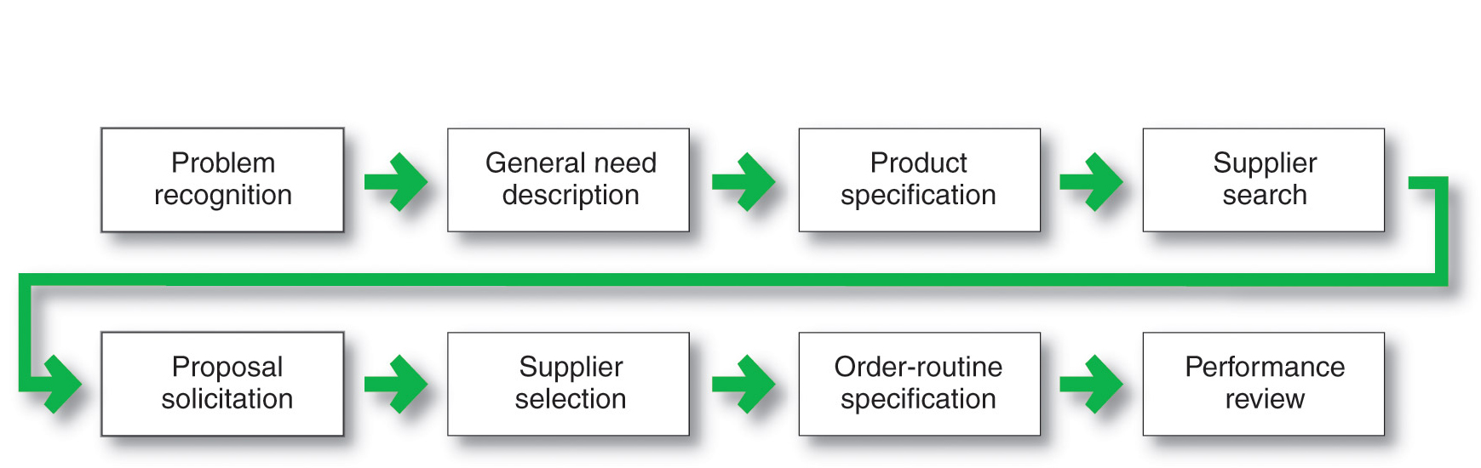
Business Buyer Behavior
The Buying Process
Notes:
The Business Buying Process
Figure 6.3 lists the eight stages of the business buying process. Buyers who face a new task buying situation usually go through all stages of the buying process. Buyers making modified or straight rebuys, in contrast, may skip some of the stages. We will examine these steps for the typical new task buying situation.

Slide 18
Business Buyer Behavior
The Buying Process
Problem recognition occurs when someone in the company recognizes a problem or need
Internal stimuli
  Need for new product or production equipment
External stimuli
  Idea from a trade show or advertising
Notes:
The buying process begins when someone in the company recognizes a problem or need that can be met by acquiring a specific product or service. Problem recognition can result from internal or external stimuli. Internally, the company may decide to launch a new product that requires new production equipment and materials. Or a machine may break down and need new parts. Perhaps a purchasing manager is unhappy with a current supplier’s product quality, service, or prices. Externally, the buyer may get some new ideas at a trade show, see an ad, or receive a call from a salesperson who offers a better product or a lower price.
<ex06.08>
In fact, in their advertising, business marketers often alert customers to potential problems and then show how their products and services provide solutions. For example, an award-winning ad from Quill.com, an online office products supplier that strives for strong customer service, highlights an important customer problem: what to do when your printer runs out of toner. The visual in the ad—which shows the headline fading the reappearing—effectively suggests both the problem and the solution. “If you run out of toner,” says the ad, “we will replace it this quickly. At Quill.com, we are here whenever you need us.”

Slide 19
Business Buyer Behavior
The Buying Process
General need description describes the characteristics and quantity of the needed item
Product specification describes the technical criteria
Value analysis is an approach to cost reduction where components are studied to determine if they can be redesigned, standardized, or made with less costly methods of production
Notes:
Having recognized a need, the buyer next prepares a general need description that describes the characteristics and quantity of the needed item. For standard items, this process presents few problems. For complex items, however, the buyer may need to work with others—engineers, users, consultants—to define the item. The team may want to rank the importance of reliability, durability, price, and other attributes desired in the item. In this phase, the alert business marketer can help the buyers define their needs and provide information about the value of different product characteristics.
Product Specification
The buying organization next develops the item’s technical product specifications, often with the help of a value analysis engineering team. Product value analysis is an approach to cost reduction in which components are studied carefully to determine if they can be redesigned, standardized, or made by less costly methods of production. The team decides on the best product characteristics and specifies them accordingly. Sellers, too, can use value analysis as a tool to help secure a new account. By showing buyers a better way to make an object, outside sellers can turn straight rebuy situations into new task situations that give them a chance to obtain new business.

Slide 20
Business Buyer Behavior
The Buying Process
Supplier search involves compiling a list of qualified suppliers
Proposal solicitation is the process of requesting proposals from qualified suppliers
Notes:
Supplier Search
The buyer now conducts a supplier search to find the best vendors. The buyer can compile a small list of qualified suppliers by reviewing trade directories, doing computer searches, or phoning other companies for recommendations. Today, more and more companies are turning to the Internet to find suppliers. For marketers, this has leveled the playing field—the Internet gives smaller suppliers many of the same advantages as larger competitors.
The newer the buying task, and the more complex and costly the item, the greater the amount of time the buyer will spend searching for suppliers. The supplier’s task is to get listed in major directories and build a good reputation in the marketplace. Salespeople should watch for companies in the process of searching for suppliers and make certain that their firm is considered.
Proposal Solicitation
In the proposal solicitation stage of the business buying process, the buyer invites qualified suppliers to submit proposals. In response, some suppliers will refer the buyer to its website or promotional materials send a salesperson to call on the prospect. However, when the item is complex or expensive, the buyer will usually require detailed written proposals or formal presentations from each potential supplier.
Business marketers must be skilled in researching, writing, and presenting proposals in response to buyer proposal solicitations. Proposals should be marketing documents, not just technical documents. Presentations should inspire confidence and should make the marketer’s company stand out from the competition.

Slide 21
Business Buyer Behavior
The Buying Process
Supplier selection is the process when the buying center creates a list of desired supplier attributes and negotiates with preferred suppliers for favorable terms and conditions
Order-routine specifications is the final order with the chosen supplier and lists all of the specifications and terms of the purchase
Notes:
Note to Instructor
This Web link brings you to staples.com, a leading supplier of office supplies for business and end consumers. It would be interesting to ask students what Staples can do to market themselves more effectively to businesses so they become the sole supplier of office products.
Supplier Selection
The members of the buying center now review the proposals and select a supplier or suppliers. During supplier selection, the buying center often will draw up a list of the desired supplier attributes and their relative importance. Such attributes include product and service quality, reputation, on-time delivery, ethical corporate behavior, honest communication, and competitive prices. The members of the buying center will rate suppliers against these attributes and identify the best suppliers.
Buyers may attempt to negotiate with preferred suppliers for better prices and terms before making the final selections. In the end, they may select a single supplier or a few suppliers. Many buyers prefer multiple sources of supplies to avoid being totally dependent on one supplier and to allow comparisons of prices and performance of several suppliers over time. Today’s supplier development managers want to develop a full network of supplier-partners that can help the company bring more value to its customers.
Order-Routine Specification
The buyer now prepares an order-routine specification. It includes the final order with the chosen supplier or suppliers and lists items such as technical specifications, quantity needed, expected delivery time, return policies, and warranties. In the case of maintenance, repair, and operating items, buyers may use blanket contracts rather than periodic purchase orders. A blanket contract creates a long-term relationship in which the supplier promises to resupply the buyer as needed at agreed prices for a set time period.
Many large buyers now practice vendor-managed inventory, in which they turn over ordering and inventory responsibilities to their suppliers. Under such systems, buyers share sales and inventory information directly with key suppliers. The suppliers then monitor inventories and replenish stock automatically as needed. For example, most major suppliers to large retailers such as Walmart, Target, Home Depot, and Lowe’s assume vendor-managed inventory responsibilities.

Slide 22
Business Buyer Behavior
The Buying Process
Performance review involves a critique of supplier performance to the purchase terms
Notes:
Performance Review
In this stage, the buyer reviews supplier performance. The buyer may contact users and ask them to rate their satisfaction. The performance review may lead the buyer to continue, modify, or drop the arrangement. The seller’s job is to monitor the same factors used by the buyer to make sure that the seller is giving the expected satisfaction.

Slide 23
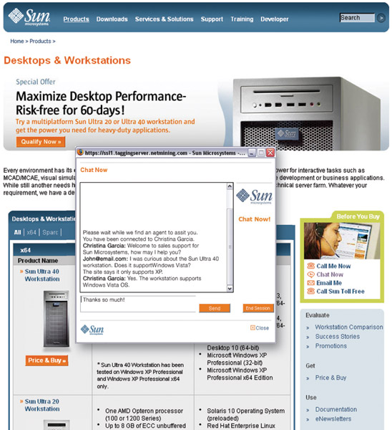
Business Buyer Behavior
E-Procurement
Online purchasing
Company-buying sites
Extranets
Notes:
E-Procurement: Buying on the Internet
Advances in information technology have changed the face of the B-to-B marketing process. Online purchasing, often called e-procurement, has grown rapidly in recent years. Virtually unknown a decade and a half ago, online purchasing is standard procedure for most companies today. E-procurement gives buyers access to new suppliers, lowers purchasing costs, and hastens order processing and delivery. In turn, business marketers can connect with customers online to share marketing information, sell products and services, provide customer support services, and maintain ongoing customer relationships.
Companies can do e-procurement in any of several ways. They can conduct reverse auctions, in which they put their purchasing requests online and invite suppliers to bid for the business. Or they can engage in online trading exchanges, through which companies work collectively to facilitate the trading process. Companies also can conduct e-procurement by setting up their own company buying sites. For example, GE operates a company trading site on which it posts its buying needs and invites bids, negotiates terms, and places orders. Or companies can create extranet links with key suppliers. For instance, they can create direct procurement accounts with suppliers such as Dell or Staples, through which company buyers can purchase equipment, materials, and supplies directly. Staples operates a business-to-business procurement division called Staples Advantage, which serves the office supplies and services buying needs of business of any size, from 20 employees to the Fortune 1000.
B-to-B marketers can help customers online and build stronger customer relationships by creating well-designed, easy-to-use websites. For example, BtoB magazine recently rated the site of Shaw Floors—a market leader in flooring products—as one of its “10 great B-to-B websites.” The site helps Shaw build strong links with its business and trade customers.

Slide 24
Business Buyer Behavior
E-Procurement
Advantages
  Access to new suppliers
  Lowers costs
  Speeds order processing and delivery
  Shares information
  Sales
  Service and support
Disadvantages
  Can erode relationships as buyers search for new suppliers
  Security
Notes:
today’s business-to-business marketers are using a wide range of digital and social marketing approaches—from websites, blogs, and smartphone apps to mainstream social networks such as Facebook, LinkedIn, YouTube, and Twitter to reach business customers and manage customer relationships anywhere, anytime. Digital and social marketing has rapidly become the new space for engaging business customers. Business-to-business e-procurement yields many benefits. First, it shaves transaction costs and results in more efficient purchasing for both buyers and suppliers. E-procurement reduces the time between order and delivery. And a Web-powered purchasing program eliminates the paperwork associated with traditional requisition and ordering procedures and helps an organization keep better track of all purchases. Finally, beyond the cost and time savings, e‑procurement frees purchasing people from a lot of drudgery and paperwork. In turn, it frees them to focus on more-strategic issues, such as finding better supply sources and working with suppliers to reduce costs and develop new products.
The rapidly expanding use of e-procurement, however, also presents some problems. For example, at the same time that the Internet makes it possible for suppliers and customers to share business data and even collaborate on product design, it can also erode decades-old customer-supplier relationships. Many buyers now use the power of the Internet to pit suppliers against one another and search out better deals, products, and turnaround times on a purchase-by-purchase basis.
E-procurement can also create potential security concerns. Although home shopping transactions can be protected through basic encryption, the secure environment that businesses need to carry out confidential interactions is sometimes still lacking. Companies are spending millions for research on defensive strategies to keep hackers at bay. Cisco Systems, for example, specifies the types of routers, firewalls, and security procedures that its partners must use to safeguard extranet connections. In fact, the company goes even further; it sends its own security engineers to examine a partner’s defenses and holds the partner liable for any security breach that originates from its computers.

Slide 25
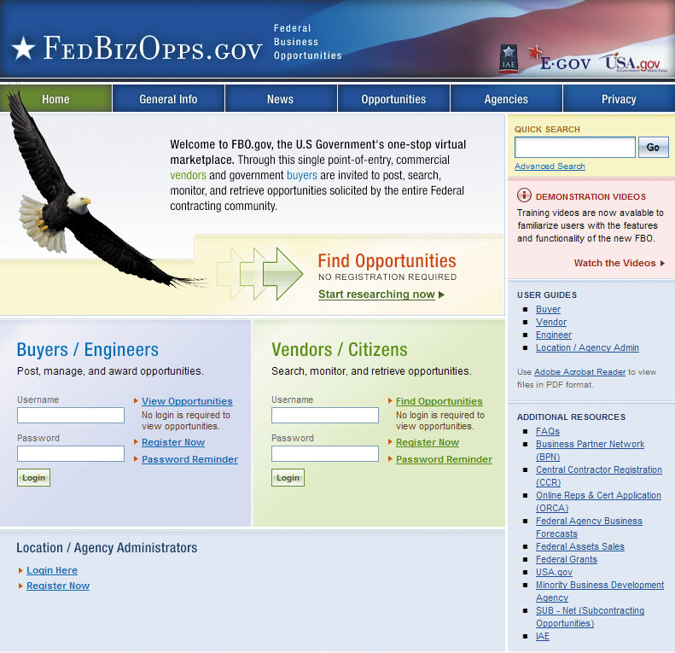
Institutional and Government Markets
Institutional markets consist of hospitals, nursing homes, and prisons that provide goods and services to people in their care
Characteristics
  Low budgets
  “Captive” audience
Notes:
Institutional Markets
The institutional market consists of schools, hospitals, nursing homes, prisons, and other institutions that provide goods and services to people in their care. Institutions differ from one another in their sponsors and their objectives. Institutional markets can be huge.
Many institutional markets are characterized by low budgets and captive patrons. For example, hospital patients have little choice but to eat whatever food the hospital supplies. A hospital purchasing agent has to decide on the quality of food to buy for patients. Because the food is provided as a part of a total service package, the buying objective is not profit. Nor is strict cost minimization the goal—patients receiving poor-quality food will complain to others and damage the hospital’s reputation. Thus, the hospital purchasing agent must search for institutional-food vendors whose quality meets or exceeds a certain minimum standard and whose prices are low.
Many marketers set up separate divisions to meet the special characteristics and needs of institutional buyers. For example, the General Mills Foodservice unit produces, packages, prices, and markets its broad assortment of cereals, cookies, snacks, and other products to better serve the specific food service requirements of hospitals, schools, hotels, and other institutional markets. Similarly, P&G’s Procter & Gamble Professional Division markets professional cleaning and laundry formulations and systems to educational, healthcare, and other institutional and commercial customers.

Slide 26
Institutional and Government Markets
Government markets: tend to favor domestic suppliers and require suppliers to submit bids and normally award to the lowest bidder
Affected by environmental factors
Non-economic factors considered
  Minority suppliers
  Depressed suppliers
  Small businesses
Notes:
Government Markets
The government market offers large opportunities for many companies, both big and small. In most countries, government organizations are major buyers of goods and services. In the United States alone, federal, state, and local governments contain more than 88,000 buying units that purchase more than $1 trillion in goods and services each year. Government buying and business buying are similar in many ways. But there are also differences that must be understood by companies that wish to sell products and services to governments. To succeed in the government market, sellers must locate key decision makers, identify the factors that affect buyer behavior, and understand the buying decision process.
Government organizations typically require suppliers to submit bids, and normally they award the contract to the lowest bidder. In some cases, a governmental unit will make allowances for the supplier’s superior quality or reputation for completing contracts on time. Governments will also buy on a negotiated contract basis, primarily in the case of complex projects involving major R&D costs and risks, and in cases where there is little competition.
Government organizations tend to favor domestic suppliers over foreign suppliers. A major complaint of multinationals operating in Europe is that each country shows favoritism toward its nationals in spite of superior offers that are made by foreign firms. The European Economic Commission is gradually removing this bias.
Like consumer and business buyers, government buyers are affected by environmental, organizational, interpersonal, and individual factors. One unique thing about government buying is that it is carefully watched by outside publics, ranging from Congress to a variety of private groups interested in how the government spends taxpayers’ money. Because their spending decisions are subject to public review, government organizations require considerable paperwork from suppliers, who often complain about excessive paperwork, bureaucracy, regulations, decision-making delays, and frequent shifts in procurement personnel.
Given all the red tape, why would any firm want to do business with the U.S. government? The reasons are quite simple: The U.S. government is the world’s largest buyer of products and services—more than $461 billion worth each year—and its checks don’t bounce. The government buys everything from socks to stealth bombers. For example, this year, the federal government will spend a whopping $80.9 billion on information technology, $20 billion of which is earmarked for transitioning to cloud computing systems.
Most governments provide would-be suppliers with detailed guides describing how to sell to the government. For example, the U.S. Small Business Administration provides on its website detailed advice for small businesses seeking government contracting opportunities (http://www.sba.gov/category/navigation-structure/contracting/contracting-opportunities ). And the U.S. Commerce Department’s website is loaded with information and advice on international trade opportunities (www.commerce.gov/about-commerce/grants-contracting-trade-opportunities).
In several major cities, the General Services Administration operates Business Service Centers with staffs to provide a complete education on the way government agencies buy, the steps that suppliers should follow, and the procurement opportunities available. Various trade magazines and associations provide information on how to reach schools, hospitals, highway departments, and other government agencies. And almost all of these government organizations and associations maintain Internet sites offering up-to-date information and advice.
Still, suppliers have to master the system and find ways to cut through the red tape, especially for large government purchases. Consider Envisage Technologies, a small software development company that specializes in Internet-based training applications and human resource management platforms. All of its contracts fall in the government sector; 65 percent are with the federal government. Envisage uses the General Services Administration’s website to gain access to smaller procurements, often receiving responses within 14 days. However, it puts the most sweat into seeking large, highly coveted contracts. A comprehensive bid proposal for one of these contracts can easily run from 600 to 700 pages because of federal paperwork requirements. And the company’s president estimates that to prepare a single bid proposal, the firm has spent as many as 5,000 man-hours over the course of a few years.
Noneconomic criteria also play a growing role in government buying. Government buyers are asked to favor depressed business firms and areas; small business firms; minority-owned firms; and business firms that avoid race, gender, or age discrimination. Sellers need to keep these factors in mind when seeking government business.
Many companies that sell to the government have not been very marketing oriented for a number of reasons. Total government spending is determined by elected officials rather than by any marketing effort to develop this market. Government buying has emphasized price, making suppliers invest their effort in technology to bring costs down. When the product’s characteristics are specified carefully, product differentiation is not a marketing factor. Nor do advertising or personal selling matter much in winning bids on an open-bid basis.
<ex06.12>
Several companies, however, have established separate government marketing departments, including GE, Boeing, and Goodyear. Other companies sell primarily to government buyers, such as Lockheed Martin, which makes 84 percent of its sales from the U.S. government, either as a prime contractor or a subcontractor. These companies anticipate government needs and projects, participate in the product specification phase, gather competitive intelligence, prepare bids carefully, and produce stronger communications to describe and enhance their companies’ reputations.
Other companies have established customized marketing programs for government buyers. For example, Dell has specific business units tailored to meet the needs of federal as well as state and local government buyers. Dell offers its customers tailor-made Premier Dell.com Web pages that include special pricing, online purchasing, and service and support for each city, state, and federal government entity.
During the past decade, a great deal of the government’s buying has gone online. The Federal Business Opportunities website (FedBizOpps.com at www.fbo.gov) provides a single point of entry through which commercial vendors and government buyers can post, search, monitor, and retrieve opportunities solicited by the entire federal contracting community. The three federal agencies that act as purchasing agents for the rest of government have also launched websites supporting online government purchasing activity. The General Services Administration, which influences more than one-quarter of the federal government’s total procurement dollars, has set up a GSA Advantage! website (www.gsaadvantage.gov). The Defense Logistics Agency offers an Internet Bid Board System (www.dibbs.bsm.dla.mil) for purchases by America’s military services. And the Department of Veterans Affairs facilitates e-procurement through its VA Advantage! website (https://VAadvantage.gsa.gov).
Such sites allow authorized defense and civilian agencies to buy everything from office supplies, food, and information technology equipment to construction services through online purchasing. The General Services Administration, the Defense Logistics Agency, and Department of Veterans Affairs not only sell stocked merchandise through their websites but also create direct links between government buyers and contract suppliers. For example, the branch of the Defense Logistics Agency that sells 160,000 types of medical supplies to military forces transmits orders directly to vendors such as Bristol-Myers Squibb. Such Internet systems promise to eliminate much of the hassle sometimes found in dealing with government purchasing.

Slide 27
Bibliography
Principles of Marketing by Philip Kotler & Gary Armstrong
Fifteenth Edition, Published by Prentice Hall
Marketing Management – A South Asian Perspective
by Philip Kotler, Kevin Lane Keller, Abraham Koshy &
Mithileshwar Jha, 13th Edition, Published by Pearson
Education, Inc.
Principles and Practices of Marketing by Jobber, D. 4th
edition, McGraw Hill International.
Principles of Advertising & IMC by Tom Duncan 2nd
Edition, Published by McGraw-Hill Irwin.

Slide 28


The End
"Don't be afraid of the space between your dreams and reality.
If you can dream it, you can make it so."
Belva Davis

