Slide 1
Fundamentals Of Marketing
(MGT-210)
Mr. Abid Saeed
(Assistant Professor)

Slide 2
Course Objectives
Students understand the basic concepts,
theories, processes and terminology of
contemporary marketing.
Analyze marketing problems and suggest
workable solutions.
Understand the effects of the marketing
concept on consumers and society.
Develop a consciousness about the
importance of ethics in the marketing discipline.

Slide 3
Learning Outcomes
Understand the importance of marketing in
business practices.
Understand the various marketing mix tools:
product, pricing, promotion, and distribution.
Recommend and justify an appropriate mix of
such strategies to form a cohesive overall
strategy for a given marketing task or situation.

Slide 4
Recommended Books
Principles of Marketing by Philip Kotler & Gary Armstrong
Fifteenth Edition, Published by Prentice Hall
Marketing Management – A South Asian Perspective
by Philip Kotler, Kevin Lane Keller, Abraham Koshy &
Mithileshwar Jha, 13th Edition, Published by Pearson
Education, Inc.
Principles and Practices of Marketing by Jobber, D. 4th
edition, McGraw Hill International.
Principles of Advertising & IMC by Tom Duncan 2nd
Edition, Published by McGraw-Hill Irwin.

Slide 5
Teaching Methodology
My basic teaching philosophy for this course is to blend the theory and practice of Marketing in a comfortable, supportive & easy language that promotes active learning.

Slide 6
Assessment Criteria
ITEM | ASSESSMENT TASK | TOTAL MARKS
1 | Assignments (4) | 10%
2 | Quizzes (4) | 10%
3 | Graded Discussion Topics (4) | 05%
4 | 1st Sessional | 10%
5 | 2nd Sessional | 15%
6 | Final Examination | 50%
Your assessment & final grades will be based as per University existing rules.

Slide 7
Course Outline
Marketing: Creating and Capturing Customer Value.
Company and Marketing Strategy: Partnering to Build
Customer Relationships.
Analyzing the Marketing Environment.
Managing Marketing Information to Gain Customer
Insights.
Consumer Markets and Consumer Buyer Behavior.
Business Markets and Business Buying Behavior.
Customer-Driven Marketing Strategy: Creating Value for
Target Customers.
Product, Services, and Brands: Building Customer Value.
New-Product Development and Product Life-Cycle
Strategies.
Understanding and Capturing Customer Value.

Slide 8
Course Outline...
Pricing Strategies.
Marketing Channels: Delivering Customer Value.
Retailing and Wholesaling.
Communicating Customer Value: Integrated Marketing
Communications Strategy.
Advertising and Public Relations.
Personal Selling and Sales Promotion.
Direct and Online Marketing: Building Direct Customer
Relationships.
Creating Competitive Advantage.
The Global Marketplace.
Sustainable Marketing Social Responsibility and Ethics.

Slide 9
Marketing:
Creating and Capturing Customer Value
LECTURE-1

Slide 10
Topic Outline
What Is Marketing?
Marketing process
Understanding the Marketplace and Customer Needs
Notes:
Objective 1 Define marketing and outline the steps in the marketing process.
What Is Marketing?
Objective 2 Explain the importance of understanding customers and the marketplace and identify the five core marketplace concepts.
Understanding the Marketplace and Customer Needs
Objective 3 Identify the key elements of a customer-driven marketing strategy and discuss the marketing management orientations that guide marketing strategy.
Designing a Customer-Driven Marketing Strategy
Preparing an Integrated Marketing Plan and Program 000–000
Objective 4 Discuss customer relationship management and identify strategies for creating value for customers and capturing value from customers in return.
Building Customer Relationships
Capturing Value from Customers
Objective 5 Describe the major trends and forces that are changing the marketing landscape in this age of relationships.
The Changing Marketing Landscape

Slide 11
What Is Marketing?
Marketing is a process by which companies create value for customers
and build strong customer relationships
to capture value from customers in return.
Notes:
Note to Instructor:
Discussion Question
Ask students for examples of either national or local companies that are excellent at marketing and ask how they reflect the definition given in this slide.
The twofold goal of marketing is
to attract new customers by promising superior value and
to keep and grow current customers by delivering satisfaction.
Sound marketing is critical to the success of every organization.
Large for-profit firms
not-for-profit organizations, such as colleges, hospitals, museums, symphony orchestras, and even churches.
Marketing—it’s all around you.
abundance of products at your nearby shopping mall
ads that fill your TV screen, spice up your magazines, or stuff your mailbox.
websites
smartphone apps
online social networks and blogs.
These new approaches do more than just blast out messages to the masses. They reach you directly and personally. Today’s marketers want to become a part of your life and enrich your experiences with their brands—to help you live their brands.

Slide 12
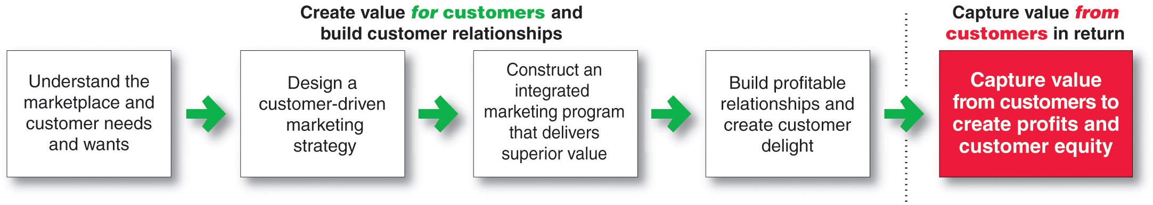
Marketing Process
Notes:
This important figure shows the simple, five-step model of the marketing process. By creating value for customers, marketers capture value from customers in return.
This five-step process forms the marketing framework for the rest of the chapter and the remainder of the book.
In the first four steps, companies work to understand consumers, create customer value, and build strong customer relationships.
In the final step, companies reap the rewards of creating superior customer value. By creating value for consumers, they in turn capture value from consumers in the form of sales, profits, and long-term customer equity.
In this chapter, we review each step but focus more on the customer relationship steps—understanding customers, building customer relationships, and capturing value from customers..
Marketing is all about creating value for customers. So, as the first step in the marketing process, the company must fully understand consumers and the marketplace in which it operates.

Slide 13
Understanding the Marketplace and Customer Needs
Customer Needs, Wants, and Demands
Needs
Physical—food, clothing, warmth, safety
Social—belonging and affection
Individual—knowledge and self-expression
Wants
Demands
Form that needs take as they are shaped by culture and individual personality
Wants backed by buying power
States of deprivation
Notes:
Discussion Question:
Ask the students to
1) give an example of a product (good or service) they purchased recently
2) Tell how did that product satisfy a need, want or desire.
Marketing must be understood in the new sense of satisfying customer needs.
Human needs are states of felt deprivation. They include basic physical needs for food, clothing, warmth, and safety; social needs for belonging and affection; and individual needs for knowledge and self-expression.
Marketers did not create these needs; they are a basic part of the human makeup.
Wants are the form human needs take as they are shaped by culture and individual personality. An American needs food but wants a Big Mac, french fries, and a soft drink. A person in Papua, New Guinea, needs food but wants taro, rice, yams, and pork. Wants are shaped by one’s society and are described in terms of objects that will satisfy those needs. When backed by buying power, wants become demands. Given their wants and resources, people demand products with benefits that add up to the most value and satisfaction.
Outstanding marketing companies go to great lengths to learn about and understand their customers’ needs, wants, and demands. They conduct consumer research and analyze mountains of customer data.

Slide 14

Understanding the Marketplace and Customer Needs
Market offerings are some combination of products, services, information, or experiences offered to a market to satisfy a need or want
Marketing myopia is focusing only on existing wants and losing sight of underlying consumer needs
Notes:
Consumers’ needs and wants are fulfilled through market offerings
physical products
services—activities or benefits offered for sale that are essentially intangible and do not result in the ownership of anything.
persons, places, organizations, information, and ideas
Many sellers make the mistake of paying more attention to the specific products they offer than to the benefits and experiences produced by these products. These sellers suffer from marketing myopia. They forget that a product is only a tool to solve a consumer problem. A manufacturer of quarter-inch drill bits may think that the customer needs a drill bit. But what the customer really needs is a quarter-inch hole. These sellers will have trouble if a new product comes along that serves the customer’s need better or less expensively. The customer will have the same need but will want the new product.
Smart marketers look beyond the attributes of the products and services they sell. By orchestrating several services and products, they create brand experiences for consumers.

Slide 15
Understanding the Marketplace and Customer Needs
Customer Value and Satisfaction
Expectations
Customers
Value and satisfaction
Marketers
Set the right level of expectations
Not too high or low
Notes:
Note to Instructor:
Discussion Question
Ask students what online retailers deliver exceptional value and satisfaction.
Why do marketer’s not always understand customer needs? How can they better identify customer needs?
Marketer’s often work in a vacuum and do not consider the customer’s needs as much as they should. Future chapters will talk about market research and marketing information, important tools for understanding customer’s needs. Students might be familiar with survey research or focus groups as techniques for gathering information or they might be asked for their zip code when they purchase in certain retailers
Marketers must be careful to set the right level of expectations. If they set expectations too low, they may satisfy those who buy but fail to attract enough buyers. If they set expectations too high, buyers will be disappointed. Customer value and customer satisfaction are key building blocks for developing and managing customer relationships.

Slide 16
Understanding the Marketplace and Customer Needs
Exchange the act of obtaining a desired object from someone by offering something in return
Marketing actions try to create, maintain, grow exchange relationships.
Notes:
Note to Instructor:
Marketing consists of actions taken to build and maintain desirable exchange relationships with target audiences involving a product, service, idea, or other object.
Beyond simply attracting new customers and creating transactions, the goal is to retain customers and grow their business with the company.
The marketer tries to bring about a response to some market offering.
Marketing consists of actions taken to create, maintain, and grow desirable exchange relationships with target audiences involving a product, service, idea, or other object. Companies want to build strong relationships by consistently delivering superior customer value.

Slide 17
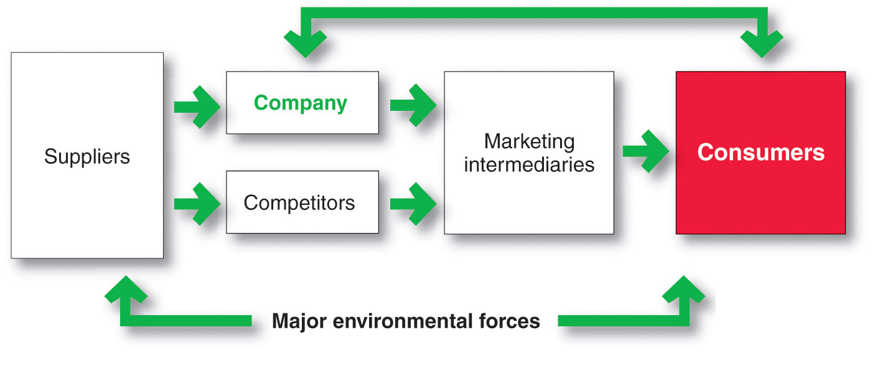
Understanding the Marketplace and Customer Needs
Markets are the set of actual and potential buyers of a product
Notes:
A market is the set of actual and potential buyers of a product or service. These buyers share a particular need or want that can be satisfied through exchange relationships.
Sellers must search for buyers, identify their needs, design good market offerings, set prices for them, promote them, and store and deliver them. Activities such as consumer research, product development, communication, distribution, pricing, and service are core marketing activities.
Consumers market when they search for products, interact with companies to obtain information, and make their purchases. In fact, today’s digital technologies, from websites and online social networks to smartphones, have empowered consumers and made marketing a truly interactive affair. Thus, in addition to customer relationship management, today’s marketers must also deal effectively with customer-managed relationships. Marketers are no longer asking only “How can we reach our customers?” but also “How should our customers reach us?” and even “How can our customers reach each other?”
Figure 1.2 shows the main elements in a marketing system. Marketing involves serving a market of final consumers in the face of competitors. The company and competitors research the market and interact with consumers to understand their needs. Then they create and send their market offerings and messages to consumers, either directly or through marketing intermediaries. Each party in the system is affected by major environmental forces (demographic, economic, natural, technological, political, and social/cultural).
Each party in the system adds value for the next level. The arrows represent relationships that must be developed and managed. Thus, a company’s success at building profitable relationships depends not only on its own actions but also on how well the entire system serves the needs of final consumers.
.

Slide 18
Bibliography
Principles of Marketing by Philip Kotler & Gary Armstrong
Fifteenth Edition, Published by Prentice Hall
Marketing Management – A South Asian Perspective
by Philip Kotler, Kevin Lane Keller, Abraham Koshy &
Mithileshwar Jha, 13th Edition, Published by Pearson
Education, Inc.
Principles and Practices of Marketing by Jobber, D. 4th
edition, McGraw Hill International.
Principles of Advertising & IMC by Tom Duncan 2nd
Edition, Published by McGraw-Hill Irwin.

Slide 19


The End
"Unless you try to do something beyond what you have already mastered, you will never grow."
Ronald E. Osborn

