Slide 1
Introduction to Management
LECTURE 9:
Introduction to Management
MGT 101

Slide 2
Introduction to Management
In lecture 8 we discussed
Topics from Chapter 4:
  The Global Marketplace
  Regional Trade Blocks
  World Trade Organization

Slide 3
Introduction to Management
Today in Chapter 4 we will discuss
  Type of International Organizations.
  How Organizations go Global?
  Global Environment & Issues
  Hofstede’s Cultural dimensions
  Challenges & Risks

Slide 4
Introduction to Management (Chapter 4)
Chapter 4:
Managing in a Global Environment

Slide 5
Introduction to Management (Chapter 4)
Types of International Organizations

Slide 6
Introduction to Management (Chapter 4)
Multinational Corporation (MNC)
  Maintains operations in multiple countries.

Slide 7
Introduction to Management (Chapter 4)
Multidomestic Corporation
  Is an MNC that decentralizes management and other decisions to the local country.

Slide 8
Introduction to Management (Chapter 4)
Global Company
  Is an MNC that centralizes its management and other decisions in the home country.

Slide 9
Introduction to Management (Chapter 4)
Transnational Corporation (Borderless Organization)
  Is an MNC that has eliminated structural divisions that impose artificial geographic barriers and is organized along business lines that reflect a geocentric attitude.

Slide 10
Introduction to Management (Chapter 4)
International New Ventures (INVs)
  Commit resources upfront (material, people, financing) to doing business in more than one country.

Slide 11
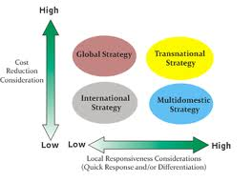

Slide 12
Introduction to Management (Chapter 4)
How Organizations Go Global ?

Slide 13
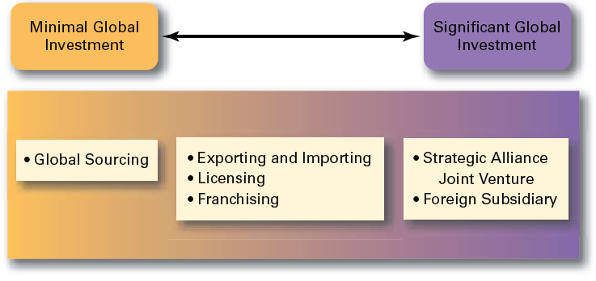
Introduction to Management (Chapter 4)

Slide 14
Introduction to Management (Chapter 4)
Strategic Alliances
  Partnerships between and organization and a foreign company in which both share resources and knowledge in developing new products or building new production facilities.

Slide 15
Introduction to Management (Chapter 4)
Joint Venture
  A specific type of strategic alliance in which the partners agree to form a separate, independent organization for some business purpose.

Slide 16
Introduction to Management (Chapter 4)
Foreign Subsidiary
  Directly investing in a foreign country by setting up a separate and independent production facility or office.

Slide 17
Introduction to Management (Chapter 4)
Global Environment & Issues

Slide 18
Introduction to Management (Chapter 4)
The Legal Environment
  Stability or instability of legal and political systems
    Legal procedures are established and followed
    Fair and honest elections held on a regular basis

Slide 19
Introduction to Management (Chapter 4)
The Legal Environment
  Differences in the laws of various nations
    Effects on business activities
    Effects on delivery of products and services

Slide 20
Introduction to Management (Chapter 4)
The Economic Environment
Economic Systems
  Market economy
    An economy in which resources are primarily owned and controlled by the private sector.
  Command economy
    An economy in which all economic decisions are planned by a central government.

Slide 21
Introduction to Management (Chapter 4)
The Economic Environment
Monetary and Financial Factors
  Currency exchange rates
  Inflation rates
  Diverse tax policies

Slide 22
Introduction to Management (Chapter 4)
The Cultural Environment
National Culture
  Is the values and attitudes shared by individuals from a specific country that shape their behavior and their beliefs about what is important.
  May have more influence on an organization than the organization culture.

Slide 23
Introduction to Management (Chapter 4)
Hofstede’s Framework for Assessing Cultures

Slide 24
Introduction to Management (Chapter 4)
Individualism
versus
Collectivism
Long-Term
versus
Short-Term Orientation
Power
Distance
Culture
Achievement versus Nurturing
Uncertainty
Avoidance

Slide 25
Introduction to Management (Chapter 4)
INDIVIDUALISM versus COLLECTIVISM
The degree to which individuals base their actions on self-interest versus the interests of the group.

Slide 26
Introduction to Management (Chapter 4)
INDIVIDUALISM versus COLLECTIVISM
In an individual culture, free will is highly valued. In a collective culture, personal needs are less important than the group's needs.

Slide 27
Introduction to Management (Chapter 4)
INDIVIDUALISM versus COLLECTIVISM
This dimension influences the role government is expected to play in markets.

Slide 28
Introduction to Management (Chapter 4)
POWER DISTANCE
The extent to which power is distributed equally within a society and the degree that society accepts this distribution.

Slide 29
Introduction to Management (Chapter 4)
POWER DISTANCE
A high power distance culture prefers hierarchical bureaucracies, strong leaders and a high regard for authority.

Slide 30
Introduction to Management (Chapter 4)
POWER DISTANCE
A low power distance culture tends to favour personal responsibility and autonomy.

Slide 31
Introduction to Management (Chapter 4)
UNCERTAINTY AVOIDANCE
The degree to which individuals require set boundaries and clear structures:
a high uncertainty culture allows individuals to cope better with risk and innovation;
a low uncertainty culture emphasizes a higher level of standardization and greater job security.

Slide 32
Introduction to Management (Chapter 4)
MASCULINITY versus FEMININITY
A measure of a society's goal orientation:
a masculine culture emphasizes status derived from wages and position;
a feminine culture emphasizes human relations and quality of life.

Slide 33
Introduction to Management (Chapter 4)
TIME ORIENTATION
The degree to which a society does or does not value long-term commitments and respect for tradition.
Long-term traditions and commitments hamper institutional change.

Slide 34
Introduction to Management (Chapter 4)
Challenges & Risks

Slide 35
Introduction to Management (Chapter 4)
Challenges
  Openness associated with globalization
  Significant cultural differences (e.g., Americanization)
  Adjusting leadership styles and management approaches

Slide 36
Introduction to Management (Chapter 4)
Risks
  Loss of investments in unstable countries
  Increased terrorism
  Economic interdependence

