Slide 1
Introduction to Management
LECTURE 7:
Introduction to Management
MGT 101

Slide 2
Introduction to Management
In lecture 6 we discussed
Topics from Chapter 3:
  Omnipotent view of management
  Symbolic view of management
  The organizational culture
  How employees learn culture ?

Slide 3
Introduction to Management (Chapter 3)
Today in Chapter 3 we will discuss
  Internal vs. External Environment
  Characteristics of External Environment
  General Environment
  Specific Environment
  Internal Environment

Slide 4
Introduction to Management (Chapter 3)
Chapter 3:
Organizational Culture
&
Environment

Slide 5
Introduction to Management (Chapter 3)
Internal Vs. External Environment

Slide 6
Introduction to Management (Chapter 3)
Internal Environment
Consists of the trends and events within an organization that affect the management, employees, and organizational culture
  important because it affects what people think, feel, and do at work
  organizational culture is the set of key values, beliefs, and attitudes shared by organizational members

Slide 7
Introduction to Management (Chapter 3)
External Environment
  Those factors and forces outside the organization that affect the organization’s performance.

Slide 8
Introduction to Management (Chapter 3)
Characteristics of External Environment

Slide 9
Introduction to Management (Chapter 3)
Components of the External Environment
  Specific environment: external forces that have a direct and immediate impact on the organization.
  General environment: broad economic, socio-cultural, political/legal, demographic, technological, and global conditions that may affect the organization.

Slide 10
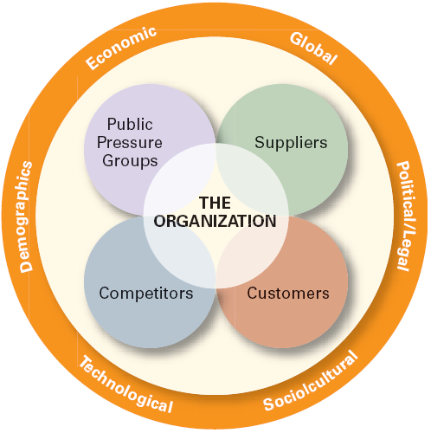
Introduction to Management (Chapter 3)

Slide 11
Introduction to Management (Chapter 3)
Characteristics of
Changing External Environments
Environmental Change
Environmental Complexity
Resource Scarcity
Uncertainty

Slide 12
Introduction to Management (Chapter 3)
Environmental Change is the rate at which a company’s environments change
  stable environments
  dynamic environments

Slide 13
Introduction to Management (Chapter 3)
Punctuated equilibrium theory
Companies cycle through long, stable periods and shorter, dynamic environments.

Slide 14
Introduction to Management (Chapter 3)
Environmental Complexity:
the number of external factors in the environment that affect organizations

Slide 15
Introduction to Management (Chapter 3)
Resource Scarcity
The degree to which an organization’s external environment has an abundance or scarcity of critical organizational resources

Slide 16
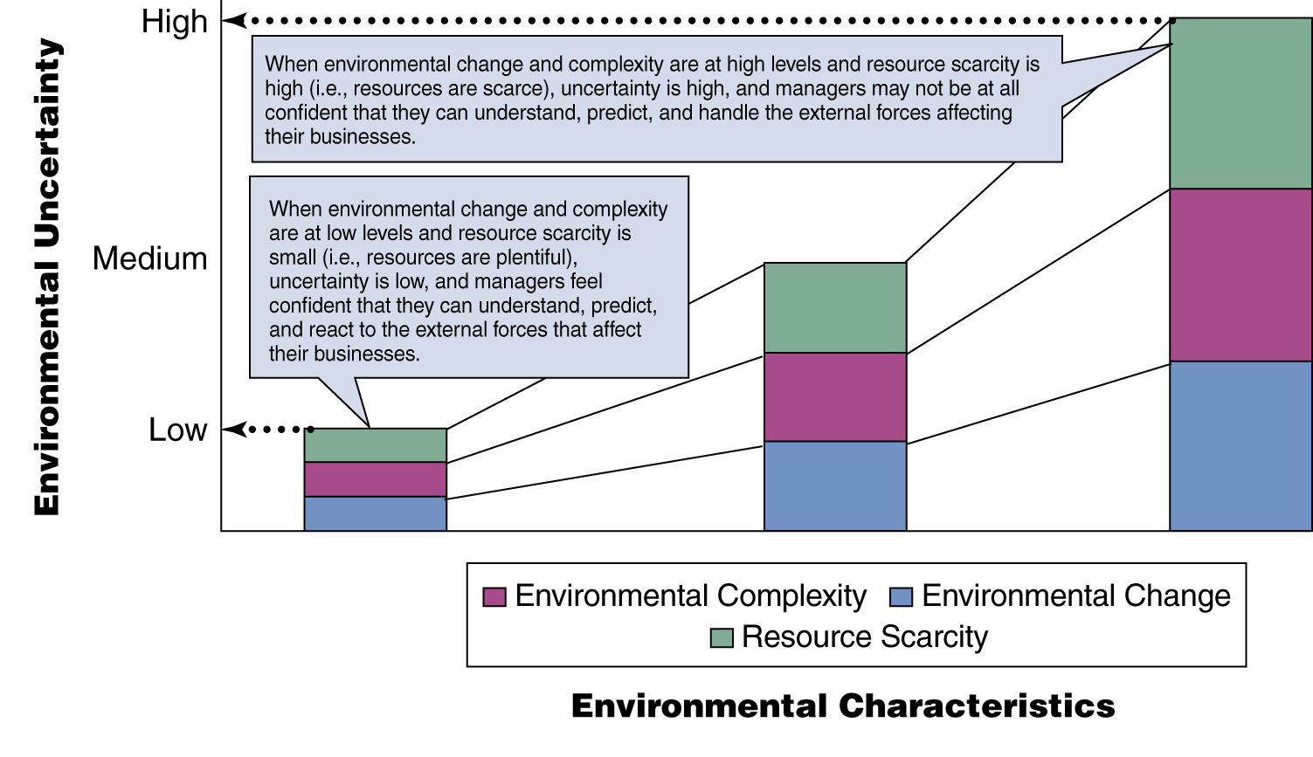
Introduction to Management (Chapter 3)

Slide 17
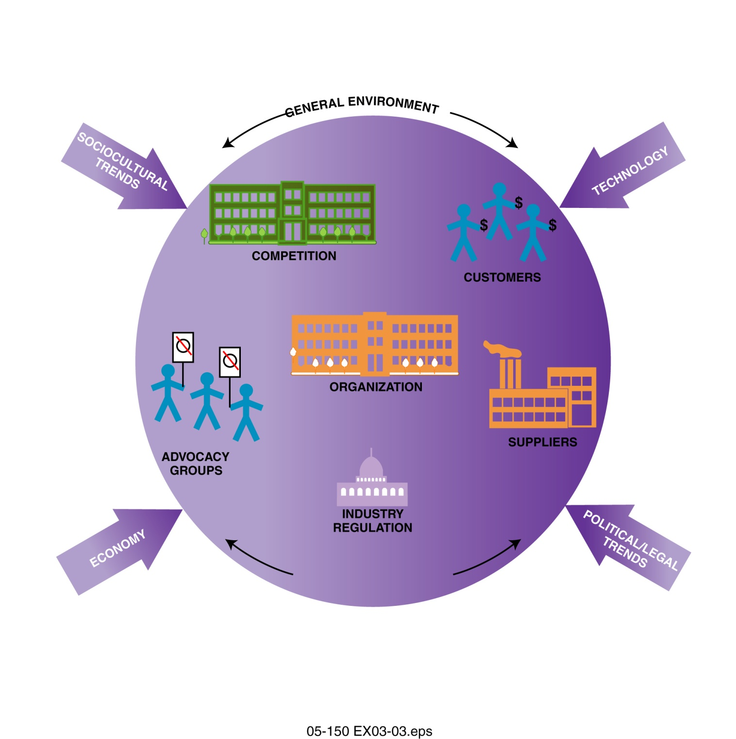
Introduction to Management (Chapter 3)

Slide 18
Introduction to Management (Chapter 3)
General Environment

Slide 19
Introduction to Management (Chapter 3)
Components of general environment:
Economy
Technological trends
Socio-cultural trends
Political / Legal trends

Slide 20
Introduction to Management (Chapter 3)
Economy:
Growing vs. shrinking economies
Predicting future economic activity
Business confidence indices

Slide 21
Introduction to Management (Chapter 3)
Technology--
Knowledge
Tools
Techniques
Input
Output
Raw
Materials
Products
Information
Services

Slide 22
Introduction to Management (Chapter 3)
Socio-cultural Components
  Demographic changes
  Changes in behavior, attitudes, and beliefs

Slide 23
Introduction to Management (Chapter 3)
Factors Influencing the Strength of Culture
  Size of the organization
  Age of the organization
  Rate of employee turnover
  Strength of the original culture
  Clarity of cultural values and beliefs

Slide 24
Introduction to Management (Chapter 3)
Political & Legal Environment
Legislation
Regulations
Court decisions

Slide 25
Introduction to Management (Chapter 3)
Specific Environment

Slide 26
Introduction to Management (Chapter 3)
Customer
Competitor
Supplier
Industry Regulation
Advocacy Group

Slide 27
Introduction to Management (Chapter 3)
Customer
Monitoring customer wants and needs is critical for business success
Reactive customer monitoring
  responding to problems, trends, and events
Proactive customer monitoring
  anticipating problems, trends, and events

Slide 28
Introduction to Management (Chapter 3)
Competitor
Competitive Analysis
Deciding who your competitors are
Anticipating competitors’ moves
Determining competitors’ strengths and weaknesses

Slide 29
Introduction to Management (Chapter 3)
Supplier
Suppliers
Buyer
Dependence
Supplier
Dependence
Behavior (Opportunity)
Behavior (Relationship)

Slide 30
Introduction to Management (Chapter 3)
Industry Regulations
Consists of regulations and rules that govern the business practices and procedures of specific industries, businesses, and professions

Slide 31
Introduction to Management (Chapter 3)
Advocacy Groups
Groups of concerned citizens who band together to try to influence the business practices of specific industries, businesses, and professions
Techniques to try to influence companies
  public communications
  media advocacy
  product boycotts

