Slide 1
Introduction to Management
LECTURE 6:
Introduction to Management
MGT 101

Slide 2
Introduction to Management
In lecture 5 we discussed
Topics from Chapter 2:
  Systems Approach
  Contingency Approach
  Current Trends & Issues

Slide 3
Introduction to Management (Chapter 3)
Today in Chapter 3 we will discuss
  Omnipotent view of management
  Symbolic view of management
  The organizational culture
  How employees learn culture ?

Slide 4
Introduction to Management (Chapter 3)
Chapter 3:
Organizational Culture
&
Environment

Slide 5
Introduction to Management (Chapter 3)
Omnipotent View
of
Management

Slide 6
Introduction to Management (Chapter 3)
Managers are directly responsible for an organization’s success or failure.
The quality of the organization is determined by the quality of its managers.

Slide 7
Introduction to Management (Chapter 3)
Managers are held accountable for an organization’s performance, yet it is difficult to attribute good or poor performance directly to their influence on the organization.

Slide 8
Introduction to Management (Chapter 3)
Symbolic View
of
Management

Slide 9
Introduction to Management (Chapter 3)
Much of an organization’s success or failure is due to external forces outside of managers’ control.
The ability of managers to affect outcomes is influenced and constrained by external factors.
  The economy, customers, governmental policies, competitors, industry conditions, technology, and the actions of previous managers

Slide 10
Introduction to Management (Chapter 3)
The Organizational Culture

Slide 11
Introduction to Management (Chapter 3)
A system of shared meanings and common beliefs held by organizational members that determines, in a large degree, how they act towards each other.
“The way we do things around here.”
  Values, symbols, rituals, myths, and practices

Slide 12
Introduction to Management (Chapter 3)
Sources of Organizational Culture
  The organization’s founder
    Vision and mission
  Past practices of the organization
    The way things have been done
  The behavior of top management

Slide 13
Introduction to Management (Chapter 3)
Continuation of the Organizational Culture
  Recruitment of like-minded employees who “fit”
  Socialization of new employees to help them adapt to the culture

Slide 14
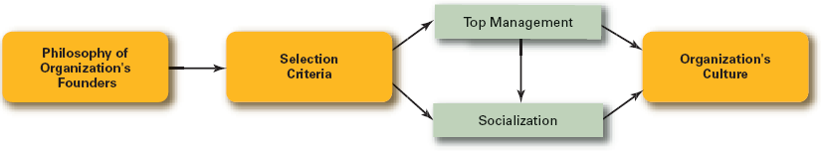
Introduction to Management (Chapter 3)
How Organizational Culture is Maintained ?

Slide 15
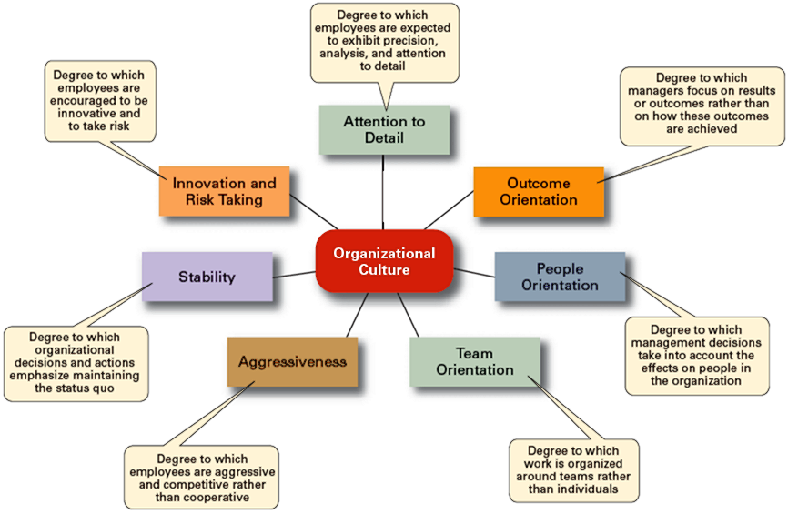
Introduction to Management (Chapter 3)

Slide 16
Introduction to Management (Chapter 3)
Strong Culture

Slide 17
Introduction to Management (Chapter 3)
Are cultures in which key values are deeply and widely held.
Have a strong influence on organizational members.

Slide 18
Introduction to Management (Chapter 3)
Factors Influencing the Strength of Culture
  Size of the organization
  Age of the organization
  Rate of employee turnover
  Strength of the original culture
  Clarity of cultural values and beliefs

Slide 19
Introduction to Management (Chapter 3)
How Employees Learn Culture ?

Slide 20
Introduction to Management (Chapter 3)
Stories
  Narratives of significant events or actions of people that convey the spirit of the organization
Rituals
  Repetitive sequences of activities that express and reinforce the values of the organization

Slide 21
Introduction to Management (Chapter 3)
Material Symbols
  Physical assets distinguishing the organization
Language
  Acronyms and jargon of terms, phrases, and word meanings specific to an organization

Slide 22
Introduction to Management (Chapter 3)
Adaptability
Consistency
Involvement
Clear Vision
Sales
Growth
Employee
Satisfaction
Profits
Return on
Assets
Quality

