Slide 1
Introduction to Management
LECTURE 5:
Introduction to Management
MGT 101

Slide 2
Introduction to Management
In lecture 4 we discussed
Topics from Chapter 2:
  General Administrative Theories
  Quantitative Approach
  Organizational Behavior

Slide 3
Introduction to Management
Today we are going to discuss
Topics from Chapter 2:
  Systems Approach
  Contingency Approach
  Current Trends & Issues
And then we will start Chapter 3

Slide 4
Introduction to Management (Chapter 2)
Systems Approach

Slide 5
Introduction to Management (Chapter 2)
System
  A set of interrelated and interdependent parts arranged in a manner that produces a unified whole.

Slide 6
Introduction to Management (Chapter 2)
Basic Types of Systems
  Closed systems
    Are not influenced by and do not interact with their environment (all system input and output is internal).
  Open systems
    Dynamically interact to their environments by taking in inputs and transforming them into outputs that are distributed into their environments.

Slide 7
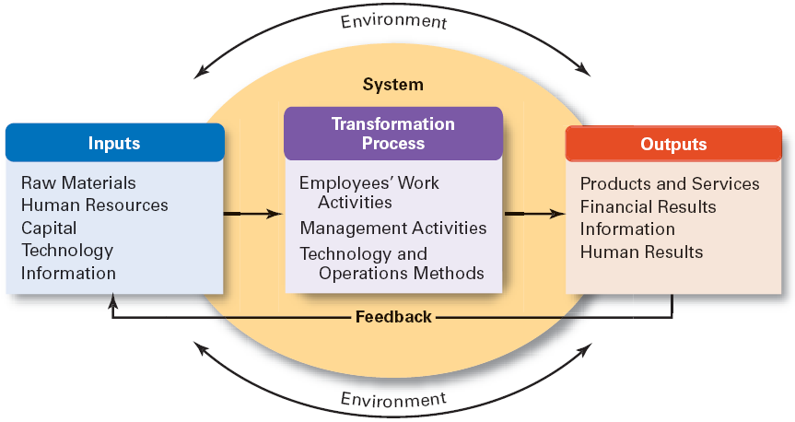
Introduction to Management (Chapter 2)

Slide 8
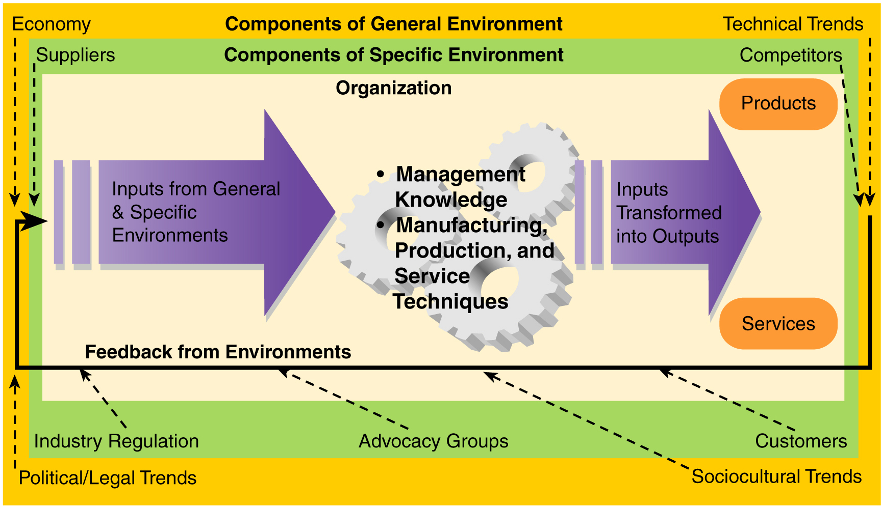
Introduction to Management (Chapter 2)

Slide 9
Introduction to Management (Chapter 2)
Implications:
Coordination of the organization’s parts is essential for proper functioning of the entire organization.
Decisions and actions taken in one area of the organization will have an effect in other areas of the organization.
Organizations are not self-contained and, therefore, must adapt to changes in their external environment.

Slide 10
Introduction to Management (Chapter 2)
Chapter 2:
Management History

Slide 11
Introduction to Management (Chapter 2)
Contingency Approach

Slide 12
Introduction to Management (Chapter 2)
Also sometimes called the situational approach.
There is no one universally applicable set of management principles (rules) by which to manage organizations.
Organizations are individually different, face different situations (contingency variables), and require different ways of managing.

Slide 13
Introduction to Management (Chapter 2)
Management is harder than it looks
Managers need to look for key contingencies that differentiate today’s situation from yesterday’s situation
Managers need to spend more time analyzing problems before taking action
Pay attention to qualifying phrases, such as “usually”

Slide 14
Introduction to Management (Chapter 2)
Key Contingency Variables:
Organization size
Routineness of task technology
Environmental uncertainty
Individual differences

Slide 15
Introduction to Management (Chapter 2)
Current Trends & Issues

Slide 16
Introduction to Management (Chapter 2)
Globalization
Ethics
Workforce Diversity
Entrepreneurship
E-Business
Knowledge Management
Learning Organizations
Quality Management

Slide 17
Introduction to Management (Chapter 2)
Globalization
  Management in international organizations
  Political and cultural challenges of operating in a global market
    Working with people from different cultures
    Movement of jobs to countries with low-cost labor

Slide 18
Introduction to Management (Chapter 2)
Ethics
  Increased emphasis on ethics education in college curriculums
  Increased creation and use of codes of ethics by businesses

Slide 19
Introduction to Management (Chapter 2)
Workforce Diversity
  Increasing heterogeneity in the workforce
    More gender, minority, ethnic, and other forms of diversity in employees
  Aging workforce
    Older employees who work longer and do not retire

Slide 20
Introduction to Management (Chapter 2)
Entrepreneurship Defined
The process of starting new businesses, generally in response to opportunities.
Entrepreneurship process
  Pursuit of opportunities
  Innovation in products, services, or business methods
  Desire for continual growth of the organization

Slide 21
Introduction to Management (Chapter 2)
Learning Organization
  An organization that has developed the capacity to continuously learn, adapt, and change.

Slide 22
Introduction to Management (Chapter 2)
Knowledge Management
  The cultivation of a learning culture where organizational members systematically gather and share knowledge with others in order to achieve better performance.

Slide 23
Introduction to Management (Chapter 2)
Quality Management
  A philosophy of management driven by continual improvement in the quality of work processes and responding to customer needs and expectations
  Quality is not directly related to cost
  Poor quality results in lower productivity

