Slide 1
Introduction to Management
LECTURE 4:
Introduction to Management
MGT 101

Slide 2
Introduction to Management
In lecture 3 we discussed
Topics from Chapter 2:
  Scientific Management.
  General Administrative Theories
  Quantitative Approach
  Organizational Behavior
  Systems Approach

Slide 3
Introduction to Management
Today we are going to discuss
Topics from Chapter 2:
  Contingency Approach
  Current Trends & Issues
And then we will start Chapter 3

Slide 4
Introduction to Management (Chapter 2)
Chapter 2:
Management History

Slide 5
Introduction to Management (Chapter 2)
Contingency Approach

Slide 6
Introduction to Management (Chapter 2)
Also sometimes called the situational approach.
There is no one universally applicable set of management principles (rules) by which to manage organizations.
Organizations are individually different, face different situations (contingency variables), and require different ways of managing.

Slide 7
Introduction to Management (Chapter 2)
Management is harder than it looks
Managers need to look for key contingencies that differentiate today’s situation from yesterday’s situation
Managers need to spend more time analyzing problems before taking action
Pay attention to qualifying phrases, such as “usually”

Slide 8
Introduction to Management (Chapter 2)
Key Contingency Variables:
Organization size
Routineness of task technology
Environmental uncertainty
Individual differences

Slide 9
Introduction to Management (Chapter 2)
Current Trends & Issues

Slide 10
Introduction to Management (Chapter 2)
Globalization
Ethics
Workforce Diversity
Entrepreneurship
E-Business
Knowledge Management
Learning Organizations
Quality Management

Slide 11
Introduction to Management (Chapter 2)
Globalization
  Management in international organizations
  Political and cultural challenges of operating in a global market
    Working with people from different cultures
    Movement of jobs to countries with low-cost labor

Slide 12
Introduction to Management (Chapter 2)
Ethics
  Increased emphasis on ethics education in college curriculums
  Increased creation and use of codes of ethics by businesses

Slide 13
Introduction to Management (Chapter 2)
Workforce Diversity
  Increasing heterogeneity in the workforce
    More gender, minority, ethnic, and other forms of diversity in employees
  Aging workforce
    Older employees who work longer and do not retire

Slide 14
Introduction to Management (Chapter 2)
Entrepreneurship Defined
The process of starting new businesses, generally in response to opportunities.
Entrepreneurship process
  Pursuit of opportunities
  Innovation in products, services, or business methods
  Desire for continual growth of the organization

Slide 15
Introduction to Management (Chapter 2)
Learning Organization
  An organization that has developed the capacity to continuously learn, adapt, and change.

Slide 16
Introduction to Management (Chapter 2)
Knowledge Management
  The cultivation of a learning culture where organizational members systematically gather and share knowledge with others in order to achieve better performance.

Slide 17
Introduction to Management (Chapter 2)
Quality Management
  A philosophy of management driven by continual improvement in the quality of work processes and responding to customer needs and expectations
  Quality is not directly related to cost
  Poor quality results in lower productivity

Slide 18
Introduction to Management (Chapter 3)
Chapter 3:
Organizational Culture
&
Environment

Slide 19
Introduction to Management (Chapter 3)
Today in this Chapter we will discuss
  Omnipotent view of management
  Symbolic view of management
  The organizational culture
  How employees learn culture ?

Slide 20
Introduction to Management (Chapter 3)
Omnipotent View
of
Management

Slide 21
Introduction to Management (Chapter 3)
Managers are directly responsible for an organization’s success or failure.
The quality of the organization is determined by the quality of its managers.

Slide 22
Introduction to Management (Chapter 3)
Managers are held accountable for an organization’s performance, yet it is difficult to attribute good or poor performance directly to their influence on the organization.

Slide 23
Introduction to Management (Chapter 3)
Symbolic View
of
Management

Slide 24
Introduction to Management (Chapter 3)
Much of an organization’s success or failure is due to external forces outside of managers’ control.
The ability of managers to affect outcomes is influenced and constrained by external factors.
  The economy, customers, governmental policies, competitors, industry conditions, technology, and the actions of previous managers

Slide 25
Introduction to Management (Chapter 3)
The Organizational Culture

Slide 26
Introduction to Management (Chapter 3)
A system of shared meanings and common beliefs held by organizational members that determines, in a large degree, how they act towards each other.
“The way we do things around here.”
  Values, symbols, rituals, myths, and practices

Slide 27
Introduction to Management (Chapter 3)
Sources of Organizational Culture
  The organization’s founder
    Vision and mission
  Past practices of the organization
    The way things have been done
  The behavior of top management

Slide 28
Introduction to Management (Chapter 3)
Continuation of the Organizational Culture
  Recruitment of like-minded employees who “fit”
  Socialization of new employees to help them adapt to the culture

Slide 29
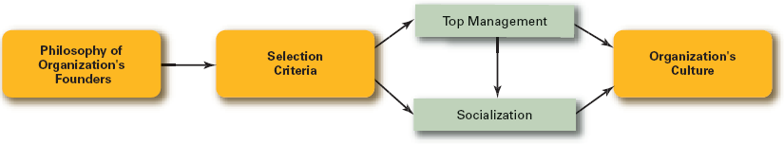
Introduction to Management (Chapter 3)
How Organizational Culture is Maintained ?

Slide 30
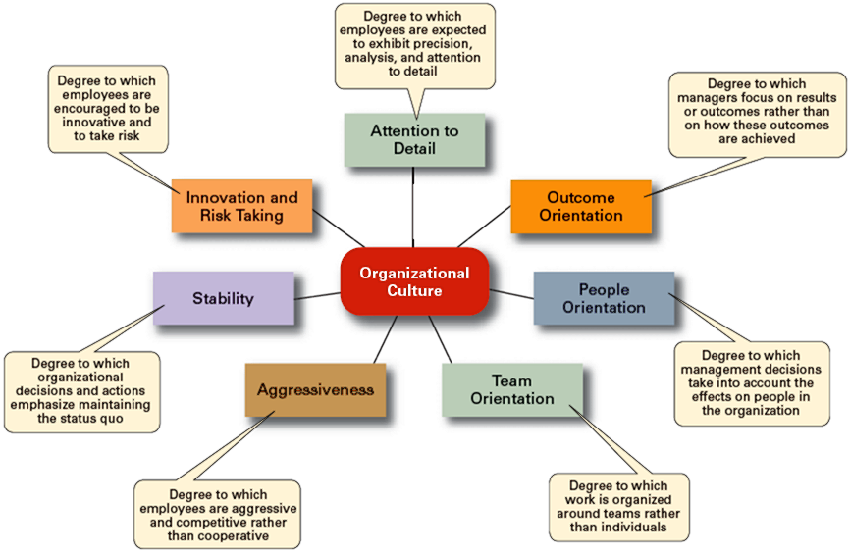
Introduction to Management (Chapter 3)

Slide 31
Introduction to Management (Chapter 3)
Strong Culture

Slide 32
Introduction to Management (Chapter 3)
Are cultures in which key values are deeply and widely held.
Have a strong influence on organizational members.

Slide 33
Introduction to Management (Chapter 3)
Factors Influencing the Strength of Culture
  Size of the organization
  Age of the organization
  Rate of employee turnover
  Strength of the original culture
  Clarity of cultural values and beliefs

Slide 34
Introduction to Management (Chapter 3)
How Employees Learn Culture ?

Slide 35
Introduction to Management (Chapter 3)
Stories
  Narratives of significant events or actions of people that convey the spirit of the organization
Rituals
  Repetitive sequences of activities that express and reinforce the values of the organization

Slide 36
Introduction to Management (Chapter 3)
Material Symbols
  Physical assets distinguishing the organization
Language
  Acronyms and jargon of terms, phrases, and word meanings specific to an organization

