Slide 1
Introduction to Management
LECTURE 32:
Introduction to Management
MGT 101

Slide 2
Introduction to Management
In lecture 31 we discussed
Topics from Chapter 16:
  Early Theories
  Contemporary Views in Leadership
Topics from Chapter 17:
  What is Control ?
  The Control Process.

Slide 3
Introduction to Management
Today in Chapter 17 we will discuss
  Comparing
  Controlling for Organizational Performance
  Tools for Measuring Organizational Performance
  Contemporary Issues in Control

Slide 4
Introduction to Management (Chapter 17)
Chapter 17:
Introduction to Controlling

Slide 5
Introduction to Management (Chapter 17)
Comparing

Slide 6
Introduction to Management (Chapter 17)
Comparing
Determining the degree of variation between actual performance and the standard.
  Significance of variation is determined by:
    The acceptable range of variation from the standard (forecast or budget).
    The size (large or small) and direction (over or under) of the variation from the standard (forecast or budget).

Slide 7
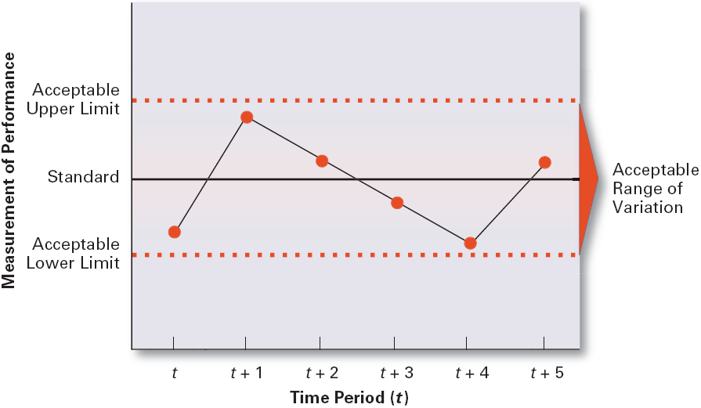
Introduction to Management (Chapter 17)
Defining the Acceptable Range of Variation

Slide 8
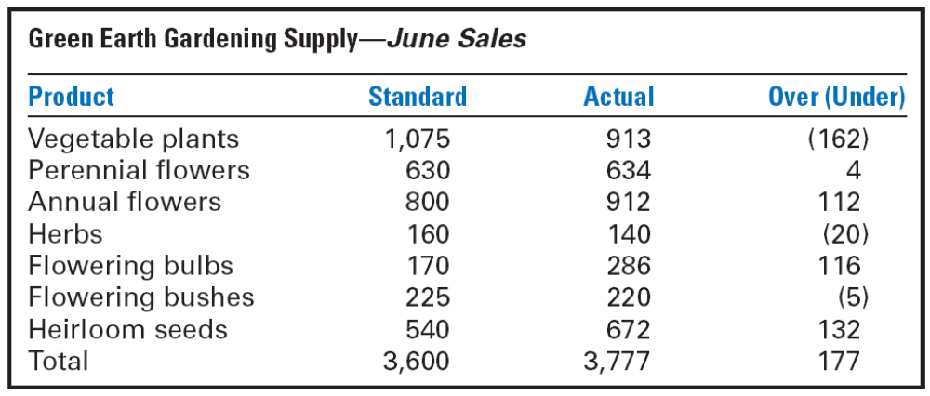
Introduction to Management (Chapter 17)
Example of Determining Significant Variation

Slide 9
Introduction to Management (Chapter 17)
Taking Managerial Action
Courses of Action
  “Doing nothing”
    Only if deviation is judged to be insignificant.

Slide 10
Introduction to Management (Chapter 17)
Taking Managerial Action
  Correcting actual (current) performance
    Immediate corrective action to correct the problem at once.
    Basic corrective action to locate and to correct the source of the deviation.

Slide 11
Introduction to Management (Chapter 17)
Taking Managerial Action
    Corrective Actions
      Change strategy, structure, compensation scheme, or training programs; redesign jobs; or fire employees

Slide 12
Introduction to Management (Chapter 17)
  Revising the standard
    Examining the standard to ascertain whether or not the standard is realistic, fair, and achievable.
      Upholding the validity of the standard.
      Resetting goals that were initially set too low or too high.

Slide 13
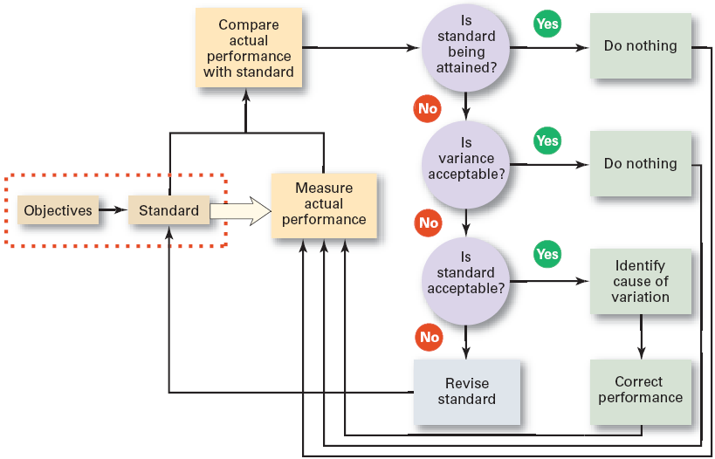
Introduction to Management (Chapter 17)
Managerial Decisions in the Control Process

Slide 14
Introduction to Management (Chapter 17)
Controlling for Organizational Performance

Slide 15
Introduction to Management (Chapter 17)
Controlling for Organizational Performance
Organizational Productivity
  Productivity: the overall output of goods and/or services divided by the inputs needed to generate that output.
    Output: sales revenues
    Inputs: costs of resources (materials, labor expense, and facilities)
  Ultimately, productivity is a measure of how efficiently employees do their work.

Slide 16
Introduction to Management (Chapter 17)
Organizational Effectiveness
  Measuring how appropriate organizational goals are and how well the organization is achieving its goals.

Slide 17
Introduction to Management (Chapter 17)
    Systems resource model
      The ability of the organization to exploit its environment in acquiring scarce and valued resources.
    The process model
      The efficiency of an organization’s transformation process in converting inputs to outputs.

Slide 18
Introduction to Management (Chapter 17)
    The multiple constituencies model
      The effectiveness of the organization in meeting each constituencies’ needs.

Slide 19
Introduction to Management (Chapter 17)
Tools for Measuring
Organizational Performance

Slide 20
Introduction to Management (Chapter 17)
Tools for Measuring Organizational Performance
Feedforward Control
  A control that prevents anticipated problems before actual occurrences of the problem.
    Building in quality through design.
    Requiring suppliers conform to ISO 9002.

Slide 21
Introduction to Management (Chapter 17)
Tools for Measuring Organizational Performance
Concurrent Control
  A control that takes place while the monitored activity is in progress.
    Direct supervision: management by walking around.

Slide 22
Introduction to Management (Chapter 17)
Feedback Control
  A control that takes place after an activity is done.
    Corrective action is after-the-fact, when the problem has already occurred.

Slide 23
Introduction to Management (Chapter 17)
  Advantages of feedback controls:
    Provide managers with information on the effectiveness of their planning efforts.
    Enhance employee motivation by providing them with information on how well they are doing.

Slide 24
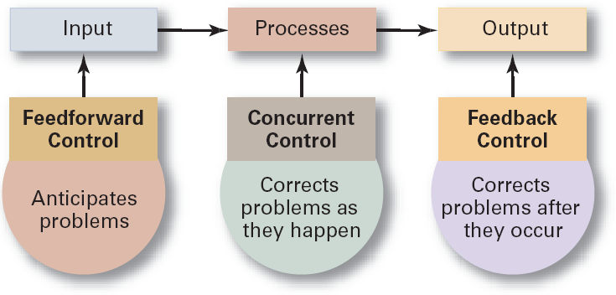
Introduction to Management (Chapter 17)
Types of Control

Slide 25
Introduction to Management (Chapter 17)
Financial Controls
Traditional Controls
  Ratio analysis Liquidity
    Leverage Activity
    Profitability
  Budget Analysis
    Quantitative standards
    Deviations

Slide 26
Introduction to Management (Chapter 17)
Managing Earnings
  “Timing” income and expenses to enhance current financial results, which gives an unrealistic picture of the organization’s financial performance.
  New laws and regulations require companies to clarify their financial information.

Slide 27
Introduction to Management (Chapter 17)
Tools for Measuring Organizational Performance (cont’d.)
Balanced Scorecard
  Is a measurement tool that uses goals set by managers in four areas to measure a company’s performance:
    Financial
    Customer
    Internal processes
    People/innovation/growth assets

Slide 28
Introduction to Management (Chapter 17)
Tools for Measuring Organizational Performance (cont’d.)
  Is intended to emphasize that all of these areas are important to an organization’s success and that there should be a balance among them.

Slide 29
Introduction to Management (Chapter 17)
Information Controls
Purposes of Information Controls
  As a tool to help managers control other organizational activities.
    Managers need the right information at the right time and in the right amount.

Slide 30
Introduction to Management (Chapter 17)
Information Controls
  As an organizational area that managers need to control.
    Managers must have comprehensive and secure controls in place to protect the organization’s important information.

Slide 31
Introduction to Management (Chapter 17)
Management Information Systems (MIS)
  A system used to provide management with needed information on a regular basis.
    Data: an unorganized collection of raw, unanalyzed facts (e.g., unsorted list of customer names).
    Information: data that has been analyzed and organized such that it has value and relevance to managers.

Slide 32
Introduction to Management (Chapter 17)
Benchmarking of Best Practices
Benchmark
  The standard of excellence against which to measure and compare.

Slide 33
Introduction to Management (Chapter 17)
Benchmarking of Best Practices
Benchmarking
  Is the search for the best practices among competitors or noncompetitors that lead to their superior performance.
  Is a control tool for identifying and measuring specific performance gaps and areas for improvement.

Slide 34
Introduction to Management (Chapter 17)
Contemporary Issues in Control

Slide 35
Introduction to Management (Chapter 17)
Contemporary Issues in Control
Cross-Cultural Issues
  The use of technology to increase direct corporate control of local operations
  Legal constraints on corrective actions in foreign countries
  Difficulty with the comparability of data collected from operations in different countries

Slide 36
Introduction to Management (Chapter 17)
Workplace Concerns
  Workplace privacy versus workplace monitoring:
    E-mail, telephone, computer, and Internet usage
    Productivity, harassment, security, confidentiality, intellectual property protection
  Employee theft
    The unauthorized taking of company property by employees for their personal use.
  Workplace violence
    Anger, rage, and violence in the workplace is affecting employee productivity.

