Slide 1
Introduction to Management
LECTURE 31:
Introduction to Management
MGT 101

Slide 2
Introduction to Management
In lecture 30 we discussed
Topics from Chapter 16:
  Leaders and Leadership
  Early Theories in Leadership

Slide 3
Introduction to Management
Today in Chapter 16 we will discuss
  Early Theories
  Contemporary Views in Leadership
Also today in Chapter 17 we will discuss
  What is Control ?
  The Control Process.

Slide 4
Introduction to Management (Chapter 16)
Chapter 16:
Managers as Leaders

Slide 5
Introduction to Management (Chapter 16)
Path-Goal Model
  States that the leader’s job is to assist his or her followers in attaining their goals and to provide direction or support to ensure their goals are compatible with organizational goals.

Slide 6
Introduction to Management (Chapter 16)
Path-Goal Model
  Leaders assume different leadership styles at different times depending on the situation:
    Directive leader
    Supportive leader
    Participative leader
    Achievement oriented leader

Slide 7
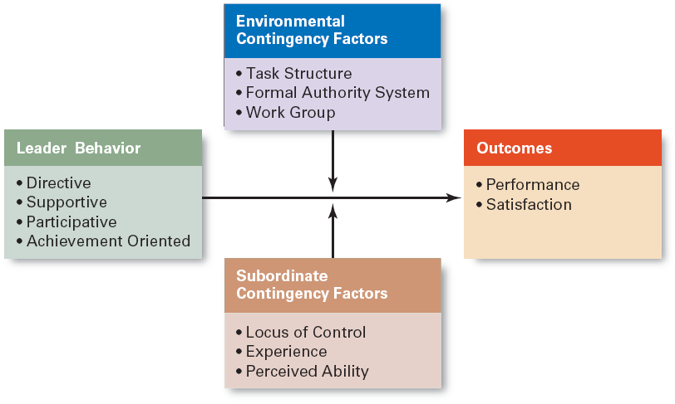
Introduction to Management (Chapter 16)
Path-Goal Theory

Slide 8
Introduction to Management (Chapter 16)
Contemporary Views of Leadership

Slide 9
Introduction to Management (Chapter 16)
Transactional Leadership
  Leaders who guide or motivate their followers in the direction of established goals by clarifying role and task requirements.
Transformational Leadership
  Leaders who inspire followers to transcend their own self-interests for the good of the organization by clarifying role and task requirements.

Slide 10
Introduction to Management (Chapter 16)
Charismatic Leadership
  An enthusiastic, self-confident leader whose personality and actions influence people to behave in certain ways.

Slide 11
Introduction to Management (Chapter 16)
  Characteristics of charismatic leaders:
    Have a vision.
    Are able to articulate the vision.
    Are willing to take risks to achieve the vision.
    Are sensitive to the environment and follower needs.
    Exhibit behaviors that are out of the ordinary.

Slide 12
Introduction to Management (Chapter 16)
Visionary Leadership
  A leader who creates and articulates a realistic, credible, and attractive vision of the future that improves upon the present situation.

Slide 13
Introduction to Management (Chapter 16)
Visionary leaders have the ability to:
  Explain the vision to others.
  Express the vision not just verbally but through behavior.
  Extend or apply the vision to different leadership contexts.

Slide 14
Introduction to Management (Chapter 16)
Team Leadership Characteristics
  Having patience to share information
  Being able to trust others and to give up authority
  Understanding when to intervene

Slide 15
Introduction to Management (Chapter 16)
Team Leader’s Job
  Managing the team’s external boundary
  Facilitating the team process
    Coaching, facilitating, handling disciplinary problems, reviewing team and individual performance, training, and communication

Slide 16
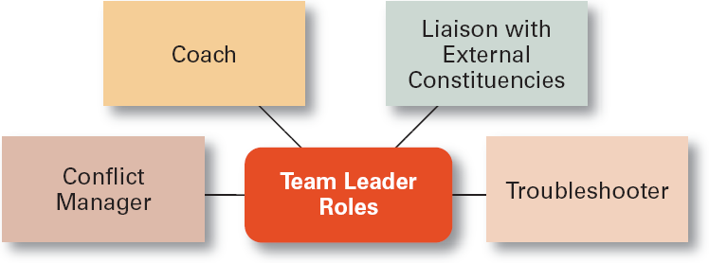
Introduction to Management (Chapter 16)
Specific Team Leadership Roles

Slide 17
Introduction to Management (Chapter 16)
Leadership Issues in 21st Century

Slide 18
Introduction to Management (Chapter 16)
Managing Power
  Legitimate power
    The power a leader has as a result of his or her position.
  Coercive power
    The power a leader has to punish or control.
  Reward power
    The power to give positive benefits or rewards.

Slide 19
Introduction to Management (Chapter 16)
  Expert power
    The influence a leader can exert as a result of his or her expertise, skills, or knowledge.
  Referent power
    The power of a leader that arise because of a person’s desirable resources or admired personal traits.

Slide 20
Introduction to Management (Chapter 17)
Chapter 17:
Introduction to Controlling

Slide 21
Introduction to Management (Chapter 17)
What is Control ?

Slide 22
Introduction to Management (Chapter 17)
Controlling
  The process of monitoring activities to ensure that they are being accomplished as planned and of correcting any significant deviations.
The Purpose of Control
  To ensure that activities are completed in ways that lead to accomplishment of organizational goals.

Slide 23
Introduction to Management (Chapter 17)
Why Is Control Important?
As the final link in management functions:
  Planning
    Controls let managers know whether their goals and plans are on target and what future actions to take.

Slide 24
Introduction to Management (Chapter 17)
Why Is Control Important?
  Empowering employees
    Control systems provide managers with information and feedback on employee performance.
  Protecting the workplace
    Controls enhance physical security and help minimize workplace disruptions.

Slide 25
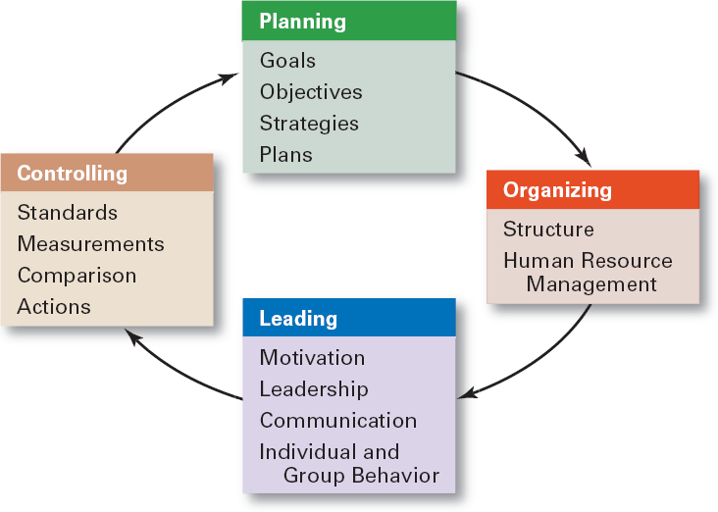
Introduction to Management (Chapter 17)
The Planning–Controlling Link

Slide 26
Introduction to Management (Chapter 17)
The Control Process

Slide 27
Introduction to Management (Chapter 17)
The Process of Control
  Measuring actual performance.
  Comparing actual performance against a standard.
  Taking action to correct deviations or inadequate standards.

Slide 28
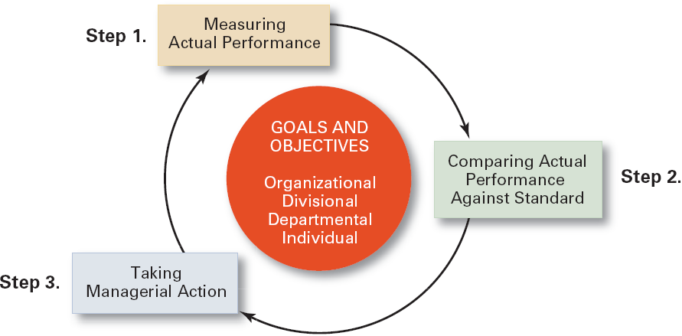
Introduction to Management (Chapter 17)
The Control Process

Slide 29
Introduction to Management (Chapter 17)
Measuring: How and What We Measure
Sources of Information (How)
  Personal observation
  Statistical reports
  Oral reports
  Written reports

Slide 30
Introduction to Management (Chapter 17)
Measuring: How and What We Measure
Control Criteria (What)
  Employees
    Satisfaction Turnover
    Absenteeism
  Budgets
    Costs Output
    Sales

Slide 31
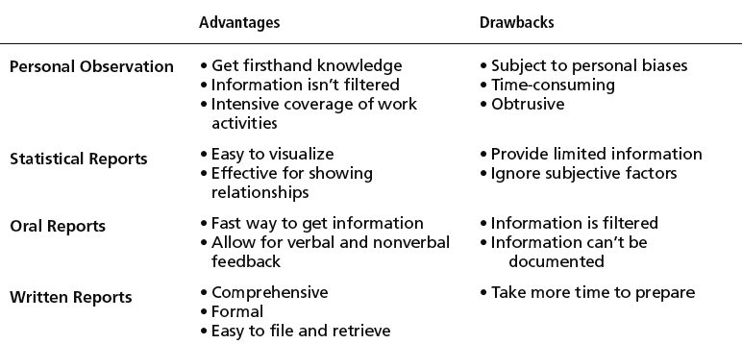
Introduction to Management (Chapter 17)
Common Sources of Information for
Measuring Performance

