Slide 1
Introduction to Management
LECTURE 30:
Introduction to Management
MGT 101

Slide 2
Introduction to Management
In lecture 29 we discussed
Topics from Chapter 15:
  Contemporary Theories in Motivation
  Current Issues in Motivation

Slide 3
Introduction to Management
Today in Chapter 16 we will discuss
  Leaders and Leadership
  Early Theories in Leadership

Slide 4
Introduction to Management (Chapter 16)
Chapter 16:
Managers as Leaders

Slide 5
Introduction to Management (Chapter 16)
Leaders and Leadership

Slide 6
Introduction to Management (Chapter 16)
Leader – Someone who can influence others and who has managerial authority
Leadership – What leaders do; the process of influencing a group to achieve goals
Ideally, all managers should be leaders
Although groups may have informal leaders who emerge, those are not the leaders we’re studying
Leadership research has tried to answer: What is an effective leader?

Slide 7
Introduction to Management (Chapter 16)
Early Leadership Theories

Slide 8
Introduction to Management (Chapter 16)
Trait Theories (1920s -1930s)
  Research focused on identifying personal characteristics that differentiated leaders from non-leaders was unsuccessful.
  Later research on the leadership process identified seven traits associated with successful leadership:
    Drive, the desire to lead, honesty and integrity, self-confidence, intelligence, job-relevant knowledge, and extraversion.

Slide 9
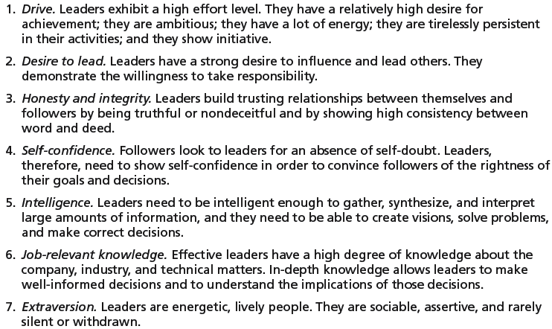
Introduction to Management (Chapter 16)
Seven Traits Associated with Leadership

Slide 10
Introduction to Management (Chapter 16)
Behavioral Theories
  University of Iowa Studies (Kurt Lewin)
    Identified three leadership styles:
      Autocratic style: centralized authority, low participation
      Democratic style: involvement, high participation, feedback
      Laissez faire style: hands-off management

Slide 11
Introduction to Management (Chapter 16)
  University of Iowa Studies (Kurt Lewin)
    Research findings: mixed results
      No specific style was consistently better for producing better performance.
      Employees were more satisfied under a democratic leader than an autocratic leader.

Slide 12
Introduction to Management (Chapter 16)
Behavioral Theories (cont’d)
  Ohio State Studies
    Identified two dimensions of leader behavior:
      Initiating structure: the role of the leader in defining his or her role and the roles of group members.
      Consideration: the leader’s mutual trust and respect for group members’ ideas and feelings.

Slide 13
Introduction to Management (Chapter 16)
  Ohio State Studies
    Research findings: mixed results
      High-high leaders generally, but not always, achieved high group task performance and satisfaction.
      Evidence indicated that situational factors appeared to strongly influence leadership effectiveness.

Slide 14
Introduction to Management (Chapter 16)
Behavioral Theories (cont’d)
  University of Michigan Studies
    Identified two dimensions of leader behavior:
      Employee oriented: emphasizing personal relationships
      Production oriented: emphasizing task accomplishment

Slide 15
Introduction to Management (Chapter 16)
  University of Michigan Studies
    Research findings:
      Leaders who are employee oriented are strongly associated with high group productivity and high job satisfaction.

Slide 16
Introduction to Management (Chapter 16)
Managerial Grid
  Appraises leadership styles using two dimensions:
    Concern for people
    Concern for production
  Places managerial styles in five categories:
    Impoverished management
    Task management
    Middle-of-the-road management
    Country club management
    Team management

Slide 17
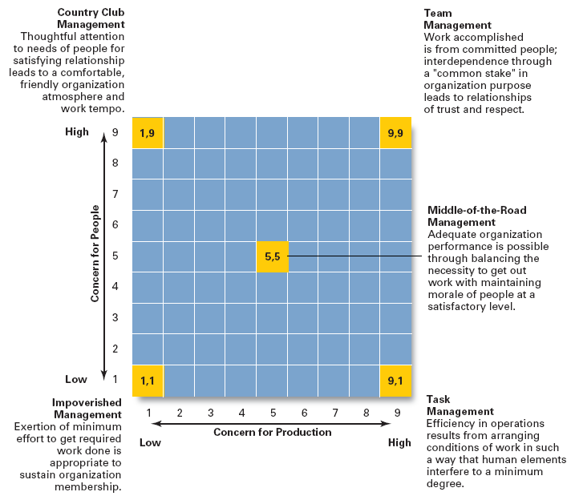
Introduction to Management (Chapter 16)

Slide 18
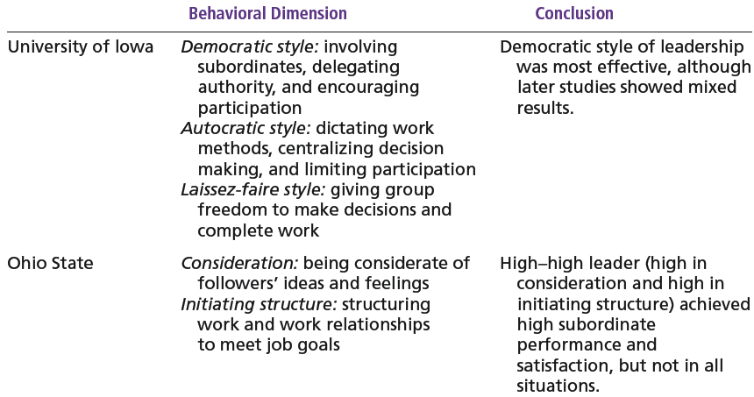
Introduction to Management (Chapter 16)

Slide 19
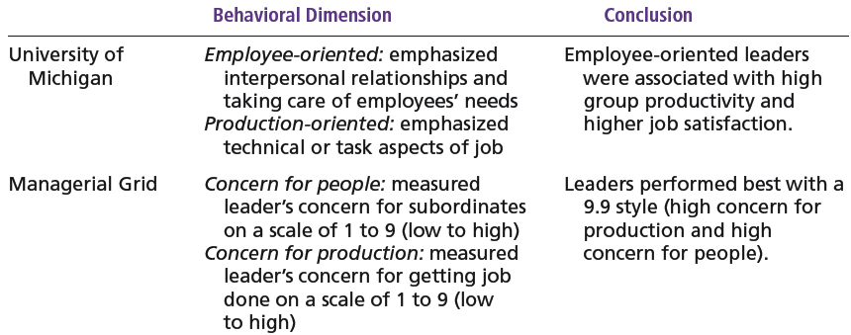
Introduction to Management (Chapter 16)

Slide 20
Introduction to Management (Chapter 16)
Contingency Theories of Leadership
The Fiedler Model
  Proposes that effective group performance depends upon the proper match between the leader’s style of interacting with followers and the degree to which the situation allows the leader to control and influence.

Slide 21
Introduction to Management (Chapter 16)
The Fiedler Model
  Assumptions:
    A certain leadership style should be most effective in different types of situations.
    Leaders do not readily change leadership styles.
      Matching the leader to the situation or changing the situation to make it favorable to the leader is required.

Slide 22
Introduction to Management (Chapter 16)
The Fiedler Model (cont’d)
  Least-preferred co-worker (LPC) questionnaire
    Determines leadership style by measuring responses to 18 pairs of contrasting adjectives.
      High score: a relationship-oriented leadership style
      Low score: a task-oriented leadership style

Slide 23
Introduction to Management (Chapter 16)
The Fiedler Model (cont’d)
  Situational factors in matching leader to the situation:
    Leader-member relations
    Task structure
    Position power

Slide 24
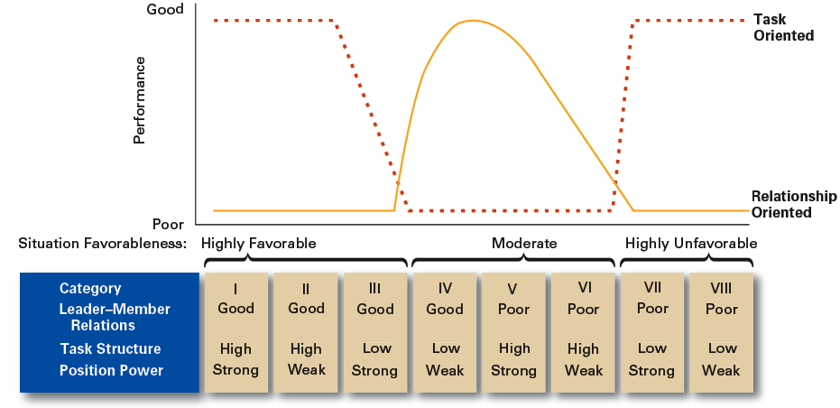
Introduction to Management (Chapter 16)
Findings of the Fiedler Model

Slide 25
Introduction to Management (Chapter 16)
Hersey and Blanchard’s Situational Leadership Theory (SLT)
  Argues that successful leadership is achieved by selecting the right leadership style which is contingent on the level of the followers’ readiness.
    Acceptance: leadership effectiveness depends on whether followers accept or reject a leader.
    Readiness: the extent to which followers have the ability and willingness to accomplish a specific task.
  Leaders must relinquish control over and contact with followers as they become more competent.

Slide 26
Introduction to Management (Chapter 16)
  Creates four specific leadership styles incorporating Fiedler’s two leadership dimensions:
    Telling: high task-low relationship leadership
    Selling: high task-high relationship leadership
    Participating: low task-high relationship leadership
    Delegating: low task-low relationship leadership

Slide 27
Introduction to Management (Chapter 16)
  Posits four stages follower readiness:
    R1: followers are unable and unwilling
    R2: followers are unable but willing
    R3: followers are able but unwilling
    R4: followers are able and willing

