Slide 1
Introduction to Management
LECTURE 3:
Introduction to Management
MGT 101

Slide 2
Introduction to Management
In lecture 2 we discussed
Topics from Chapter 1:
  Skills Manager Require.
  What is an Organization ?
  Why Study Management ?
Topics from Chapter 2
  Historical Background
    Early examples of Management
    Adam Smith
    Industrial Revolution

Slide 3
Introduction to Management
Today we will discuss
Topics from Chapter 2
  Scientific Management
  General Administrative Theories
  Quantitative Approach
  Organizational Behavior
  Systems Approach

Slide 4
Introduction to Management (Chapter 2)
Chapter 2:
Management History

Slide 5
Introduction to Management (Chapter 2)
Scientific Management

Slide 6
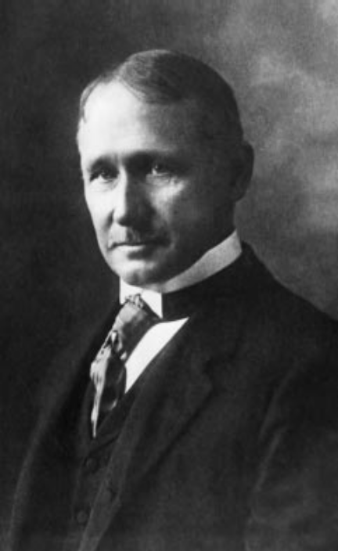
Introduction to Management (Chapter 2)
Fredrick Winslow Taylor
  The “father” of scientific management
  Published Principles of Scientific Management (1911)

Slide 7
Introduction to Management (Chapter 2)
  The theory of scientific management
    Using scientific methods to define the “one best way” for a job to be done:
      Putting the right person on the job with the correct tools and equipment.
      Having a standardized method of doing the job.
      Providing an economic incentive to the worker.

Slide 8
Introduction to Management (Chapter 2)
Taylor’s Principles
Develop a science for each element of an individual’s work, which will replace the old rule-of-thumb method.
Scientifically select and then train, teach, and develop the worker.

Slide 9
Introduction to Management (Chapter 2)
Heartily cooperate with the workers so as to ensure that all work is done in accordance with the principles of the science that has been developed.
Divide work and responsibility almost equally between management and workers. Management takes over all work for which it is better fitted than the workers.

Slide 10
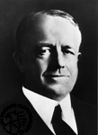
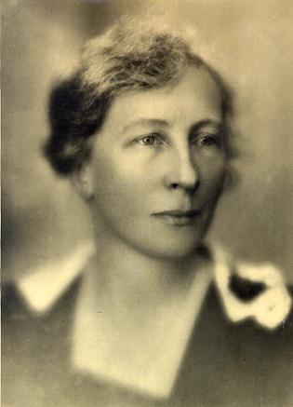
Introduction to Management (Chapter 2)
Frank and Lillian Gilbreth
  Focused on increasing worker productivity through the reduction of wasted motion
  Developed the microchronometer to time worker motions and optimize work performance

Slide 11

Introduction to Management (Chapter 2)
Henry Gantt

Slide 12
Introduction to Management (Chapter 2)
How Do Today’s Managers Use Scientific Management?
  Use time and motion studies to increase productivity
  Hire the best qualified employees
  Design incentive systems based on output

Slide 13
Introduction to Management (Chapter 2)
General Administrative Theories

Slide 14
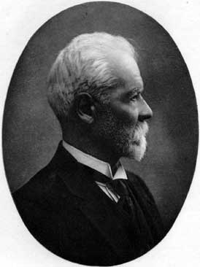
Introduction to Management (Chapter 2)
Henri Fayol
  Believed that the practice of management was distinct from other organizational functions
  Developed principles of management that applied to all organizational situations

Slide 15
Introduction to Management (Chapter 2)
Fayol’s 14 Principles
Division of work
Authority
Discipline
Unity of command
Unity of direction
Subordination of individual interests to the general interest
Remuneration
Centralization
Scalar chain
Order
Equity
Stability of tenure of personnel
Initiative
Esprit de corps

Slide 16
Introduction to Management
LECTURE 4:
Introduction to Management
MGT 101

Slide 17
Introduction to Management
In lecture 3 we discussed
Topics from Chapter 2:
  Scientific Management.
  General Administrative Theories

Slide 18
Introduction to Management
Today we will discuss
Topics from Chapter 2
  General Administrative Theories
  Quantitative Approach
  Organizational Behavior

Slide 19
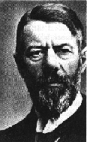
Introduction to Management (Chapter 2)
Max Weber
  Developed a theory of authority based on an ideal type of organization (bureaucracy)
  The exercise of control on the basis of knowledge, expertise, or experience.
    Emphasized rationality, predictability, impersonality, technical competence, and authoritarianism

Slide 20
Introduction to Management (Chapter 2)
Weber’s Bureaucracy
1. Qualification-based hiring
2. Merit-based promotion
3. Chain of command
4. Division of labor
5. Impartial application of rules and procedures
6. Recorded in writing
7. Managers separate from owners

Slide 21
Introduction to Management (Chapter 2)
Quantitative Approach

Slide 22
Introduction to Management (Chapter 2)
Also called operations research or management science
Evolved from mathematical and statistical methods developed to solve WWII military logistics and quality control problems
Focuses on improving managerial decision making by applying:
  Statistics, optimization models, information models, and computer simulations

Slide 23
Introduction to Management (Chapter 2)
Quality Management
Intense focus on the customer
Concern for continual improvement
Process-focused
Improvement in the quality of everything
Accurate measurement
Empowerment of employees

Slide 24
Introduction to Management (Chapter 2)
Organizational Behavior

Slide 25
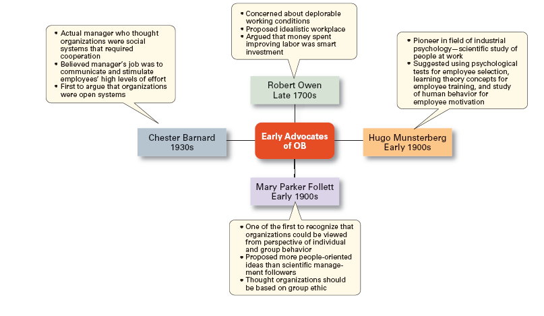
Introduction to Management (Chapter 2)

Slide 26
Introduction to Management (Chapter 2)
Human Relations Management
&
Organizational Behavior
Efficiency alone is not enough to produce organizational success.
Success also depends on treating workers well.

Slide 27
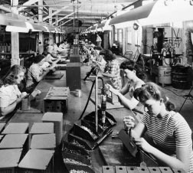
Introduction to Management (Chapter 2)
Hawthorne Studies
A series of productivity experiments conducted at Western Electric from 1924 to 1932.

Slide 28
Introduction to Management (Chapter 2)
Experimental findings
  Productivity unexpectedly increased under imposed adverse working conditions.
  The effect of incentive plans was less than expected.
Research conclusion
  Social norms, group standards and attitudes more strongly influence individual output and work behavior than do monetary incentives.

Slide 29
Introduction to Management (Chapter 2)
Cooperation and Acceptance of Authority: Chester Barnard
Managers can gain cooperation by:
Securing essential services from individuals
Unifying people by clearly formulating an organization’s purpose and objectives
Providing a system of effective communication

Slide 30
Introduction to Management (Chapter 2)
People will be indifferent to managerial directives if they…
are understood
are consistent with the purpose of the organization
are compatible with the people’s personal interests
can actually be carried out by those people

Slide 31
Introduction to Management (Chapter 2)
Systems Approach

Slide 32
Introduction to Management (Chapter 2)
System
  A set of interrelated and interdependent parts arranged in a manner that produces a unified whole.

Slide 33
Introduction to Management (Chapter 2)
Basic Types of Systems
  Closed systems
    Are not influenced by and do not interact with their environment (all system input and output is internal).
  Open systems
    Dynamically interact to their environments by taking in inputs and transforming them into outputs that are distributed into their environments.

Slide 34
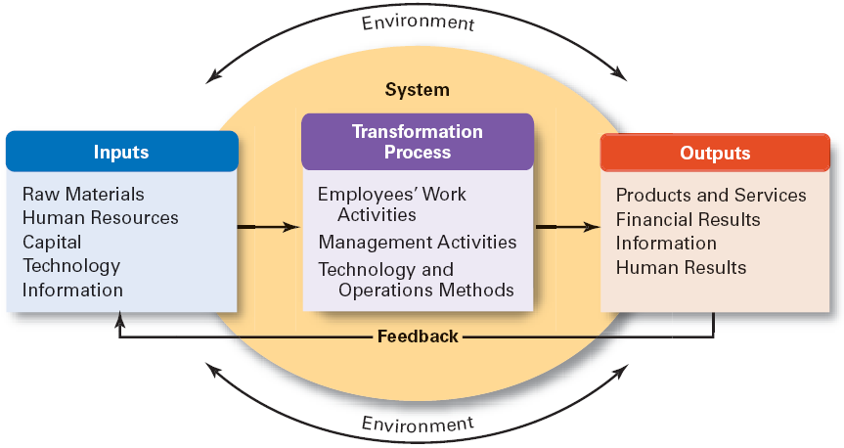
Introduction to Management (Chapter 2)

Slide 35
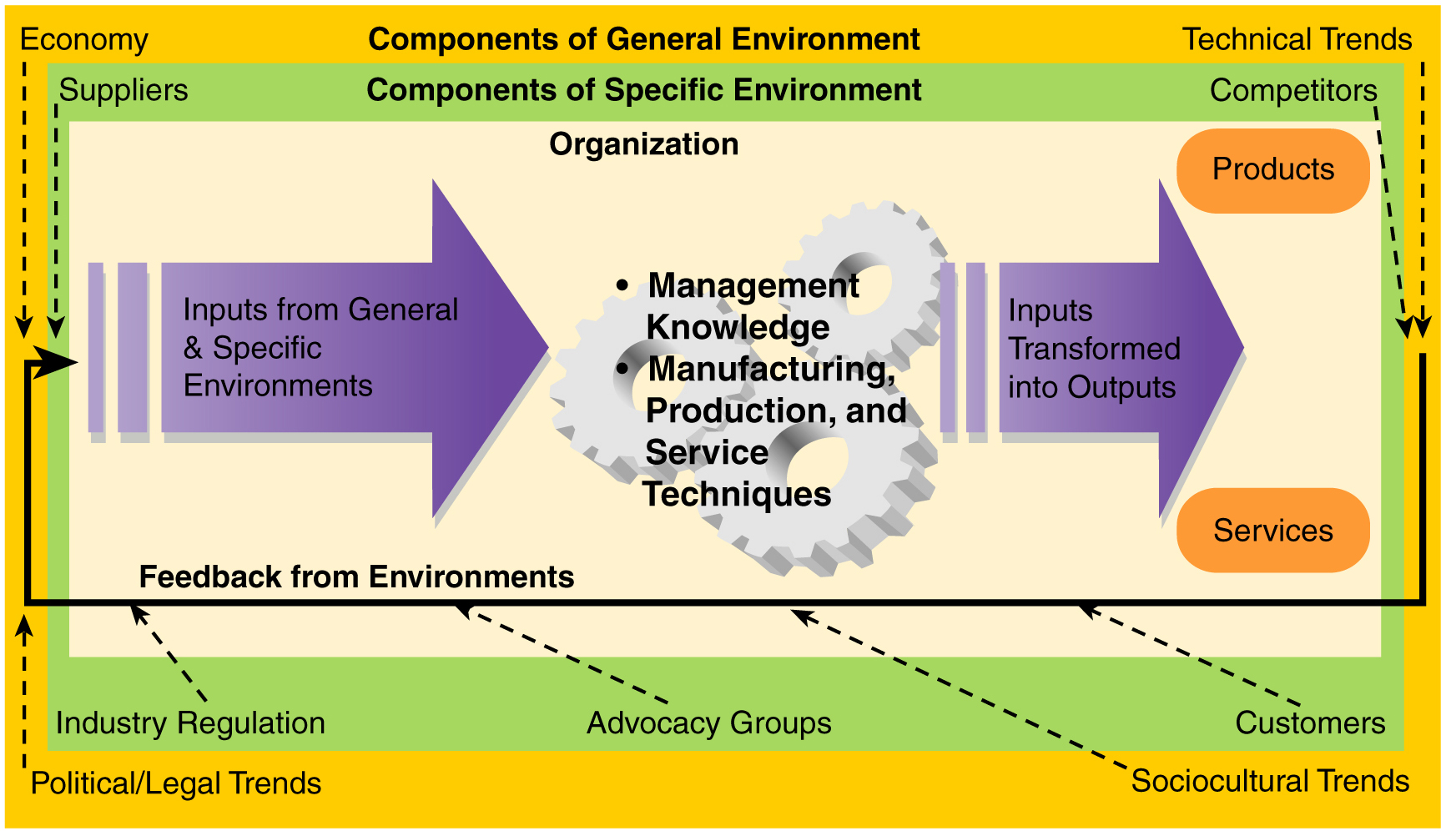
Introduction to Management (Chapter 2)

Slide 36
Introduction to Management (Chapter 2)
Implications:
Coordination of the organization’s parts is essential for proper functioning of the entire organization.
Decisions and actions taken in one area of the organization will have an effect in other areas of the organization.
Organizations are not self-contained and, therefore, must adapt to changes in their external environment.

