Slide 1
Introduction to Management
LECTURE 29:
Introduction to Management
MGT 101

Slide 2
Introduction to Management
In lecture 28 we discussed
Topics from Chapter 15:
  What is Motivation?
  Early Theories of Motivation.
  Contemporary Theories of Motivation

Slide 3
Introduction to Management
Today in Chapter 15 we will discuss
  Contemporary Theories in Motivation
  Current Issues in Motivation

Slide 4
Introduction to Management (Chapter 15)
Contemporary Theories

Slide 5
Introduction to Management (Chapter 15)
Job Characteristics Model (JCM)
  A conceptual framework for designing motivating jobs that create meaningful work experiences that satisfy employees’ growth needs.

Slide 6
Introduction to Management (Chapter 15)
  Five primary job characteristics:
    Skill variety: how many skills and talents are needed?
    Task identity: does the job produce a complete work?
    Task significance: how important is the job?
    Autonomy: how much independence does the jobholder have?
    Feedback: do workers know how well they are doing?

Slide 7
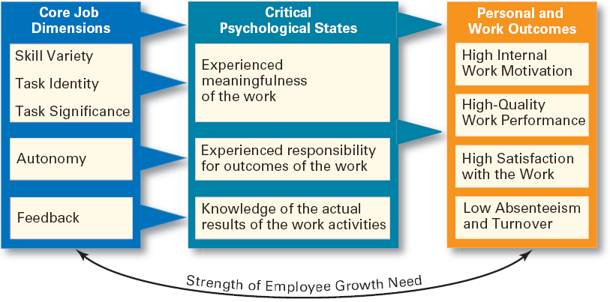
Introduction to Management (Chapter 15)
Job Characteristics Model (JCM)

Slide 8
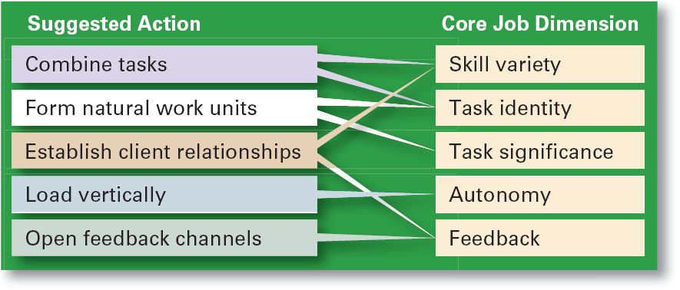
Introduction to Management (Chapter 15)
Guidelines for Job Redesign

Slide 9
Introduction to Management (Chapter 15)
Suggestions for Using the JCM
  Combine tasks (job enlargement) to create more meaningful work.
  Create natural work units to make employees’ work important and whole.
  Establish external and internal client relationships to provide feedback.

Slide 10
Introduction to Management (Chapter 15)
Suggestions for Using the JCM
  Expand jobs vertically (job enrichment) by giving employees more autonomy.
  Open feedback channels to let employees know how well they are doing.

Slide 11
Introduction to Management (Chapter 15)
Equity Theory
  Proposes that employees perceive what they get from a job situation (outcomes) in relation to what they put in (inputs) and then compare their inputs-outcomes ratio with the inputs-outcomes ratios of relevant others.

Slide 12
Introduction to Management (Chapter 15)
Equity Theory
    If the ratios are perceived as equal then a state of equity (fairness) exists.
    If the ratios are perceived as unequal, inequity exists and the person feels under- or over-rewarded.
    When inequities occur, employees will attempt to do something to rebalance the ratios (seek justice).

Slide 13
Introduction to Management (Chapter 15)
  Employee responses to perceived inequities:
    Distort own or others’ ratios.
    Induce others to change their own inputs or outcomes.
    Change own inputs (increase or decrease efforts) or outcomes (seek greater rewards).
    Choose a different comparison (referent) other (person, systems, or self).
    Quit their job.

Slide 14
Introduction to Management (Chapter 15)
  Employees are concerned with both the absolute and relative nature of organizational rewards.

Slide 15
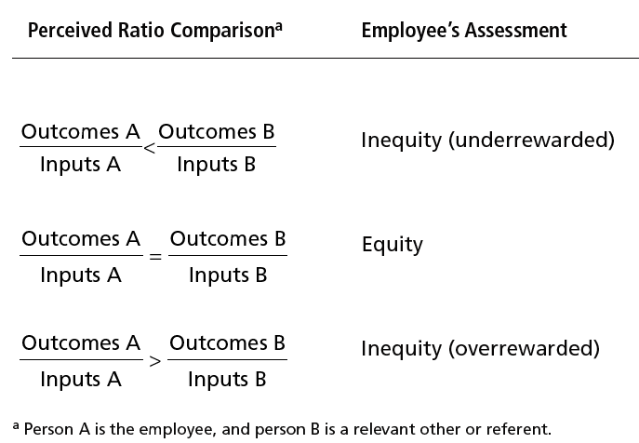
Introduction to Management (Chapter 15)

Slide 16
Introduction to Management (Chapter 15)
  Distributive justice
    The perceived fairness of the amount and allocation of rewards among individuals (i.e., who received what).
      Influences an employee’s satisfaction.
  Procedural justice
    The perceived fairness of the process use to determine the distribution of rewards (i.e., how who received what).
      Affects an employee’s organizational commitment.

Slide 17
Introduction to Management (Chapter 15)
Expectancy Theory
  States that an individual tends to act in a certain way based on the expectation that the act will be followed by a given outcome and on the attractiveness of that outcome to the individual.

Slide 18
Introduction to Management (Chapter 15)
Expectancy Theory
  Key to the theory is understanding and managing employee goals and the linkages among and between effort, performance and rewards.
    Effort: employee abilities and training/development
    Performance: valid appraisal systems
    Rewards (goals): understanding employee needs

Slide 19
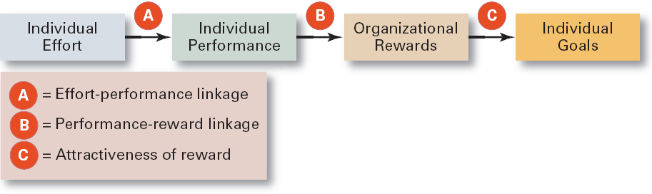
Introduction to Management (Chapter 15)
Simplified Expectancy Model

Slide 20
Introduction to Management (Chapter 15)
Expectancy Relationships
  Expectancy (effort-performance linkage)
    The perceived probability that an individual’s effort will result in a certain level of performance.
  Instrumentality
    The perception that a particular level of performance will result in the attaining a desired outcome (reward).
  Valence
    The attractiveness/importance of the performance reward (outcome) to the individual.

Slide 21
Introduction to Management (Chapter 15)
Current Issues in Motivation

Slide 22
Introduction to Management (Chapter 15)
Cross-Cultural Challenges
  Motivational programs are most applicable in cultures where individualism and achievement are cultural characteristics
    Uncertainty avoidance of some cultures inverts Maslow’s needs hierarchy.
    The need for achievement (nAch) is lacking in other cultures.
    Collectivist cultures view rewards as “entitlements” to be distributed based on individual needs, not individual performance.

Slide 23
Introduction to Management (Chapter 15)
Cross-Cultural Challenges
  Cross-Cultural Consistencies
    Interesting work is widely desired, as is growth, achievement, and responsibility.

Slide 24
Introduction to Management (Chapter 15)
Motivating Diverse Workforce
  Motivating a diverse workforce through flexibility:
    Men desire more autonomy than do women.
    Women desire learning opportunities, flexible work schedules, and good interpersonal relations.

Slide 25
Introduction to Management (Chapter 15)
Motivating Diverse Workforce
  Compressed workweek
    Longer daily hours, but fewer days
  Flexible work hours (flextime)
    Specific weekly hours with varying arrival, departure, lunch and break times around certain core hours during which all employees must be present.

Slide 26
Introduction to Management (Chapter 15)
Motivating Diverse Workforce
  Job Sharing
    Two or more people split a full-time job.
  Telecommuting
    Employees work from home using computer links.

Slide 27
Introduction to Management (Chapter 15)
Motivating Professionals
  Characteristics of professionals
    Strong and long-term commitment to their field of expertise.
    Loyalty is to their profession, not to the employer.
    Have the need to regularly update their knowledge.
    Don’t define their workweek as 8:00 am to 5:00 pm.

Slide 28
Introduction to Management (Chapter 15)
Motivating Professionals
  Motivators for professionals
    Job challenge
    Organizational support of their work

Slide 29
Introduction to Management (Chapter 15)
Motivating Contingent Workers
  Opportunity to become a permanent employee
  Opportunity for training
  Equity in compensation and benefits
Motivating Low-Skilled, Minimum-Wage Employees
  Employee recognition programs
  Provision of sincere praise

