Slide 1
Introduction to Management
LECTURE 28:
Introduction to Management
MGT 101

Slide 2
Introduction to Management
In lecture 27 we discussed
Topics from Chapter 13:
  Psychological Factors
    Personality
    Emotions
    Perception
    Learning

Slide 3
Introduction to Management
Today in Chapter 15 we will discuss
  What is Motivation?
  Early Theories of Motivation.
  Contemporary Theories of Motivation

Slide 4
Introduction to Management (Chapter 15)
Chapter 15:
Motivating Employees

Slide 5
Introduction to Management (Chapter 15)
Motivating Employees

Slide 6
Introduction to Management (Chapter 15)
Motivation ?

Slide 7
Introduction to Management (Chapter 15)
Motivation
  Is the result of an interaction between the person and a situation; it is not a personal trait.
  Is the process by which a person’s efforts are energized, directed, and sustained towards attaining a goal.

Slide 8
Introduction to Management (Chapter 15)
    Energy: a measure of intensity or drive.
    Direction: toward organizational goals
    Persistence: exerting effort to achieve goals.
  Motivation works best when individual needs are compatible with organizational goals.

Slide 9
Introduction to Management (Chapter 15)
Early Theories of Motivation

Slide 10
Introduction to Management (Chapter 15)
Early Theories of Motivation
Maslow’s Hierarchy of Needs
McGregor’s Theories X and Y
Herzberg’s Two-Factor Theory
McClelland’s Three Needs Theory

Slide 11
Introduction to Management (Chapter 15)
Maslow’s Hierarchy of Needs Theory
  Needs were categorized as five levels of lower- to higher-order needs.
    Individuals must satisfy lower-order needs before they can satisfy higher order needs.
    Satisfied needs will no longer motivate.
    Motivating a person depends on knowing at what level that person is on the hierarchy.

Slide 12
Introduction to Management (Chapter 15)
Maslow’s Hierarchy of Needs Theory
  Hierarchy of needs
    Lower-order (external): physiological, safety
    Higher-order (internal): social, esteem, self-actualization

Slide 13
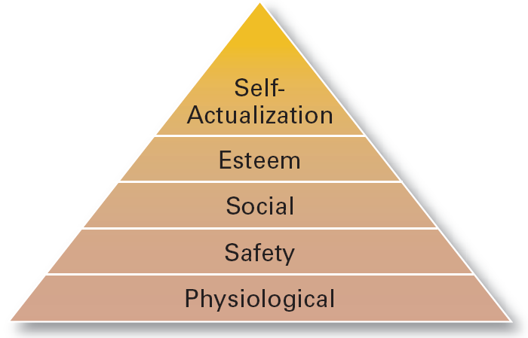
Introduction to Management (Chapter 15)

Slide 14
Introduction to Management (Chapter 15)
McGregor’s Theory X and Theory Y
  Theory X
    Assumes that workers have little ambition, dislike work, avoid responsibility, and require close supervision.
  Theory Y
    Assumes that workers can exercise self-direction, desire responsibility, and like to work.

Slide 15
Introduction to Management (Chapter 15)
McGregor’s Theory X and Theory Y
  Assumption:
    Motivation is maximized by participative decision making, interesting jobs, and good group relations.

Slide 16
Introduction to Management (Chapter 15)
Herzberg’s Motivation-Hygiene Theory
  Job satisfaction and job dissatisfaction are created by different factors.
    Hygiene factors: extrinsic (environmental) factors that create job dissatisfaction.
    Motivators: intrinsic (psychological) factors that create job satisfaction.

Slide 17
Introduction to Management (Chapter 15)
Herzberg’s Motivation-Hygiene Theory
  Attempted to explain why job satisfaction does not result in increased performance.
    The opposite of satisfaction is not dissatisfaction, but rather no satisfaction.

Slide 18
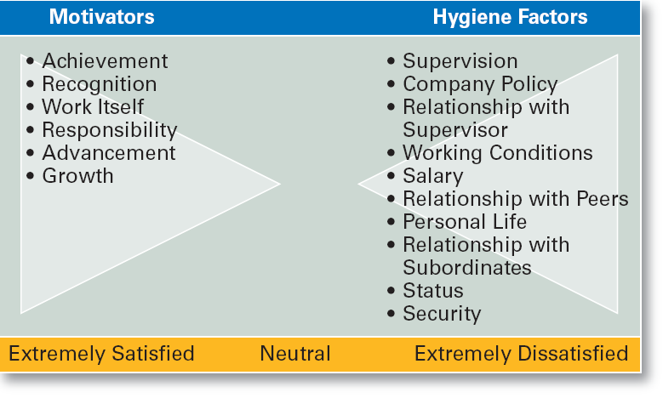
Introduction to Management (Chapter 15)
Herzberg’s Motivation-Hygiene Theory

Slide 19
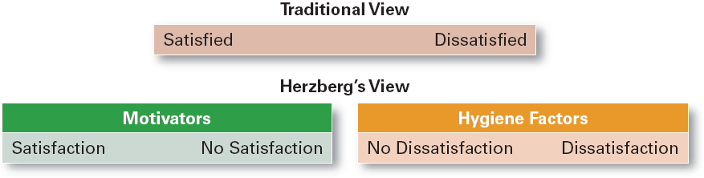
Introduction to Management (Chapter 15)
Contrasting Views of Satisfaction- Dissatisfaction

Slide 20
Introduction to Management (Chapter 15)
Three- Needs Theory
  There are three major acquired needs that are major motives in work.

Slide 21
Introduction to Management (Chapter 15)
Three- Needs Theory
    Need for achievement (nAch)
      The drive to excel and succeed
    Need for power (nPow)
      The need to influence the behavior of others
    Need of affiliation (nAff)
      The desire for interpersonal relationships

Slide 22
Introduction to Management (Chapter 15)
Contemporary Theories of Motivation

Slide 23
Introduction to Management (Chapter 15)
Goal-Setting Theory
Reinforcement Theory
Designing Motivating Jobs
Equity Theory
Expectancy Theory

Slide 24
Introduction to Management (Chapter 15)
Goal-Setting Theory
  Proposes that setting goals that are accepted, specific, and challenging yet achievable will result in higher performance than having no or easy goals.

Slide 25
Introduction to Management (Chapter 15)
Goal-Setting Theory
Benefits of Participation in Goal-Setting
  Increases the acceptance of goals.
  Fosters commitment to difficult, public goals.
  Provides for self-feedback (internal locus of control) that guides behavior and motivates performance (self-efficacy).

Slide 26
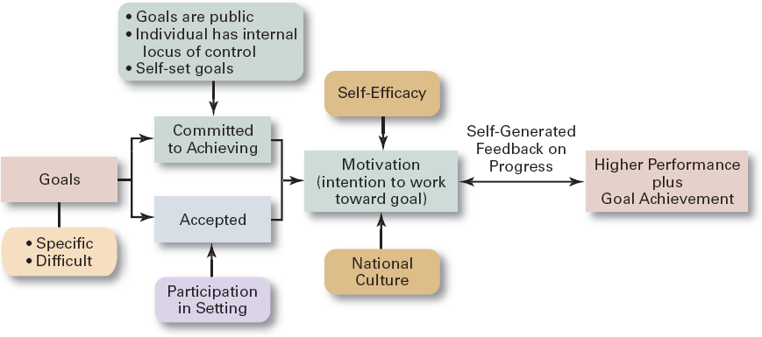
Introduction to Management (Chapter 15)
Goal-Setting Theory

Slide 27
Introduction to Management (Chapter 15)
Reinforcement Theory
  Assumes that a desired behavior is a function of its consequences, is externally caused, and if reinforced, is likely to be repeated.
    Positive reinforcement is preferred for its long-term effects on performance.
    Ignoring undesired behavior is better than punishment which may create additional dysfunctional behaviors.

Slide 28
Introduction to Management (Chapter 15)
Designing Motivating Jobs
Job Design
  The way into which tasks can be combined to form complete jobs.

Slide 29
Introduction to Management (Chapter 15)
Designing Motivating Jobs
  Factors influencing job design:
    Changing organizational environment/structure
    The organization’s technology
    Employees’ skill, abilities, and preferences

Slide 30
Introduction to Management (Chapter 15)
Designing Motivating Jobs
  Job enlargement
    Increasing the job’s scope (number and frequency of tasks)
  Job enrichment
    Increasing responsibility and autonomy (depth) in a job.

