Slide 1
Introduction to Management
LECTURE 26:
Introduction to Management
MGT 101

Slide 2
Introduction to Management
In lecture 25 we discussed
Topics from Chapter 12:
  What is Change ?
  The Change Process.
  Organizational Development
  Innovation

Slide 3
Introduction to Management
Today in Chapter 13 we will discuss
  Organizational & Employee Behavior
  Psychological Factor Effecting Employee Behavior

Slide 4
Introduction to Management (Chapter 13)
Chapter 13:
Understanding Individual Behavior

Slide 5
Introduction to Management (Chapter 13)
Organizational & Employee Behavior

Slide 6
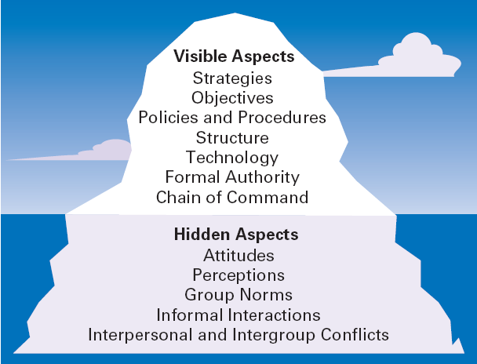
Introduction to Management (Chapter 13)
The Organization as an Iceberg

Slide 7
Introduction to Management (Chapter 13)
Organizational Behavior
Organizational Behavior (OB)
  The actions of people at work

Slide 8
Introduction to Management (Chapter 13)
Organizational Behavior
Focus of Organizational Behavior
  Individual behavior
    Attitudes, personality, perception, learning, and motivation
  Group behavior
    Norms, roles, team building, leadership, and conflict
  Organizational
    Structure, culture, and human resource policies and practices

Slide 9
Introduction to Management (Chapter 13)
Goals of Organizational Behavior
  To explain, predict and influence behavior.
Employee Productivity
  A performance measure of both efficiency and effectiveness
Absenteeism
  The failure to report to work when expected
Turnover
  The voluntary and involuntary permanent withdrawal from an organization

Slide 10
Introduction to Management (Chapter 13)
Important Employee Behaviors
Organizational Citizenship Behavior (OCB)
  Discretionary behavior that is not a part of an employee’s formal job requirements, but which promotes the effective functioning of the organization.
Job Satisfaction
  The individual’s general attitude
  toward his or her job

Slide 11
Introduction to Management (Chapter 13)
Important Employee Behaviors
Workplace Misbehavior
  Any intentional employee behavior that has negative consequences for the organization or individuals within the organization.
  Types of Misbehavior
    Deviance
    Aggression
    Antisocial behavior
    Violence

Slide 12
Introduction to Management (Chapter 13)
Psychological Factor Affecting Employee Behavior

Slide 13
Introduction to Management (Chapter 13)
Psychological Factors Affecting Employee Behavior
Employee Productivity
Absenteeism
Turnover
Organizational Citizenship
Job Satisfaction
Workplace Misbehavior
Attitudes
Personality
Perception
Learning

Slide 14
Introduction to Management (Chapter 13)
Psychological Factors – Attitudes
Attitudes
  Evaluative statements—either favorable or unfavorable—concerning objects, people, or events.

Slide 15
Introduction to Management (Chapter 13)
Psychological Factors – Attitudes
Components of an Attitude
  Cognitive component: the beliefs, opinions, knowledge, or information held by a person.
  Affective component: the emotional or feeling part of an attitude.
  Behavioral component: the intention to behave in a certain way.

Slide 16
Introduction to Management (Chapter 13)
Psychological Factors – Attitudes
Job Satisfaction
  Job satisfaction is affected by level of income earned and by the type of job a worker does.
Job Satisfaction and Productivity
  The correlation between satisfaction and productivity is fairly strong.
  Organizations with more satisfied employees are more effective than those with fewer satisfied employees.

Slide 17
Introduction to Management (Chapter 13)
Psychological Factors – Attitudes
Job Satisfaction and Absenteeism
  Satisfied employees tend to have lower levels of absenteeism, although satisfied employees are bound to take company approved days off (e.g. sick days)

Slide 18
Introduction to Management (Chapter 13)
Psychological Factors – Attitudes
Job Satisfaction and Turnover
  Satisfied employees have lower levels of turnover; dissatisfied employees have higher levels of turnover.
  Turnover is affected by the level of employee performance.
    The preferential treatment afforded superior employees makes satisfaction less important in predicting their turnover decisions.

Slide 19
Introduction to Management (Chapter 13)
Psychological Factors – Attitudes
Job Satisfaction and Customer Satisfaction
  The level of job satisfaction for frontline employees is related to increased customer satisfaction and loyalty.
  Interaction with dissatisfied customers can increase an employee’s job dissatisfaction.

Slide 20
Introduction to Management (Chapter 13)
Psychological Factors – Attitudes
  Actions to increase job satisfaction for customer service workers:
    Hire upbeat and friendly employees.
    Reward superior customer service.
    Provide a positive work climate.
    Use attitude surveys to track employee satisfaction.

Slide 21
Introduction to Management (Chapter 13)
Psychological Factors – Attitudes
Job Involvement
  The degree to which an employee identifies with his or her job, actively participates in it, and considers his or her performance to be important to his or her self-worth.
    High levels of commitment are related to fewer absences and lower resignation rates.

Slide 22
Introduction to Management (Chapter 13)
Psychological Factors – Attitudes
Organizational Commitment
  Is the degree to which an employee identifies with a particular organization and its goals and wishes to maintain membership in the organization.
  Leads to lower levels of both absenteeism and turnover.

Slide 23
Introduction to Management (Chapter 13)
Psychological Factors – Attitudes
Perceived Organizational Support
  Is the general belief of employees that their organization values their contribution and cares about their well-being.
  Represents the commitment of the organization to the employee.
  Providing high levels of support increases job satisfaction and lower turnover.

Slide 24
Introduction to Management (Chapter 13)
Attitudes and Consistency
People seek consistency in two ways:
  Consistency among their attitudes.
  Consistency between their attitudes and behaviors.
If an inconsistency arises, individuals:
  Alter their attitudes or Alter their behavior
  or Develop a rationalization for the inconsistency

Slide 25
Introduction to Management (Chapter 13)
Cognitive Dissonance Theory
  Any incompatibility or inconsistency between attitudes or between behavior and attitudes.
    Any form of inconsistency is uncomfortable and individuals will try to reduce the dissonance.

Slide 26
Introduction to Management (Chapter 13)
Cognitive Dissonance Theory
  The intensity of the desire to reduce the dissonance is influenced by:
    The importance of the factors creating the dissonance.
    The degree to which an individual believes that the factors causing the dissonance are controllable.
    Rewards available to compensate for the dissonance.

Slide 27
Introduction to Management (Chapter 13)
Attitude Surveys
  A instrument/document that presents employees with a set of statements or questions eliciting how they feel about their jobs, work groups, supervisors, or their organization.
  Provide management with feedback on employee perceptions of the organization and their jobs.

Slide 28
Introduction to Management (Chapter 13)
The Importance of Attitudes
  Attitudes warn of potential behavioral problems:
    Managers should do things that generate the positive attitudes that reduce absenteeism and turnover.
  Attitudes influence behaviors of employees:
    Managers should focus on helping employees become more productive to increase job satisfaction.

Slide 29
Introduction to Management (Chapter 13)
The Importance of Attitudes
  Employees will try to reduce dissonance unless:
    Managers identify the external sources of dissonance.
    Managers provide rewards compensating for the dissonance.

