Slide 1
Introduction to Management
LECTURE 25:
Introduction to Management
MGT 101

Slide 2
Introduction to Management
In lecture 24 we discussed
Topics from Chapter 11:
  Group Decision
  Conflict Management
  Teams Management

Slide 3
Introduction to Management
Today in Chapter 12 we will discuss
  What is Change ?
  The Change Process.
  Organizational Development
  Innovation

Slide 4
Introduction to Management (Chapter 12)
Chapter 12:
Managing Change & Innovations

Slide 5
Introduction to Management (Chapter 12)
What is Change ?

Slide 6
Introduction to Management (Chapter 12)
What Is Change?
Characteristics of Change
  Is constant yet varies in degree and direction
  Produces uncertainty yet is not completely unpredictable
  Creates both threats and opportunities
Managing change is an integral part
of every manager’s job.

Slide 7
Introduction to Management (Chapter 12)
External and Internal Forces for Change
External
• Changing consumer needs and wants
• New governmental laws
• Changing technology
• Economic changes

Slide 8
Introduction to Management (Chapter 12)
External and Internal Forces for Change
Internal
  • New organizational strategy
  • Change in composition of workforce
  • New equipment
  • Changing employee attitudes

Slide 9
Introduction to Management (Chapter 12)
The Change Process

Slide 10
Introduction to Management (Chapter 12)
The Change Process
The Calm Waters Metaphor
  Lewin’s description of the change process as a break in the organization’s equilibrium state
    Unfreezing the status quo
    Changing to a new state
    Refreezing to make the change permanent

Slide 11
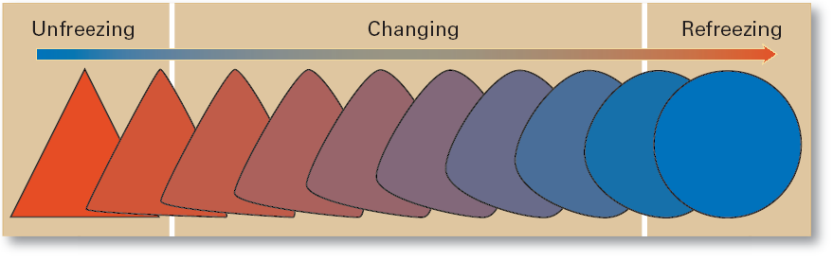
Introduction to Management (Chapter 12)
The Change Process

Slide 12
Introduction to Management (Chapter 12)
White-Water Rapids Metaphor
  The lack of environmental stability and predictability requires that managers and organizations continually adapt (manage change actively) to survive.

Slide 13
Introduction to Management (Chapter 12)
Organizational Change & Change Agents

Slide 14
Introduction to Management (Chapter 12)
Organizational Change
  Any alterations in the people, structure, or technology of an organization
Change Agents
  Persons who act as catalysts and assume the responsibility for managing the change process.

Slide 15
Introduction to Management (Chapter 12)
Types of Change Agents
  Managers: internal entrepreneurs
  Nonmanagers: change specialists
  Outside consultants: change implementation experts

Slide 16
Introduction to Management (Chapter 12)
Types of Change
Structure
  Changing an organization’s structural components or its structural design

Slide 17
Introduction to Management (Chapter 12)
Technology
  Adopting new equipment, tools, or operating methods that displace old skills and require new ones
    Automation: replacing certain tasks done by people with machines
    Computerization
People
  Changing attitudes, expectations, perceptions, and behaviors of the workforce

Slide 18
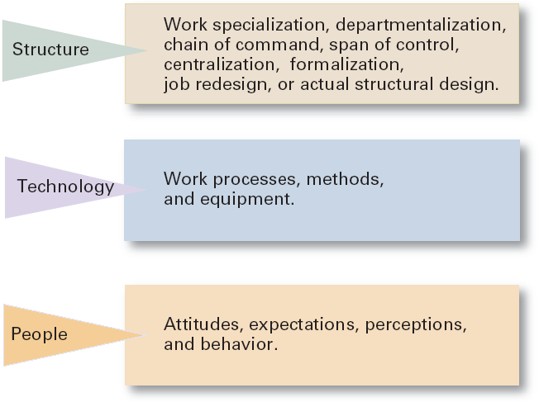
Introduction to Management (Chapter 12)
Three Types of Change

Slide 19
Introduction to Management (Chapter 12)
Organizational Development

Slide 20
Introduction to Management (Chapter 12)
Organizational Development (OD)
  Techniques or programs to change people and the nature and quality of interpersonal work relationships.

Slide 21
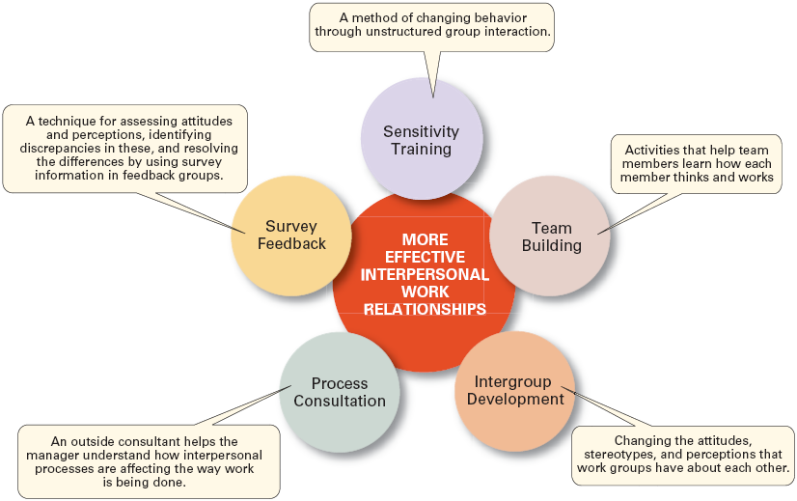
Introduction to Management (Chapter 12)
Popular OD Techniques

Slide 22
Introduction to Management (Chapter 12)
Why People Resist Change
  The ambiguity and uncertainty that change introduces
  The comfort of old habits
  A concern over personal loss of status, money, authority, friendships, and personal convenience
  The perception that change is incompatible with the goals and interest of the organization

Slide 23
Introduction to Management (Chapter 12)
Issues in Managing Change
Changing Organizational Cultures
  Cultures are naturally resistant to change.
  Conditions that facilitate cultural change:
    The occurrence of a dramatic crisis
    Leadership changing hands
    A young, flexible, and small organization
    A weak organizational culture

Slide 24
Introduction to Management (Chapter 12)
Issues in Managing Change
Handling Employee Stress
  Stress
    The adverse reaction people have to excessive pressure placed on them from extraordinary demands, constraints, or opportunities.

Slide 25
Introduction to Management (Chapter 12)
Issues in Managing Change
    Functional Stress
      Stress that has a positive effect on performance.
  How Potential Stress Becomes Actual Stress
    When there is uncertainty over the outcome.
    When the outcome is important.

Slide 26
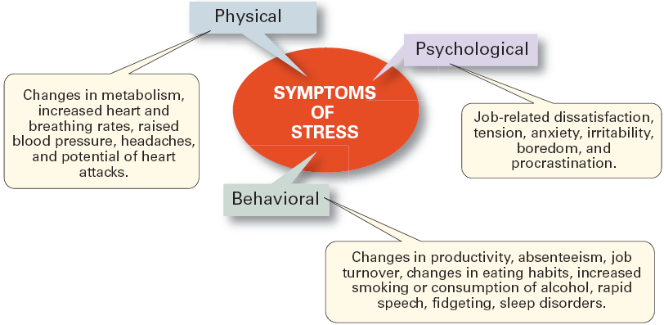
Introduction to Management (Chapter 12)
Symptoms of Stress

Slide 27
Introduction to Management (Chapter 12)
Innovation

Slide 28
Introduction to Management (Chapter 12)
Stimulating Innovation
Creativity
  The ability to combine ideas in a unique way or to make an unusual association.
Innovation
  Turning the outcomes of the creative process into useful products, services, or work methods.

Slide 29
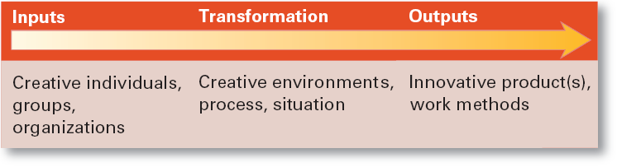
Introduction to Management (Chapter 12)
Systems View of Innovation

Slide 30
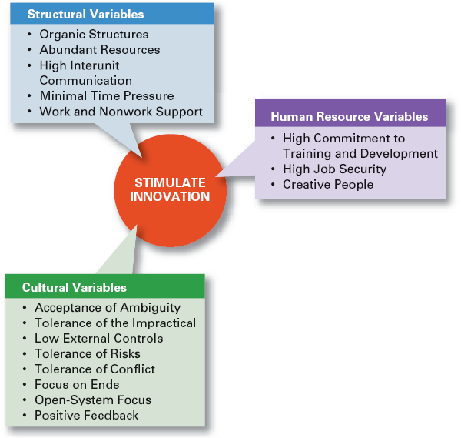
Introduction to Management (Chapter 12)
Innovation
Variables

