Slide 1
Introduction to Management
LECTURE 24:
Introduction to Management
MGT 101

Slide 2
Introduction to Management
In lecture 23 we discussed
Topics from Chapter 11:
  Group
  Stages in Group Development
  Group Performance Satisfaction Model

Slide 3
Introduction to Management
Today in Chapter 11 we will discuss
  Group Decision
  Conflict Management
  Teams Management

Slide 4
Introduction to Management (Chapter 11)
Chapter 11:
Managing Teams

Slide 5
Introduction to Management (Chapter 11)
Group Decision

Slide 6
Introduction to Management (Chapter 11)
Advantages
  Generates more complete information and knowledge.
  Generates more diverse alternatives.
  Increases acceptance of a solution.
Disadvantages
  Time consuming
  Minority domination
  Pressures to conform
  Ambiguous responsibility

Slide 7
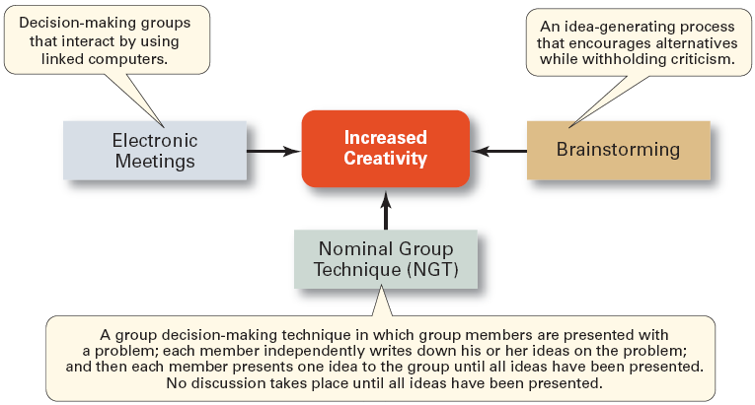
Introduction to Management (Chapter 11)
Techniques for Making More Creative Group Decisions

Slide 8
Introduction to Management (Chapter 11)
Conflict Management

Slide 9
Introduction to Management (Chapter 11)
Group Processes: Conflict Management
Conflict
  The perceived incompatible differences in a group resulting in some form of interference with or opposition to its assigned tasks.

Slide 10
Introduction to Management (Chapter 11)
Group Processes: Conflict Management
Conflict
    Traditional view: conflict must be avoided.
    Human relations view: conflict is a natural and inevitable outcome in any group.
    Interactionist view: conflict can be a positive force and is absolutely necessary for effective group performance.

Slide 11
Introduction to Management (Chapter 11)
Categories of Conflict
  Functional conflicts are constructive.
  Dysfunctional conflicts are destructive.
Types of Conflict
  Task conflict: content and goals of the work
  Relationship conflict: interpersonal relationships
  Process conflict: how the work gets done

Slide 12
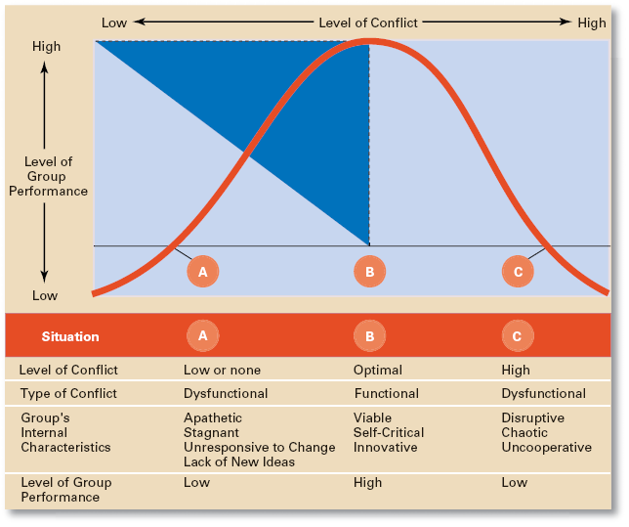
Introduction to Management (Chapter 11)
Conflict and Group Performance

Slide 13
Introduction to Management (Chapter 11)
Techniques to Manage Conflict:
  Avoidance
  Accommodation
  Forcing
  Compromise
  Collaboration

Slide 14
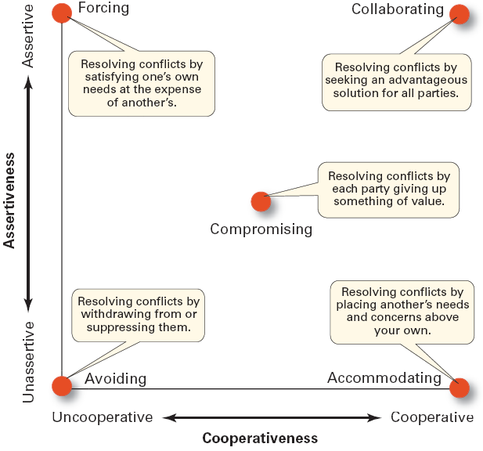
Introduction to Management (Chapter 11)
Conflict-Management Techniques

Slide 15
Introduction to Management (Chapter 11)
Teams Management

Slide 16
Introduction to Management (Chapter 11)
Group Tasks and Group Effectiveness
Highly complex and interdependent tasks require:
  Effective communications: discussion among group members.
  Controlled conflict: More interaction among group members.

Slide 17
Introduction to Management (Chapter 11)
Advantages of Using Teams
Teams outperform individuals.
Teams provide a way to better use employee talents.
Teams are more flexible and responsive.
Teams can be quickly assembled, deployed, refocused, and disbanded.

Slide 18
Introduction to Management (Chapter 11)
What Is a Work Team?
Work Team
  A group whose members work intensely on a specific common goal using their positive synergy, individual and mutual accountability, and complementary skills.

Slide 19
Introduction to Management (Chapter 11)
Types of Teams
  Problem-solving teams
  Self-managed work teams
  Cross-functional teams
  Virtual teams

Slide 20
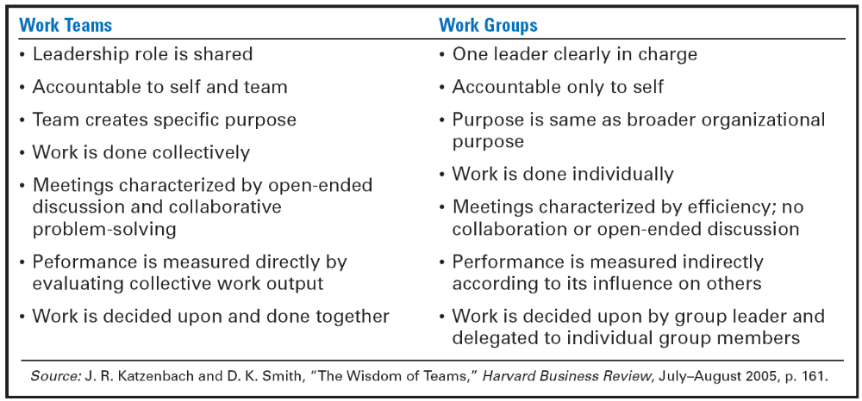
Introduction to Management (Chapter 11)
Groups versus Teams

Slide 21
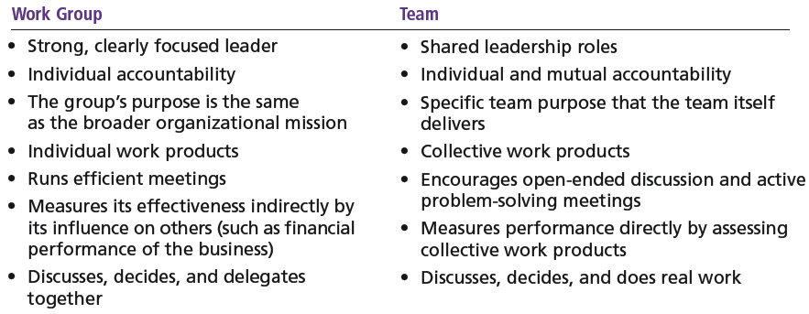
Introduction to Management (Chapter 11)
Groups versus Teams

Slide 22
Introduction to Management (Chapter 11)
Types of Teams
Problem-Solving Teams
  Employees from the same department and functional area who are involved in efforts to improve work activities or to solve specific problems.

Slide 23
Introduction to Management (Chapter 11)
Self-Managed Work Teams
  A formal group of employees who operate without a manager and responsible for a complete work process or segment.

Slide 24
Introduction to Management (Chapter 11)
Cross-Functional Teams
  A hybrid grouping of individuals who are experts in various specialties and who work together on various tasks.

Slide 25
Introduction to Management (Chapter 11)
Virtual Teams
  Teams that use computer technology to link physically dispersed members in order to achieve a common goal.

Slide 26
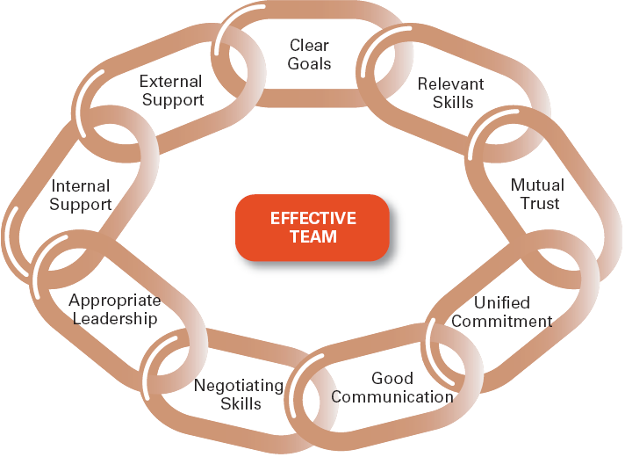
Introduction to Management (Chapter 11)
Characteristics of Effective Teams

Slide 27
Introduction to Management (Chapter 11)
Characteristics of Effective Teams
Have a clear understanding of their goals.
Have competent members with relevant technical and interpersonal skills.
Exhibit high mutual trust in the character and integrity of their members.
Are unified in their commitment to team goals.
Have good communication systems.
Possess effective negotiating skills.
Have appropriate leadership.
Have both internally and externally supportive environments.

Slide 28
Introduction to Management (Chapter 11)
Current Challenges in Managing Teams
Getting employees to:
  Cooperate with others
  Share information
  Confront differences
  Sublimate personal interest for the greater good of the team

Slide 29
Introduction to Management (Chapter 11)
Managing Global Teams
Group Member Resources
  Unique cultural characteristics of team members

Slide 30
Introduction to Management (Chapter 11)
Managing Global Teams
Group Structure
  Conformity—less groupthink
  Status—varies in importance among cultures
  Social loafing—predominately a Western bias
  Cohesiveness—more difficult to achieve

Slide 31
Introduction to Management (Chapter 11)
Managing Global Teams
Group processes—capitalize on diverse ideas.
Manager’s role—a communicator sensitive to the type of global team to use.

