Slide 1
Introduction to Management
LECTURE 23:
Introduction to Management
MGT 101

Slide 2
Introduction to Management
In lecture 22 we discussed
Topics from Chapter 10:
  Selection
  Employee needed knowledge & skills
  Employee performance management
  Contemporary issues in HRM

Slide 3
Introduction to Management
Today in Chapter 11 we will discuss
  Group
  Stages in Group Development
  Group Performance Satisfaction Model

Slide 4
Introduction to Management (Chapter 11)
Chapter 11:
Managing Teams

Slide 5
Introduction to Management (Chapter 11)
Groups

Slide 6
Introduction to Management (Chapter 11)
Group
  Two or more interacting and interdependent individuals who come together to achieve specific goals.

Slide 7
Introduction to Management (Chapter 11)
  Formal groups
    Work groups defined by the organization’s structure that have designated work assignments and tasks.
      Appropriate behaviors are defined by and directed toward organizational goals.
  Informal groups
    Groups that are independently formed to meet the social needs of their members.

Slide 8
Introduction to Management (Chapter 11)
Examples of Formal Groups
Command Groups
  Groups that are determined by the organization chart and composed of individuals who report directly to a given manager.
Task Groups
  Groups composed of individuals brought together to complete a specific job task; their existence is often temporary because once the task is completed, the group disbands.

Slide 9
Introduction to Management (Chapter 11)
Examples of Formal Groups
Cross-Functional Teams
  Groups that bring together the knowledge and skills of individuals from various work areas or groups whose members have been trained to do each others’ jobs.
Self-Managed Teams
  Groups that are essentially independent and in addition to their own tasks, take on traditional responsibilities such as hiring, planning and scheduling, and performance evaluations.

Slide 10
Introduction to Management (Chapter 11)
Stages in Group Development

Slide 11
Introduction to Management (Chapter 11)
Stages in Group Development
Forming
  Members join and begin the process of defining the group’s purpose, structure, and leadership.
Storming
  Intragroup conflict occurs as individuals resist control by the group and disagree over leadership.

Slide 12
Introduction to Management (Chapter 11)
Stages in Group Development
Norming
  Close relationships develop as the group becomes cohesive and establishes its norms for acceptable behavior.
Performing
  A fully functional group structure allows the group to focus on performing the task at hand.

Slide 13
Introduction to Management (Chapter 11)
Adjourning
  The group prepares to disband and is no longer concerned with high levels of performance.

Slide 14
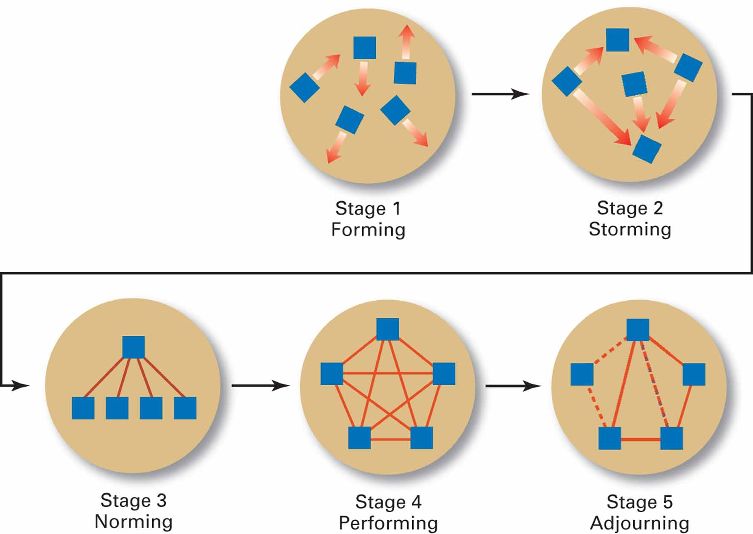
Introduction to Management (Chapter 11)

Slide 15
Introduction to Management (Chapter 11)
Groups Performance Satisfaction Model

Slide 16
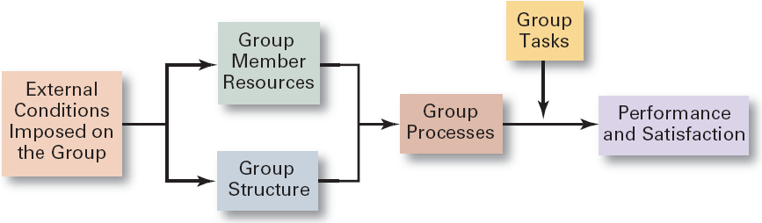
Introduction to Management (Chapter 11)
Group Performance Satisfaction Model

Slide 17
Introduction to Management (Chapter 11)
External Conditions Imposed on the Group
  Organization’s strategy
  Authority relationships
  Formal regulations
  Available organizational resources
  Employee selection criteria
  Performance management system
  Organizational culture
  General physical layout of work space

Slide 18
Introduction to Management (Chapter 11)
Group Member Resources
Knowledge
Skills
  Interpersonal skills such as conflict management and resolution, collaborative problem solving, and communication determine how effectively members perform in a group

Slide 19
Introduction to Management (Chapter 11)
Group Member Resources
Abilities
  Determine what members can do
Personality traits
  Positive traits tend to be positively related to group productivity and morale

Slide 20
Introduction to Management (Chapter 11)
Group Structure
Role
  The set of expected behavior patterns attributed to someone who occupies a given position in a social unit that assists the group in task accomplishment or maintaining group member satisfaction.

Slide 21
Introduction to Management (Chapter 11)
Group Structure
  Role
  Role conflict: experiencing differing role expectations
  Role ambiguity: uncertainty about role expectations

Slide 22
Introduction to Management (Chapter 11)
Norms
  Acceptable standards or expectations that are shared by the group’s members.
Common types of norms
  Effort and performance
    Output levels, absenteeism, promptness, socializing
  Dress
  Loyalty

Slide 23
Introduction to Management (Chapter 11)
Conformity
  Individuals conform in order to be accepted by groups.
  Group pressures can have an effect on an individual member’s judgment and attitudes.
  The effect of conformity is not as strong as it once was, although still a powerful force.

Slide 24
Introduction to Management (Chapter 11)
Conformity
  Groupthink
    The extensive pressure of others in a strongly cohesive or threatened group that causes individual members to change their opinions to conform to that of the group.

Slide 25
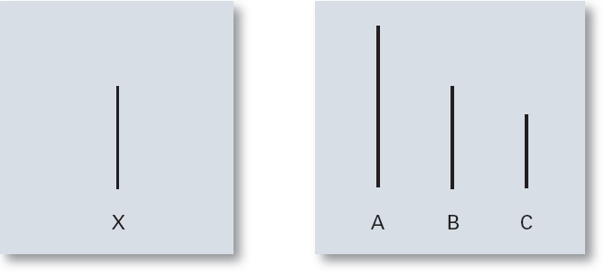
Introduction to Management (Chapter 11)
Examples of Cards Used in the Asch Study

Slide 26
Introduction to Management (Chapter 11)
Status System
  The formal or informal prestige grading, position, or ranking system for members of a group that serves as recognition for individual contributions to the group and as a behavioral motivator.
    Formal status systems are effective when the perceived ranking of an individual and the status symbols accorded that individual are congruent.

Slide 27
Introduction to Management (Chapter 11)
Group Size
Small groups
  Complete tasks faster than larger groups.
  Make more effective use of facts.
Large groups
  Solve problems better than small groups.
  Are good for getting diverse input.
  Are more effective in fact-finding.

Slide 28
Introduction to Management (Chapter 11)
Group Size
Social Loafing
  The tendency for individuals to expend less effort when working collectively than when working individually.

Slide 29
Introduction to Management (Chapter 11)
Group Cohesiveness
  The degree to which members are attracted to a group and share the group’s goals.
    Highly cohesive groups are more effective and productive than less cohesive groups when their goals aligned with organizational goals.

Slide 30
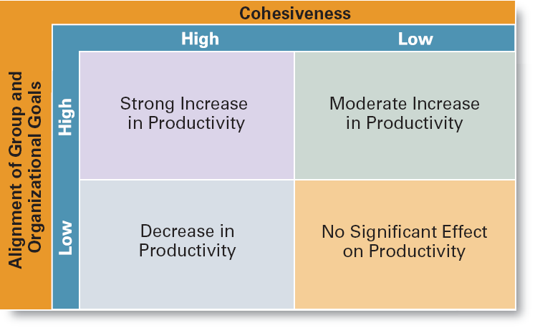
Introduction to Management (Chapter 11)
The Relationship Between Cohesiveness
and Productivity

