Slide 1
Introduction to Management
LECTURE 22:
Introduction to Management
MGT 101

Slide 2
Introduction to Management
In lecture 21 we discussed
Topics from Chapter 10:
  Importance of HRM
  HRM Process
  Managing Human Resource
  Selection

Slide 3
Introduction to Management
Today in Chapter 10 we will discuss
  Selection
  Employee needed knowledge & skills
  Employee performance management
  Contemporary issues in HRM

Slide 4
Introduction to Management (Chapter 10)
Chapter 10:
Managing Human Resource

Slide 5
Introduction to Management (Chapter 10)
Selection

Slide 6
Introduction to Management (Chapter 10)
Application Forms
Strengths and weaknesses:
  Almost universally used
  Relevant biographical data and facts that can be verified
  Can predict job performance
  Weighted-item applications are difficult and expensive to create and maintain

Slide 7
Introduction to Management (Chapter 10)
Written Tests
Types of Tests
  Intelligence : how smart are you?
  Aptitude : can you learn to do it?
  Attitude : how do you feel about it?
  Ability : can you do it now?
  Interest : do you want to do it?

Slide 8
Introduction to Management (Chapter 10)
Legal Challenges to Tests
  Lack of job-relatedness of test items or interview questions to job requirements
  Discrimination in equal employment opportunity against members of protected classes

Slide 9
Introduction to Management (Chapter 10)
Performance Simulation Tests
Testing an applicant’s ability to perform actual job behaviors, use required skills, and demonstrate specific knowledge of the job.

Slide 10
Introduction to Management (Chapter 10)
Performance Simulation Tests
  Work sampling
    Requiring applicants to actually perform a task or set of tasks that are central to successful job performance.
  Assessment centers
    Dedicated facilities in which job candidates undergo a series of performance simulation tests to evaluate their managerial potential.

Slide 11
Introduction to Management (Chapter 10)
Other Selection Approaches
Interviews
  Although used almost universally, managers need to approach interviews carefully.
Background Investigations
  Verification of application data
  Reference checks:
    Lack validity because self-selection of references ensures only positive outcomes.

Slide 12
Introduction to Management (Chapter 10)
Other Selection Approaches
Physical Examinations
  Useful for physical requirements and for insurance purposes related to pre-existing conditions.

Slide 13
Introduction to Management (Chapter 10)
Other Selection Approaches
Realistic Job Preview (RJP)
  The process of relating to an applicant both the positive and the negative aspects of the job.
    Encourages mismatched applicants to withdraw.
    Aligns successful applicants’ expectations with actual job conditions, reducing turnover.

Slide 14
Introduction to Management (Chapter 10)
Employee Needed Skills & Knowledge

Slide 15
Introduction to Management (Chapter 10)
Orientation
  Education that introduces a new employee to his or her job and the organization.
    Work unit orientation
    Organization orientation
Employee Training

Slide 16
Introduction to Management (Chapter 10)
Types of Training
Type | Includes
General | Communication skills, computer systems application and programming, customer service, executive development, management skills and development, personal growth, sales, supervisory skills, and technological skills and knowledge
Specific | Basic life/work skills, creativity, customer education, diversity/cultural awareness, remedial writing, managing change, leadership, product knowledge, public speaking/presentation skills, safety, ethics, sexual harassment, team building, wellness, and others

Slide 17
Introduction to Management (Chapter 10)
Training Methods
Traditional
Training Methods
  On-the-job
  Job rotation
  Mentoring and coaching
  Experiential exercises
  Workbooks/manuals
  Classroom lectures
Technology-Based Training Methods
  CD-ROM/DVD/videotapes/ audiotapes
  Videoconferencing/ teleconferencing/
  satellite TV
  E-learning

Slide 18
Introduction to Management (Chapter 10)
Employee Performance Management

Slide 19
Introduction to Management (Chapter 10)
Performance Management System
  A process of establishing performance standards and appraising employee performance.

Slide 20
Introduction to Management (Chapter 10)
Performance Appraisal Methods
Method | Advantage | Disadvantage
Written essays | Simple to use | More a measure of evaluator’s writing ability than of employee’s actual performance
Critical incidents | Rich examples; behaviorally based | Time-consuming; lack quantification
Graphic rating scales | Provide quantitative data; less time-consuming than others | Do not provide depth of job behavior assessed
BARS | Focus on specific and measurable job behaviors | Time-consuming; difficult to develop
Multiperson comparisons | Compares employees with one another | Unwieldy with large number of employees; legal concerns
MBO | Focuses on end goals; results oriented | Time-consuming
360-degree appraisals | Thorough | Time-consuming

Slide 21
Introduction to Management (Chapter 10)
Compensation & Benefits
Benefits of a Fair, Effective, and Appropriate Compensation System
  Helps attract and retain high-performance employees
  Impacts the strategic performance of the firm

Slide 22
Introduction to Management (Chapter 10)
Compensation & Benefits
Types of Compensation
  Base wage or salary
  Wage and salary add-ons
  Incentive payments
  Skill-based pay
  Variable pay

Slide 23
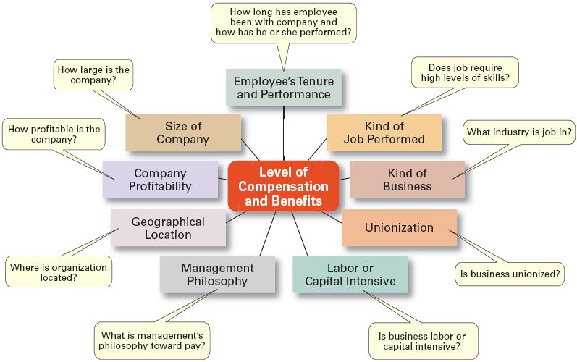
Introduction to Management (Chapter 10)
Factors That Influence Compensation and Benefits

Slide 24
Introduction to Management (Chapter 10)
Contemporary Issues in Managing Human Resource

Slide 25
Introduction to Management (Chapter 10)
Managing Downsizing
  The planned elimination of jobs in an organization
    Provide open and honest communication.
    Provide assistance to employees being downsized.
    Reassure and counseling to surviving employees.

Slide 26
Introduction to Management (Chapter 10)
Managing Workforce Diversity
  Widen the recruitment net for diversity
  Ensure selection without discrimination
  Provide orientation and training that is effective

Slide 27
Introduction to Management (Chapter 10)
Work-Life Balance
  Employees have personal lives that they don’t leave behind when they come to work.

Slide 28
Introduction to Management (Chapter 10)
Work-Life Balance
  Organizations have become more attuned to their employees by offering family-friendly benefits:
    On-site child care
    Summer day camps
    Flextime
    Job sharing
    Leave for personal matters
    Flexible job hours

