Slide 1
Introduction to Management
LECTURE 21:
Introduction to Management
MGT 101

Slide 2
Introduction to Management
In lecture 20 we discussed
Topics from Chapter 9:
  Organizational Design
  Factor influencing Centralization & Decentralization
  Contingency Factors
  Common Organizational Designs
  Contemporary Organizational Designs

Slide 3
Introduction to Management
Today in Chapter 10 we will discuss
  Importance of HRM
  HRM Process
  Managing Human Resource
  Selection

Slide 4
Introduction to Management (Chapter 10)
Chapter 10:
Managing Human Resource

Slide 5
Introduction to Management (Chapter 10)
Importance

Slide 6
Introduction to Management (Chapter 10)
As a significant source of competitive advantage
  People-oriented HR creates superior shareholder value
As an important strategic tool
  Achieve competitive success through people by treating employees as partners
To improve organizational performance
  High performance work practices lead to both high individual and high organizational performance.

Slide 7
Introduction to Management (Chapter 10)
Examples of High-Performance Work Practices
Self-managed teams
Decentralized decision making
Training programs to develop knowledge, skills, and abilities
Flexible job assignments
Open communication
Performance-based compensation
Staffing based on person–job and person–organization fit

Slide 8
Introduction to Management (Chapter 10)
HRM Process

Slide 9
Introduction to Management (Chapter 10)
Functions of the HRM Process
  Ensuring that competent employees are identified and selected.
  Providing employees with up-to-date knowledge and skills to do their jobs.
  Ensuring that the organization retains competent and high-performing employees.

Slide 10
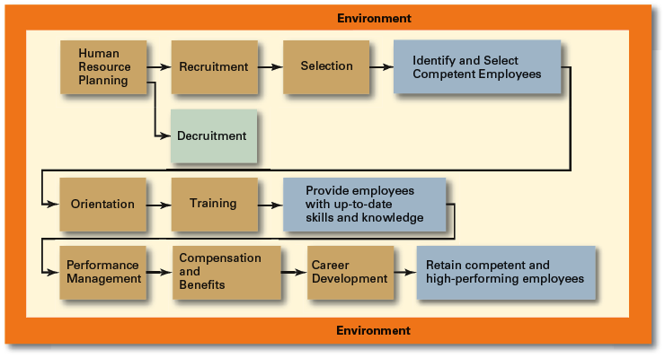
Introduction to Management (Chapter 10)

Slide 11
Introduction to Management (Chapter 10)
Environmental Factors Affecting HRM
Employee Labor Unions
  Organizations that represent workers and seek to protect their interests through collective bargaining.
    Collective bargaining agreement
      A contractual agreement between a firm and a union elected to represent a bargaining unit of employees of the firm in bargaining for wage, hours, and working conditions.

Slide 12
Introduction to Management (Chapter 10)
Environmental Factors Affecting HRM
Governmental Laws and Regulations
  Limit managerial discretion in hiring, promoting, and discharging employees.
    Affirmative Action: Organizational programs that enhance the status of members of protected groups.

Slide 13
Introduction to Management (Chapter 10)
Managing Human Resource

Slide 14
Introduction to Management (Chapter 10)
Human Resource (HR) Planning
  The process by which managers ensure that they have the right number and kinds of people in the right places, and at the right times, who are capable of effectively and efficiently performing their tasks.

Slide 15
Introduction to Management (Chapter 10)
Human Resource (HR) Planning
  Helps avoid sudden talent shortages and surpluses.
  Steps in HR planning:
    Assessing current human resources
    Assessing future needs for human resources

Slide 16
Introduction to Management (Chapter 10)
Current Assessment
Human Resource Inventory
  A review of the current make-up of the organization’s current resource status.

Slide 17
Introduction to Management (Chapter 10)
Current Assessment
Human Resource Inventory
  Job Analysis
    An assessment that defines a job and the behaviors necessary to perform the job.
    Requires conducting interviews, engaging in direct observation, and collecting the self-reports of employees and their managers.

Slide 18
Introduction to Management (Chapter 10)
Current Assessment
Job Description
  A written statement that describes a job.
Job Specification
  A written statement of the minimum qualifications that a person must possess to perform a given job successfully.

Slide 19
Introduction to Management (Chapter 10)
Meeting Future Human Resource Needs
Supply of Employees
Demand for Employees
Factors Affecting Staffing
Strategic Goals
Forecast demand for products and services
Availability of knowledge, skills, and abilities

Slide 20
Introduction to Management (Chapter 10)
Recruitment and Decruitment
Recruitment
  The process of locating, identifying, and attracting capable applicants to an organization
Decruitment
  The process of reducing a surplus of employees in the workforce of an organization

Slide 21
Introduction to Management (Chapter 10)
Recruitment and Decruitment
Online Recruiting
  Recruitment of employees through the Internet
    Organizational Web sites
    Online recruiters

Slide 22
Introduction to Management (Chapter 10)
Selection

Slide 23
Introduction to Management (Chapter 10)
What is Selection?
  An exercise in predicting which applicants, if hired, will be (or will not be) successful in performing well on the criteria the organization uses to evaluate performance.

Slide 24
Introduction to Management (Chapter 10)
What is Selection?
  Selection errors:
    Reject errors for potentially successful applicants
    Accept errors for ultimately poor performers

Slide 25
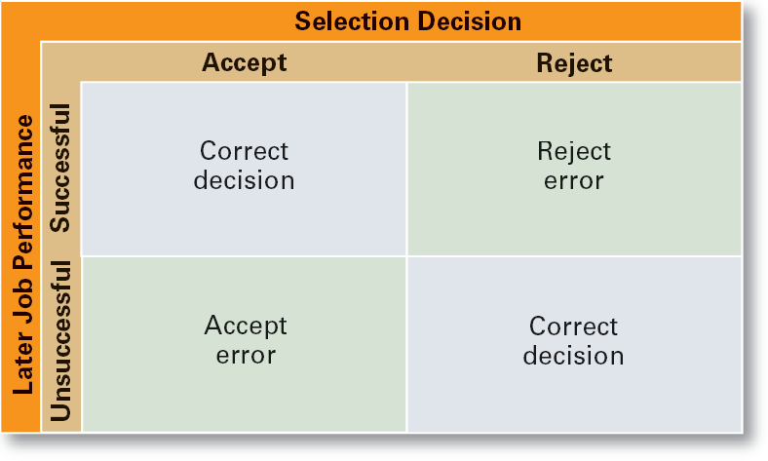
Introduction to Management (Chapter 10)
Selection Decision Outcomes

Slide 26
Introduction to Management (Chapter 10)
Selection Tools
Application Forms
Written Tests
Performance Simulations Tests
Interviews
Background Investigations
Physical Examinations

Slide 27
Introduction to Management (Chapter 10)
Validity (of Prediction)
  A proven relationship between the selection device used and some relevant criterion for successful performance in an organization.
Reliability (of Prediction)
  The degree of consistency with which a selection device measures the same thing.
    Individual test scores obtained with a selection device are consistent over multiple testing instances.

