Slide 1
Introduction to Management
LECTURE 20:
Introduction to Management
MGT 101

Slide 2
Introduction to Management
In lecture 19 we discussed
Topics from Chapter 9:
  Organizational Structure
  Organizational Design

Slide 3
Introduction to Management
Today in Chapter 9 we will discuss
  Factor influencing Centralization & Decentralization
  Contingency Factors
  Common Organizational Designs
  Contemporary Organizational Designs

Slide 4
Introduction to Management (Chapter 9)
Chapter 9:
Organizational Structure & Design

Slide 5
Introduction to Management (Chapter 9)
Factors Influence
Centralization & Decentralization

Slide 6
Introduction to Management (Chapter 9)
More Centralization
  Environment is stable.
  Lower-level managers are not as capable or experienced at making decisions as upper-level managers.
  Lower-level managers do not want to have a say in decisions.

Slide 7
Introduction to Management (Chapter 9)
More Centralization
  Decisions are relatively minor.
  Organization is facing a crisis or the risk of company failure.
  Company is large.
  Effective implementation of company strategies depends on managers retaining say over what happens.

Slide 8
Introduction to Management (Chapter 9)
More Decentralization
  Environment is complex, uncertain.
  Lower-level managers are capable and experienced at making decisions.
  Lower-level managers want a voice in decisions.

Slide 9
Introduction to Management (Chapter 9)
More Decentralization
  Decisions are significant.
  Corporate culture is open to allowing managers to have a say in what happens.
  Company is geographically dispersed.
  Effective implementation of company strategies depends on managers having involvement and flexibility to make decisions.

Slide 10
Introduction to Management (Chapter 9)
Formalization
  The degree to which jobs within the organization are standardized and the extent to which employee behavior is guided by rules and procedures.

Slide 11
Introduction to Management (Chapter 9)
Formalization
    Highly formalized jobs offer little discretion over what is to be done.
    Low formalization means fewer constraints on how employees do their work.

Slide 12


Introduction to Management (Chapter 9)
• High specialization
• Rigid departmentalization
• Clear chain of command
• Narrow spans of control
• Centralization
• High formalization
• Cross-functional teams
• Cross-hierarchical teams
• Free flow of information
• Wide spans of control
• Decentralization
• Low formalization

Slide 13
Introduction to Management (Chapter 9)
Contingency Factors

Slide 14
Introduction to Management (Chapter 9)
Structural decisions are influenced by:
  Overall strategy of the organization
    Organizational structure follows strategy.
  Size of the organization
    Firms change from organic to mechanistic organizations as they grow in size.

Slide 15
Introduction to Management (Chapter 9)
Structural decisions are influenced by:
  Technology use by the organization
    Firms adapt their structure to the technology they use.
  Degree of environmental uncertainty
    Dynamic environments require organic structures; mechanistic structures need stable environments.

Slide 16
Introduction to Management (Chapter 9)
Strategy Frameworks:
  Innovation
    Pursuing competitive advantage through meaningful and unique innovations favors an organic structuring.
  Cost minimization
    Focusing on tightly controlling costs requires a mechanistic structure for the organization.

Slide 17
Introduction to Management (Chapter 9)
Strategy and Structure
  Achievement of strategic goals is facilitated by changes in organizational structure that accommodate and support change.

Slide 18
Introduction to Management (Chapter 9)
Size and Structure
  As an organization grows larger, its structure tends to change from organic to mechanistic with increased specialization, departmentalization, centralization, and rules and regulations.

Slide 19
Introduction to Management (Chapter 9)
Technology and Structure
  Organizations adapt their structures to their technology.

Slide 20
Introduction to Management (Chapter 9)
Technology and Structure
  Woodward’s classification of firms based on the complexity of the technology employed:
    Unit production of single units or small batches
    Mass production of large batches of output
    Process production in continuous process of outputs

Slide 21
Introduction to Management (Chapter 9)
Technology and Structure
  Routine technology = mechanistic organizations
  Non-routine technology = organic organizations

Slide 22
Introduction to Management (Chapter 9)
Environmental Uncertainty and Structure
  Mechanistic organizational structures tend to be most effective in stable and simple environments.
  The flexibility of organic organizational structures is better suited for dynamic and complex environments.

Slide 23
Introduction to Management (Chapter 9)
Common Organizational Designs

Slide 24
Introduction to Management (Chapter 9)
Traditional Designs
  Simple structure
    Low departmentalization, wide spans of control, centralized authority, little formalization

Slide 25
Introduction to Management (Chapter 9)
Traditional Designs
  Functional structure
    Departmentalization by function
      Operations, finance, marketing, human resources, and product research and development

Slide 26
Introduction to Management (Chapter 9)
  Traditional Designs
  Divisional structure
    Composed of separate business units or divisions with limited autonomy under the coordination and control the parent corporation.

Slide 27
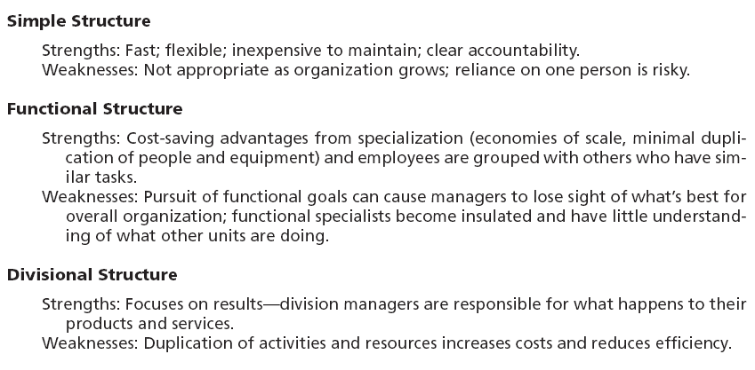
Introduction to Management (Chapter 9)
Strengths and Weaknesses of Traditional
Organizational Designs

Slide 28
Introduction to Management (Chapter 9)
Contemporary Organizational Designs

Slide 29
Introduction to Management (Chapter 9)
  Team structures
    The entire organization is made up of work groups or self-managed teams of empowered employees.

Slide 30
Introduction to Management (Chapter 9)
  Boundaryless Organization
    An flexible and unstructured organizational design that is intended to break down external barriers between the organization and its customers and suppliers.
    Removes internal (horizontal) boundaries:
      Eliminates the chain of command
      Has limitless spans of control
      Uses empowered teams rather than departments
    Eliminates external boundaries:
      Uses virtual, network, and modular organizational structures to get closer to stakeholders.

Slide 31
Introduction to Management (Chapter 9)
Virtual Organization
  An organization that consists of a small core of full-time employees and that temporarily hires specialists to work on opportunities that arise.
Network Organization
  A small core organization that outsources its major business functions (e.g., manufacturing) in order to concentrate on what it does best.
Modular Organization
  A manufacturing organization that uses outside suppliers to provide product components for its final assembly operations.

