Slide 1
Introduction to Management
LECTURE 2:
Introduction to Management
MGT 101

Slide 2
Introduction to Management (Chapter 1)
In the last lecture we discussed:
  What is Management ?
  Who is a Manager ?
  Types of Managers.
  Functions Managers perform.
  Managerial Roles.
  Skills Manager Require.

Slide 3
Introduction to Management (Chapter 1)
Today’s Topic from Chapter 1:
  Skills Manager Require.
  What is an Organization ?
  Why Study Management ?
And then we will start Chapter 2

Slide 4
Introduction to Management
Chapter 1:
Introduction to Management and Organizations

Slide 5
Introduction to Management (Chapter 1)
What Skills Manager Require ?
Technical Skills
Human Skills
Conceptual Skills
Motivation to Manage

Slide 6
Introduction to Management (Chapter 1)
Skills Manager Require ? (Contd.)
Technical Skills
    Knowledge and proficiency in a specific field
Human Skills
    The ability to work well with other people
Conceptual Skills
    The ability to think and conceptualize about abstract and complex situations concerning the organization

Slide 7
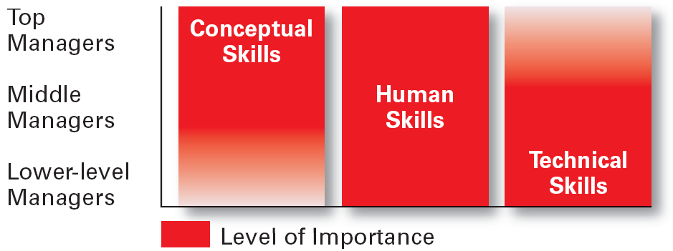
Introduction to Management (Chapter 1)
Skills Manager Require ? (Contd.)

Slide 8
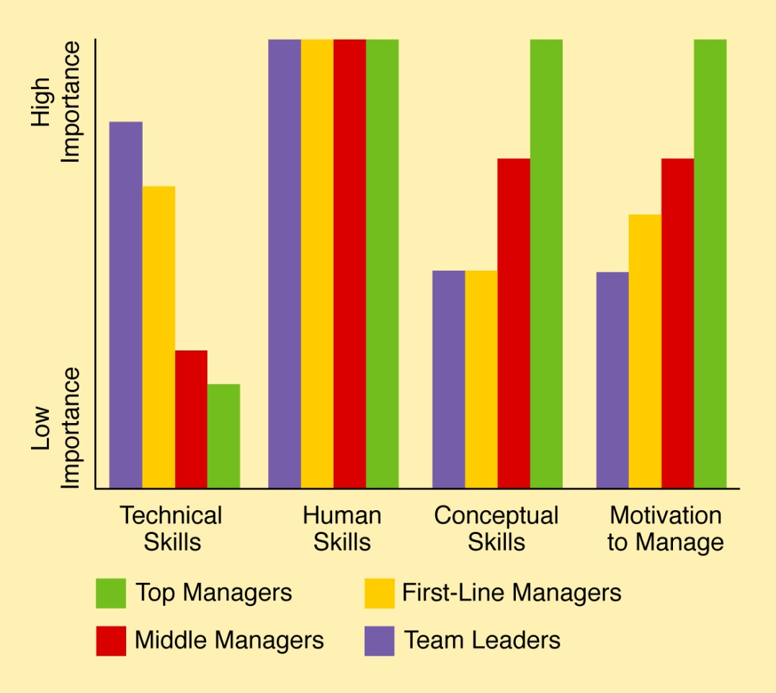
Introduction to Management (Chapter 1)
Skills Manager Require ? (Contd.)

Slide 9
Introduction to Management (Chapter 1)
Skills Manager Require ? (Contd.)
Conceptual Skills
Ability to use information to solve business problems
Identification of opportunities for innovation
Recognition of problem areas and implementation of solutions
Selection of critical information from masses of data
Understanding of business uses of technology
Understanding of organization’s business model

Slide 10
Introduction to Management (Chapter 1)
Skills Manager Require ? (Contd.)
Interpersonal Skills
Coaching and mentoring skills
Diversity skills: working with diverse people and cultures
Networking within the organization
Networking outside the organization
Working in teams; cooperation and commitment

Slide 11
Introduction to Management (Chapter 1)
Skills Manager Require ? (Contd.)
Communication Skills
Ability to transform ideas into words and actions
Credibility among colleagues, peers, and subordinates
Listening and asking questions
Presentation skills; spoken format
Presentation skills; written and/or graphic formats

Slide 12
Introduction to Management (Chapter 1)
Skills Manager Require ? (Contd.)
Effectiveness Skills
Contributing to corporate mission/departmental objectives
Customer focus
Multitasking: working at multiple tasks in parallel
Negotiating skills
Project management
Reviewing operations and implementing improvements

Slide 13
Introduction to Management (Chapter 1)
What is an Organization?
  A deliberate arrangement of people to accomplish some specific purpose.
  Common Characteristics
  Have a distinct purpose (goal)
  Composed of people
  Have a deliberate structure

Slide 14
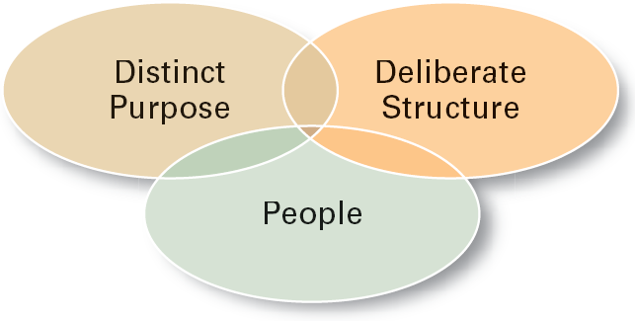
Introduction to Management (Chapter 1)
What is an Organization? (Contd.)
Common Characteristics

Slide 15
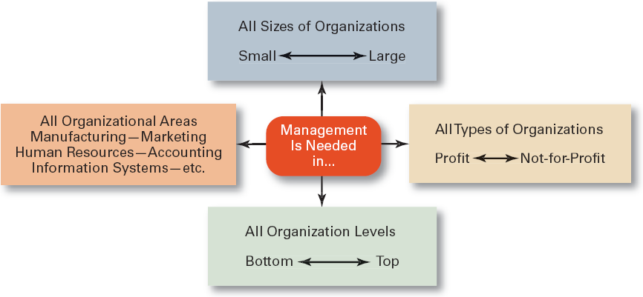
Introduction to Management (Chapter 1)
Why study Management ?
Universal Need of Management

Slide 16
Introduction to Management (Chapter 2)
Chapter 2:
Management History

Slide 17
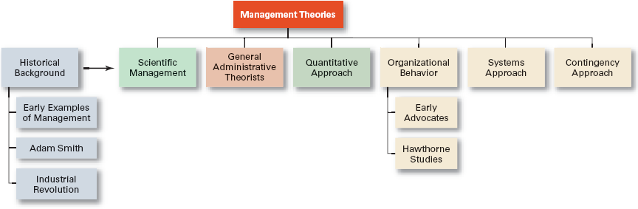
Introduction to Management (Chapter 2)

Slide 18
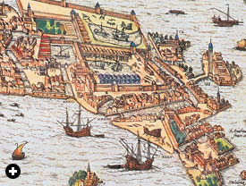
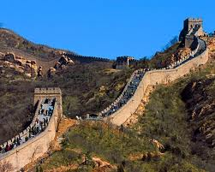
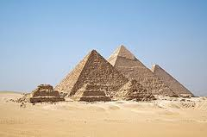
Introduction to Management (Chapter 2)
Historical Background
Early Examples of Management
  Egypt (pyramids)
  China (Great Wall)
  Venetians (floating warship assembly lines)

Slide 19
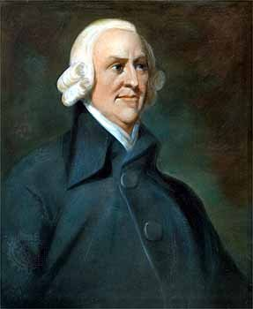
Introduction to Management (Chapter 2)
Historical Background
Adam Smith
  Published The Wealth of Nations in 1776
  Advocated the division of labor (job specialization) to increase the productivity of workers

Slide 20

Introduction to Management (Chapter 2)
Historical Background
Industrial Revolution
  From 1750 to 1850
  Substituted machine power for human labor
  Created large organizations in need of management

Slide 21
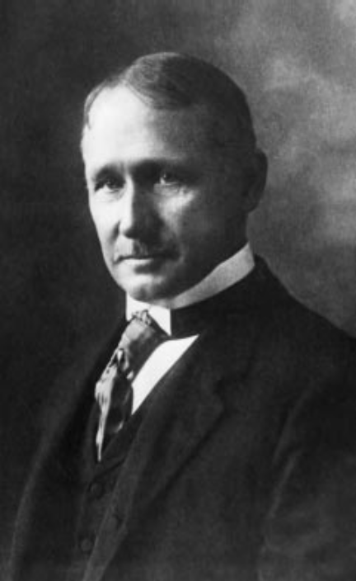
Introduction to Management (Chapter 2)
Scientific Management
Fredrick Winslow Taylor
  The “father” of scientific management
  Published Principles of Scientific Management (1911)
  The theory of scientific management
    Using scientific methods to define the “one best way” for a job to be done:
      Putting the right person on the job with the correct tools and equipment.
      Having a standardized method of doing the job.
      Providing an economic incentive to the worker.

Slide 22
Introduction to Management (Chapter 2)
Taylor’s Scientific Management Principles
Develop a science for each element of an individual’s work, which will replace the old rule-of-thumb method.
Scientifically select and then train, teach, and develop the worker.
Heartily cooperate with the workers so as to ensure that all work is done in accordance with the principles of the science that has been developed.
Divide work and responsibility almost equally between management and workers. Management takes over all work for which it is better fitted than the workers.

Slide 23
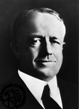
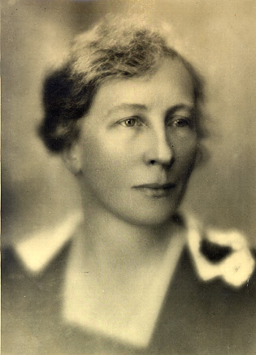
Introduction to Management (Chapter 2)
Scientific Management
Frank and Lillian Gilbreth
  Focused on increasing worker productivity through the reduction of wasted motion
  Developed the microchronometer to time worker motions and optimize work performance

Slide 24

Introduction to Management (Chapter 2)
Henry Gantt

Slide 25
Introduction to Management (Chapter 2)
Scientific Management
How Do Today’s Managers Use Scientific Management?
  Use time and motion studies to increase productivity
  Hire the best qualified employees
  Design incentive systems based on output

Slide 26
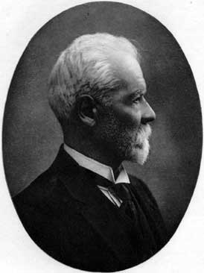
Introduction to Management (Chapter 2)
General Administrative Theory
Henri Fayol
  Believed that the practice of management was distinct from other organizational functions
  Developed principles of management that applied to all organizational situations

Slide 27
Introduction to Management (Chapter 2)
Fayol’s 14 Principles of Management
Division of work
Authority
Discipline
Unity of command
Unity of direction
Subordination of individual interests to the general interest
Remuneration
Centralization
Scalar chain
Order
Equity
Stability of tenure of personnel
Initiative
Esprit de corps

Slide 28
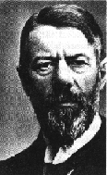
Introduction to Management (Chapter 2)
General Administrative Theory
Max Weber
  Developed a theory of authority based on an ideal type of organization (bureaucracy)
  The exercise of control on the basis of knowledge, expertise, or experience.
    Emphasized rationality, predictability, impersonality, technical competence, and authoritarianism

Slide 29
Introduction to Management (Chapter 2)
Weber’s Bureaucracy
1. Qualification-based hiring
2. Merit-based promotion
3. Chain of command
4. Division of labor
5. Impartial application of rules and procedures
6. Recorded in writing
7. Managers separate from owners

Slide 30
Introduction to Management (Chapter 2)
Quantitative Approach
Also called operations research or management science
Evolved from mathematical and statistical methods developed to solve WWII military logistics and quality control problems
Focuses on improving managerial decision making by applying:
  Statistics, optimization models, information models, and computer simulations

Slide 31
Introduction to Management (Chapter 2)
Quality Management
Intense focus on the customer
Concern for continual improvement
Process-focused
Improvement in the quality of everything
Accurate measurement
Empowerment of employees

