Slide 1
Introduction to Management
LECTURE 18:
Introduction to Management
MGT 101

Slide 2
Introduction to Management
In lecture 17 we discussed
Topics from Chapter 8:
  What is Strategic Management
  Strategic Management Process
  Types of Organizational Strategies
  Corporate Strategy- Growth Strategies

Slide 3
Introduction to Management
Today in Chapter 8 we will discuss
  Corporate Strategies
  Competitive Strategies
  Strategic Management Today

Slide 4
Introduction to Management (Chapter 8)
Chapter 8:
Strategic Management

Slide 5
Introduction to Management (Chapter 8)
Types of Organizational Strategies

Slide 6
Introduction to Management (Chapter 8)
  Corporate Strategies
Stability Strategy
  A strategy that seeks to maintain the status quo to deal with the uncertainty of a dynamic environment, when the industry is experiencing slow- or no-growth conditions, or if the owners of the firm elect not to grow for personal reasons.

Slide 7
Introduction to Management (Chapter 8)
  Corporate Strategies
Renewal Strategies
  Developing strategies to counter organization weaknesses that are leading to performance declines.

Slide 8
Introduction to Management (Chapter 8)
  Corporate Strategies
Renewal Strategies
    Retrenchment: focusing of eliminating non-critical weaknesses and restoring strengths to overcome current performance problems.
    Turnaround: addressing critical long-term performance problems through the use of strong cost elimination measures and large-scale organizational restructuring solutions.

Slide 9
Introduction to Management (Chapter 8)
Corporate Portfolio Analysis
Managers manage portfolio (or collection) of businesses using a corporate portfolio matrix such as the BCG Matrix.

Slide 10
Introduction to Management (Chapter 8)
Corporate Portfolio Analysis
BCG Matrix
  Developed by the Boston Consulting Group
  Considers market share and industry growth rate

Slide 11
Introduction to Management (Chapter 8)
Corporate Portfolio Analysis
BCG Matrix
  Classifies firms as:
  Cash cows: low growth rate, high market share
  Stars: high growth rate, high market share
  Question marks: high growth rate, low market share
  Dogs: low growth rate, low market share

Slide 12
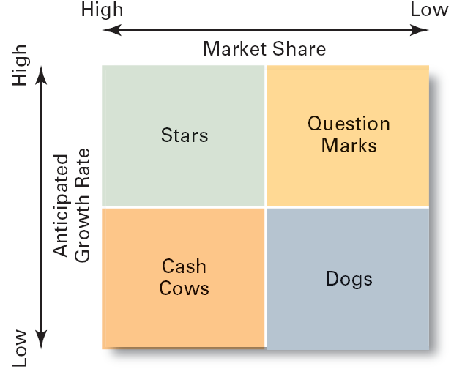
Introduction to Management (Chapter 8)

Slide 13
Introduction to Management (Chapter 8)
Competitive Strategies

Slide 14
Introduction to Management (Chapter 8)
Competitive Strategies
  A strategy focused on how an organization will compete in each of its SBUs (strategic business units).

Slide 15
Introduction to Management (Chapter 8)
Competitive Strategies
The Role of Competitive Advantage
Competitive Advantage
  An organization’s distinctive competitive edge.

Slide 16
Introduction to Management (Chapter 8)
The Role of Competitive Advantage
Quality as a Competitive Advantage
  Differentiates the firm from its competitors.
  Can create a sustainable competitive advantage.
  Represents the company’s focus on quality management to achieve continuous improvement and meet customers’ demand for quality.

Slide 17
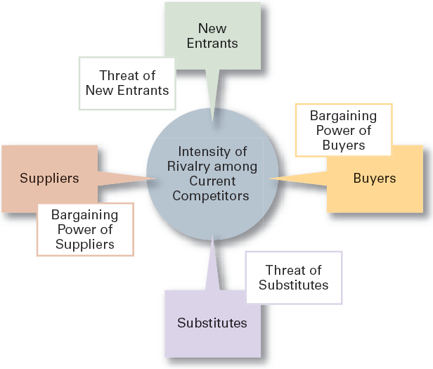
Introduction to Management (Chapter 8)
Porter Five Forces Model

Slide 18
Introduction to Management (Chapter 8)
Threat of New Entrants
  The ease or difficulty with which new competitors can enter an industry.

Slide 19
Introduction to Management (Chapter 8)
Threat of Substitutes
  The extent to which switching costs and brand loyalty affect the likelihood of customers adopting substitutes products and services.

Slide 20
Introduction to Management (Chapter 8)
Bargaining Power of Buyers
  The degree to which buyers have the market strength to hold sway over and influence competitors in an industry.

Slide 21
Introduction to Management (Chapter 8)
Bargaining Power of Suppliers
  The relative number of buyers to suppliers and threats from substitutes and new entrants affect the buyer-supplier relationship.

Slide 22
Introduction to Management (Chapter 8)
Current Rivalry
  Intensity among rivals increases when industry growth rates slow, demand falls, and product prices descend.

Slide 23
Introduction to Management (Chapter 8)
Types of Competitive Strategies
Cost Leadership Strategy
  Seeking to attain the lowest total overall costs relative to other industry competitors.

Slide 24
Introduction to Management (Chapter 8)
Types of Competitive Strategies
Differentiation Strategy
  Attempting to create a unique and distinctive product or service for which customers will pay a premium.

Slide 25
Introduction to Management (Chapter 8)
Types of Competitive Strategies
Focus Strategy
  Using a cost or differentiation advantage to exploit a particular market segment rather a larger market.

Slide 26
Introduction to Management (Chapter 8)
Strategic Management Today

Slide 27
Introduction to Management (Chapter 8)
Strategic Flexibility
New Directions in Organizational Strategies
  e-business
  customer service
  innovation

Slide 28
Introduction to Management (Chapter 8)
Creating Strategic Flexibility
Know what’s happening with strategies currently being used by monitoring and measuring results.
Encourage employees to be open about disclosing and sharing negative information.
Get new ideas and perspectives from outside the organization.
Have multiple alternatives when making strategic decisions.
Learn from mistakes.

Slide 29
Introduction to Management (Chapter 8)
Strategies for Applying
e-Business Techniques
Cost Leadership
  On-line activities: bidding, order processing, inventory control, recruitment and hiring

Slide 30
Introduction to Management (Chapter 8)
Strategies for Applying
e-Business Techniques
Differentiation
  Internet-based knowledge systems, online ordering and customer support

Slide 31
Introduction to Management (Chapter 8)
Strategies for Applying
e-Business Techniques
Focus
  Chat rooms and discussion boards, targeted Web sites

Slide 32
Introduction to Management (Chapter 8)
Customer Service Strategies
Giving the customers what they want.
Communicating effectively with them.
Providing employees with customer service training.

Slide 33
Introduction to Management (Chapter 8)
Innovation Strategies
Possible Events
  Radical breakthroughs in products.
  Application of existing technology to new uses.
Strategic Decisions about Innovation
  Basic research
  Product development
  Process innovation

Slide 34
Introduction to Management (Chapter 8)
Innovation Strategies
First Mover
  An organization that brings a product innovation to market or use a new process innovations

