Slide 1
Introduction to Management
LECTURE 17:
Introduction to Management
MGT 101

Slide 2
Introduction to Management
In lecture 16 we discussed
Topics from Chapter 7:
  Setting Goals & Developing Plans
  Approaches of Planning

Slide 3
Introduction to Management
Today in Chapter 8 we will discuss
  What is Strategic Management
  Strategic Management Process
  Types of Organizational Strategies
  Corporate Strategy- Growth Strategies

Slide 4
Introduction to Management (Chapter 8)
Chapter 8:
Strategic Management

Slide 5
Introduction to Management (Chapter 8)
Strategic Management

Slide 6
Introduction to Management (Chapter 8)
  What managers do to develop an organization’s strategies
Strategies
  The decisions and actions that determine the long-run performance of an organization.

Slide 7
Introduction to Management (Chapter 8)
  What managers do to develop an organization’s strategies
Business Model
  Is a strategic design for how a company intends to profit from its strategies, work processes, and work activities.

Slide 8
Introduction to Management (Chapter 8)
  What managers do to develop an organization’s strategies
Business Model
  Focuses on two things:
    Whether customers will value what the company is providing.
    Whether the company can make any money doing that.

Slide 9
Introduction to Management (Chapter 8)
Why Is Strategic Management Important?
It results in higher organizational performance.
It requires that managers examine and adapt to business environment changes.
It coordinates diverse organizational units, helping them focus on organizational goals

Slide 10
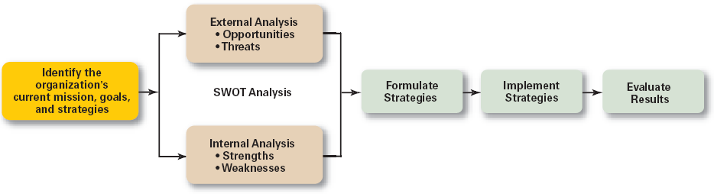
Introduction to Management (Chapter 8)
The Strategic Management Process

Slide 11
Introduction to Management (Chapter 8)
Strategic Management Process

Slide 12
Introduction to Management (Chapter 8)
Step 1: Identifying the organization’s current mission, goals, and strategies
  Mission: a statement of the purpose of an organization
    The scope of its products and services
  Goals: the foundation for further planning
    Measurable performance targets

Slide 13
Introduction to Management (Chapter 8)
Step 2: Doing an external analysis
  The environmental scanning of specific and general environments
    Focuses on identifying opportunities and threats

Slide 14
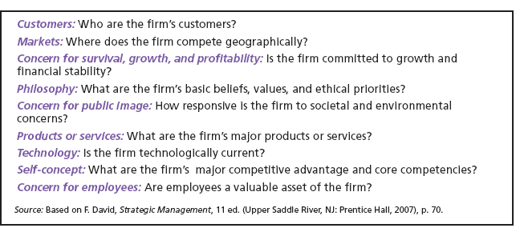
Introduction to Management (Chapter 8)
Components of a Mission Statement

Slide 15
Introduction to Management (Chapter 8)
Step 3: Doing an internal analysis
  Assessing organizational resources, capabilities, and activities:
    Strengths create value for the customer and strengthen the competitive position of the firm.
    Weaknesses can place the firm at a competitive disadvantage.

Slide 16
Introduction to Management (Chapter 8)
Step 3: Doing an internal analysis
  Analyzing financial and physical assets is fairly easy, but assessing intangible assets (employee’s skills, culture, corporate reputation, and so forth) isn’t as easy.
Steps 2 and 3 combined are called a SWOT analysis. (Strengths, Weaknesses, Opportunities, and Threats)

Slide 17
Introduction to Management (Chapter 8)
Step 4: Formulating strategies
  Develop and evaluate strategic alternatives
  Select appropriate strategies for all levels in the organization that provide relative advantage over competitors
  Match organizational strengths to environmental opportunities
  Correct weaknesses and guard against threats

Slide 18
Introduction to Management (Chapter 8)
Step 5: Implementing strategies
  Implementation: effectively fitting organizational structure and activities to the environment.
  The environment dictates the chosen strategy; effective strategy implementation requires an organizational structure matched to its requirements.

Slide 19
Introduction to Management (Chapter 8)
Step 6: Evaluating results
  How effective have strategies been?
  What adjustments, if any, are necessary?

Slide 20
Introduction to Management (Chapter 8)
Types of Organizational Strategies

Slide 21
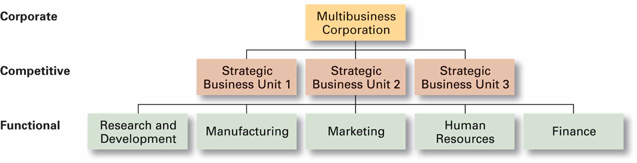
Introduction to Management (Chapter 8)
Types of Organizational Strategies

Slide 22
Introduction to Management (Chapter 8)
Corporate Strategies
  Top management’s overall plan for the entire organization and its strategic business units

Slide 23
Introduction to Management (Chapter 8)
Corporate Strategies
Types of Corporate Strategies
  Growth: expansion into new products and markets
  Stability: maintenance of the status quo
  Renewal: examination of organizational weaknesses that are leading to performance declines

Slide 24
Introduction to Management (Chapter 8)
Growth Strategy
  Seeking to increase the organization’s business by expansion into new products and markets.

Slide 25
Introduction to Management (Chapter 8)
Growth Strategy
Types of Growth Strategies
  Concentration
  Vertical integration
  Horizontal integration
  Diversification

Slide 26
Introduction to Management (Chapter 8)
Concentration
  Focusing on a primary line of business and increasing the number of products offered or markets served.

Slide 27
Introduction to Management (Chapter 8)
Vertical Integration
  Backward vertical integration: attempting to gain control of inputs (become a self-supplier).
  Forward vertical integration: attempting to gain control of output through control of the distribution channel or provide customer service activities (eliminating intermediaries).

Slide 28
Introduction to Management (Chapter 8)
Horizontal Integration
  Combining operations with another competitor in the same industry to increase competitive strengths and lower competition among industry rivals.

Slide 29
Introduction to Management (Chapter 8)
Related Diversification
  Expanding by combining with firms in different, but related industries that are “strategic fits.”
Unrelated Diversification
  Growing by combining with firms in unrelated industries where higher financial returns are possible.

