Slide 1
Introduction to Management
LECTURE 16:
Introduction to Management
MGT 101

Slide 2
Introduction to Management
In lecture 15 we discussed
Topics from Chapter 7:
  What is Planning?
  Types of Plans

Slide 3
Introduction to Management
Today in Chapter 7 we will discuss
  Setting Goals & Developing Plans
  Approaches of Planning

Slide 4
Introduction to Management (Chapter 7)
Chapter 7:
Foundations of Planning

Slide 5
Introduction to Management (Chapter 7)
Setting Goals & Developing Plans

Slide 6
Introduction to Management (Chapter 7)
Traditional Goal Setting
  Broad goals are set at the top of the organization.
  Goals are then broken into sub-goals for each organizational level.

Slide 7
Introduction to Management (Chapter 7)
Traditional Goal Setting
  Assumes that top management knows best because they can see the “big picture.”
  Goals are intended to direct and guide.

Slide 8
Introduction to Management (Chapter 7)
Traditional Goal Setting
  Goals lose clarity and focus as lower-level managers attempt to interpret and define the goals for their areas of responsibility.

Slide 9
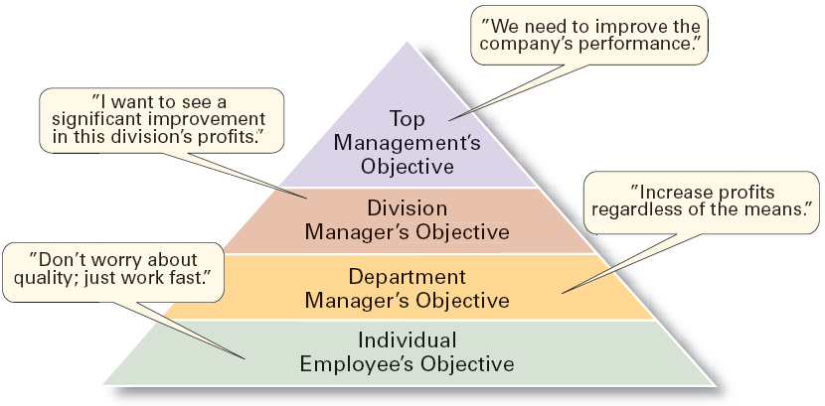
Introduction to Management (Chapter 7)
The Downside of Traditional Goal Setting

Slide 10
Introduction to Management (Chapter 7)
Maintaining the Hierarchy of Goals
  Means–Ends Chain
    The integrated network of goals that results from establishing a clearly-defined hierarchy of organizational goals.
    Achievement of lower-level goals is the means by which to reach higher-level goals (ends).

Slide 11
Introduction to Management (Chapter 7)
Management By Objectives (MBO)
  Specific performance goals are jointly determined by employees and managers.

Slide 12
Introduction to Management (Chapter 7)
Management By Objectives (MBO)
  Progress toward accomplishing goals is periodically reviewed.
  Rewards are allocated on the basis of progress towards the goals.

Slide 13
Introduction to Management (Chapter 7)
Management By Objectives (MBO)
  Key elements of MBO:
    Goal specificity
    Participative decision making
    Explicit performance/evaluation period
    Feedback

Slide 14
Introduction to Management (Chapter 7)
Steps in a Typical MBO Program
The organization’s overall objectives and strategies are formulated.
Major objectives are allocated among divisional and departmental units.
Unit managers collaboratively set specific objectives for their units with their managers.
Specific objectives are collaboratively set with all department members.

Slide 15
Introduction to Management (Chapter 7)
Steps in a Typical MBO Program
Action plans, defining how objectives are to be achieved, are specified and agreed upon by managers and employees.
The action plans are implemented.
Progress toward objectives is periodically reviewed, and feedback is provided.
Successful achievement of objectives is reinforced by performance-based rewards.

Slide 16
Introduction to Management (Chapter 7)
Does MBO Work?
Reason for MBO Success
  Top management commitment and involvement

Slide 17
Introduction to Management (Chapter 7)
Does MBO Work?
Potential Problems with MBO Programs
  Not as effective in dynamic environments that require constant resetting of goals.
  Overemphasis on individual accomplishment may create problems with teamwork.
  Allowing the MBO program to become an annual paperwork shuffle.

Slide 18
Introduction to Management (Chapter 7)
Well Written Goals
Written in terms of outcomes, not actions
  Focuses on the ends, not the means.
Measurable and quantifiable
  Specifically defines how the outcome is to be measured and how much is expected.
Clear as to time frame
  How long before measuring accomplishment.

Slide 19
Introduction to Management (Chapter 7)
Well Written Goals
Challenging yet attainable
  Low goals do not motivate.
  High goals motivate if they can be achieved.
Written down
  Focuses, defines, and makes goals visible.
Communicated to all necessary organizational members
  Puts everybody “on the same page.”

Slide 20
Introduction to Management (Chapter 7)
Steps in Goal Setting
Review the organization’s mission statement.
  Do goals reflect the mission?
Evaluate available resources.
  Are resources sufficient to accomplish the mission?

Slide 21
Introduction to Management (Chapter 7)
Steps in Goal Setting
Determine goals individually or with others.
  Are goals specific, measurable, and timely?
Write down the goals and communicate them.
  Is everybody on the same page?

Slide 22
Introduction to Management (Chapter 7)
Steps in Goal Setting
Review results and whether goals are being met.
  What changes are needed in mission, resources, or goals?

Slide 23
Introduction to Management (Chapter 7)
Developing Plans
Contingency Factors in a Manager’s Planning
  Manager’s level in the organization
    Strategic plans at higher levels
    Operational plans at lower levels

Slide 24
Introduction to Management (Chapter 7)
Developing Plans
  Degree of environmental uncertainty
    Stable environment: specific plans
    Dynamic environment: specific but flexible plans

Slide 25
Introduction to Management (Chapter 7)
Developing Plans
  Length of future commitments
    Commitment Concept: current plans affecting future commitments must be sufficiently long-term to meet those commitments.

Slide 26
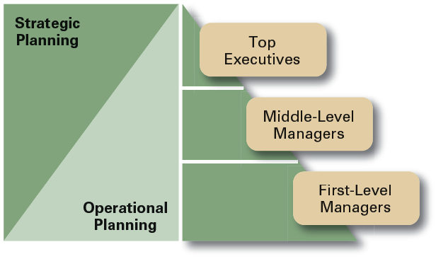
Introduction to Management (Chapter 7)

Slide 27
Introduction to Management (Chapter 7)
Approaches of Planning

Slide 28
Introduction to Management (Chapter 7)
Establishing a formal planning department
  A group of planning specialists who help managers write organizational plans.
  Planning is a function of management; it should never become the sole responsibility of planners.

Slide 29
Introduction to Management (Chapter 7)
Involving organizational members in the process
  Plans are developed by members of organizational units at various levels and then coordinated with other units across the organization.

Slide 30
Introduction to Management (Chapter 7)
Contemporary Issues in Planning
Criticisms of Planning
  Planning may create rigidity.
  Plans cannot be developed for dynamic environments.
  Formal plans cannot replace intuition and creativity.

Slide 31
Introduction to Management (Chapter 7)
Contemporary Issues in Planning
Criticisms of Planning
  Planning focuses managers’ attention on today’s competition not tomorrow’s survival.
  Formal planning reinforces today’s success, which may lead to tomorrow’s failure.
  Just planning isn’t enough.

Slide 32
Introduction to Management (Chapter 7)
Effective Planning in Dynamic Environments
  Develop plans that are specific but flexible.
  Understand that planning is an ongoing process.
  Change plans when conditions warrant.
  Persistence in planning eventually pay off.
  Flatten the organizational hierarchy to foster the development of planning skills at all organizational levels.

