Slide 1
Introduction to Management
LECTURE 15:
Introduction to Management
MGT 101

Slide 2
Introduction to Management
In lecture 14 we discussed
Topics from Chapter 6:
  Intuition
  Types of Problems & Decision Making
  Decision Making Conditions
  Common Decision Making Errors & Biases

Slide 3
Introduction to Management
Today in Chapter 7 we will discuss
  What is Planning?
  Types of Plans

Slide 4
Introduction to Management (Chapter 7)
Chapter 7:
Foundations of Planning

Slide 5
Introduction to Management (Chapter 7)
What is Planning ?

Slide 6
Introduction to Management (Chapter 7)
Planning
  A primary managerial activity that involves:
    Defining the organization’s goals
    Establishing an overall strategy for achieving those goals
    Developing plans for organizational work activities

Slide 7
Introduction to Management (Chapter 7)
  Formal planning
    Specific goals covering a specific time period
    Written and shared with organizational members

Slide 8
Introduction to Management (Chapter 7)
Purposes of Planning
  Provides direction
  Reduces uncertainty
  Minimizes waste and redundancy
  Sets the standards for controlling

Slide 9
Introduction to Management (Chapter 7)
The Relationship Between Planning and Performance
  Formal planning is associated with:
    Higher profits and returns on assets.
    Positive financial results.

Slide 10
Introduction to Management (Chapter 7)
The Relationship Between Planning and Performance
  The quality of planning and implementation affects performance more than the extent of planning.

Slide 11
Introduction to Management (Chapter 7)
The Relationship Between Planning and Performance
  The external environment can reduce the impact of planning on performance.

Slide 12
Introduction to Management (Chapter 7)
The Relationship Between Planning and Performance
  Formal planning must be used for several years before planning begins to affect performance.

Slide 13
Introduction to Management (Chapter 7)
Elements of Planning
  1. Goals (also Objectives)
    Desired outcomes for individuals, groups, or entire organizations
    Provide direction and evaluation performance criteria

Slide 14
Introduction to Management (Chapter 7)
Elements of Planning
  2. Plans
    Documents that outline how goals are to be accomplished
    Describe how resources are to be allocated and establish activity schedules

Slide 15
Introduction to Management (Chapter 7)
Financial Goals
Are related to the expected internal financial performance of the organization.

Slide 16
Introduction to Management (Chapter 7)
Strategic Goals
  Are related to the performance of the firm relative to factors in its external environment (e.g., competitors).

Slide 17
Introduction to Management (Chapter 7)
Stated Goals versus Real Goals
  Broadly-worded official statements of the organization (intended for public consumption) that may be irrelevant to its real goals (what actually goes on in the organization).

Slide 18
Introduction to Management (Chapter 7)
Types of Plans

Slide 19
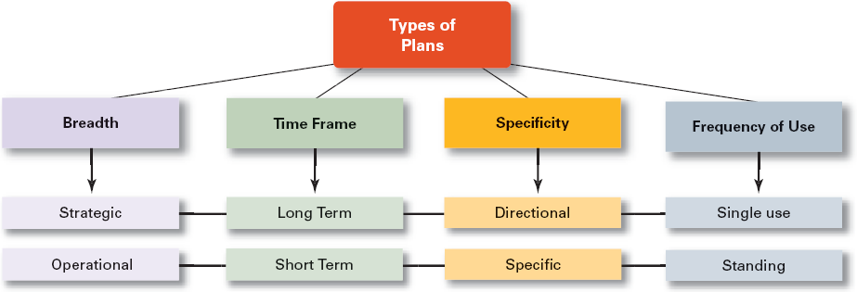
Introduction to Management (Chapter 7)

Slide 20
Introduction to Management (Chapter 7)
Strategic Plans
  Apply to the entire organization.
  Establish the organization’s overall goals.
  Seek to position the organization in terms of its environment.
  Cover extended periods of time.

Slide 21
Introduction to Management (Chapter 7)
Operational Plans
  Specify the details of how the overall goals are to be achieved.
  Cover a short time period.

Slide 22
Introduction to Management (Chapter 7)
Long-Term Plans
  Plans with time frames extending beyond three years
Short-Term Plans
  Plans with time frames of one year or less

Slide 23
Introduction to Management (Chapter 7)
Specific Plans
  Plans that are clearly defined and leave no room for interpretation
Directional Plans
  Flexible plans that set out general guidelines and provide focus, yet allow discretion in implementation

Slide 24
Introduction to Management (Chapter 7)
Single-Use Plan
  A one-time plan specifically designed to meet the need of a unique situation.
Standing Plans
  Ongoing plans that provide guidance for activities performed repeatedly.

Slide 25
Introduction to Management (Chapter 7)

