Slide 1
Introduction to Management
LECTURE 14:
Introduction to Management
MGT 101

Slide 2
Introduction to Management
In lecture 13 we discussed
Topics from Chapter 6:
  Decision Making
  Stages of Decision Making
  Rationality & Bounded Rationality

Slide 3
Introduction to Management
Today in Chapter 6 we will discuss
  Intuition
  Types of Problems & Decision Making
  Decision Making Conditions
  Common Decision Making Errors & Biases

Slide 4
Introduction to Management (Chapter 6)
Chapter 6:
Managers as Decision Makers

Slide 5
Introduction to Management (Chapter 6)
Intuition

Slide 6
Introduction to Management (Chapter 6)
Intuitive decision making
  Making decisions on the basis of experience, feelings, and accumulated judgment.

Slide 7
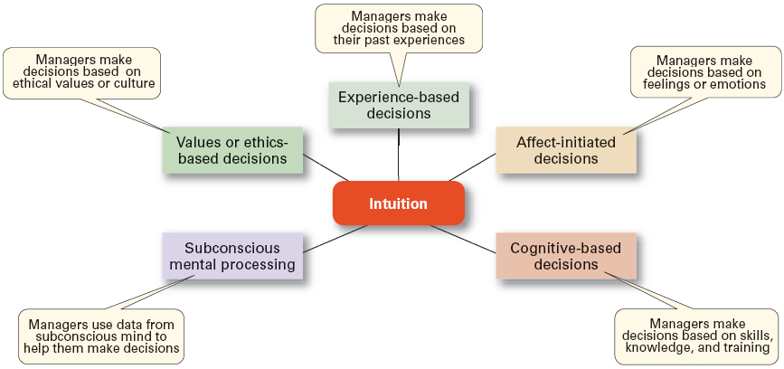
Introduction to Management (Chapter 6)

Slide 8
Introduction to Management (Chapter 6)
Types of Problem & Decision Making

Slide 9
Introduction to Management (Chapter 6)
Structured Problems
  Involve goals that are clear.
  Are familiar (have occurred before).
  Are easily and completely defined—information about the problem is available and complete.

Slide 10
Introduction to Management (Chapter 6)
Programmed Decision
  A repetitive decision that can be handled by a routine approach.

Slide 11
Introduction to Management (Chapter 6)
Types of Programmed Decisions
Procedure
  A series of interrelated steps that a manager can use to respond (applying a policy) to a structured problem.

Slide 12
Introduction to Management (Chapter 6)
Types of Programmed Decisions
Rule
  An explicit statement that limits what a manager or employee can or cannot do.

Slide 13
Introduction to Management (Chapter 6)
Types of Programmed Decisions
Policy
  A general guideline for making a decision about a structured problem.

Slide 14
Introduction to Management (Chapter 6)
Policy, Procedure, and Rule Examples
Policy
  Accept all customer-returned merchandise.
Procedure
  Follow all steps for completing merchandise return documentation.
Rules
  Managers must approve all refunds over $50.00.
  No credit purchases are refunded for cash.

Slide 15
Introduction to Management (Chapter 6)
Unstructured Problems
  Problems that are new or unusual and for which information is ambiguous or incomplete.
  Problems that will require custom-made solutions.

Slide 16
Introduction to Management (Chapter 6)
Nonprogrammed Decisions
  Decisions that are unique and nonrecurring.
  Decisions that generate unique responses.

Slide 17
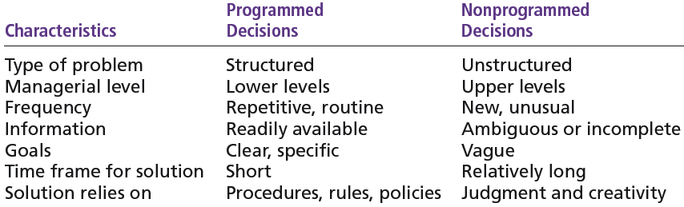
Introduction to Management (Chapter 6)

Slide 18
Introduction to Management (Chapter 6)
Decision Making Conditions

Slide 19
Introduction to Management (Chapter 6)
Certainty
  A situation in which a manager can make an accurate decision because the outcome of every alternative choice is known.

Slide 20
Introduction to Management (Chapter 6)
Risk
  A situation in which the manager is able to estimate the likelihood (probability) of outcomes that result from the choice of particular alternatives.

Slide 21
Introduction to Management (Chapter 5)
Expected
Expected × Probability = Value of Each
Event Revenues Alternative
Heavy snowfall $850,000 0.3 = $255,000
Normal snowfall 725,000 0.5 = 362,500
Light snowfall 350,000 0.2 = 70,000
$687,500

Slide 22
Introduction to Management (Chapter 6)
Uncertainty
  Limited information prevents estimation of outcome probabilities for alternatives associated with the problem and may force managers to rely on intuition, hunches, and “gut feelings.”

Slide 23
Introduction to Management (Chapter 6)
Uncertainty
    Maximax: the optimistic manager’s choice to maximize the maximum payoff
    Maximin: the pessimistic manager’s choice to maximize the minimum payoff
    Minimax: the manager’s choice to minimize maximum regret.

Slide 24
Introduction to Management (Chapter 6)
Common Decision Making Errors & Biases

Slide 25
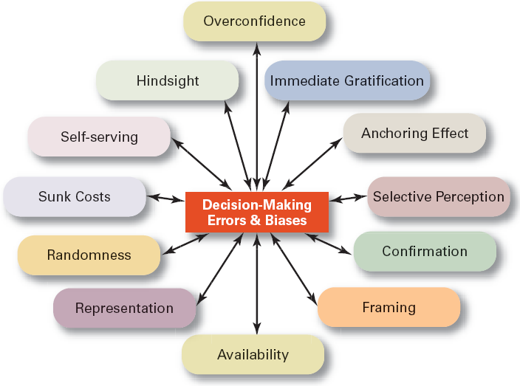
Introduction to Management (Chapter 6)

Slide 26
Introduction to Management (Chapter 6)
Heuristics
  Using “rules of thumb” to simplify decision making.
Overconfidence Bias
  Holding unrealistically positive views of oneself and one’s performance.
Immediate Gratification Bias
  Choosing alternatives that offer immediate rewards and that to avoid immediate costs.

Slide 27
Introduction to Management (Chapter 6)
Anchoring Effect
  Fixating on initial information and ignoring subsequent information.
Selective Perception Bias
  Selecting organizing and interpreting events based on the decision maker’s biased perceptions.
Confirmation Bias
  Seeking out information that reaffirms past choices and discounting contradictory information.

Slide 28
Introduction to Management (Chapter 6)
Sunk Costs Errors
  Forgetting that current actions cannot influence past events and relate only to future consequences.
Self-Serving Bias
  Taking quick credit for successes and blaming outside factors for failures.
Hindsight Bias
  Mistakenly believing that an event could have been predicted once the actual outcome is known (after-the-fact).

Slide 29
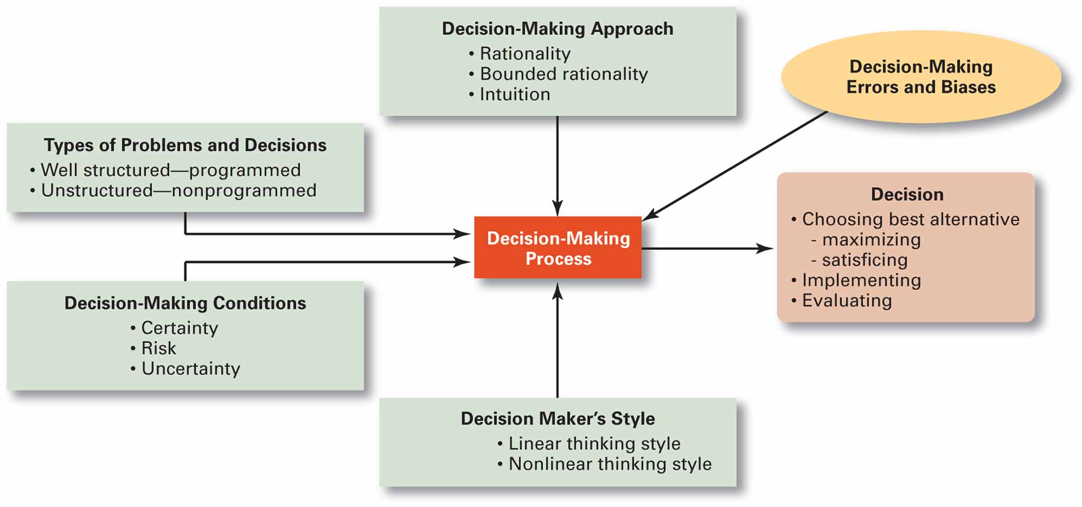
Introduction to Management (Chapter 6)

