Slide 1
Introduction to Management
LECTURE 13:
Introduction to Management
MGT 101

Slide 2
Introduction to Management
In lecture 12 we discussed
Topic from Chapter 5:
  How managers can improve ethics in organization ?

Slide 3
Introduction to Management
Today in Chapter 5 we will discuss
  Being an Ethical Decision Maker
  And in Chapter 6 we will discuss
  Decision Making
  Stages of Decision Making
  Rationality & Bounded Rationality

Slide 4
Introduction to Management (Chapter 5)
Chapter 5:
Social Responsibility & Managerial Ethics

Slide 5
Introduction to Management (Chapter 5)
Being an Ethical Leader

Slide 6
Introduction to Management (Chapter 5)
Be a good role model by being ethical and honest.
° Tell the truth always.
° Don’t hide or manipulate information
° Be willing to admit your failures.

Slide 7
Introduction to Management (Chapter 5)
Share your personal values by regularly communicating them to employees.
Stress the organization’s or team’s important shared values.
Use the reward system to hold everyone accountable to the values.

Slide 8
Introduction to Management (Chapter 5)
Managing Ethical Lapses and Social Irresponsibility
Provide ethical leadership
Protect employees who raise ethical issues (whistle-blowers)

Slide 9
Introduction to Management (Chapter 5)
Businesses Promoting Positive Social Change
Corporate Philanthropy
  Campaigns
  Donations
  Funding own foundations

Slide 10
Introduction to Management (Chapter 6)
Chapter 6:
Managers as Decision Makers

Slide 11
Introduction to Management (Chapter 6)
Decision Making

Slide 12
Introduction to Management (Chapter 6)
Decision
  Making a choice from two or more alternatives.

Slide 13
Introduction to Management (Chapter 6)
The Decision-Making Process
  Identifying a problem and decision criteria and allocating weights to the criteria.
  Developing, analyzing, and selecting an alternative that can resolve the problem.
  Implementing the selected alternative.
  Evaluating the decision’s effectiveness.

Slide 14
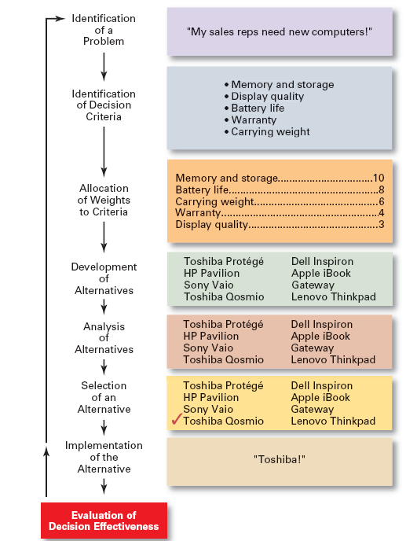
Introduction to Management (Chapter 6)

Slide 15
Introduction to Management (Chapter 6)
Identifying the Problem

Slide 16
Introduction to Management (Chapter 6)
Problem
  A discrepancy between an existing and desired state of affairs.

Slide 17
Introduction to Management (Chapter 6)
Characteristics of Problems
  A problem becomes a problem when a manager becomes aware of it.
  There is pressure to solve the problem.
  The manager must have the authority, information, or resources needed to solve the problem.

Slide 18
Introduction to Management (Chapter 6)
Identifying the Decision Criteria

Slide 19
Introduction to Management (Chapter 6)
Decision criteria are factors that are important (relevant) to resolving the problem such as:
  Costs that will be incurred (investments required)
  Risks likely to be encountered (chance of failure)
  Outcomes that are desired (growth of the firm)

Slide 20
Introduction to Management (Chapter 6)
Allocating Weights to the Criteria

Slide 21
Introduction to Management (Chapter 6)
Decision criteria are not of equal importance:
  Assigning a weight to each item places the items in the correct priority order of their importance in the decision-making process.

Slide 22
Introduction to Management (Chapter 6)
Criterion Weight
Memory and Storage 10
Battery life 8
Carrying Weight 6
Warranty 4
Display Quality 3

Slide 23
Introduction to Management (Chapter 6)
Selecting an Alternative

Slide 24
Introduction to Management (Chapter 6)
Choosing the best alternative
  The alternative with the highest total weight is chosen.

Slide 25
Introduction to Management (Chapter 6)
Implementing the Alternative

Slide 26
Introduction to Management (Chapter 6)
Putting the chosen alternative into action.
  Conveying the decision to and gaining commitment from those who will carry out the decision.

Slide 27
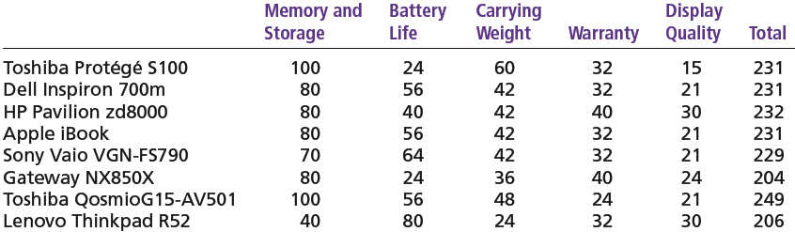
Introduction to Management (Chapter 6)

Slide 28
Introduction to Management (Chapter 6)
Evaluating the Decision’s Effectiveness

Slide 29
Introduction to Management (Chapter 6)
The soundness of the decision is judged by its outcomes.
  How effectively was the problem resolved by outcomes resulting from the chosen alternatives?
  If the problem was not resolved, what went wrong?

Slide 30
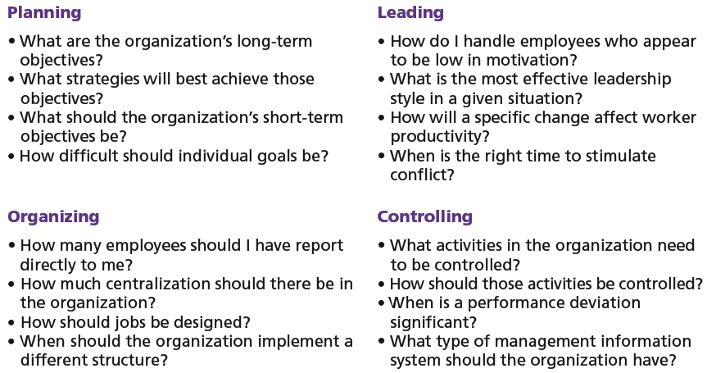
Introduction to Management (Chapter 6)

Slide 31
Introduction to Management (Chapter 6)
Making Decision

Slide 32
Introduction to Management (Chapter 6)
Rationality
  Managers make consistent, value-maximizing choices with specified constraints.

Slide 33
Introduction to Management (Chapter 6)
  Assumptions are that decision makers:
    Are perfectly rational, fully objective, and logical.
    Have carefully defined the problem and identified all viable alternatives.
    Have a clear and specific goal
    Will select the alternative that maximizes outcomes in the organization’s interests rather than in their personal interests.

Slide 34
Introduction to Management (Chapter 6)
Bounded Rationality
  Managers make decisions rationally, but are limited (bounded) by their ability to process information.

Slide 35
Introduction to Management (Chapter 6)
  Assumptions are that decision makers:
    Will not seek out or have knowledge of all alternatives
    Will satisfice—choose the first alternative encountered that satisfactorily solves the problem—rather than maximize the outcome of their decision by considering all alternatives and choosing the best.

Slide 36
Introduction to Management (Chapter 6)
  Influence on decision making
    Escalation of commitment: an increased commitment to a previous decision despite evidence that it may have been wrong.

