Slide 1
Introduction to Management
LECTURE 10:
Introduction to Management
MGT 101

Slide 2
Introduction to Management
In lecture 9 we discussed
Topics from Chapter 4:
  How Organizations go Global?
  Global Environment & Issues
  Hofstede’s Cultural dimensions
  Challenges & Risks

Slide 3
Introduction to Management
Today in Chapter 5 we will discuss
  Obligations, Responsiveness & Responsibility
  Social Responsibility
  Greening of Management

Slide 4
Introduction to Management (Chapter 5)
Chapter 5:
Social Responsibility & Managerial Ethics

Slide 5
Introduction to Management (Chapter 5)
Obligation, Responsiveness & Responsibility

Slide 6
Introduction to Management (Chapter 5)
Social Obligation
  The obligation of a business is to meet its economic and legal responsibilities and nothing more.

Slide 7
Introduction to Management (Chapter 5)
Social Responsiveness
  When a firm engages in social actions in response to some popular social need.

Slide 8
Introduction to Management (Chapter 5)
Social Responsibility
  A business’s intention, beyond its legal and economic obligations, to do the right things and act in ways that are good for society.

Slide 9


Slide 10
Introduction to Management (Chapter 5)
Social Responsibility

Slide 11
Introduction to Management (Chapter 5)
The Classical View
  Management’s only social responsibility is to maximize profits (create a financial return) by operating the business in the best interests of the stockholders (owners of the corporation).

Slide 12
Introduction to Management (Chapter 5)
The Classical View
  Expending the firm’s resources on doing “social good” unjustifiably increases costs that lower profits to the owners and raises prices to consumers.

Slide 13
Introduction to Management (Chapter 5)
The Socioeconomic View
  Management’s social responsibility goes beyond making profits to include protecting and improving society’s welfare.
  Corporations are not independent entities responsible only to stockholders.

Slide 14
Introduction to Management (Chapter 5)
The Socioeconomic View
  Firms have a moral responsibility to larger society to become involved in social, legal, and political issues.
  “To do the right thing”

Slide 15
Introduction to Management (Chapter 5)
Social Responsibility Social Responsiveness
Major consideration Ethical Pragmatic
Focus Ends Means
Emphasis Obligation Responses
Decision framework Long term Medium and short term

Slide 16
Introduction to Management (Chapter 5)
Arguments For and Against Social Responsibility
For
  Public expectations
  Long-run profits
  Ethical obligation
  Public image
  Better environment
  Discouragement of further governmental regulation
  Balance of responsibility and power
  Stockholder interests
  Possession of resources
  Superiority of prevention over cures
Against
  Violation of profit maximization
  Dilution of purpose
  Costs
  Too much power
  Lack of skills
  Lack of accountability

Slide 17
Introduction to Management (Chapter 5)
Does Social Responsibility Pay ?

Slide 18
Introduction to Management (Chapter 5)
Studies appear to show a positive relationship between social involvement and the economic performance of firms.
  Difficulties in defining and measuring “social responsibility” and “economic performance” raise issues of validity and causation in the studies.
  Mutual funds using social screening in investment decisions slightly outperformed other mutual funds.

Slide 19
Introduction to Management (Chapter 5)
A general conclusion is that a firm’s social actions do not harm its long-term performance.

Slide 20
Introduction to Management (Chapter 5)
Greening of Management

Slide 21
Introduction to Management (Chapter 5)
The recognition of the close link between an organization’s decision and activities and its impact on the natural environment.
  Global environmental problems facing managers:
    Air, water, and soil pollution from toxic wastes
    Global warming from greenhouse gas emissions
    Natural resource depletion

Slide 22
Introduction to Management (Chapter 5)
How Organizations Go Green
Legal (or Light Green) Approach
  Firms simply do what is legally required by obeying laws, rules, and regulations willingly and without legal challenge.
Market Approach
  Firms respond to the preferences of their customers for environmentally friendly products.

Slide 23
Introduction to Management (Chapter 5)
Stakeholder Approach
  Firms work to meet the environmental demands of multiple stakeholders—employees, suppliers, and the community.
Activist Approach
  Firms look for ways to respect and preserve environment and be actively socially responsible.

Slide 24
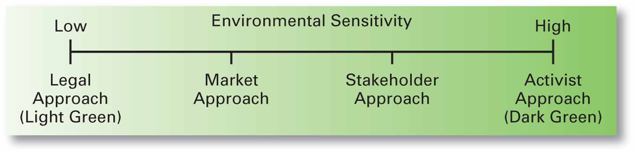
Introduction to Management (Chapter 5)

Slide 25
Introduction to Management (Chapter 5)
Evaluating the Greening of Management
Organizations become “greener” by
  Using the Sustainability Reporting Guidelines to document “green” actions.
  Adopting ISO 14000 standards for environmental management.
  Being named as one of the 100 Most Sustainable Corporations in the World.

