Slide 1

Introduction to Management
Reserved Area
LECTURE 1:
Introduction to Management
MGT 101

Slide 2
Introduction to Management
Reserved Area
Course Objectives:
1. To provide students with the theoretical background regarding Introduction to management.
2. To assist students in applying acquired skills and knowledge to real-life situations.
3. To provide a virtual classroom environment that enhances the quality of learning of the off campus students.

Slide 3
Introduction to Management
Reserved Area
Course Policy
Course Description:
  Management and theories.
  Organizational Culture
  Decision Making
  Planning Fundamentals
  Organizational Structure
  Strategic Management
  Organizing
  Human Resource Management
  Leadership
  Understanding groups and teams
  Motivating Employees
  Communication
  Controlling

Slide 4
Introduction to Management
Reserved Area
Course Policy (Contd.)
Marks Distribution:
Marks
Assignments (04) : 15
Quiz (04) : 10
Sessional Exam 1 : 10
Sessional Exam 2 : 15
Internal Marks : 50
5. Final Examination : 50
Total : 100
Passing Marks: 50

Slide 5
Introduction to Management
Reserved Area
Course Policy (Contd.)
Text Book:
Management, 10th Edition by Stephen P. Robbins & Mary Coulter, Pearson-Education.
Reference Text:
Management by Chuck Williams, South-Western Publishing.

Slide 6
Introduction to Management
Reserved Area
Chapter 1:
Introduction to Management and Organizations

Slide 7
Introduction to Management (Chapter 1)
Reserved Area
In this chapter we will discuss:
  What is Management ?
  Who is a Manager ?
  Types of Managers.
  Functions Managers perform.
  Managerial Roles.
  Skills Manager Require.
  What is an Organization ?
  Why Study Management ?

Slide 8
Introduction to Management (Chapter 1)
Reserved Area
What is Management ?
Getting work
done through
others
Efficiency
Effectiveness

Slide 9
Introduction to Management (Chapter 1)
Reserved Area
What is Management ? (Contd.)
Efficiency
  Getting work done with a minimum of effort, expense, or waste
  Doings things right—most output for least input
Effectiveness
  Accomplishing tasks that help fulfill organizational objectives
  Doing the right things

Slide 10
Introduction to Management (Chapter 1)
Reserved Area
What is Management ? (Contd.)
Management involves coordinating and overseeing the work activities of others so that their activities are completed efficiently and effectively.
Who is a Manager ?
  Someone who coordinates and oversees the work of other people so that organizational goals can be accomplished.

Slide 11
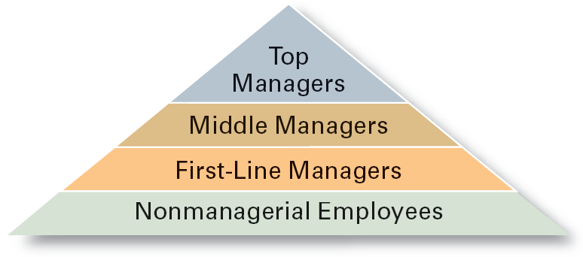
Introduction to Management (Chapter 1)
Reserved Area
Types of Managers?

Slide 12
Introduction to Management (Chapter 1)
Reserved Area
Types of Managers?
First-line Managers
Manage the performance of entry-level employees
Encourage, monitor, and reward the performance of workers
Teach entry-level employees how to do their jobs
Make detailed schedules and operating plans

Slide 13
Introduction to Management (Chapter 1)
Reserved Area
Types of Managers? (Contd.)
Middle Managers
Plan and allocate resources to meet objectives
Coordinate and link groups, departments, and divisions
Monitor and manage the performance
of subunits and managers who report to them
Implement changes or strategies generated by top managers

Slide 14
Introduction to Management (Chapter 1)
Reserved Area
Types of Managers? (Contd.)
Top Managers
Creating a context for change
Developing commitment and ownership in employees
Creating a positive organizational culture through
language and action
Monitoring their business environments

Slide 15
Introduction to Management (Chapter 1)
Reserved Area
Functions Managers Perform?
Planning
Determining organizational goals and means for achieving them
Organizing
Deciding where decisions will be made
Who will do what jobs and tasks
Who will work for whom
Leading
    Working with and through people to accomplish goals.
Controlling
Monitoring progress toward goal achievement and taking corrective action when needed

Slide 16
Introduction to Management (Chapter 1)
Reserved Area
Managerial Roles (Contd.)
Informational
Role | Activity | Examples
Monitor | Seek and acquire work related information. | Scan/read trade press, periodicals and reports; attend seminars and training; maintain personal contacts.
Disseminator | Communicate/disseminate information to others within the organization. | Send memos and reports; information staffers and subordinates of decisions.
Spokesperson | Communicate/transmit information to outsiders. | Pass on memos, reports and informational materials; participate in conferences/meetings and report progress.

Slide 17
Introduction to Management (Chapter 1)
Reserved Area
Managerial Roles (Contd.)
Interpersonal
Role | Activity | Examples
Figurehead | Perform social and legal duties, act as symbolic leader. | Greet visitors, sign legal documents, attend ribbon cutting ceremonies etc.
Leader | Direct and motivate subordinates, select and train employees. | Includes almost all interactions with subordinates.
Liaison | Establish and maintain contacts within and outside the organization. | Business correspondence, participation in meetings with representatives of other divisions and organizations.

Slide 18
Introduction to Management (Chapter 1)
Reserved Area
Managerial Roles (Contd.)
Decisional
Role | Activity | Examples
Decisional | Identify new ideas and initiate improvement projects. | Implement innovations; Plan for the future.
Disturbance Handler | Deals with dispute or problems and takes corrective actions. | Settle conflicts between subordinates; choose strategic alternatives; Overcome crisis situations.
Resource Allocator | Decides where to apply resources. | Draft and approval of plans, schedules, budgets; Set priorities.
Negotiator | Negotiates to have a win situation for the organization. | Negotiating a business deal.

Slide 19
Introduction to Management (Chapter 1)
Reserved Area
What Skills Manager Require ?
Technical Skills
Human Skills
Conceptual Skills
Motivation to Manage

Slide 20
Introduction to Management (Chapter 1)
Reserved Area
Skills Manager Require ? (Contd.)
Technical Skills
    Knowledge and proficiency in a specific field
Human Skills
    The ability to work well with other people
Conceptual Skills
    The ability to think and conceptualize about abstract and complex situations concerning the organization

Slide 21
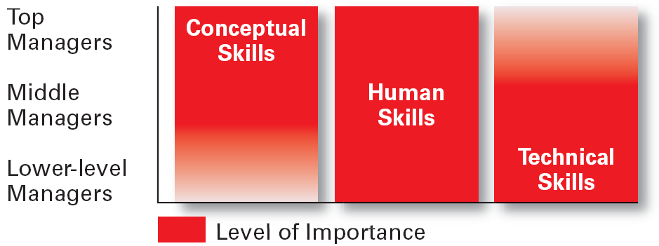
Introduction to Management (Chapter 1)
Reserved Area
Skills Manager Require ? (Contd.)

Slide 22
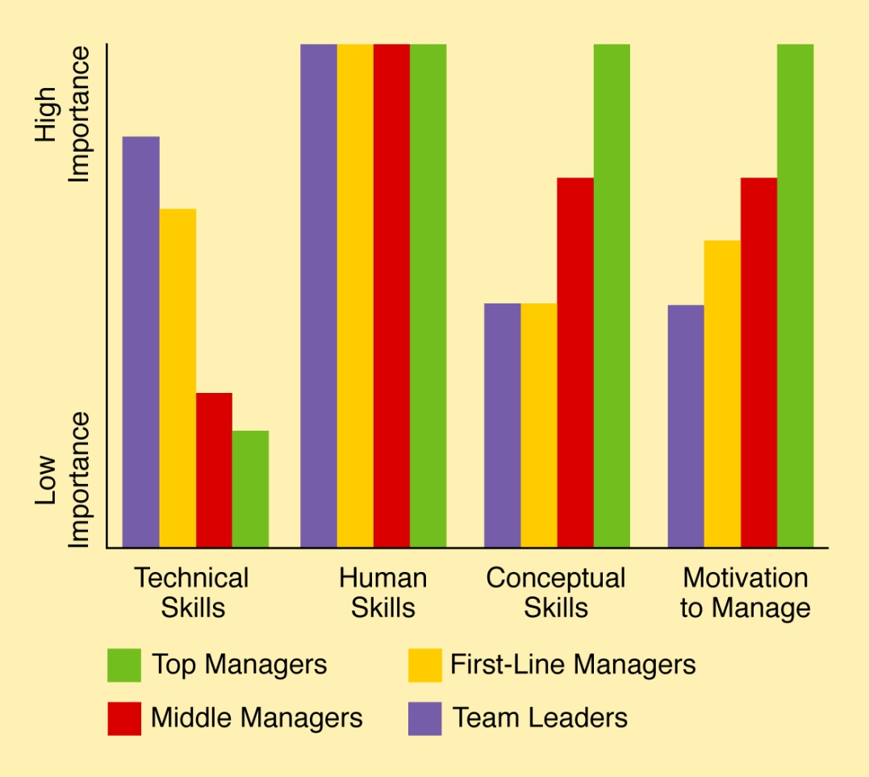
Introduction to Management (Chapter 1)
Reserved Area
Skills Manager Require ? (Contd.)

Slide 23
Introduction to Management (Chapter 1)
Reserved Area
Skills Manager Require ? (Contd.)
Conceptual Skills
Ability to use information to solve business problems
Identification of opportunities for innovation
Recognition of problem areas and implementation of solutions
Selection of critical information from masses of data
Understanding of business uses of technology
Understanding of organization’s business model

Slide 24
Introduction to Management (Chapter 1)
Reserved Area
Skills Manager Require ? (Contd.)
Interpersonal Skills
Coaching and mentoring skills
Diversity skills: working with diverse people and cultures
Networking within the organization
Networking outside the organization
Working in teams; cooperation and commitment

Slide 25
Introduction to Management (Chapter 1)
Reserved Area
Skills Manager Require ? (Contd.)
Communication Skills
Ability to transform ideas into words and actions
Credibility among colleagues, peers, and subordinates
Listening and asking questions
Presentation skills; spoken format
Presentation skills; written and/or graphic formats

Slide 26
Introduction to Management (Chapter 1)
Reserved Area
Skills Manager Require ? (Contd.)
Effectiveness Skills
Contributing to corporate mission/departmental objectives
Customer focus
Multitasking: working at multiple tasks in parallel
Negotiating skills
Project management
Reviewing operations and implementing improvements

Slide 27
Introduction to Management (Chapter 1)
Reserved Area
What is an Organization?
  A deliberate arrangement of people to accomplish some specific purpose.
  Common Characteristics
  Have a distinct purpose (goal)
  Composed of people
  Have a deliberate structure

Slide 28
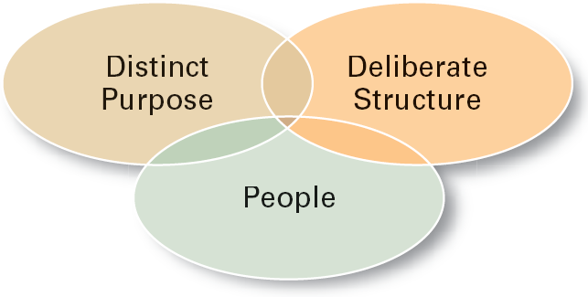
Introduction to Management (Chapter 1)
Reserved Area
What is an Organization? (Contd.)
Common Characteristics

Slide 29
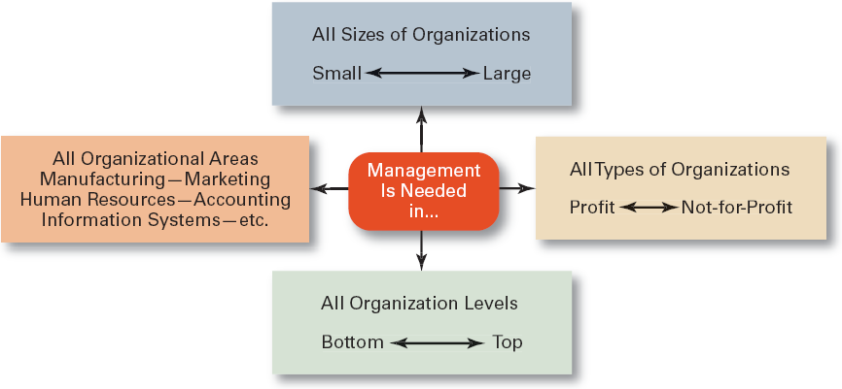
Introduction to Management (Chapter 1)
Reserved Area
Reference:
Exhibit 1-10,
Management 10th Ed. by Stephen P. Robbins & Mary Coulter, Pearson Education.
Why study Management ?
Universal Need of Management

Slide 30
Introduction to Management
Reserved Area
END OF CHAPTER 1:
Introduction to Management
MGT 101

