Slide 1
Lecture 31

Slide 2
Chapter
20
Understanding Financial And Risk Management

Slide 3
Chapter Outline
Role Of The Financial Manager
Why Do Businesses Need Funds?
Sources Of Short-Term Funds
Sources Of Long-Term Funds
Financial Management For Small Business
Risk Management

Slide 4
Trade Credit
Open-Book Credit
  Good faith agreement
Promissory Notes
  Legally binding document to pay in future
Trade Draft Vs. Trade Acceptance

Slide 5
Trade Credit
Trade Draft Vs. Trade Acceptance
  Attached to the merchandizing shipment
  On receipt, the buyers signs it
    Tells about the payment and the date
  After signing it becomes a trade acceptance

Slide 6
Secured
Short-Term Loans
Collateral
Inventory Loans
  Lends some portion of the inventory value
Accounts Receivable
  Pledging
  Factoring
    Purchaser of the A/R known as the factor

Slide 7
Unsecured
Short-Term Loans
No Collateral
Compensating Balance
  Keep a portion of the loan amount with the bank in a non interest bearing account
Line Of Credit
Revolving Credit Agreement
Commercial Paper
  Short-term securities containing the borrower promise to pay

Slide 8
Debt Financing
Long-Term Obligation
Long-Term Loans
  Often Arranged Quickly
    Limited number of parties involved
  No Public Disclosure
  Duration Matched To Needs
  Clauses Make It Possible To Change Terms

Slide 9
Issues In
Debt Financing
Interest Rates
  Fixed
  Floating
Corporate Bonds
  A promise to pay the holder a certain amount of money on a specified date
  Large amount for a long period of time
Bond Indentures

Slide 10
Five “C’s” Of Credit
Character
Capacity
Capital
Conditions
Collateral

Slide 11
Equity Financing
Claim To Earnings
Common Stock
  Dividends
  Appreciation (Growth)
Retained Earnings
Financial Burden
Hybrid- Preferred Stock

Slide 12
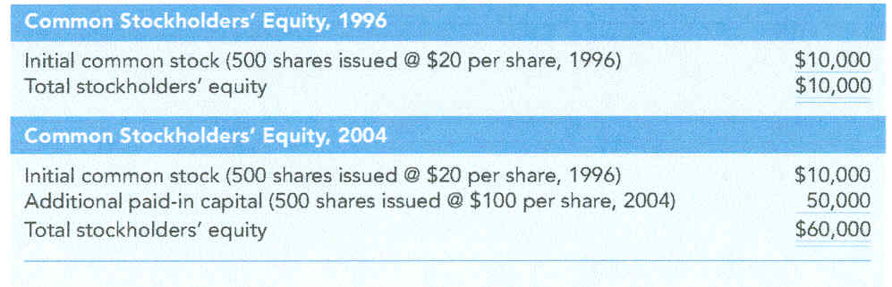
Stockholders’ Equity

Slide 13
Debt Vs. Equity
Capital Structure
Financial Risk
Investors’ Return Expectations

Slide 14
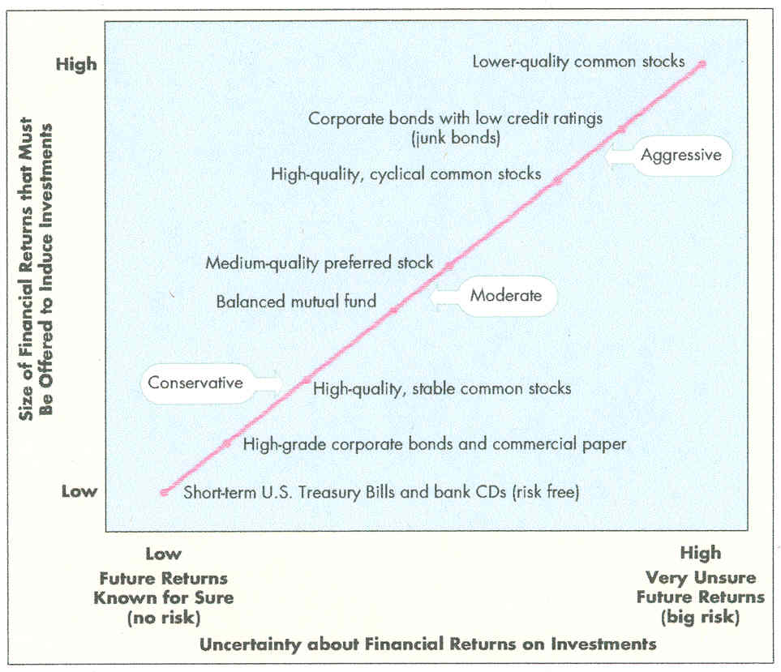
Risk-Return Relationship

Slide 15
Establishing
Bank/Trade Credit
Long-Term Funding
  Established Company
  New Business
Business Plan
  Why money is needed
  Amount
  How the money will be used
Venture Capital
  Part ownership

Slide 16
Risk Management
Risk = Uncertain Outcome
Speculative Risk- Gain Vs. Loss
Pure Risk- Loss Vs. No Loss
Risk Management
  Process of conserving the firms earning power and assets by reducing the threats of losses due to uncontrollable events

Slide 17
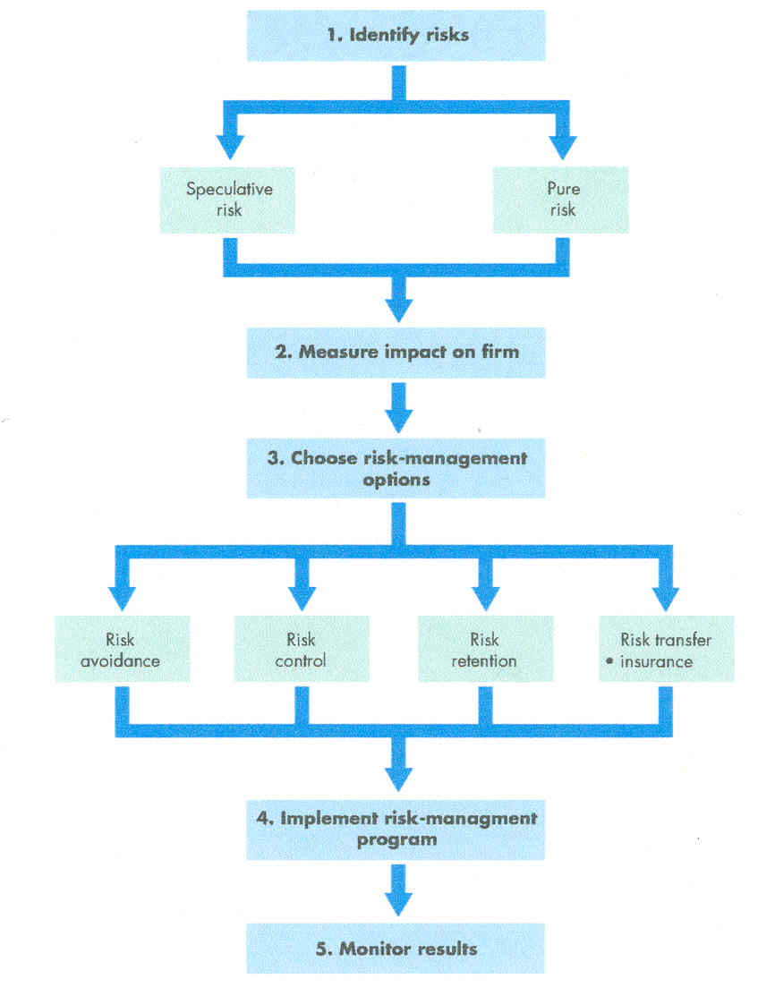
Risk-Management Process

Slide 18
Risk Alternatives
Avoidance
Control
Retention
Transfer

Slide 19
Criteria For
Insurable Vs. Uninsurable Risk
Predictability
Casualty
Unconnectedness
Verifiability

Slide 20
Business
Insurance Products
Liability
  Workers’ Compensation
Property

Slide 21
Employee
Insurance Products
Life
Health

Slide 22
Areas Of Potential
Risk In E-Commerce
Media Liability
Errors And Omissions
Loss Of Service

