Slide 1
Lecture 29

Slide 2
Financial Statements
Balance Sheet- Statement of Financial Position
Income Statement- Statement of Revenue and Expenses
Statement of Cash Flows Budget

Slide 3

Balance Sheet
Assets
Liabilities
Owners’ Equity

Slide 4
Current Assets
Liquidity
Accounts Receivable
  Amount due from customers who have purchased goods on credit
  Allowance for doubtful accounts
Merchandise Inventory
  Cost of merchandise that has been acquired for sale and is still on hand
  On assumptions

Slide 5
Current Assets
Prepaid Expenses
  Supplies on hand and rent paid for the period to come
Marketable Securities
  Bonds and shares which have been purchased as short term investment

Slide 6
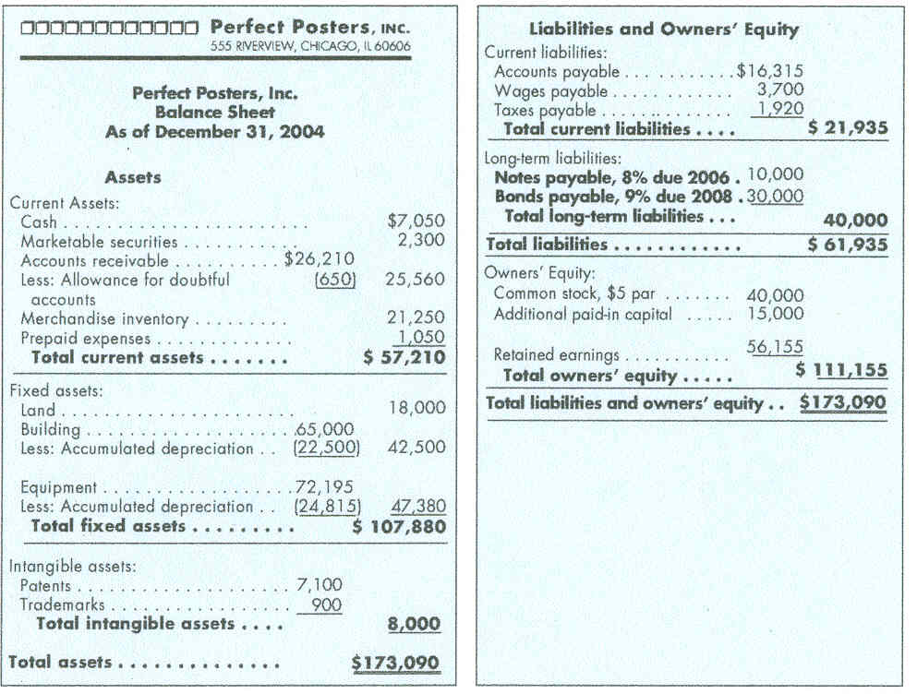
Balance Sheet

Slide 7
Fixed Assets
Long-Term
Depreciation
  spread cost over the useful life
  Wear out or become obsolete as a result of which the value decreases

Slide 8
Intangible Assets
Monetary Value?
  In terms of expected benefits
Intellectual Property
  Patents
  Copyrights
  Trademarks
  Franchise Fees
Goodwill

Slide 9
Liabilities
Current
  Accounts Payable
      Unpaid bills
  Wages & Salaries Payable
  Taxes Payable
Long-Term –
  1+ Years
  Borrowed funds on which the company must pay interest

Slide 10
Owners’ Equity
Common Stock
Paid-In Capital
  Additional money invested by the owner
Retained Earnings

Slide 11
Balance Sheet

Slide 12
Income Statement
Profit & Loss
Revenues
Gross Profit (Gross Margin)
Expense
“Bottom Line”
Revenue – Expense = Profit (Loss)

Slide 13
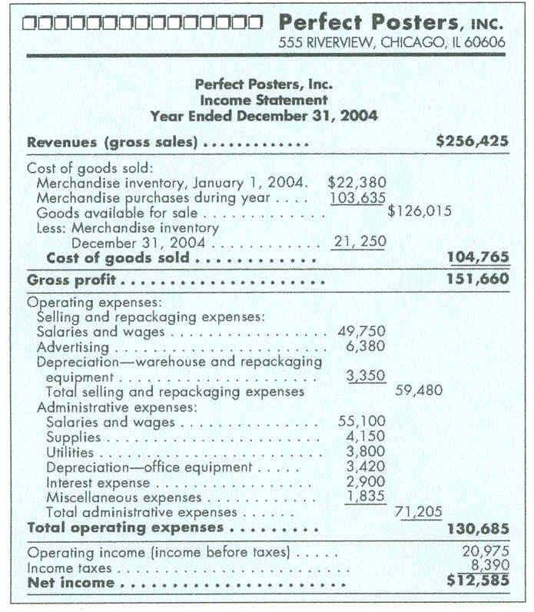
Income Statement

Slide 14
Operating Expenses
Selling Expenses
  Sales Force Salaries
  Advertising
General & Administrative
  Management Salaries
  Maintenance Costs
    Telephone
    Rent
    Utilities
    Etc.

Slide 15
Statement
Of Cash Flows
Cash Flows From Operations
Cash Flows From Investing
Cash Flows From Financing

Slide 16
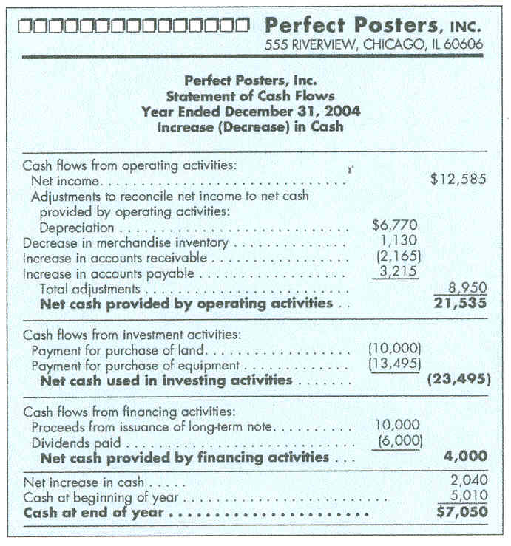
Cash Flow

Slide 17
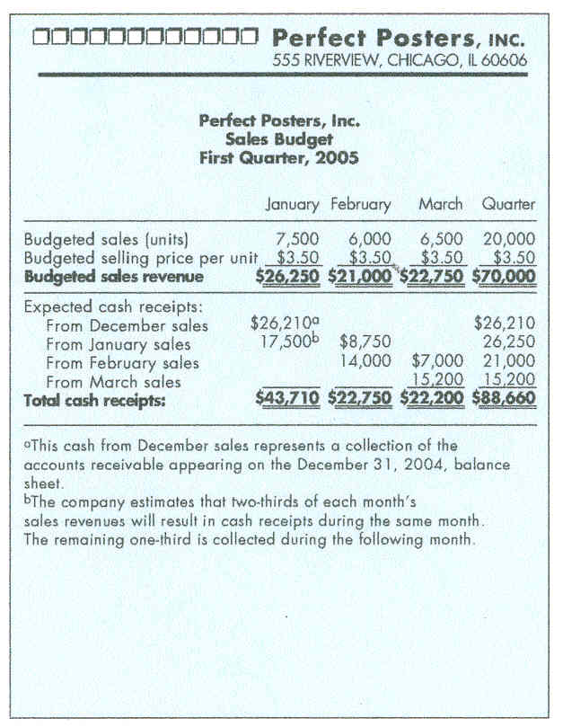
Budget

Slide 18
Reporting
Standards & Practices
Revenue Recognition
  Sale Complete & Product Delivered
  Sales Price Collected Or Is Collectible (Accounts Receivable)
Matching Principle
  Expense will be matched with the revenue to determine net income
Full Disclosure

Slide 19
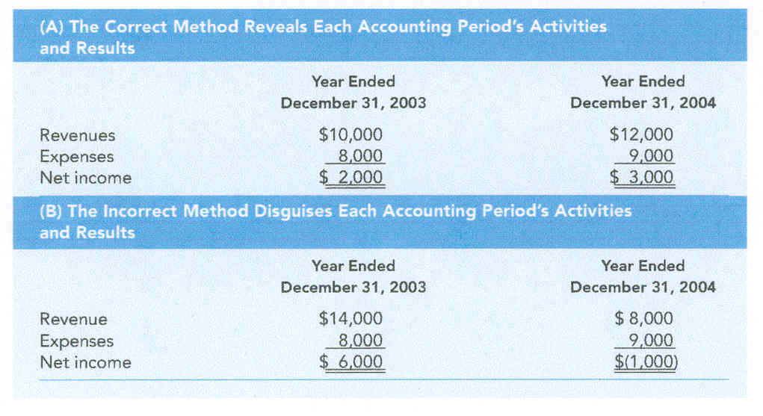
Matching Principle

Slide 20
Analyzing Statements
Solvency Ratios
  Short-Term
  Long-Term
Profitability Ratios
Activity Ratios

Slide 21
Short-Term
Solvency Ratios
Liquidity
Current Ratio
Working Capital
Current Assets
Current Liabilities
Current Assets – Current Liabilities

Slide 22
Long-Term Solvency
Debt-to-Owners’ Equity Ratio
Leverage
Debt
Owners’ Equity

Slide 23
Profitability Ratios
Return On Equity
Earnings Per Share
Net Income
Total Owners’ Equity
Net Income
# Of Common Shares Outstanding

Slide 24
Activity Ratios
Measure Efficiency
Inventory Ratio
Average Inventory
Cost Of Goods Sold
Average Inventory
Beginning Inventory + Ending Inventory
2

Slide 25
International Accounting
Foreign Currency Exchange- Weak vs. Strong
International Transactions
International Accounting Standards

