Slide 1
Lecture 24

Slide 2
Chapter
12
Distributing Products

Slide 3
Chapter Outline
The Distribution Mix
Wholesaling
Retailing
Physical Distribution

Slide 4
Intermediaries/Middlemen
Intermediaries Help To Distribute Goods Either By Moving Them Or Providing Information That Stimulate Their Movement
Wholesaler
  Sells Products To Retailers For Re-Sale
Retailer
  Sells Products Directly To Consumer

Slide 5
Channels
Distribution Channel
  Network Through Which Product Passes On Its Way To The End User
  All Channels Start With The Producer and End With A Consumer Or an Industrial Consumer

Slide 6
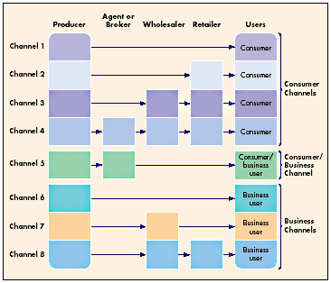
Channels Of Distribution

Slide 7
Direct Distribution
No Intermediaries
Producer Uses Own Sales Force
Used By Many Internet Companies

Slide 8
Retail Distribution
Producer Sells To Retailer
Growing Area In Internet Sales

Slide 9
Wholesale To Consumer
Once Most Prevalent Nondirect Method
Requires Large Amount Of Floor Space
Space Is Too Expensive

Slide 10
Sales Agents/Brokers
Agents/Brokers Represent Producer
Agents/Brokers Paid On Commission
Agents May Represent Several Similar Producers/Product Lines

Slide 11
NonDirect Distribution
Each Link Makes A Profit By Charging A Commission – Result Higher Prices
  10 – 40 % For Manufacturer
  2-25% for Wholesaler
  5-100% for Retailers
Intermediaries Create Added Value By Saving Time and Money
Makes Product Available Where and When It Is Needed

Slide 12
Nondirect Distribution
Pros
Intermediaries Provide Added Value
Value Grows With Each Link
Cons
Markup At Each Link In Chain
Higher Consumer Prices

Slide 13
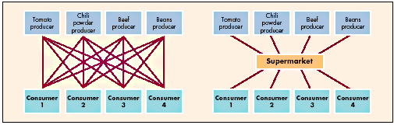
Value-Adding

Slide 14
Agent Distribution
Agent Is Sole Intermediary
Agent Distributes To Consumer & Business

Slide 15
Industrial Distribution
Usually Direct From Producer To Industrial Buyer
Goods Usually Purchased In Large Quantities

Slide 16
Wholesale Distribution Of Industrial Products
Used Mostly For Accessory Equipment
Intermediaries Breakdown Large Quantities To Manageable Size

Slide 17
Wholesale Distribution To Business Retailers
Intermediaries Similar To Traditional Wholesalers
Consumers Use Discount Stores That Buy In Volume And Sell In Small Quantities With Small Markup

Slide 18
Distribution Strategies
Determines Amount And Cost Of Market Coverage
Intensive
  As many channels and channel members
  Low cost with wide spread appeal
Exclusive
  Limited numbers of wholesalers and retailers
  High cost prestige products
Selective
  Producers select the wholesaler and retailers who will give special attention in sales effort, display advantage etc.

Slide 19

Distribution Strategies
Intensive
Selective
Exclusive

Slide 20
Channels
Conflict- Channel Members Disagree About Roles/Rewards
Leadership/Captain- Most Powerful Member of Distribution Channel

