Slide 1
Lecture 23

Slide 2
Chapter
11
Developing And Pricing Products

Slide 3
Chapter Outline
What Is A Product?
Developing New Products
Identifying Products
Determining Prices
Pricing Strategies & Tactics

Slide 4
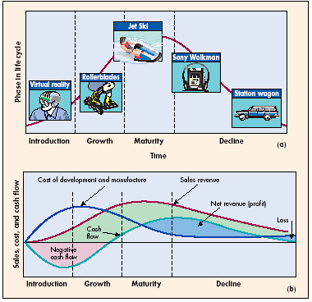
Product Life Cycle

Slide 5
Stages Of
Product Life Cycle
Introduction- New Product, extensive promotion and development cost erase all profits
Growth
  Consumers Attracted
  Sales Climb
  Slight profit
  Competition increases
Maturity- Sales Level-Off
  Highest profit early in this stage
  Increased competition results in price cuts
  Sales fall toward the end of stage
Decline
  Other Competing New Products Introduced
  Sales & Profits Decline
  Ends or reduce promotion

Slide 6
Alternatives To
New Products
Extension
  Existing product that is marketed globally instead of just domestically
Adaptation
  The product is modified for greater appeal in different countries
Reintroduction
  Reviving obsolete products for new markets

Slide 7
Identifying Products
Developing a product features is only one part, marketers need to identify products so that consumers recognize them
Branding
Packaging
Labeling

Slide 8
Identifying Products
Branding
  Process of using symbols to communicate the qualities of a product
Packaging
  Physical container in which a product is sold, advertised or protected
Labeling
  Part of packaging that identifies its name, manufacturer and content

Slide 9
Product Branding
Adding Value
  Brand Equity
    Degree of consumer loyalty to and awareness of a brand and its market share
  Brand Awareness
    Extent to which a brand name comes to mind when consumers considers a particular product category
Types Of Brand Names
  National
  Licensed
  Private

Slide 10
Product Branding
Types Of Brand Names
  National
    Produced and distributed by the manufacturer
  Licensed
    Seller purchases the right from an organization or individual
  Private
    When a whole seller or a retailer develops a brand

Slide 11
Pricing Objectives
Profit-Maximizing
E-Business
Market-Share
  Initial low prices to get market share
    Market share is a company’s %age of total market sales for a specific product type

Slide 12
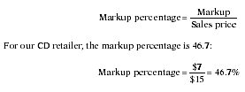
Price Setting Tools
1. Cost-Oriented Pricing
Combines Desire To Make a Profit and Cover Costs
Components
  Markup $
  Markup %
  Sales Price

Slide 13
2. Breakeven Analysis Components
Variable Cost (covered using cost oriented pricing)
Fixed Cost
Breakeven Point

Slide 14
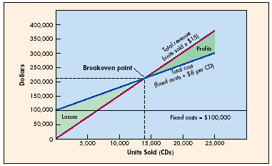
Breakeven Analysis

Slide 15
Pricing Strategies

Slide 16
Pricing Existing Products
Relative To Current Market Prices For Similar Products
Current Market
  Above
  Below
  At/Near

Slide 17
New Product Pricing
Price Skimming
Market Penetration

Slide 18
E-Business Pricing
Fixed
  Most Common
Dynamic
  Available Information Forces Constant Price Adjustment

Slide 19
Pricing Tactics
Price Lining
  A store predetermines 3 or 4 price points at which a particular product is sold
Psychological- Odd/Even
Discounting

Slide 20
International Pricing
Determine What Market Will Bear
Post-Purchase- Encourage To Trade Up As Personal Economics Allow
Dumping

