Slide 1
Lecture 22

Slide 2
Chapter
11
Developing And Pricing Products

Slide 3
Chapter Outline
What Is A Product?
Developing New Products
Identifying Products
Determining Prices
Pricing Strategies & Tactics

Slide 4
Product?
A product is a combination of benefits, features and intangible reward
Features - Qualities
  Tangible
  Intangible
Benefits
Value Package – Product marketed as a bundle of value adding attributes, including reasonable cost

Slide 5
Goods/Services-
Classification
Consumer
Industrial

Slide 6
Consumer Products
Convenience- Rapidly Consumed, inexpensive and are purchased often
Shopping
  Moderately Priced
  Infrequent Purchase
  Compare Brands
  Evaluate Alternatives
Specialty
  Expensive
  Rarely Purchased
  Accept No Substitute

Slide 7
Industrial Products
Expense Items
  Regularly Purchased
  Consumed Rapidly
Capital Items
  Expensive
  Long-lasting
  Infrequently Purchased

Slide 8
Product Mix
The Group Of Products That A Company makes Available For Sale
Product Line
  Similar Products
  Similar Buyers
  Similar Use
Single
Multiple/Diversified

Slide 9
New Product Development
Product Mortality- Failure Or Obsolescence
Speed To Market- Market Changes

Slide 10
New Product Development Process
Product Ideas
Commercialization
Testing & Marketing
Screening
Prototype
Concept Testing
Business Analysis

Slide 11
Services
Process Variations
Differences in Step 1 and 5
Service Package- Tangible & Intangible Features
Service Process Design
  Process Selection – Sequencing and time
  Worker Requirements
  Facility Requirements

Slide 12
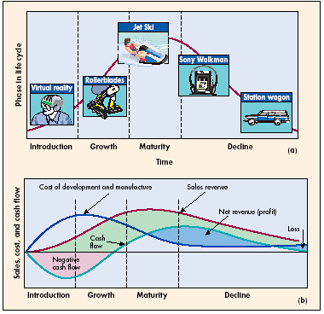
Product Life Cycle

Slide 13
Stages Of
Product Life Cycle
Introduction- New Product, extensive promotion and development cost erase all profits
Growth
  Consumers Attracted
  Sales Climb
  Slight profit
  Competition increases
Maturity- Sales Level-Off
  Highest profit early in this stage
  Increased competition results in price cuts
  Sales fall toward the end of stage
Decline
  Other Competing New Products Introduced
  Sales & Profits Decline
  Ends or reduce promotion

