Slide 1
Lecture 21

Slide 2
Influences On
Consumer Behavior
Study Of The Decision Process By Which People Buy And Consume products

Slide 3
Influences On
Consumer Behavior
Psychological –motivation,perception,attitude
Personal-lifestyle, personality, economic status
Social-family, opinion leaders, friends
Cultural
  Cultural – way of living that distinguishes one group from the other
  Subculture – smaller groups with shared values
  Social class – ranking of group based on occupation and income
Weak affect of factors because of brand loyalty

Slide 4
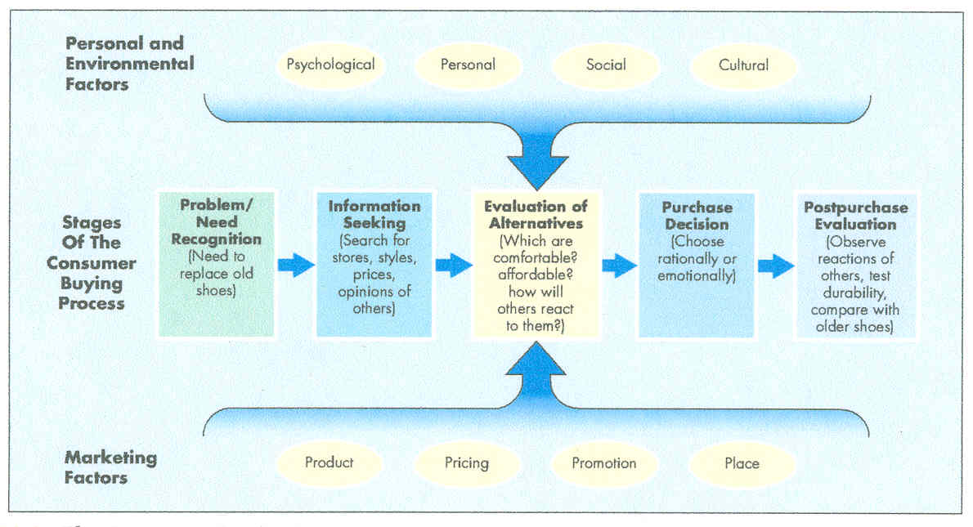
Buying Process

Slide 5
Data
Warehousing- Collecting, Storing, & Retrieving Data
Mining- Searching, Sifting, & Reorganizing Data

Slide 6
Organizational Markets
Industrial – businesses that buy goods to be converted in to other products or goods that are used up during production
Reseller – consists of intermediaries, who buy and resell finished goods
Government/Institutional

Slide 7
Buying Behavior- Organizational
Buyer Differences
  Professional – trained for negotiating
  Specialist
  Experts
Buyer-Seller Relationship
  Frequent
  enduring

Slide 8
Marketing Mix- International
Products- Redesign For Foreign Buyer
Pricing- Cover Increased Cost Of Transport/Selling
Distribution- Delays In Establishing Network For Startup
Promotion- Cultural Differences

Slide 9
Marketing Mix-
Small Business
Products- Limited Buying Market
Pricing- Incorrect Cost Estimation
Distribution- Location Is Critical
Promotion- Local Which Is Cheaper

