Slide 1
Lecture 15

Slide 2
Chapter
8
Managing Human Resources And Labor Relations

Slide 3
Chapter Outline
Foundations of Human Resource Management
Staffing The Organization
Developing The Workforce
Compensation & Benefits
Legal Context Of HR Management
New Challenges In The Changing Workplace
Dealing With Organized Labor
Collective Bargaining

Slide 4
The Strategic
Importance of HRM
HRM- Activities For Attracting, Developing, & Maintaining An Effective Workforce
Today’s Reasons For Importance
  Growing Legal Issues
  Employees Important For Improving Productivity
  Poor HR Management Is Expensive

Slide 5
Human
Resource Planning
Job Analysis
  Job Description
    Duties, responsibilities, working condition
    Tools, material, equipment and information requirement
  Job Specification
    Skills, abilities, qualifications needed to perform
  Importance: selection methods, appraisal system, compensation

Slide 6
Human
Resource Planning
Forecasting HR Demand/Supply
  Internal supply
  External supply
Replacement Charts
  List important positions
  How long the person will stay
  Who is now qualified or will be qualified
Skills Inventories / Employee information system
  Employee education, skill, experience, career aspirations

Slide 7
Human
Resource Planning
Matching HR Supply/Demand
  Over staffing
  Understaffing

Slide 8
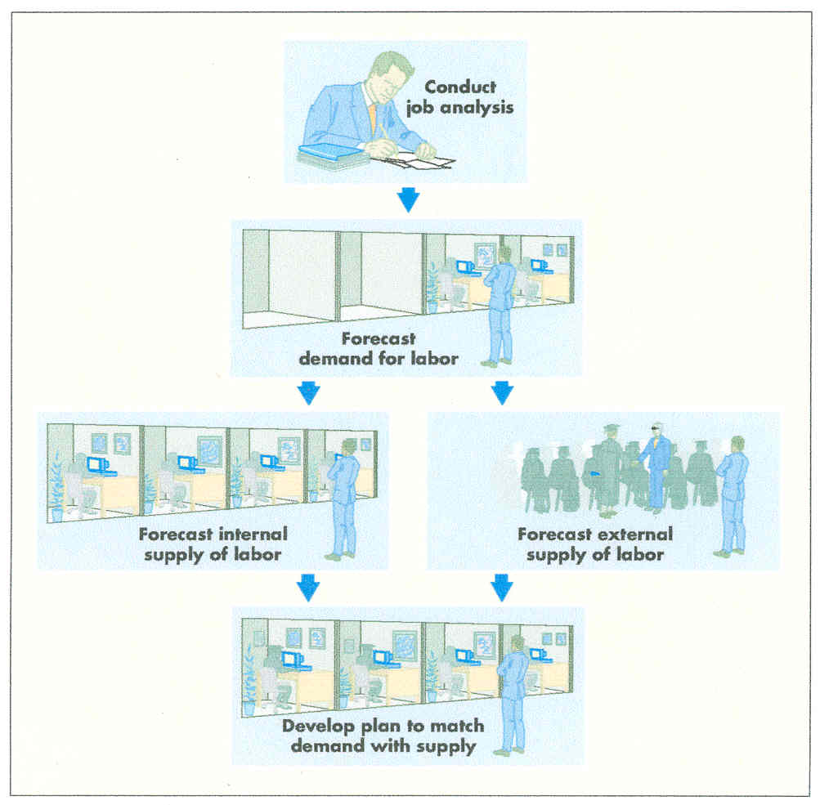
HR Planning Process

Slide 9
Recruiting
Human Resources
Recruiting- Attracting Qualified Persons To Apply for a Job
  Internal
    Considering present employees as candidates for opening
  External
    Considering outside applicants as candidates for opening

Slide 10
Selecting
Human Resources
Application Form
Tests
Interviews
Other Techniques
Hire

Slide 11
Selecting
Human Resources
Application Forms
  Should have question related to job aspects
  Applicants merits further evaluation
Tests
  Ability, skill, aptitude, or knowledge relevant
  All applicants should be given the same time, same directions and same testing environment
  Valid
  Reliable
Interviews
  Structured a
  Unstructured
Other techniques
  Physical exam
  Drug test

Slide 12



Training
The Workforce
On-The-Job
Off-The-Job
Vestibule

Slide 13
Performance Appraisal
Evaluation of a company job performance in order to determine the degree to which the employee is performing effectively
Appraisal process
  Defines performance standards
  Observes employee performance
  Compares expectations with performance
Types of appraisal

Slide 14
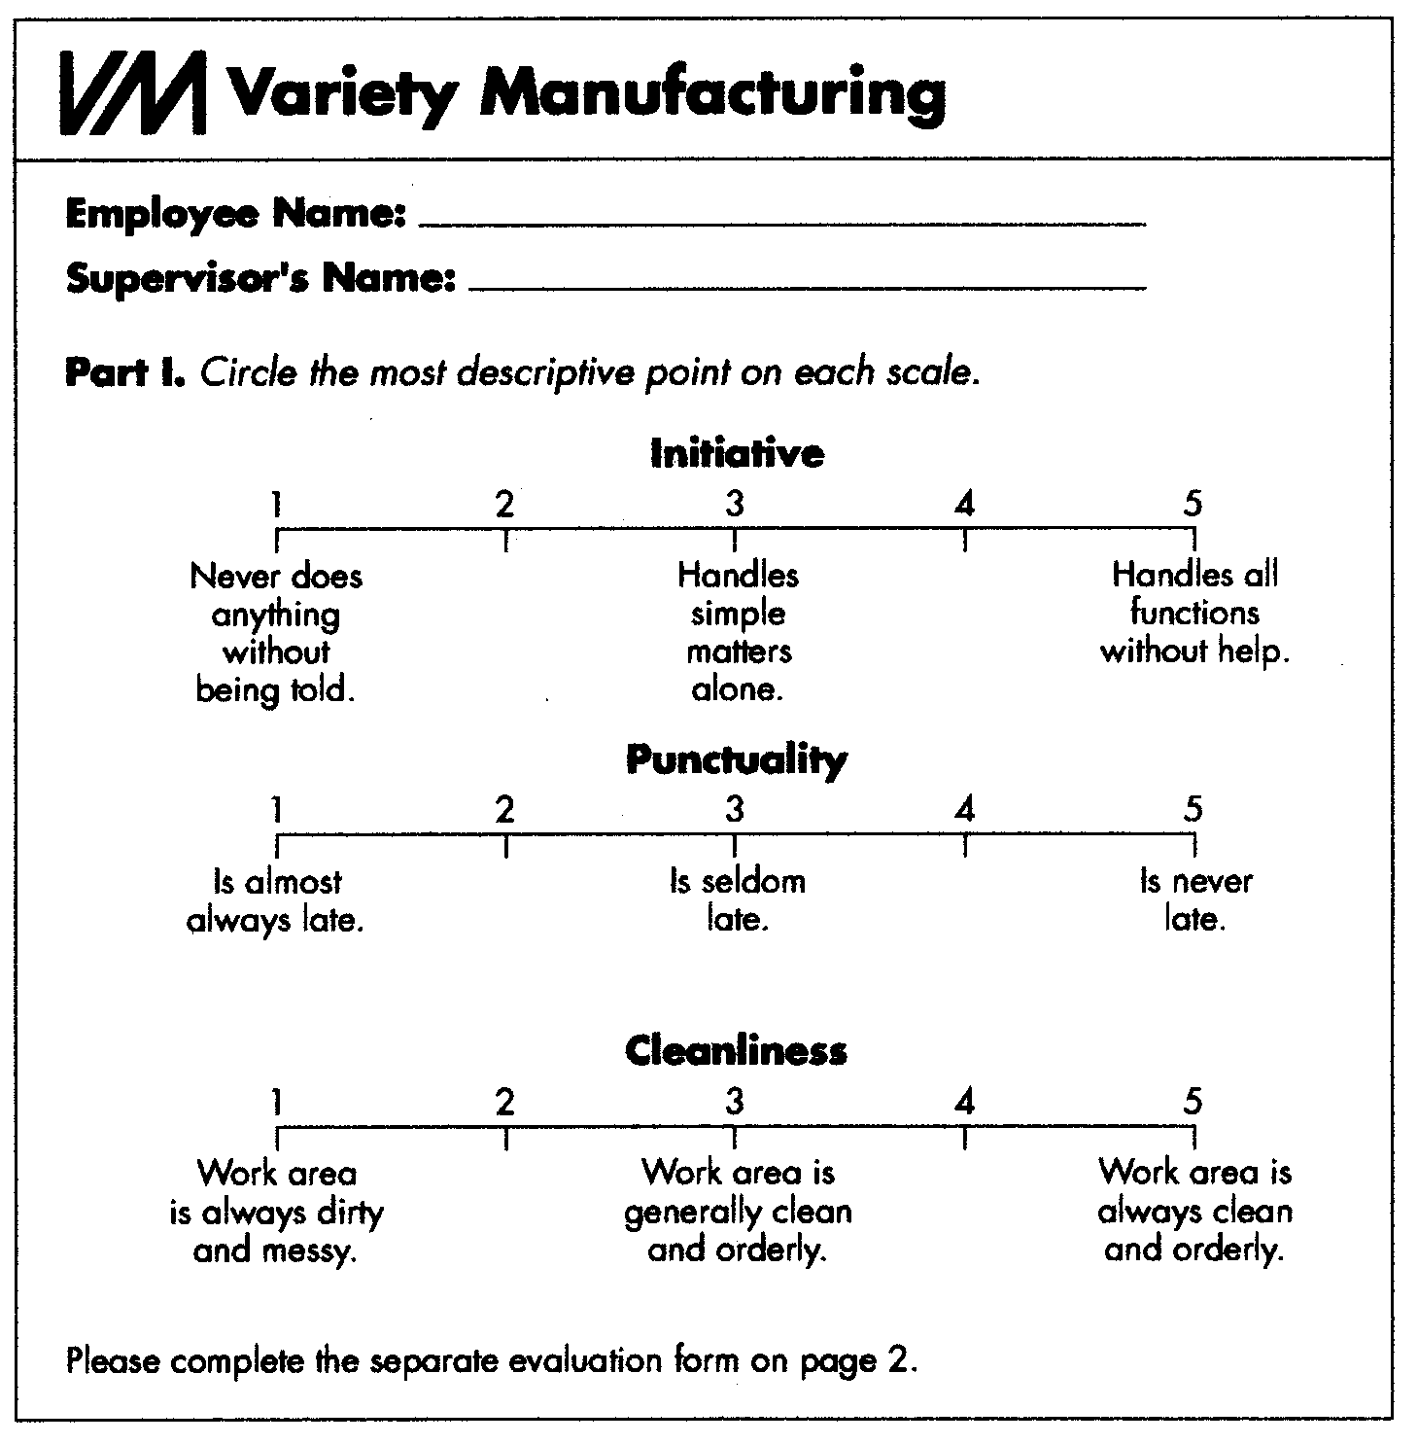
Performance Appraisal

Slide 15
Compensation
& Benefits
The total package of reward that the firm offers employee in return for their work is called a compensation package
  Includes
    Wages
    Salary
    Benefits
    incentives

Slide 16
Compensation
& Benefits
Wages- Time Worked
Salaries- Job Performed
  Comparison with competitors
  Internal salary in comparison to various job
Incentives
  Special pay programs designed to motivate high performance
  Money motivates when it is tied to performance

Slide 17
Incentive Programs
Individual
  Bonuses
  Merit Salary Systems
  Stock Options
  Pay For Performance (variable pay
    Company wide performance
    Business unit performance
    Personal record
Companywide
  Profit-Sharing
  Gainsharing
  Pay-For-Knowledge

Slide 18
Benefit Programs
Compensation other than salary and wage is called benefit
Health insurance
Paid time off for vacations and holiday
Retirement Plans
Cafeteria Benefits Plan

Slide 19
Legal Context of HR Management

Slide 20
Equal
Employment Opportunity
Protect Classes from unfair or inappropriate discrimination
Discrimination on the basis of job performance is legal
Illegal discrimination is based a stereotype, belief or a prejudice about classes of people.

Slide 21
OSH Laws
Occupational Health And Safety Laws
The main law governing OHS is the Factories Act 1934 Chapter 3. The Hazardous Occupation Rules of 1978 regulate certain occupations as hazardous, and contain special provisions to regulate the working conditions in those occupations. Each province has also enacted its own Rules within the mandate of the Factories Act.

Slide 22
OSH Laws
In addition there are other laws dealing with OHS:
The Mines Act 1923
Social Security Ordinance 1965
Workmen’s Compensation Act 1923
Shop and Establishment Ordinance 1969
Dock Labourer Act 1934

Slide 23
OSH Laws
No data about occupational health and safety (OHS) are available in Pakistan because the majority of accidents are not reported to the Labour Department. Diseases and accidents in the work place are an appalling tragedy. The incidence of occupational diseases and injuries is very high in Pakistan because thousands of workers are routinely exposed to hazardous chemicals.

Slide 24
Emerging Areas
Of Discrimination
Sexual Harassment
  Hostile Work Environment

Slide 25
Employment At Will
Employer & Employee Have Right To Terminate
No Advance Notice Necessary

Slide 26
New Challenges in the Changing Work Place

Slide 27
Workforce Diversity
Attitudes
Values
Beliefs
Behaviors
Gender
Race
Age
Ethnicity
Physical Ability

Slide 28
Knowledge Workers
Information Age- Workers Valued For:
  Accomplishments
  Experience
Include
  Computer Scientists
  Engineers
  Physical Scientists

Slide 29
Managing
Knowledge Workers
Independent
Identify With Profession Not Organization
Require Extensive Training & Retraining
Require Continued Compensation Updates

Slide 30
Contingent/Temporary
Workers
Other Than Permanent Or Full-Time
Includes
  Independent Contractors
  On-Call Workers
  “Temps”
  Contract/Leased

Slide 31
Managing Contingent & Temporary Workers
Flexibility Requires Careful Planning
Acknowledge Advantages & Disadvantages
Assess Real Cost
How Do They Fit Into Company Strategy?

Slide 32
Organized Labor
Labor Union – a group working together to achieve shared job related goal
Labor Relations – dealing with employees who are represented by a union
Collective Bargaining – drafting and administering of the terms of a labor contract

Slide 33
Union Bargaining
Historically
  Increases In Wages/Salaries
  Benefits
Today
  Job Security
  Jobs Going Overseas
  Preserve What Has Already Been Won

Slide 34
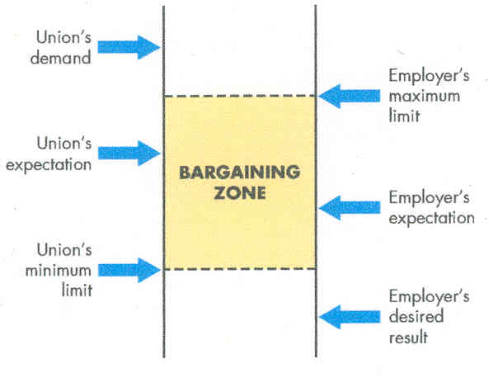
Collective Bargaining

Slide 35
Union Tactics
When Bargaining Fails
Impasse -no agreement on contract
Union tactics
  Strike
  Pickets
  Boycotts
  Work Slowdown

Slide 36
Management Tactics
Lockouts
Strikebreakers

Slide 37
Mediation & Arbitration
Mediation – third party can suggest not impose settlement
Arbitration
  Voluntary – third party dictates the settlement, and both party have agreed to submit before outside judgment
  Compulsory/Binding – arbitration is legally required between the government and public employee

