Slide 1
Introduction to Business
LECTURE 2:
Introduction to Business
MGT 100

Slide 2
Demand and Supply in a Market Economy
Demand and Supply Schedule
  The relationships among different levels of demand and supply at different price levels as obtained from marketing research, historical data, and other studies of the market.
    Demand curve: How much product will be demanded (bought) at different prices.
    Supply curve: How much product will be supplied (offered for sale) at different prices.
    Market price (equilibrium price): The price at which the quantity of goods demanded and the quantity of goods supplied are equal.
2

Slide 3
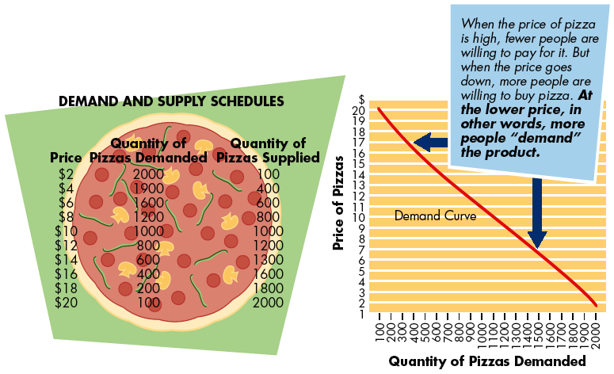
3

Slide 4
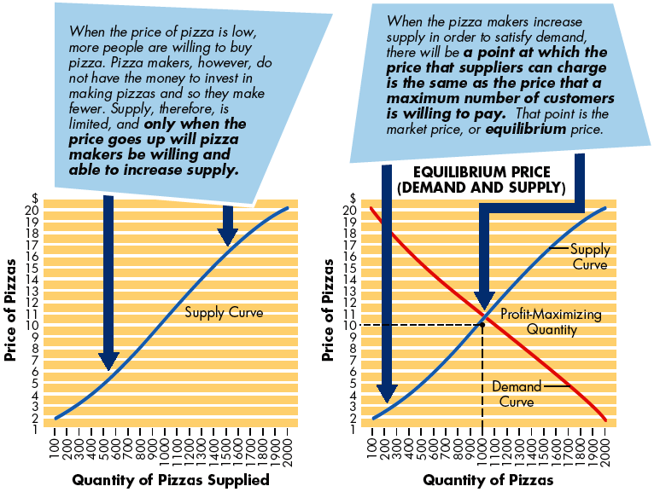
4

Slide 5
Surpluses and Shortages
Surplus
  A situation in which the quantity supplied exceeds the quantity demanded
    Causes losses
Shortage
  A situation in which the quantity demanded will be greater than the quantity supplied
    Causes lost profits
    Invites increased competition
5

Slide 6
Private enterprise in a Market Economy
Private Enterprise System
  Allows individuals to pursue their own interests with minimal government restriction.
Elements of a Private Enterprise System
  Private property rights
  Freedom of choice
  Profits
  Competition
6

Slide 7
Degree of Competition
Perfect Competition
  Prices are determined by supply and demand because no single firm is powerful enough to influence the price of its product.
    All firms in an industry are small.
    The number of firms in the industry is large.
  Principles of perfect competition:
    Buyers view all products as identical.
    Buyers and sellers know the prices that others are paying and receiving in the marketplace.
    It is easy for firms to enter or leave the market.
    Prices are set exclusively by supply and demand and accepted by both sellers and buyers.
7

Slide 8
Degree of Competition (cont)
Monopolistic Competition
  There are numerous sellers trying to differentiate their products from those of competitors so as to have some control over price.
  There are many sellers, though fewer than in pure competition.
  Sellers can enter or leave the market easily.
  The large number of buyers relative to sellers applies potential limits to prices.
8

Slide 9
Degree of Competition (cont)
Oligopoly
  An industry with only a few large sellers.
  Entry by new competitors is hard because large capital investment is needed.
  The actions of one firm can significantly affect the sales of every other firm in the industry.
  The prices of comparable products are usually similar.
  As the trend toward globalization continues, most experts believe that oligopolies will become increasingly prevalent.
9

Slide 10
Degree of Competition (cont)
Monopoly
  An industry or market that has only one producer (or else is so dominated by one producer that other firms cannot compete with it).
    The sole supplier enjoys complete control over the prices of its products; its only constraint is a decrease in consumer demand due to increased prices.
  Natural monopolies: Industries in which one firm can most efficiently supply all needed goods or services; typically allowed and regulated by legislated acts and governmental agencies.
    Example: Electric company
10

