Slide 1

MBF707: Monetary and Fiscal Framework in Islamic Finance
COMSATS Institute of Information Technology (Virtual Campus)

Slide 2
Lecture 08
Musharakah
&
Mudarabah
More Related Cases

Slide 3
FINANCING OF Working Capital

Slide 4
Review of the Last Lecture
Running Musharakah Account
Gross Profit in Musharakah
Termination of Agreement
Combination of Musharakah and Mudarabah

Slide 5
WORKING CAPITAL FINANCE
Musharakah:
Contribute in Cash or Non-liquid
Value of Business Assets ---------> Working partner
Profit :
On the Basis of Value of Business
Exceed Profit of working Partner ( 70% 30%)
Termination or Expiry:
Purchase share of Financer

Slide 6
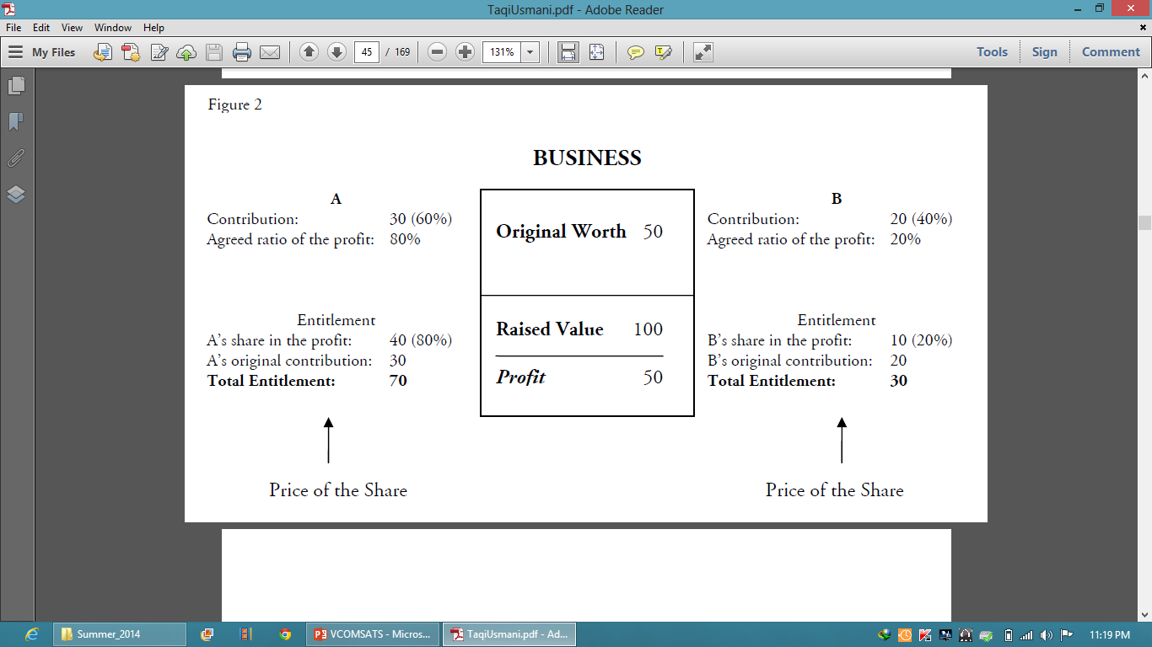

Slide 7
Objections on Musharakah Financing

Slide 8
1. Risk of Loss
Argument:
“Musharakah is more likely to pass on losses of the
business to the bank . This loss will be passed on to depositors “
Answer:
Banks Study the feasibility & select projects.
Banks and financial institutions deal in money and papers leading to the macroeconomic problems.
Conventional Sys. separates the banking and financing from the normal trade activities
Diversified Musharakah Portfolio

Slide 9
2. DISHONESTY
Argument:
not paying any return to the financiers
Claim that it has suffered a loss
Solution:
well designed system of auditing
Profit on the basis of gross margins only
Punitive Step: Unable to avail any facility from the Bank.
Legal Papers are involved in transactions.

Slide 10
3. Secrecy of the Business
it may disclose the secrets of the business to the financier,
Solution
may put a condition that the financier will not interfere with the management affairs, and he will not disclose any information about the business to any person without prior permission of the client.

Slide 11
Client’s Unwillingness to Share Profits
clients are not willing to share with the banks the actual profits of their business.
passed on to the tax authorities and Clients’ tax
liability increases.
Solution:
clients need to be convinced and persuaded that borrowing on interest is a cardinal sin,
The governments should also try to appreciate the fact that if rates of taxation are reasonable and if tax-payers are convinced that they will benefit

Slide 12
Lecture 09
Diminishing Musharakah
Some Applications

Slide 13
Review of the Last Lecture

Slide 14
Introduction of Diminishing Musharakah
Another form of musharakah, developed in the near past, is ‘diminishing musharakah’. According to this concept, a financier and his client participate either in the joint ownership of a property or an equipment, or in a joint commercial enterprise. The share of the financier is further divided into a number of units and it is understood that the client will purchase the units of the share of the financier one by one periodically, thus increasing his own share till all the units of the financier are purchased by him so as to make him the sole owner of the property, or the commercial enterprise, as the case may be.

Slide 15
Examples of DM
House Purchasing
Cab or Photocopy Machine
Bookshop
Any other Business

Slide 16
House Financing:Arrangements
To create joint ownership in the property (Shirkat-al-Milk).
Giving the share of the financier to the client on rent.
Promise from the client to purchase the units of share of the financier.
Actual purchase of the units at different stages.
Adjustment of the rental according to the remaining share of the financier in the property.

Slide 17
DM for Carrying out Business
Creating joint ownership in a cab in the form of Shirkah al-Milk is allowed in Shari‘ah.
Musharakah in the income generated through the services of cab is also allowed.
Purchase of different units of the share of the financier by the client. This is again subject to the conditions already detailed in the case of House financing. However, there is a slight difference between House financing and the arrangement suggested in this second example. The cab, when used as a hired vehicle, normally depreciates in value over time, therefore, depreciation in the value of cab must be kept in mind while determining the price of different units of the share of the financier.

Slide 18
DM in Trade
Here the price of units of the financier cannot be fixed in the promise to purchase, because if the price is fixed before hand at the time of entering into musharakah, it will practically mean that the client has ensured the principal invested by the financier with or without profit, which is strictly prohibited in the case of musharakah.
It is better to sell the units on the basis of valuation of the business at the time of the purchase of each unit.

Slide 19
Sum-up
Local Business
International Trade and Finance
MNCs
Others.

Slide 20

Thank You

