Slide 1

MBF707: Monetary and Fiscal Framework in Islamic Finance
COMSATS Institute of Information Technology (Virtual Campus)

Slide 2
Lecture 31
Summary of the Course
(Part 1)

Slide 3
Significance of the Course
Introduction
Significance of the Subject
Economic Models
Retrospective of the Islamic Financial System

Slide 4
Significance
What is the government budget deficit?
How does it affect the economy?
Why are so many countries poor?
What policies might help them grow out of poverty?

Slide 5
Literature
The Makkah Seminar (1978):
The papers are available in Monetary and Fiscal
Economics of Islam (ed., Muhammad Ariff).
Themes of the Papers
Siddiqi, Chapra and Ariff – monetary policy
Kahf – both fiscal and monetary policies
Uzair – central banking operations
Salama – Fiscal analysis of zakah
Mahfooz Ahmad – theme of distributive justice

Slide 6
Literature
The Islamabad Seminar (1981):
The papers are available in Money and Banking in
Islam and Fiscal Policy and Resource Allocation
In Islam (eds., Z. Ahmad, M. Iqbal and F. Khan).
Themes of the Papers
Chapra – monetary policy
Al-Jarhi – Institutional framework for mon. pol.
Faridi and Salama – Theory of fiscal policy
Metwally – Macrecon. analysis of fiscal policy
Kahf – Taxation

Slide 7
Literature
Developments in the 1980s
At the conceptual level, Dr. Umar Chapra wrote his masterpiece Towards a Just Monetary System (1985). And, Dr. Ziauddin came up with a systematic inquiry into “Public Finance in Islam” (1989 – IMF Working Paper).
Other than the above, mostly analytical works were produced in this period. Thus, effects of fiscal and/or monetary policies are studied in the context of macroeconomic models. Some of these works are as follows:

Slide 8
Literature
Developments in the 1980s (contd.)
Muhammad Mukhtar Mutwally, Macroeconomic Models of Islamic Doctrines (1981)
Ausaf Ahmad, Income Determination in an Islamic Economy (1984, published in 1987)
Tahir, “A Simple of Aggregate Output, Income and Economic Inequalities Determination in an Islamic Economies” (1986, published in 1989)

Slide 9
Literature
Developments in the 1980s (contd.)
Mohsin Khan, “Islamic Interest-Free Banking – A Theoretical Analysis (1986)
Mohsin Khan and Abbas Mirakhor (1987), “The Financial System and Monetary Policy in an Islamic Economy” (1987)
Muhammad Anwar, Modeling Interest-Free Economy: A study in Macroeconomics and Development (1987)
Nadir Habibi, “The Consequences of Islamic Banking in a Macroeconomic Framework” (1987, published in 1991)

Slide 10
Literature
Developments in the 1990s
With increasing attention received by Islamic
banking and finance in the 1990s, central banking,
monetary management and monetary policy have
received more attention from the Islamic economists. Some notable papers are:
Mohsin Khan and Abbas Mirakhor, “Monetary Management in an Islamic Economy” (1994)
N. Choudhry and Abbas Mirakhor, “Indirect Instruments of Monetary Control” (1999?)

Slide 11
Literature
Developments in the 1990s (contd.)
On the fiscal policy side, some work on taxation and
implications of equity-financed budgetary deficit for
stability of the economy were explored:
Mohammad Hussain, “A Macroeconomic Taxation Model for an Islamic Economy” (1993)
Aynul Hasan and A.N. Siddiqui, “Is Equity Financed Budgetary Deficit Stable in an Interest-Free Economy?” (1996)
It is noteworthy that in these and virtually all the analytical papers the analysis is limited to the stabilization role of fiscal and monetary policies

Slide 12
Contribution
All the papers, especially those written at
the conceptual level, are silent on some
fundamental matters. These include:
Islamic economy, i.e., the framework in which the policies are to be conceived.—The focus in the Islamic economics literature is on the Islamic Economic System.
The nature and role of government in the Shari’ah  The Fiqh for Government
The Shari’ah-basis of the policy goals

Slide 13
The Policy Perspective
Individual is a part of the economy, not the vice versa.
Nucleus: Family
Market economy
The Financial Scene and the Financial Landscape (see next)
Government (details follow)

Slide 14
The Financial Scene
Islamic banks
The Securities Markets
Murabahah financing securities
Salam certificates
Ijarah financing securities & warrants
Redeemable musharakah securities
The Equity Market: The Islamic stock market
Islamic insurance

Slide 15
Government in the Modern Age
Natural Role of the Government:
1- Protection of territorial integrity of the state
2- Enforcement of the state’s claims and discharge of the state obligations
3- Civil Administration
4- Development and maintenance of an institutional framework in which the citizens may operate
5- Maintenance of civil liberties
6- Protection of recognized property rights of the citizens
7- Provision of justice

Slide 16
Policy Goals in Islamic Economy
Development and preservation of institutional framework to support economic and distributional activity
Education, incl. that of science and technology
Fulfillment of the fundamental economic rights of the citizens
Elimination of poverty
Reduction in inter-regional economic disparities
Temporary help to local communities over temporary economic constraints (for local public goods)
Economic development
Maintenance of a credible deterrence

Slide 17
Policy Goals
Fiscal Policy (Consensus, 1981, Islamabad)
Ideological orientation with equal attention to material and spiritual welfare
Fulfillment of basic needs of all the people
Providing the necessary infrastructure to promote economic growth
Promoting an egalitarian (social equality) economic and social order

Slide 18
Policy Goals
Monetary Policy (Chapra, 1980, Islamabad):
Economic well-being with full employment and optimum rate of economic growth,
Socioeconomic justice and equitable distribution of income and wealth, and
Stability in the value of money (Chapra).

Slide 19
Asset-backed Financing
Every financing in an Islamic system creates real assets. [This is true even in the case of Murabahah and leasing, despite the fact that they are not believed to be ideal modes of financing]
Interest-based financing does not necessarily create real assets.
Supply of money through the loans creates imbalance with real goods and services produced in the society

Slide 20
Capital and Entrepreneur
Capital has an intrinsic element of 'entrepreneurship', so far as the risk of the business is concerned.
Flow of the actual profits earned by the society may be directed towards the depositors in equitable proportions which may distribute wealth in a wider circle and may hamper concentration of wealth.

Slide 21
Present Practices of Islamic Banks
Islamic Banks did not bring any visible change in the economic set-up, not even in the field of financing
Distributive justice under the umbrella of Islamic banking are exaggerated.
Islamic banks and financial institutions-small proportion of the system.
Just three decades as against 300 years.
Not supported by the governments.

Slide 22
Musharakah
Technically, Musharakah is a contract between the partners to contribute capital to an enterprise or a venture, whether existing or new, or to owner of a real estate or moveable asset, either on a temporary or permanent basis. Profits generated by that venture or real estate or asset are shared in accordance with the terms of the Musharakah agreement, while losses are shared in proportion to each partner’s share of capital.”
Source: (Draft of Shariah parameter reference 4:Musharakah Contract, a paper published by Bank Negara in 2010 defined Musharakah )

Slide 23
Application of Musharakah
Trading
Stocks
Businesses
Musharakah Certificates
MP-expansion/contraction
Diminishing Musharakah

Slide 24
Diminishing Musharakah
DM is used in house financing, auto financing, plant and machinery financing, factory or building financing and all other fixed asset financing.

Slide 25
Mudarabah v/s Musharakah
Investment
Participation in Management
Loss Share
  In Partnership
  Rabbul Maal
  Mudarib
Liability (limited vs unlimited)
Appreciation in the value of the assets

Slide 26
Types of Mudarabah
Al Muqayyadah ( Restricted Mudarabah)
Al Mutlaqah ( Un-Restricted Mudarabah)
One Mudarib or more Mudaribs can be employed by the RabulMaal.

Slide 27
Combination of
Musharakah & Mudarabah
In Mudarabah, Fund Provider -----> Rabbul Maal
Mudarib add Capital, if agreed with Mudarabi
Combination:
Rabbul Maal -------------------> Rs. 100,000
Mudarib Add Own -------------> Rs. 50,000
Profit Distribution Mudarabi:
Certain Percentage of Profit as Mubarib
Another Percentage of Profit as Sharik
1/3 : 2/3 or 1/3 + ¼ of the remaining profit to mudarib or any other agree proportion.

Slide 28
RUNNING MUSHARKAH ACCOUNT
Conventional System
Many financial institutions finance the working capital of an enterprise by opening a running account for them from where the clients draw different amounts at different intervals, but at the same time, they keep returning their surplus amounts. On the date of maturity, the interest is calculated on the basis of daily products.
Musharakah:
Opening Running A/c
FI’s finance working capital of the clients
Deposit & Withdraw Amount any time
Profit on Average Balance

Slide 29
RUNNING MUSHARKAH ACCOUNT
A certain percentage of the actual profit must be allocated for the management.
The remaining percentage of the profit must be allocated for the investors.
The loss, if any, should be borne by the investors only in exact proportion of their respective investments.
The average balance of the contributions made to the musharakah account calculated on the basis of daily products shall be treated as the share capital of the financier.
The profit accruing at the end of the term shall be calculated on daily product basis, and shall be distributed accordingly.

Slide 30
WORKING CAPITAL FINANCE
Musharakah:
Contribute in Cash or Non-liquid
Value of Business Assets ---------> Working partner
Profit :
On the Basis of Value of Business
Exceed Profit of working Partner ( 70% 30%)
Termination or Expiry:
Purchase share of Financer

Slide 31
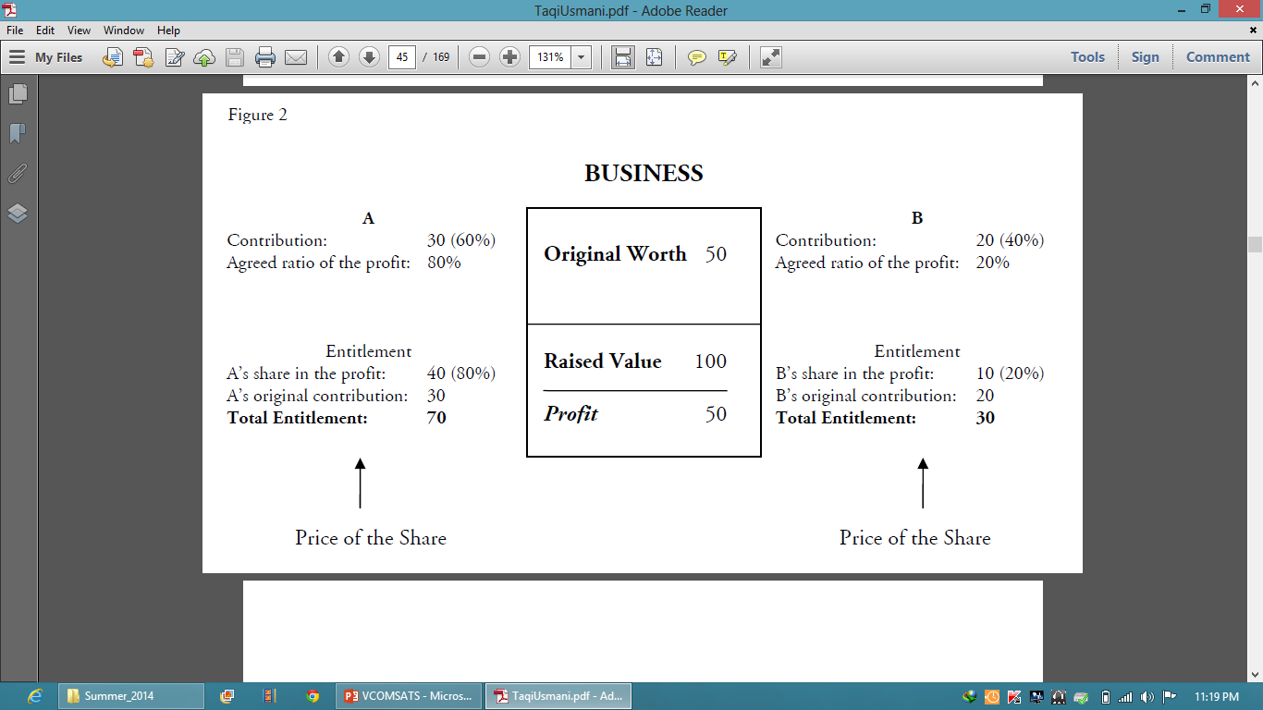

Slide 32
Examples of DM
House Purchasing
Cab or Photocopy Machine
Bookshop
Any other Business

Slide 33
Murabahah
“Murabahah” refers to a particular kind of sale having nothing to do with financing in its original sense. If a seller agrees with his purchaser to provide him a specific commodity on a certain profit added to his cost, it is called a murabahah transaction.
Very common in Banking Operations.
Not necessarily deferred payment.
‘Musawamah’ (bargaining).

Slide 34
Bai’Muajjal (Sale on Deferred Payment)
A sale in which the parties agree that the payment of price shall be deferred is called a “Bai’ Mu’ajjal”.
Bai’ Mu’ajjal is valid if the due date of payment is fixed in an unambiguous manner.
The due time of payment can be fixed either with reference to a particular date, or by specifying a period, like three months, but it cannot be fixed with reference to a future event the exact date of which is unknown or is uncertain. If the time of payment is unknown or uncertain, the sale is void.
If a particular period is fixed for payment, like one month, it will be deemed to commence from the time of delivery, unless the parties have agreed otherwise.
The deferred price may be more than the cash price, but it must be fixed at the time of sale.

Slide 35
Some Issues Involved in Murabahah
1. Different Pricing for Cash and Credit
The modern capitalist theory does not differentiate between money and commodity in commercial transactions.
2. Use of Interest Rate as a Benchmark (KIBOR)
Promise to Purchase
Detail follows

Slide 36
Islamic Fiqh Academy Jeddah
It should be one-sided promise.
The promise must have caused the promise to incur some liabilities.
If the promise is to purchase something, the actual sale must take place at the appointed time by the exchange of offer and acceptance. Mere promise itself should not be taken as the concluded sale.
If the promisor backs out of his promise, the court may force him either to purchase the commodity or pay actual damages to the seller. The actual damages will include the actual monetary loss suffered by him, but will not include the opportunity cost.

Slide 37
Some Basic Mistakes in Murabahah Financing
Some financial institutions are using murabahah for financing overhead expenses of a firm or company like paying salaries of their staff, paying the bills of electricity etc. and setting off their debts payable to other parties.
Use of funds fictitiously documented commodity (control by direct purchase; checking invoices; physical inspection )

Slide 38
Ijarah
“Ijarah” in Islamic fiqh means ‘to give something on rent’. In the Islamic jurisprudence, the term ‘ijarah’ is used for two different situations. In the first place, it means ‘to employ the services of a person on wages given to him as a consideration for his hired services.’ The employer is called musta’jir while the employee is called ajir.
Wages paid to the ajir are called their ‘ujrah’.
It is a type of transactions.
Giving property to another person in exchange for a rent is (ujrah for usufructs of assets)….Leasing.

Slide 39
Ijarah
‘ijarah’ is not a mode of financing in its origin.
It is a type of transactions.
Investing money in the property for the purpose of earning rent on it ….Financing.

Slide 40
Salam
Salam is a sale whereby the seller undertakes to supply some specific goods to the buyer at a future date in exchange of an advanced price fully paid at spot.
The buyer is called “rabb-us-salam”, the seller is “muslam ilaih”, the cash price is “ra’s-ul-mal” and the purchased commodity is termed as “muslam fih”.
It is good option for agricultural products sale.

Slide 41
Istisna
To order manufacturing of a specific commodity for the purchaser for which it is necessary for the validity of ‘istisna’ that the price is fixed with the consent of the two parties.
After the manufacturer has started work, the contract cannot be cancelled unilaterally.

Slide 42
Difference Between Istisna & Ijarah
If the material is provided by the customer, and the manufacturer is required to use his labor and skill only, the transaction is not istisna’. In this case it will be a transaction of ijarah whereby the services of a person are hired for a specified fee paid to him.
After manufacturing, the product can be or cannot be accepted if not in conformity with specified features.

Slide 43
Islamic Investment Fund (IIF)
The term “Islamic Investment Fund” means a joint pool wherein the investors contribute their surplus money for the purpose of its investment to earn halal profits in strict conformity with the precepts of Islamic Shari‘ah.
The documents of IIF may be called ‘certificates’, ‘units’, ‘shares’ or any other financial term.
The investment is done on the PLS basis.
The investment is covered under Shriah compliance in different modes to follow.

Slide 44
Ijarah Funds
In this fund the subscription amounts are used to purchase assets like real estate, motor vehicles or other equipment for the purpose of leasing them out to their ultimate users.
Each subscriber is given a certificate (‘sukûk’) to evidence his proportionate ownership in the leased assets and to ensure his entitlement to the pro rata share in the income.
Sukûk are fully negotiable and can be traded in the secondary market (representing tangible assets).

Slide 45
Commodity Funds
Subscribers purchase different commodities for the purpose of their resale.
All the conditions of sale of commodity must be observed (possession, halal, etc…).
The units of such a fund can also be traded in with the condition that the portfolio owns some commodities at all times.

Slide 46
Murabaha Funds
If a fund is created to undertake this kind of sale, it should be a closed-end fund and its units cannot be negotiable in a secondary market. The reason is that in the case of murabahah, as undertaken by the present financial institutions, the commodities are sold to the clients immediately after their purchase from the original supplier, while the price being on deferred payment basis becomes a debt payable by the client.

Slide 47
Mixed Funds
The portfolio of different funds can also be generated at large scale.
In this case the tangible assets of the Fund are more than 51% while the liquidity and debts are less than 50%
The units of the fund may be negotiable.

Slide 48
Money
Money as a medium of exchange, greatly favours the transition from barter to a money economy.
Prohibition of interest was considered vital for freeing the money economy from injustice and exploitation and making it rational.
Justice and efficiency considerations demand that money should remain 'neutral', and the abolition of interest is must.

Slide 49
Interest-Free Banking
Model is based on a two-tier Mudarabah contract.
Islamic economists felt uneasy about the conclusion of loss.
The bank may build loss-compensating reserves out of good profits at good time.
Depositors want to be sure of getting their deposits back in full, if not with any profits.

Slide 50
Issues Need Attention
The supply of short-term interest-free loans.
Discounting of bills of exchange
Supply of credit to consumers
Financing of the public sector

Slide 51
INTERNATIONAL BANKING
The recently founded International Association of Islamic Banks is a step in that direction.
One of its declared aims is to advise its members on investment and to attend to their liquidity problems, besides effecting coordination in their working and standardization in their practices.
Foreign exchange reserves of the oil rich countries are exercising inflationary pressures at home and have, surprisingly enough, increased their vulnerability to the maneuverings of international high finance.
Interest-free loans on a liberal scale and long-term profit-sharing arrangements, possibly with an initial period of grace, could usher in an era of rapid all-round development to the advantage of the entire region.

