Slide 1

MBF707: Monetary and Fiscal Framework in Islamic Finance
COMSATS Institute of Information Technology (Virtual Campus)

Slide 2
Topics of Discussion
Introduction
Significance of the Subject
Economic Models
Retrospective of the Islamic Financial System
Reconstruction of the Argument
The Policy Perspective – Islamic Economy
The Financial Scene and Landscape
The Fiqh for Government
The Policy Goals in an Islamic Economy
The Policy Goals in a non-Islamic Economy

Slide 3
Introduction
Fiscal and Monetary (Public Policies)
Fiscal Policy (Fisc-Treasury in Roman Empire)
Monetary Policy
Monetary and Fiscal Policy in Islamic Perspective
This course revolves around the issues related to these two policies from the Islamic perspective.

Slide 4
Significance of the Subject
Macroeconomics: the study of the economy as a whole, addresses many topical issues:
Why does the cost of living keep rising?
Why are millions of people unemployed,
even when the economy is booming?
What causes recessions?
Can the government do anything to combat recessions? Should it??

Slide 5
Significance (cont..)
What is the government budget deficit?
How does it affect the economy?
Why are so many countries poor?
What policies might help them grow out of poverty?

Slide 6
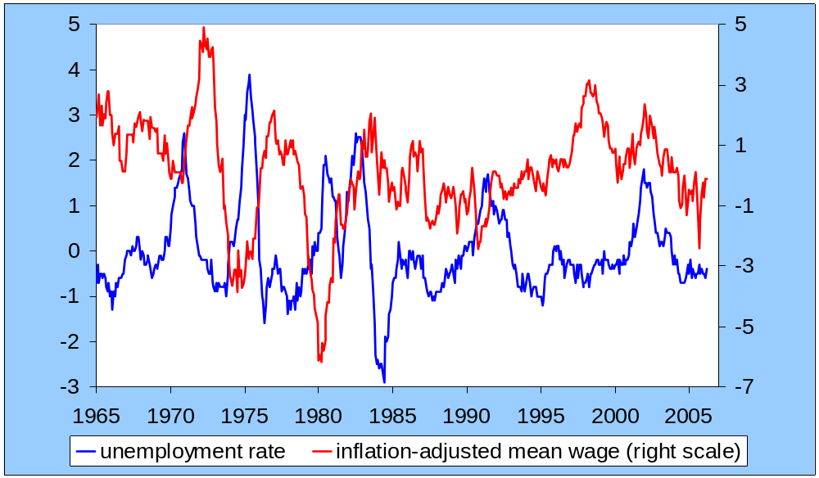
Significance (contd..)
The policies affect social well-being & politics of the country.
change from 12 mos earlier
percent change from 12 mos earlier

Slide 7
Economic Models Address Eco. Issues
…are simplified versions of a more complex reality
irrelevant details are stripped away
…are used to
show relationships between variables
explain the economy’s behavior
devise policies to improve economic performance

Slide 8
Retrospective of the Islamic Fin Sys
Islamic economics formally took off in 1976 with the 1st International Conference on Islamic Economics.
The pioneers focused on themes that had an immediate practical relevance for the Muslim countries.
In the follow-up to the 1st Conference, two seminars on fiscal and monetary policies were held in Makkah and Islamabad.
The proceedings of these seminars have been published by King Abdul Aziz University, Jeddah and Institute of Policy Studies, Islamabad.

Slide 9
Retrospective (cont..)
The Makkah Seminar (1978):
The papers are available in Monetary and Fiscal
Economics of Islam (ed., Muhammad Ariff).
Themes of the Papers
Siddiqi, Chapra and Ariff – monetary policy
Kahf – both fiscal and monetary policies
Uzair – central banking operations
Salama – Fiscal analysis of zakah
Mahfooz Ahmad – theme of distributive justice

Slide 10
Retrospective (cont..)
The Islamabad Seminar (1981):
The papers are available in Money and Banking in
Islam and Fiscal Policy and Resource Allocation
In Islam (eds., Z. Ahmad, M. Iqbal and F. Khan).
Themes of the Papers
Chapra – monetary policy
Al-Jarhi – Institutional framework for mon. pol.
Faridi and Salama – Theory of fiscal policy
Metwally – Macrecon. analysis of fiscal policy
Kahf – Taxation

Slide 11
Retrospective (cont..)
Developments in the 1980s
At the conceptual level, Dr. Umar Chapra wrote his masterpiece Towards a Just Monetary System (1985). And, Dr. Ziauddin came up with a systematic inquiry into “Public Finance in Islam” (1989 – IMF Working Paper).
Other than the above, mostly analytical works were produced in this period. Thus, effects of fiscal and/or monetary policies are studied in the context of macroeconomic models. Some of these works are as follows:

Slide 12
Retrospective (cont..)
Developments in the 1980s (contd.)
Muhammad Mukhtar Mutwally, Macroeconomic Models of Islamic Doctrines (1981)
Ausaf Ahmad, Income Determination in an Islamic Economy (1984, published in 1987)
Tahir, “A Simple of Aggregate Output, Income and Economic Inequalities Determination in an Islamic Economies” (1986, published in 1989)

Slide 13
Retrospective (cont..)
Developments in the 1980s (contd.)
Mohsin Khan, “Islamic Interest-Free Banking – A Theoretical Analysis (1986)
Mohsin Khan and Abbas Mirakhor (1987), “The Financial System and Monetary Policy in an Islamic Economy” (1987)
Muhammad Anwar, Modeling Interest-Free Economy: A study in Macroeconomics and Development (1987)
Nadir Habibi, “The Consequences of Islamic Banking in a Macroeconomic Framework” (1987, published in 1991)

Slide 14
Retrospective (cont..)
Developments in the 1990s
With increasing attention received by Islamic
banking and finance in the 1990s, central banking,
monetary management and monetary policy have
received more attention from the Islamic economists. Some notable papers are:
Mohsin Khan and Abbas Mirakhor, “Monetary Management in an Islamic Economy” (1994)
N. Choudhry and Abbas Mirakhor, “Indirect Instruments of Monetary Control” (1999?)

Slide 15
Retrospective (cont..)
Developments in the 1990s (contd.)
On the fiscal policy side, some work on taxation and
implications of equity-financed budgetary deficit for
stability of the economy were explored:
Mohammad Hussain, “A Macroeconomic Taxation Model for an Islamic Economy” (1993)
Aynul Hasan and A.N. Siddiqui, “Is Equity Financed Budgetary Deficit Stable in an Interest-Free Economy?” (1996)
It is noteworthy that in these and virtually all the analytical papers the analysis is limited to the stabilization role of fiscal and monetary policies

Slide 16
Retrospective (cont..)
All the papers, especially those written at
the conceptual level, are silent on some
fundamental matters. These include:
Islamic economy, i.e., the framework in which the policies are to be conceived.—The focus in the Islamic economics literature is on the Islamic Economic System.
The nature and role of government in the Shari’ah  The Fiqh for Government
The Shari’ah-basis of the policy goals

Slide 17
Retrospective (cont..)
Thus, Islamic economists are taking positions without a proper conceptual framework: Islamic economy, the nature and role of government, the institutional setup for the policies, etc.
Moreover,
Islamic economists are talking about policies for the Muslim countries.
Scant attention is paid to “Islamization of economy” as a policy goal.
Elimination of poverty gets a passing mention as a policy objective.

Slide 18

Thank You

Slide 19
MBF707: Monetary and Fiscal Framework in Islamic Finance
COMSATS Institute of Information Technology (Virtual Campus)

Slide 20
Review
Introduction
Significance of the Subject
Economic Models
Retrospective of the Islamic Financial System

Slide 21
Topics to Cover
Reconstruction of the Argument
The Policy Perspective – Islamic Economy
The Financial Scene and Landscape
The Fiqh for Government
The Policy Goals in an Islamic Economy
The Policy Goals in a non-Islamic Economy

Slide 22
Reconstruction of the Argument
The Policy Perspective – Islamic Economy
The Financial Scene and Landscape
The Fiqh for Government
The Policy Goals in an Islamic Economy
The Policy Goals in a non-Islamic Economy

Slide 23
The Policy Perspective
Individual is a part of the economy, not the vice versa.
Nucleus: Family
Market economy
The Financial Scene and the Financial Landscape (see next)
Government (details follow)

Slide 24
The Financial Scene
Islamic banks
The Securities Markets
Murabahah financing securities
Salam certificates
Ijarah financing securities & warrants
Redeemable musharakah securities
The Equity Market: The Islamic stock market
Islamic insurance

Slide 25
The Financial Landscape
The role function of financial institutions will be redefined.
Financial follows will either run parallel to real flows (as in murabahah, salam and ijarah financing) or be tied to real economic activity (as in partnership based financing).
The financial and the real sectors will be closely integrated.

Slide 26
Government in the Modern Age
Whereas the Fiqh for Government is our principal concern, the argument is presented
after a look the following matters in the
modern age:
Natural Role of the Government
Economic Role/Functions performed by Modern Governments
How the Government performs Its Role

Slide 27
Government in the Modern Age
Natural Role of the Government:
1- Protection of territorial integrity of the state
2- Enforcement of the state’s claims and discharge of the state obligations
3- Civil Administration
4- Development and maintenance of an institutional framework in which the citizens may operate
5- Maintenance of civil liberties
6- Protection of recognized property rights of the citizens
7- Provision of justice

Slide 28
Government in the Modern Age
Economic Functions performed by Governments in the Modern Age
1- Allocation of resources through affecting price signals—taxes and subsidies—and sometimes through direct involvement in the economic activity
2- Distribution ─ redistribution of income and wealth through fiscal measures—The current emphasis is on Poverty Reduction.
3- Stabilization ─ macroeconomic management of the economy for alleviating unemployment, inflation and other socioeconomic evils

Slide 29
Government in the Modern Age
The way in which a modern Government performs Its role
In the case of government activity, the decisions are made by one group of people (the ruling elite—sometimes the parliament and sometimes those at the helm of the affairs), implemented by another (the bureaucracy) and are the financial obligation of yet another group of people (the public).

Slide 30
Fiqh for the Government
The Issues from the Shari’ah Perspective
All activities in the name of the government by the rulers, or those by the bureaucracy on behalf of the government, fall in the domain of mua’malat: transactions and exchanges.
Is there some Shari’ah for those at the helm of affairs of the people or the government?
The Position in the fiqhi domain in the past
The writings focus on personal conduct of the rulers, and the art of the statecraft (Ahkam Al-Sutaniyyah)

Slide 31
Fiqh for the Government
The Position in the Fiqhi Domain
The basic Ahkam of the Shari’ah are given in the Qur’an and the Sunnah at the micro level for primary cases in a do/don’t form.
The fiqhi writings in the past focused on personal conduct of the rulers, and the art of the statecraft (Ahkam Al-Sutaniyyah).
The present situation is no different.
It is surprising that detailed Shar’ee Ahkam are provided on what an individual may/may not do in various walks of life, but there are no “Ahkam” for the same individual if he becomes a “ruler”.

Slide 32
Fiqh for the Government
The Nature and the Role of the Government in
Modern times in the Light of the Shari’ah Principles:
One must differentiate between “State” and “Government”.
The state is a permanent geo-legal entity, while
governments—individuals— come and go. The fiqh
for government comes in the picture here.

Slide 33
Fiqh for the Government
The Nature and the Role of the Government in
Modern times in the Light of the Shari’ah Principles:
The persona of ‘Government’ has two dimensions:
Government as representative of the Shari’ah
Government as representative—whether elected or not— of the people

Slide 34
Fiqh for the Government
The Ahkam for the Government in Its Capacity as
a Representative of the Shari’ah
Fulfillment of basic needs of the people of that are guaranteed by the Shari’ah
Enforcement of the Shari’ah, incl. establishment of the system of zakah
Spearheading the Islamization agenda — both Islamization of the economy and diffusing the message of Islam
Protection of the state sovereignty

Slide 35
Fiqh for the Government
The Ahkam for the Government in Personal
Capacity of the Rulers or in Their Capacity as
Representatives of the People
All the prohibitions of the Shari’ah apply to the government. But the matter may be somewhat different in the case of the permissible things.
The issue of public property — No trading. Use in public interest
The government and economic activity
The government and charity
The government and pure public goods
The government and semi-public goods

Slide 36
Policy Goals in Islamic Economy
Development and preservation of institutional framework to support economic and distributional activity
Education, incl. that of science and technology
Fulfillment of the fundamental economic rights of the citizens
Elimination of poverty
Reduction in inter-regional economic disparities
Temporary help to local communities to tied over temporary economic constraints (for local public goods)
Economic development
Maintenance of a credible deterrence

Slide 37
Policy Goals in Non-Islamic Economy
Islamization of economy
All other goals admissible in an Islamic economy, as explained earlier
Notes:
Our focus is on the ultimate goals that fiscal and monetary policies are supposed to aim at. Of course, they may be translated in terms of more specific targets.
The departure from traditional roles assigned to fiscal and monetary policies is notable.

Slide 38
Policy Goals
Fiscal Policy (Consensus view at the 1981
Islamabad Seminar)
Ideological orientation with equal attention to material and spiritual welfare
Fulfillment of basic needs of all the people
Providing the necessary infrastructure to promote economic growth
Promoting an egalitarian economic and social order

Slide 39
Policy Goals
Monetary Policy (due to Dr. Chapra, The 1980
Islamabad Seminar):
Economic well-being with full employment and optimum rate of economic growth,
Socioeconomic justice and equitable distribution of income and wealth, and
Stability in the value of money (Dr. Chapra)

Slide 40
Policy Goals (Difference)
The same goals are proposed here for both fiscal and monetary policies.
Islamization of economy is recognized here as a goal for non-Islamic economies.
There is some deviation from the goals traditionally assigned to the two policies.

Slide 41
Some Reflections on Working of the Fiscal Policy in an Islamic Economy
The government should focus on the fulfillment of the absolutely critical minimum needs of the citizens and the provision of a credible deterrence.
Both initiative and necessary action for anti-poverty purposes should come from the private sector with the government playing only the facilitator’s role.
Government should also pay attention to distributive implications of its expenditures for a given target.─For example, no consumption subsidies and making an also for an expenditure not deteriorating economic disparities and poverty.

Slide 42
Some Reflections on Working of the Fiscal Policy in an Islamic Economy
The government should keep its hands largely off direct participation in economic activity and, in particular, avoiding entering into long-term economic commitments.
The government should pursue its fiscal agenda in conjunction with the options available on the monetary side.
The government should spearhead the development agenda with the involvement of the private sector.

Slide 43
Some Reflections on Working of the Monetary Policy in an Islamic Economy
The Islamic financial system should be allowed to find its own equilibrium.
Activist monetary policy should not to be on the cards due to inflation not being a major concern in the Islamic setup [because of to the financial flows being tied to (or, running parallel to) the real flows in the economy].
The central bank should focus on solvency of the financial system through prudential regulations, reserve requirements and its discounting operations.

Slide 44
Some Reflections on Working of the Monetary Policy in an Islamic Economy
The central bank should influence the flow of financing into high-priority sectors through annual financing ceilings, regulating the equity stake of bank in deposits mobilized for the various purposes, etc.
Fresh money may be injected into the system through Shari’ah-permitted fiscal deficits or through injecting liquidity into the system on partnership basis for financing high-priority sectors.

Slide 45
Thank You

