Slide 1
MBF-705
LEGAL AND REGULATORY ASPECTS OF BANKING SUPERVISION
Session: Four
OSMAN BIN SAIF

Slide 2
Summary of Previous Session
  Credit rating agencies
  Mortgage Brokers
  Secondary Mortgage Markets
The Mess
  Evolution of Home Mortgage
  New model of Mortgage lending
  Private sub prime mortgage process
  Reasons for forming of subprime mess

Slide 3
Agenda of this session
Big Assumption
Misaligned incentives & pitfalls
Good Days turn Bad
Start of Failure
Sub prime Global financial crisis
Financial Crisis
  Poor investors
  Desperate Bank
Lessons Learned and Action Plans

Slide 4
Agenda of this Session
Finance and Economy
Investment devalued across the Globe
Impact of Financial crisis across the Globe

Slide 5
Big assumptions
Belief that modern capital markets had become so much more advanced than their predecessors that banks would always be able to trade debt securities. This encouraged banks to keep lowering lending standards, since they assumed they could sell the risk on.

Slide 6
Big Assumptions (Contd.)
Many investors assumed that the credit rating agencies offered an easy and cost-effective compass with which to navigate this ever more complex world. Thus many continued to purchase complex securities throughout the first half of 2007 – even though most investors barely understood these products.

Slide 7
Big Assumptions (Contd.)
Most crucially, there was a widespread assumption that the process of “slicing and dicing” debt had made the financial system more stable. Policymakers thought that because the pain of any potential credit defaults was spread among millions of investors, rather than concentrated in particular banks, it would be much easier for the system to absorb shocks than in the past.
Housing prices will keep going up all time

Slide 8
Misaligned incentives & pitfalls
“churning” of capital “allows even an institution without a great amount of fixed capital to make a huge amount of loans, lending in a year much more money than it has
If an individual or class of victims obtains a large judgment, the lender’s management can simply declare bankruptcy, liquidate whatever limited assets are left, and possibly reform a new company a short time later.

Slide 9
Misaligned incentives & pitfalls (Contd.)
Securitization conduit divides various lending tasks into multiple corporate entities—a broker, an originator, a servicer, a document custodian, etc.—the conduit tends to prevent the accumulation of a large enough pool of at risk assets to attract the attention of class action attorneys, which tend to be the only actors capable of obtaining system-impacting judgments.

Slide 10
Good days turn bad. Crisis at the door (mid 2006 onwards):
Through financial innovations loans issued to borrowers at minimal rate, adjusted rate. By mid 2006 time to pay bigger amounts comes
Household income did not increase in same proportion as house prices
Subprime mortgage owners start defaulting

Slide 11
Good days turn bad. Crisis at the door (mid 2006 onwards):
Rating agencies revise ratings of MBS/CDO as expected number of defaults turn out higher. Many ratings are lowered
Bewildered investors lost faith in ratings, many stop buying MBS/CDO altogether
Alarm bell at SIV/SPVs
Banks find themselves in non-comfortable position , stop making loans
Housing prices plummet owing to increase in foreclosure, delinquency and stoppage of loans

Slide 12
what a mess….
More frenzy in market and more defaults, again revised ratings, again further stoppage of funding and further stoppage of loans, further fall in house prices as demand and supply mismatch....problem feeding itself in circular fashion.
As MBS/CDO market is shaken….investors start debating other derivatives true worth…panic spreads across and people start getting out….further hurting the banks

Slide 13
What a mess
The crisis unfolded as silent Tsunami on Wall Street where by the time people realized the graveness of the mess they were in , it had gone beyond control.
Since, most of the player in the market, mortgage brokers, investment banks were running in debts. They are suddenly caught unaware and are in insolvency and start tumbling down….many are saved by nationalization as their fall would spread the contagion way far .

Slide 14
What a mess
Central government start pumping in money as last resort but one thing is surely not returning soon and which is very vital in financial industry -FAITH.

Slide 15
In Short
When homeowners default, the amount of cash flowing into MBS declines and becomes uncertain.
Investors and businesses holding MBS have been significantly affected.
The effect is magnified by the high debt levels maintained by individuals and corporations, sometimes called financial leverage.

Slide 16
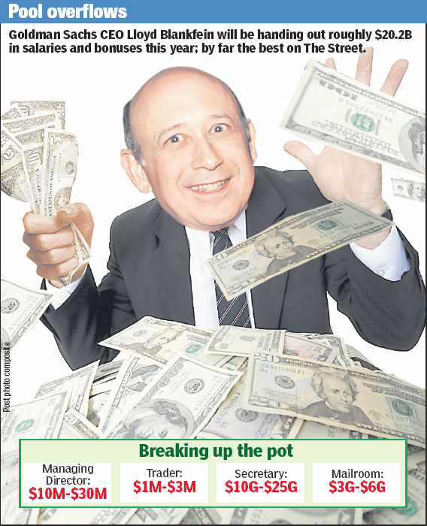
Those good old days were gone now!!

Slide 17
How Subprime became Global Financial Crisis?
How could problems with subprime mortgages, being such a small sector of global financial markets, provoke such dislocation?
Lets look into it from start again:
Industry data suggest that between 2000 and 2006, nominal global issuance of credit instruments(MBS/CDO) rose twelvefold, to $3,000bn a year from $250bn

Slide 18
How Subprime became Global Financial Crisis? (Contd.)
Became intense from 2004, partly because investors were searching for ways to boost returns after a long period in which central banks had kept interest rates low.
“slicing and dicing” was fuelling a credit bubble, leading to artificially low borrowing costs, spiraling leverage and a collapse in lending standards

Slide 19
How Subprime became Global Financial Crisis? (Contd.)
In billion US $

Slide 20
Build up into a financial crisis…
In 2003, Bank of International Settlements(BIS) repeatedly warned that risk dispersion might not always be benign. But US Federal Reserve was convinced that financial innovation had changed the system in a fundamentally beneficial way.
No efforts made to correct debt to equity ratios of bank
Huge trust in the intellectual capital of Wall Street –supported by the fact that banks were making big money.
When high rates of subprime default emerged in late 2006, market players assumed that the system would absorb the pain.

Slide 21
Build up into a financial crisis (Contd.)
Initial estimate of subprime loss put to $50bn-$100bn by US FED
Subprime losses started to hit the financial system in the early summer of 2007 in unexpected ways. As the surprise spread, the pillars of faith that had supported the credit boom started to crumble.
Investors woke up to the fact that it was dangerous to use the ratings agencies as a guide for complex debt securities.
In the summer of 2007, the agencies started downgrading billions of dollars of supposedly “ultra-safe” debt – causing prices to crumble.

Slide 22
Poor Investors….
Shocked investors (sitting in all parts of the world) lost faith in ratings, many stopped buying complex instruments altogether
That created an immediate funding crisis at many investment vehicles ( remember SIV), since most had funded themselves by issuing notes in the asset-backed commercial paper market.
  Many banks had not yet passed on the risk to others. Many were holding asset-backed securities in “warehouses” and were working on splicing them up into CDOs, getting them rated by a credit agency such as Moody’s or Standard & Poor’s. Several banks were caught out not only because it took time to structure the securities but because they deliberately held on to what they regarded as “safe” tranches of loans. Ex. UBS was badly damaged by retaining “super-senior” CDO debt.

Slide 23
Poor Investors (Contd.)
It also meant that banks were no longer able to turn assets such as mortgages into subprime bonds and sell these on.
That in turn meant the key assumption that the capital markets would always stay liquid – was overturned.
Assumption that banks would be better protected from a crisis because of risk dispersion – also cracked.
As investment vehicles lost their ability to raise finance, they turned to their banks for help. That squeezed the banks’ balance sheets at the very moment that they were facing their own losses on debt securities and finding it impossible to sell on loans.

Slide 24
Desperate banks….
As a result, western banks found themselves running out of capital
Banks started hoarding cash and stopped lending to each other as financiers lost faith in their ability to judge the health of other institutions – or even their own.
The London interbank offered rate(LIBOR), the main measure of interbank lending rates, rose sharply

Slide 25
Desperate Bank (Contd.)
Firms became reluctant to participate in money markets ... as a result subprime credit problems turned into a systemic liquidity crunch.
Vicious deleveraging spiral got under way. As banks scurried to improve their balance sheets, they began selling assets and cutting loans to hedge funds.
But that hit asset prices, hurting those balance sheets once again.
Mark-to-market accounting forced banks to readjust their books after every panicky price drop

Slide 26
Lessons learned & Action plans ….
lesson of the CDO (Collateralized debt obligation) collapse is that technology does not obviate the need to assess a borrower carefully. Neither banks nor credit agencies did this well enough on behalf of investors and it proved a painful experience for everyone
In the medium term, regulators are preparing reforms that aim to make the system look credible
Source: Financial Times , http://www.ft.com/cms/s/0/a09f751e-6187-11dd-af94-000077b07658,dwp_uuid=698e638e-e39a-11dc-8799-0000779fd2ac.html

Slide 27
Lessons learned & Action plans (Contd.)
These would force banks to hold more capital and ensure that the securitization process is more transparent
More immediately, the banks are trying to rekindle investor trust by replenishing their capital bases

Slide 28
Subprime losses by Big Banks
Worldwide :US$ 586.2 billion and still counting

Slide 29
Finance & Economy
The collapse of an enormous financial institution stirs uncertainty, and uncertainty rattles Wall Street. Lenders are happiest when they are confident they will be repaid. If they think there's a chance that borrowers will default, they simply don't make loans. Their refusal, in turn, can shut down the economy and the financial system.

Slide 30
Finance & Economy (Contd.)
Financial system is what provides the funding for all the other sectors of the economy, and if you have a broken financial system, you have a broken economy

Slide 31
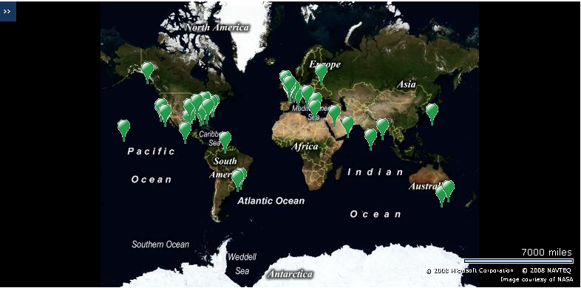
Investments devalued across the Globe

Slide 32
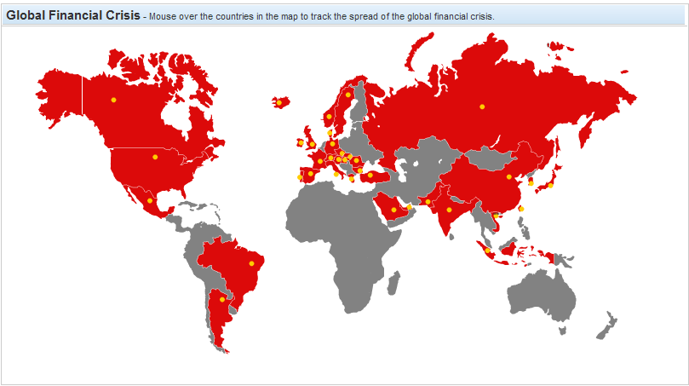
Impact of Financial crisis-felt across the globe

Slide 33
Summary of this session
Big Assumption
Misaligned incentives & pitfalls
Good Days turn Bad
Start of Failure
Sub prime Global financial crisis
Financial Crisis
  Poor investors
  Desperate Bank
Lessons Learned and Action Plans

Slide 34
Summary of this Session
Finance and Economy
Investment devalued across the Globe
Impact of Financial crisis across the Globe

Slide 35
THANK YOU

