Slide 1
MBF-705
LEGAL AND REGULATORY ASPECTS OF BANKING SUPERVISION
Session: THIRTY
OSMAN BIN SAIF

Slide 2
Summary of last Session
The negotiable Instruments ACT,
Financial Institutions Ordinance 2001.

Slide 3
Agenda of this Session
What are prudential Regulations?
Prudential regulations
  For agriculture financing
  For corporate / commercial banking
  For Small & Medium Enterprise Financing
  For consumer financing
  For Microfinance Banks

Slide 4
What are Prudential Regulations?
  Prudential—to reduce the level of risk bank creditors are exposed to (that is, to protect depositors);
  Regulations which are governed by laws.

Slide 5
PR’s by State Bank of Pakistan
Prudential regulations
  For agriculture financing
  For corporate / commercial banking
  For Small & Medium Enterprise Financing
  For consumer financing
  For Microfinance Banks

Slide 6
PR for Agricultural Financing
The importance of agriculture cannot be overemphasized for the economy of Pakistan.
Agriculture constitutes about 23% of the GDP of Pakistan and accounts for 42.1% of the total employed labour force in Pakistan.
By serving as the base sector for major industries like textile and sugar etc., the agriculture sector stands out as the largest source of foreign exchange earnings.

Slide 7
PR for Agricultural Financing (Contd.)
In view of its wide-ranging backward and forward linkages, agriculture in Pakistan assumes a vital role in overall growth of the economy.
Thus, a progressive and well developed agriculture sector can play a pivotal role in accelerating the overall pace of development of the country and alleviating poverty.

Slide 8
PR for Agricultural Financing (Contd.)
State Bank of Pakistan, in consultation with commercial banks/DFIs has been endeavoring for the past many decades to ensure the flow of sufficient funds to the agriculture sector. While substantial progress has been made in this respect, there is still a lot of room for further improvement.

Slide 9
PR for Agricultural Financing (Contd.)
The new and innovative financial products for financing the agriculture sector can create a win-win situation, whereby, on one hand, the financing needs of agriculture sector can be met and, on the other hand, banks/DFIs can earn a reasonable rate of return on their funds

Slide 10
PR for Agricultural Financing (Contd.)
State Bank of Pakistan is continuously working to ensure that its regulatory framework for banks/DFIs matches the changes taking place in the market and is conducive for the development of new financial products and helps banks/DFIs to optimally utilize their resources for maximizing the benefits to the banking sector and different segments of the society and economy.

Slide 11
PR for Agricultural Financing (Contd.)
While SBP supervised Agriculture Loans Schemes have been very useful in channelizing the bank financing to agriculture sector, it was felt that a separate set of Prudential Regulations for Agriculture Financing is needed to provide a broader regulatory framework to the banks/DFIs.

Slide 12
PR for Agricultural Financing (Contd.)
So that banks/DFIs could be able to develop their own financing schemes/products for financing the agriculture sector.

Slide 13
PR for Agricultural Financing (Contd.)
The Prudential Regulations for Agriculture Financing may be considered only as the minimum standards and the banks/DFIs should take adequate measures to ensure that agricultural financing is undertaken in a prudent manner.

Slide 14
PR for Agricultural Financing (Contd.)
Banks/DFIs are encouraged to extend agricultural financing on the basis of future cash flows instead of relying solely on the collateral.
Standard cash flows can be estimated for different crops in different geographical areas and these cash flows can then be adjusted for specific borrowers by trained credit officers of the banks/DFIs, keeping in view the quality of land, efficiency of the individual farmers, etc.

Slide 15
PR for Agricultural Financing (Contd.)
This will not only facilitate expeditious decision making, but will also reduce subjectivity in the process of decision making.

Slide 16
PR for Agricultural Financing (Contd.)
Keeping in view the national importance of agriculture sector, State Bank expects banks/DFIs to take extra care in facilitating their borrowers.
For better understanding of their customers, banks/DFIs are encouraged to translate their application forms, check lists of all required documents and brochures in Urdu and other regional languages.

Slide 17
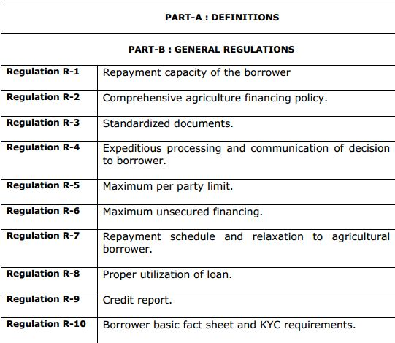
PR for Agricultural Financing (Contd.)

Slide 18
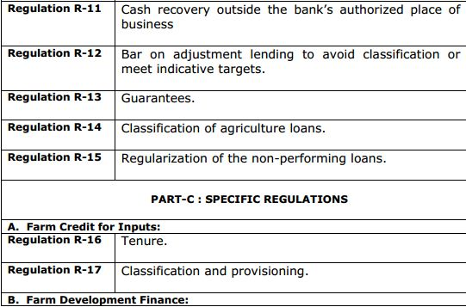
PR for Agricultural Financing (Contd.)

Slide 19
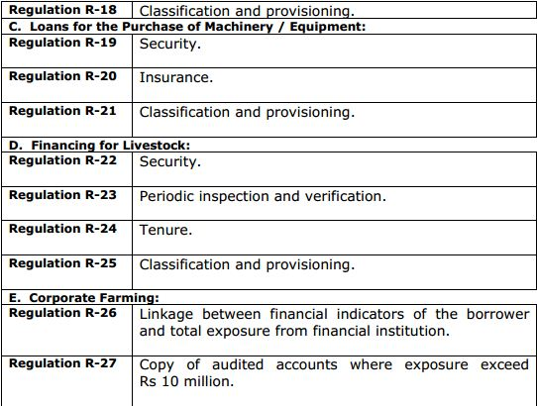
PR for Agricultural Financing (Contd.)

Slide 20
PR for Corporate/Commercial Banking
The Prudential Regulations for Corporate/Commercial Banking cover four categories viz.
  Risk Management (R),
  Corporate Governance (G), Customer Due Diligence and
  Anti Money Laundering (M), and
  Operations (O).

Slide 21
PR for Corporate/Commercial Banking (Contd.)
It may further be noted that any financing facility, other than the one defined under the SMEs, Consumer, Agriculture and Micro Financing, shall be governed by the Prudential Regulations for Corporate/Commercial Banking.
However, in case of international operations, the Prudential Regulations of host country shall prevail.

Slide 22
PR for Corporate/Commercial Banking (Contd.)
The Prudential Regulations for Corporate/Commercial Banking do not supersede other directives issued by State Bank of Pakistan in respect of areas not covered here.

Slide 23
PR for Corporate/Commercial Banking (Contd.)
Any violation or circumvention of these regulations shall render the bank/DFI/officer(s) concerned liable for penalties under the Banking Companies Ordinance, 1962.

Slide 24
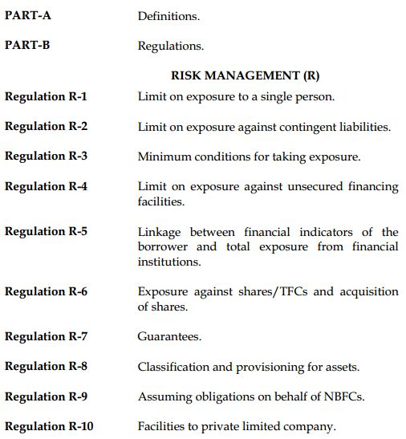
PR for Corporate/Commercial Banking (Contd.)

Slide 25
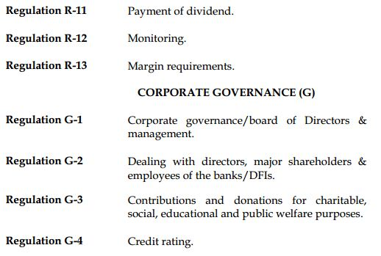
PR for Corporate/Commercial Banking (Contd.)

Slide 26
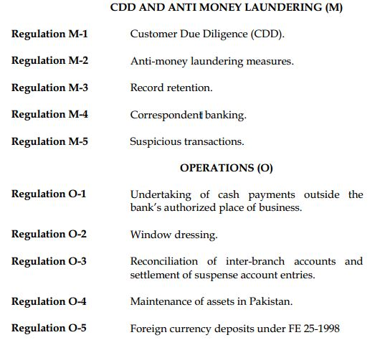
PR for Corporate/Commercial Banking (Contd.)

Slide 27
PR for SME’s
SMEs represent 30 percent of national GDP, 25 percent of exports of manufactured goods, and 35 percent of manufacturing value added.
Thus, the impact of financial exclusion on this sector has important implications for economic growth, competitiveness, and job creation.

Slide 28
PR for SME’s (Contd.)
The potential for this sector to contribute to the
  economic development objectives of Pakistan, including generating employment,
  increasing incomes, and
  reducing poverty is the justification for a strategy of support to unleash the sector’s potential.
Keeping this in view, SBP issued separate Prudential Regulations for SMEs in 2003.

Slide 29
PR for SME’s (Contd.)
Since Medium Enterprises relatively are less credit constrained in accessing loans on account of their size and sophistication level, the Regulations governing them have not been changed, with the exception of separate definition for Medium Enterprises, and revising their individual & aggregate exposure limits upward.

Slide 30
PR for SME’s (Contd.)
The Regulatory Framework will bear its intended results, only if the banks/DFIs take the necessary steps including the following:
  Bring Strategic change at higher level to expand share in SME portfolio.
  Use relevant/practical cash flow estimation techniques and other proxies to assess repayment capacity of SME borrowers.
  Adopt Program-based lending & down scaling strategies. Allocate adequate resources for Research & development.

Slide 31
PR for SME’s (Contd.)
  Make appropriate alignment in their Risk Management processes.
  Take effective measures to capture market niche by conducting market segmentation
  Strengthen credit appraisal and monitoring mechanism by greater use of Technology and Documentation to undertake effective review of SME Portfolio.
  Effective use of internal audit and control functions.
  Adopt measures for greater ‘financial awareness’ of SMEs specially “SEs”

Slide 32
PR for SME’s (Contd.)
It may be noted that revised PRs are applicable with immediate effect for the fresh financing facilities.
However, since the banks/DFIs need to segregate their existing SME portfolio according to the new definitions and revised classification criteria, Banks/DFIs are allowed a maximum implementation period up to September 30, 2013 for the purpose for existing portfolio.

Slide 33
PR for SME’s (Contd.)
State Bank of Pakistan will be monitoring the situation closely, and will work with banks / DFIs to make SME Banking a viable success on sustainable basis.
For this purpose, SBP will be open to review any regulatory provision, if necessary, while ensuring at the same time that banks/DFIs observe due prudence and necessary oversight.

Slide 34
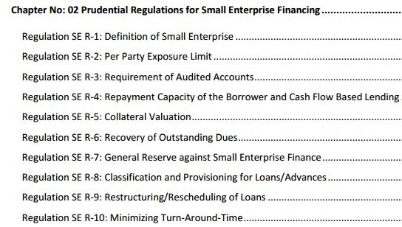
PR for SME’s (Contd.)

Slide 35
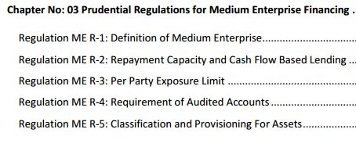
PR for SME’s (Contd.)

Slide 36
PR for Consumer Financing
The amendments made in the Prudential Regulations for Consumer Financing during January 31, 2009 to January 31, 2011 have been incorporated in this updated version for ease of reference of the users

Slide 37
PR for Consumer Financing (Contd.)
The Prudential Regulations for Consumer Financing do not supersede other directives issued by State Bank of Pakistan in respect of areas not covered here.
Any violation or circumvention of these regulations shall render the bank/DFI/officer(s) concerned liable for penalties under the Banking Companies Ordinance, 1962.

Slide 38
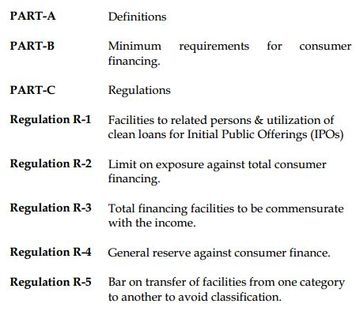
PR for Consumer Financing (Contd.)

Slide 39
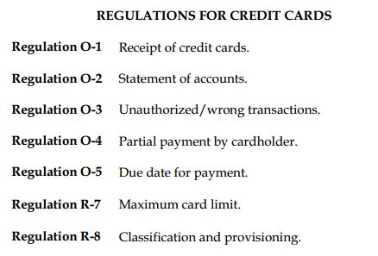
PR for Consumer Financing (Contd.)

Slide 40
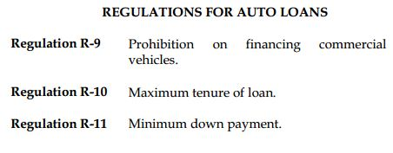
PR for Consumer Financing (Contd.)

Slide 41
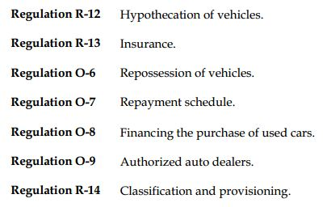
PR for Consumer Financing (Contd.)

Slide 42
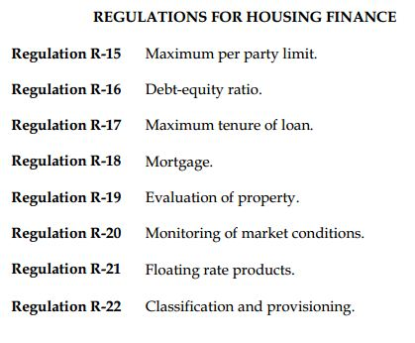
PR for Consumer Financing (Contd.)

Slide 43
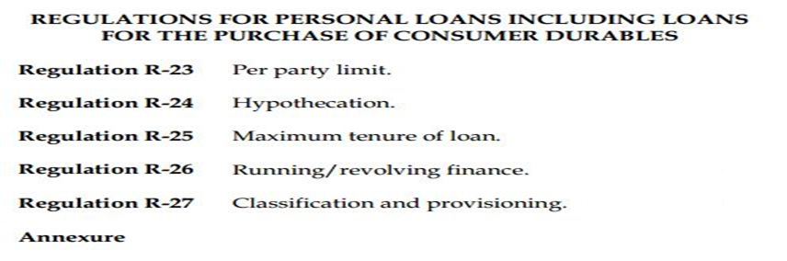
PR for Consumer Financing (Contd.)

Slide 44
PR for Microfinance Banks
These Prudential Regulations for Microfinance Banks provide minimum regulatory requirements that Microfinance banks should follow in their normal businesses.

Slide 45
PR for Microfinance Banks (Contd.)
In Pakistan, microenterprises operate in numerous forms including carpenters, electricians, food stalls, farmers, live-stocks, lathe machines, mechanics etc. and these have traditionally lacked access to formal financial services.

Slide 46
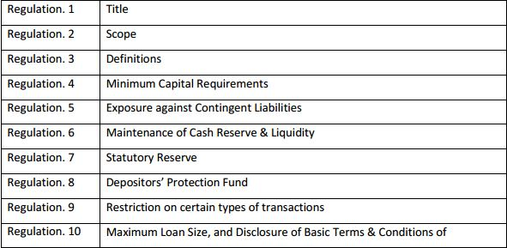
PR for Microfinance Banks (Contd.)

Slide 47
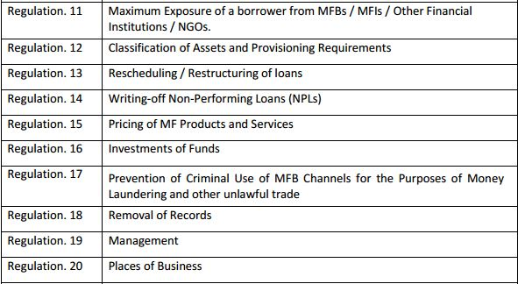
PR for Microfinance Banks (Contd.)

Slide 48
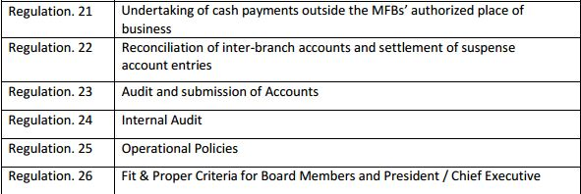
PR for Microfinance Banks (Contd.)

Slide 49
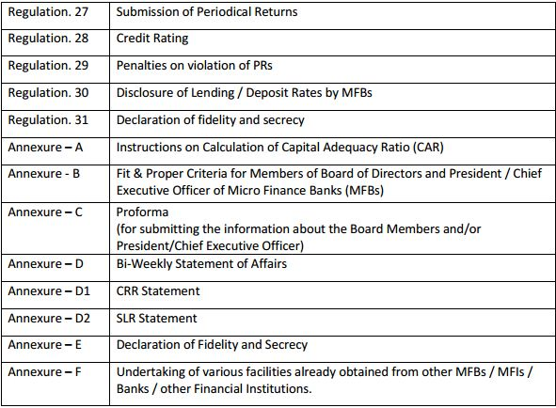
PR for Microfinance Banks (Contd.)

Slide 50
Summary of this Session
What are prudential Regulations?
Prudential regulations
  For agriculture financing
  For corporate / commercial banking
  For Small & Medium Enterprise Financing
  For consumer financing
  For Microfinance Banks

Slide 51
THANK YOU

