Slide 1
MBF-705
LEGAL AND REGULATORY ASPECTS OF BANKING SUPERVISION
Session: Two
OSMAN BIN SAIF

Slide 2
Summary of Previous Session
Course Objectives
Key Learning Outcomes
Course Contents/ Structure
Why we need regulations?
Who are the supervisors / regulators of banking industry?
How bank earns Profit?
What is safety and soundness of a bank?
How is safety and soundness of a bank measured? CAMELS

Slide 3
Summary of Previous Session (Contd.)
What is consumer protection?
What are the key objectives of bank regulation?

Slide 4
Agenda of this session
General principles of banking regulation
Banking Crises
  Banking system (Operations, potential Problems, Criticality)
  Institutional investors
  investment banks
  Pension Funds
  Hedge funds
  Central Bank. US Example

Slide 5
Agenda of this Session (Contd.)
  Government Securities / Bonds
  Credit rating agencies
  Mortgage Brokers
  Secondary Mortgage Markets
  Mortgage backed security
  OTC

Slide 6
General Principles of Bank Regulations
Banking regulations can vary widely across nations and jurisdictions.
The general principles of bank regulation throughout the world are—
  Minimum Requirements;
  Supervisory Review;
  Market Discipline.

Slide 7
General Principles of Bank Regulations (Contd.)
Minimum Requirements
Requirements are imposed on banks in order to promote the objectives of the regulator.
The most important minimum requirement in banking regulation is maintaining minimum capital ratios.

Slide 8
General Principles of Bank Regulations (Contd.)
Supervisory Review
Banks are required to be issued with a bank license by the regulator in order to carry on business as a bank, and the regulator supervises licensed banks for compliance with the requirements and responds to breaches of the requirements through obtaining undertakings, giving directions, imposing penalties or revoking the bank’s license.

Slide 9
General Principles of Bank Regulations (Contd.)
Market Discipline
The regulator requires banks to publicly disclose financial and other information, and depositors and other creditors are able to use this information to assess the level of risk and to make investment decisions.
As a result of this, the bank is subject to market discipline and the regulator can also use market pricing information as an indicator of the bank’s financial health.

Slide 10

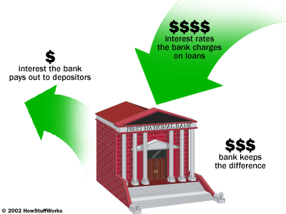
Bank
Operation
  Take money as deposits on which they pay interests
  Lend it to borrowers who use if for investment or consumption
  Borrow money from other banks (inter bank market)
  Make profit on the difference between interest paid and received
Notes:
10

Slide 11
Potential problems in Bank
Most of bank liabilities have shorter maturity period than assets
  This can be a potential cause of bank failure incase all depositors take out money at once (bank run)
Credit risk
  Possibility that borrowers will be unable to repay their loans
  More risk in prosperity period as lending terms tends to be relaxed
Interest rate risk
  Most deposits at floating rate
  Loans at fixed rate
  If floating rate is more than fixed rate bank loses ( S&LI ,America 1979)
Notes:
11

Slide 12
Criticality of Banking system
As bank provide credit and operate payments- failure can have a more damaging effect on the economy than the collapse of other businesses
Hence need for more regulation by government
  Reserve requirement – holding a proportion of bank deposits at the central bank (CRR)
  Match a proportion of risky assets (i.e loans) with capital in form of equity or retained earnings
    Capital of internationally active banks should amount to at least 8% of the value of risky assets. (Basel Accord)
Notes:
12

Slide 13

Investment Banks
Help firms raise money in the capital markets (equity and bonds market)
Advise firms whether to finance themselves with debt or equity
Underwrite such issues by agreeing often with other banks in syndicate, to buy any unsold securities
Notes:
13

Slide 14
Investment Banks (Contd.)
Paid a commission for this service
Advice on mergers and acquisitions
(most lucrative work- not during
sub-prime crisis though!!)
Glass-Steagall act – prevented
commercial banks from giving Investment
banks services

Slide 15

Institutional investors
At most basic , they are simply vast pools of money
Institutional investors are
  Pension funds
  Mutual funds
  Insurance companies
Dominate the securities( stocks, bonds) market
Control a huge chunk of most rich countries retirement savings and other wealth
These have been growing at the expense of banking system
As biggest owners of stocks and bonds they have growing influence in corporate finance and hence corporate governance
Notes:
15

Slide 16

Pension funds
Designed for employees of companies or governments
Common form –Trust- overseen by trustees for the benefit plan members
In traditional pension plan, the employer guarantees a fixed pension in old age. The company and employee both pay monthly contributions into pension fund, where the money is invested.
Trustee is responsible to make sure that the fund’s asset cover its liabilities.
Notes:
16

Slide 17

Hedge funds
Try explicitly to make money whether markets are going up or down
Mostly private partnerships instead of public companies
Most regulators allow only rich to invest in them
Over the years shifted from being largely private funds for rich families to being larger institutions whose investors are pension funds, hospitals, endowments and foundations.
Notes:
17

Slide 18


Insurance companies
Oldest type of institutional investor
From protection to savings + protection
Law of large numbers – risk can be managed by pooling individual exposures in large portfolios
  Catch1- law works if risk are not correlated
  Catch2- losses in any 1 year may differ hugely from the long run trend
Notes:
18

Slide 19
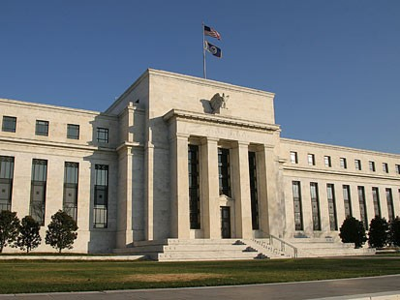
Central Bank-US Example
Primary purpose is to address banking panics
To strike a balance between private interests of banks and the centralized responsibility of government
  To supervise and regulate banking institutions
  To protect the credit rights of consumers

Slide 20
Central Bank-US Example (Contd.)
To manage the nation's money supply through monetary policy to achieve the sometimes conflicting goals of
  maximum employment
  stable prices
  moderate long-term interest rates
To maintain the stability of the financial system and contain systemic risk in financial markets

Slide 21
Central Bank-US Example (Contd.)
To provide financial services to depository institutions, the U.S. government, and foreign official institutions, including playing a major role in operating the nation’s payments system
  To facilitate the exchange of payments among regions
  To respond to local liquidity needs

Slide 22
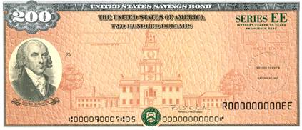
Government securities/bonds
Governments usually borrow by issuing securities, government bonds and bills to make up for the expenses and revenue (tax collected) differential
One can treat it as commercial paper
Least risky investment in US

Slide 23
Summary of this Session
General principles of banking regulation
Banking Crises
  Banking system (Operations, potential Problems, Criticality)
  Institutional investors
  investment banks
  Pension Funds
  Hedge funds
  Central Bank. US Example

Slide 24
Summary of this Session (Contd.)
  Government Securities / Bonds

Slide 25
THANK YOU

