Slide 1
Summary of Last Lecture
The market
The average consumer in the market
Tapping the opportunities

Slide 2
WHO SERVES THE
BOP MARKET—AND
WHO DOESN’T?

Slide 3
Introduction
In this lecture we look at the supply side of the BOP market for financial services, developing a view of who serves the market and how, as well as a better understanding of the gaps.

Slide 4
Introduction
But first let’s look at two very different kinds of players who are already in those markets, doing business with BOP clients.

Slide 5
Major Corporations: Shampoo and
Cell Phones
Not many formal businesses or multinational corporations serve BOP customers; one of the market’s defining characteristics is its relative isolation from major institutions.

Slide 6
Major Corporations: Shampoo and
Cell Phones
Among the first to enter this territory were consumer products companies like Lever Brothers and Procter & Gamble, who innovated in marketing and distribution to derive significant income from poor markets.

Slide 7
Major Corporations: Shampoo and
Cell Phones
In response to tiny amounts of disposable income, they developed sachet marketing— providing products in small individual packages affordable to even very low-income customers—which became a useful model for other industries, such as mobile phone service.

Slide 8
Major Corporations: Shampoo and
Cell Phones
Mobile handset makers and wireless service providers have recognized the tremendous potential of taking entire nations directly to wireless communications at incredible speed.

Slide 9
Major Corporations: Shampoo and
Cell Phones
Nigeria reportedly connected only 450,000 landlines in three decades, but has subscribed 32 million mobile customers since 2001. In fact, mobile communications provides a huge productivity boost.

Slide 10
Major Corporations: Shampoo and
Cell Phones
The London Business School recently determined that every 10 percent increase in mobile phone ownership in a developing economy is worth 0.6 percent of additional gross domestic product growth.

Slide 11
Major Corporations: Shampoo and
Cell Phones
Technology companies are racing to invent products affordable to these BOP consumers, too, whether it’s a $100 laptop from One Laptop per Child or a $1,500 electrocardiograph machine from GE Healthcare.

Slide 12
Major Corporations: Shampoo and
Cell Phones
The success of these industries in low-income markets doesn’t just point the way—in some cases they are providing the infrastructure that also paves the way.

Slide 13
Informal Finance Providers: Moneylenders and
Merry-Go-Rounds
In the absence of formal financial institutions, low-income people turn to informal sources of finance, as they have for centuries. Not all informal lenders are menacing, criminal loan sharks.

Slide 14
Informal Finance Providers: Moneylenders and
Merry-Go-Rounds
ACCION team members noticed that in his experience in Thailand, they were frequently aunties who owned small beauty parlors.

Slide 15
Informal Finance Providers: Moneylenders and
Merry-Go-Rounds
And the most common forms of informal finance begin with friends and family, like the rotating credit and savings clubs found on every continent (known in different parts of Africa, for example, as tontines, susus, merry-go-rounds, and stokvels).

Slide 16
Informal Finance Providers: Moneylenders and
Merry-Go-Rounds
It is easy to simply dismiss informal finance providers as the “enemy,” but in fact they have a lot to teach:
They demonstrate market potential. Loan sharks prove that profits can be made in grassroots markets.

Slide 17
Informal Finance Providers: Moneylenders and
Merry-Go-Rounds
They are actually the competition. BOP customers often manage loans from formal banks and moneylenders at the same time.

Slide 18
Informal Finance Providers: Moneylenders and
Merry-Go-Rounds
They could even become distributors or agents. In Ghana, Barclays Bank works through susu collectors who are traditional, independent savings agents walking the street markets.

Slide 19
Informal Finance Providers: Moneylenders and
Merry-Go-Rounds
Their practices point toward successful product design. Microfinance group loan techniques borrowed liberally from informal models.

Slide 20
Informal Finance Providers: Moneylenders and
Merry-Go-Rounds
The consumer products companies and the loan sharks show that doing business at the base of the pyramid can work.

Slide 21
Formal Providers: Banks, Microfinance Institutions, and Consumer Lenders
Only a fraction of people at the bottom of the pyramid enjoy access to financial services provided by formal institutions.

Slide 22
Formal Providers: Banks, Microfinance Institutions, and Consumer Lenders
This market segment is so neglected that there is little comprehensive data on how demand for financial services matches up with supply.

Slide 23
Formal Providers: Banks, Microfinance Institutions, and Consumer Lenders
A few critical pieces of evidence will help us grasp the main points. We will look at each major group of providers, starting with banks.

Slide 24
The Banking Sector
By and large, commercial banks in developing countries still fail the majority, although some of the banks we profile in Part 2 are working to change this picture.

Slide 25
The Banking Sector
A simple comparison between the number of savings accounts, bank loans, and branch accounts and the population of various countries demonstrates this.

Slide 26
The Banking Sector
In Spain, a highly banked country, there are two deposit accounts per adult, and in Austria there are three. But in the Philippines there is only one savings account for every 3 adults, and in Kenya the ratio is one for every 14.

Slide 27
The Banking Sector
Perhaps that explains why merry-go-rounds—informal savings clubs among small groups of women—are so popular in Kenya.

Slide 28
The Banking Sector
In Spain there is a bank loan outstanding for every 2 adults, while in Ecuador there is one loan for every 13 adults, and in Bangladesh one for 18.

Slide 29
The Banking Sector
The ratio of bank branches to adults in Spain is one to 1,000. Some European governments are actually starting to argue that fewer bank branches would create a more vibrant neighborhood feel in center cities.

Slide 30
The Banking Sector
Fiji, Bangladesh, and South Africa would love to have the same problem: they have closer to one branch per 20,000 people (see Table 1). And even in rich countries, low-income neighborhoods are underserved.

Slide 31
The Banking Sector
These patterns apply to many countries. In Mexico, Colombia, and Brazil, studies show that between 65 and 85 percent of urban households lack any deposit account in a formal financial institution.

Slide 32
The Banking Sector
Comparable figures for the United States and Spain were 10 percent and 2 percent, respectively.

Slide 33
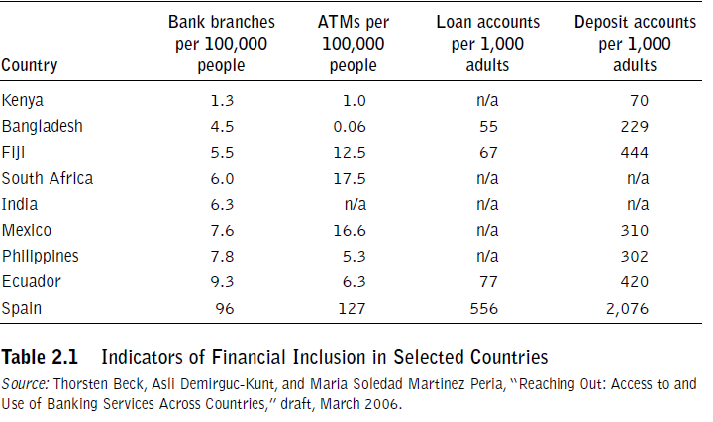
The Banking Sector

Slide 34
Alternative Financial Institutions
While mainstream commercial banks still largely bypass the bottom of the pyramid, the good news is that specialized providers, such as microfinance institutions, cooperatives, consumer finance companies, and some public sector “banks for the people” have made substantial progress.

Slide 35
Alternative Financial Institutions
In a study of alternative financial institutions—institutions serving clients of an economic level below those traditionally served by commercial banks—the Consultative Group to Assist the Poor (CGAP), a donor consortium, identified 3,000 institutions serving 152 million borrowers.

Slide 36
Alternative Financial Institutions
CGAP found 573 million savings accounts globally, slightly over half of which were in government-owned postal savings banks.

Slide 37
Alternative Financial Institutions
The leading alternative financial institutions demonstrate how to reach the BOP market profitably and at scale. The best of them have captured first mover advantages while lowering entry barriers for any second mover that can quickly copy their innovations.

Slide 38
Alternative Financial Institutions
Let’s look closely at two types of alternative financial institutions: MFIs and consumer lenders. This course will return repeatedly to the innovations, advantages, and disadvantages of consumer lenders and microfinance institutions.

Slide 39
Alternative Financial Institutions
It is worth taking a few moments now to introduce them. They are in many ways the guides along the road to inclusive finance. Once operating in separate realms and with widely different motivations, increasingly these two sets of players compete head-to-head.

Slide 40
Alternative Financial Institutions
We will start with MFIs and consumer lenders in the next lecture.

Slide 41
Summary
Who serves the market?

