Slide 1
Revise Lecture 2

Slide 2
History of Banking

Slide 3
Banking system in Pakistan

Slide 4
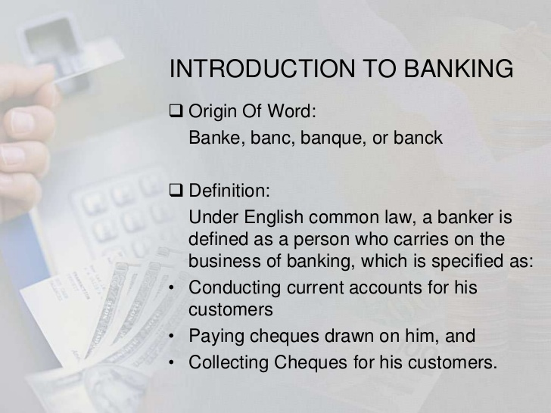
Introduction to Banking

Slide 5
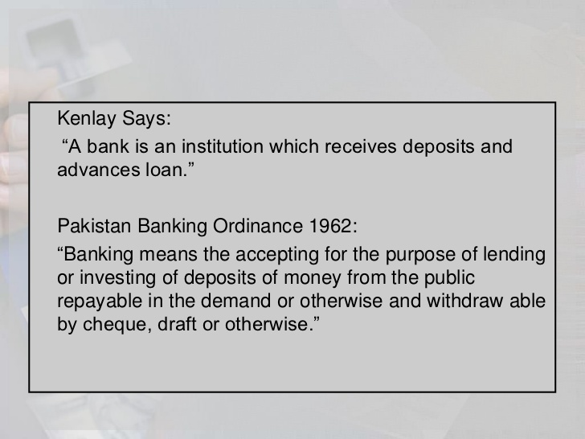
Introduction to Banking

Slide 6
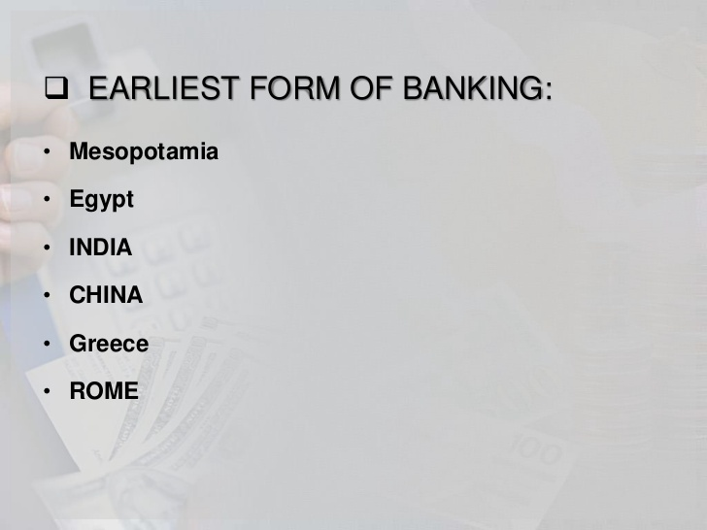
Introduction to Banking

Slide 7
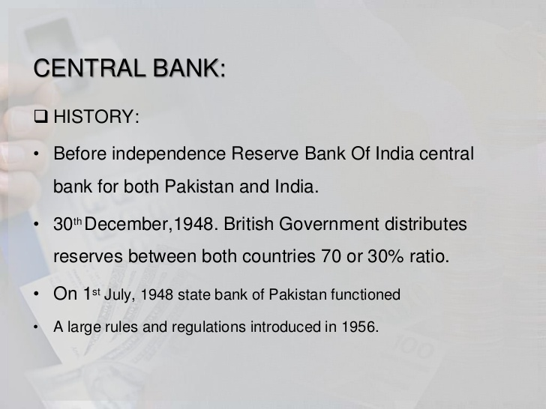
Introduction to Banking

Slide 8
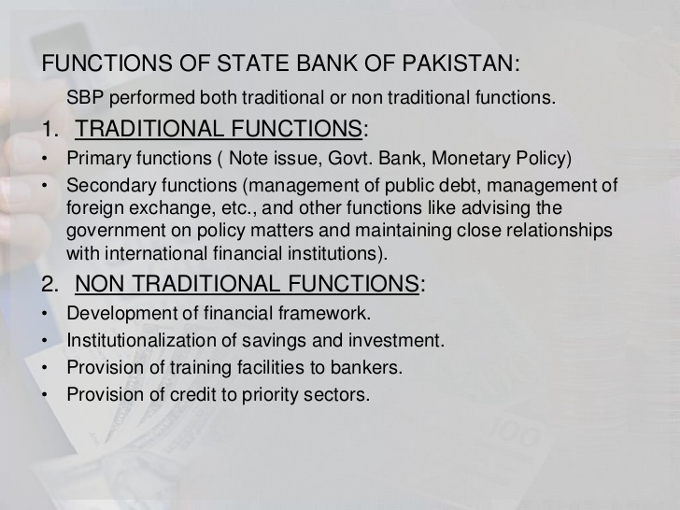
Introduction to Banking

Slide 9
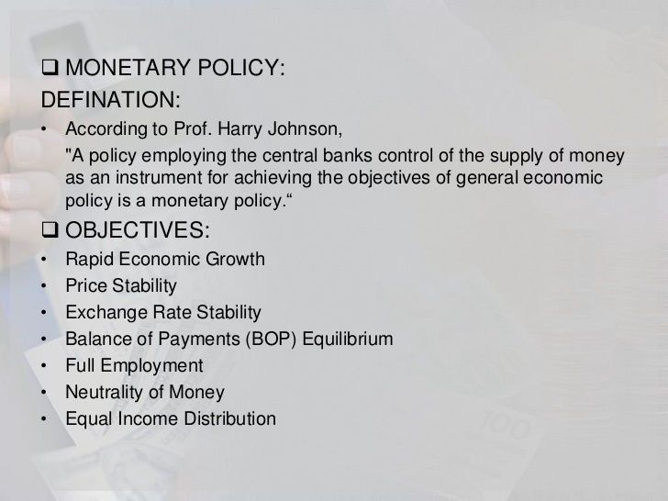
Introduction to Banking

Slide 10
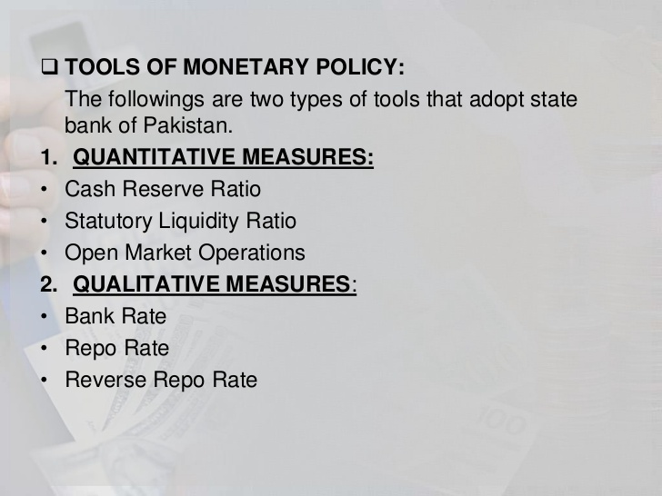
Introduction to Banking

Slide 11
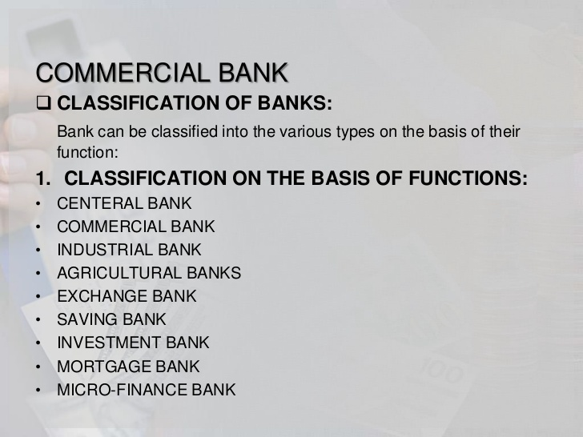
Introduction to Banking

Slide 12
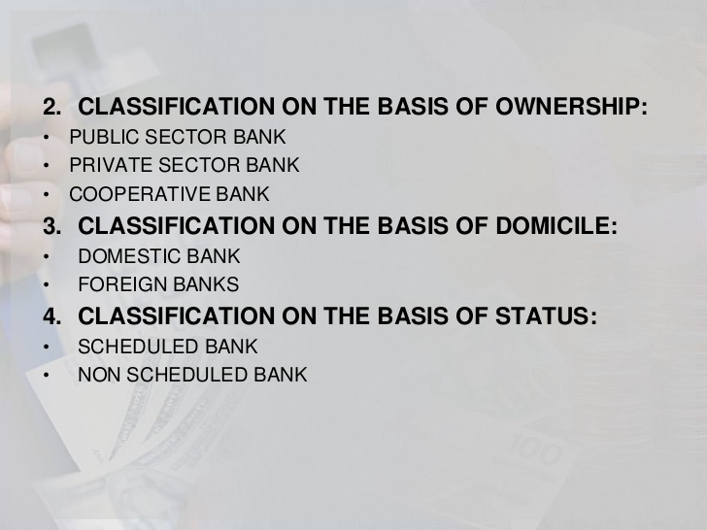
Introduction to Banking

Slide 13
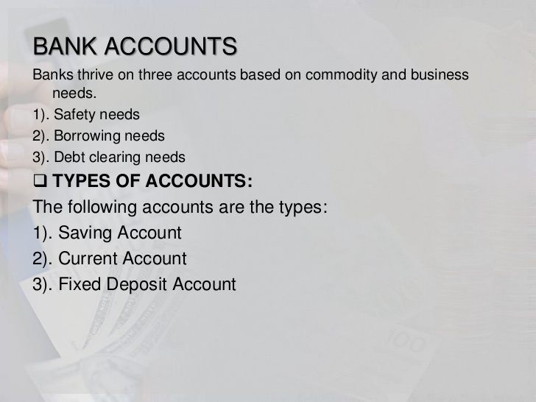
Introduction to Banking

Slide 14
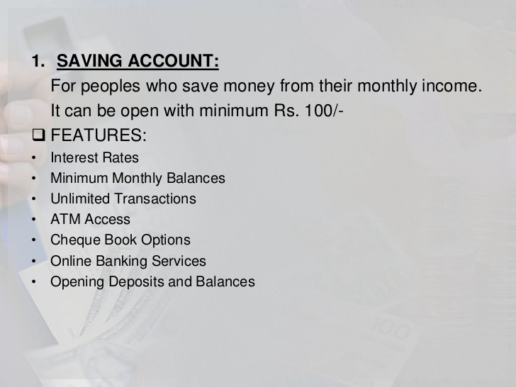
Introduction to Banking

Slide 15
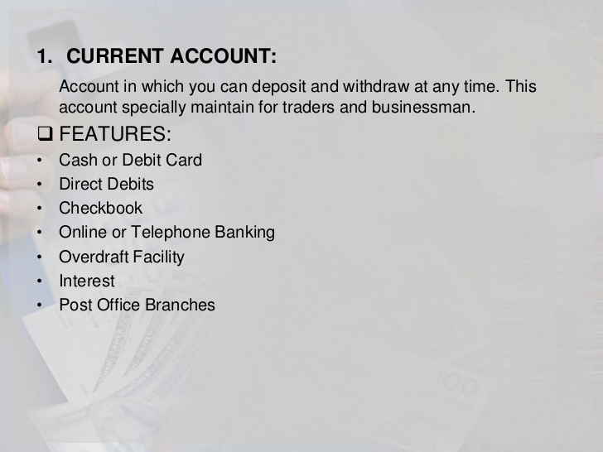
Introduction to Banking

Slide 16
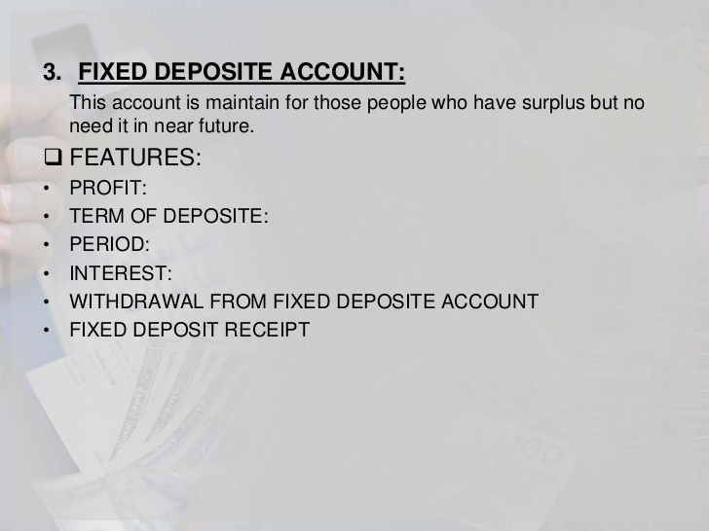
Introduction to Banking

Slide 17
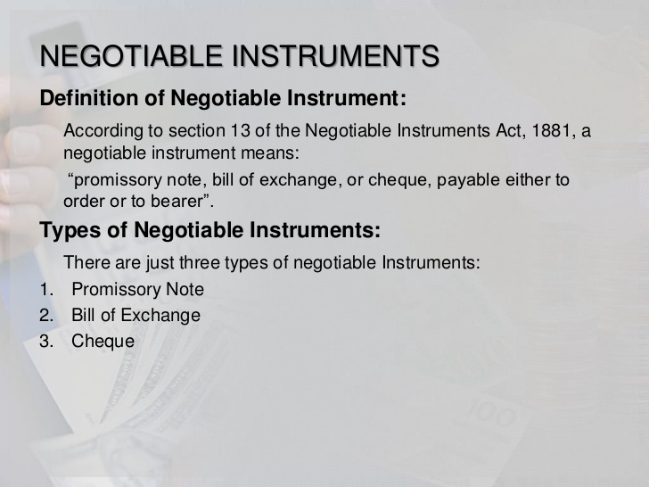
Introduction to Banking

Slide 18
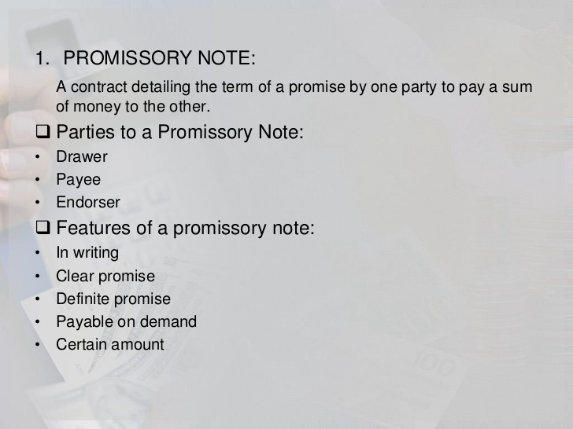
Introduction to Banking

Slide 19
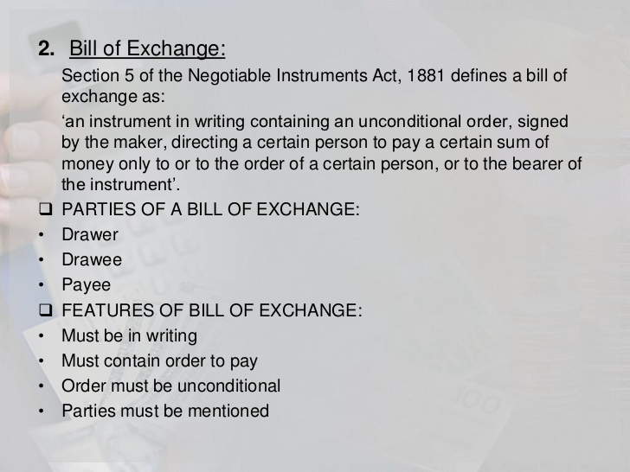
Introduction to Banking

Slide 20
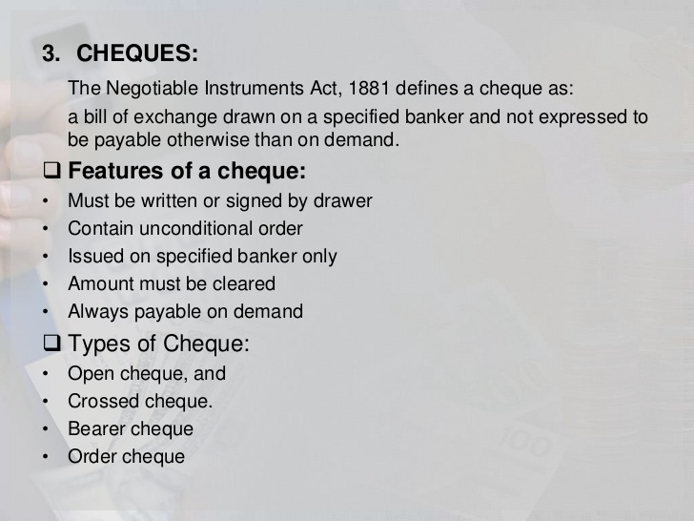
Introduction to Banking

Slide 21
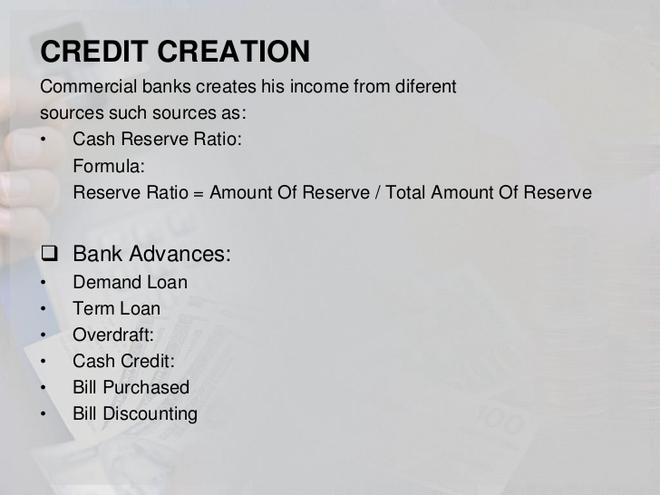
Introduction to Banking

Slide 22
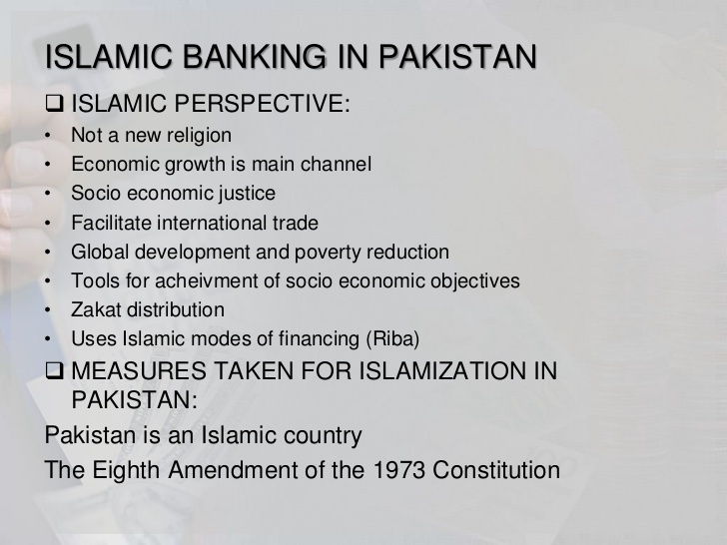
Introduction to Banking

Slide 23
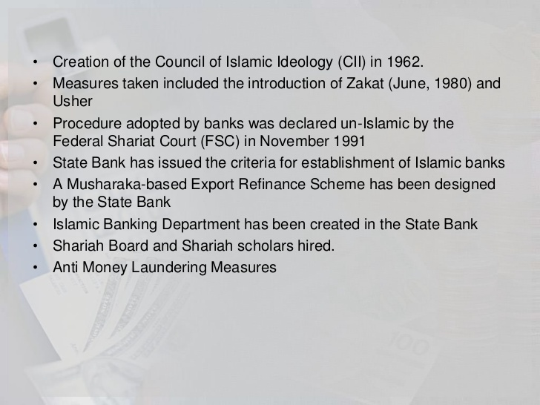
Introduction to Banking

Slide 24
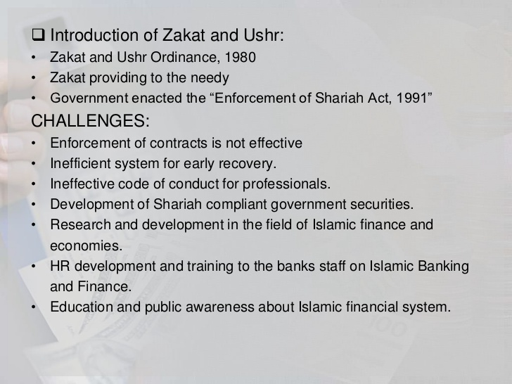
Introduction to Banking

Slide 25

Introduction to Banking

